Slide 1


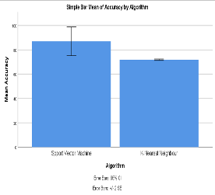
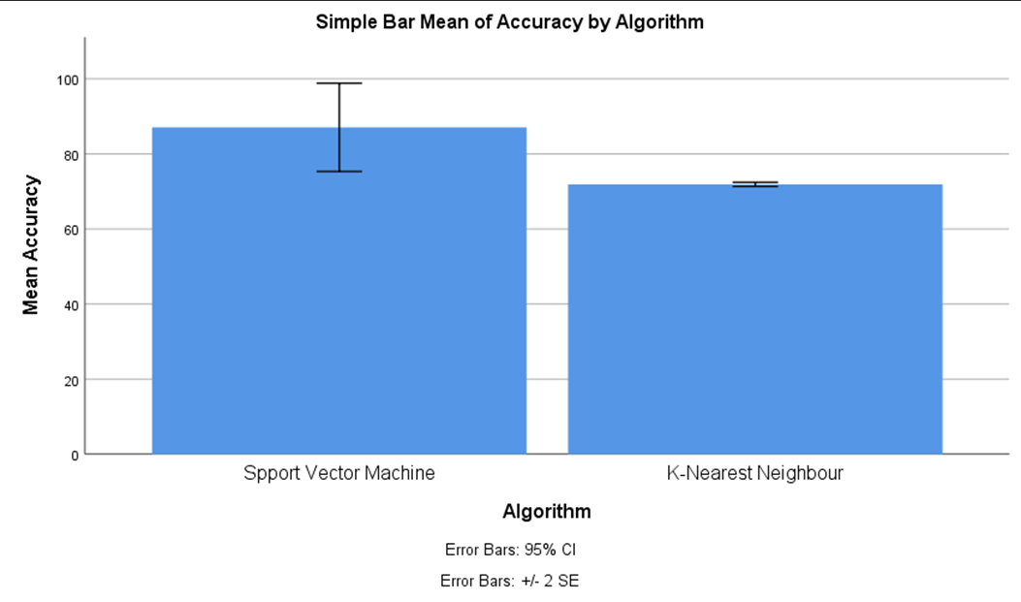
Name: VarunKumar Register Number: 192110128
Guided by: Dr. J.Joslin Jeya Sheela
Ms. Poorani.S
Guided by Dr. Mary Valantina. G
A Meta Classifier Model for Dispatch Spyware Discernment Using
Support Vector Machines (SVM) Comparing With KNN
INTRODUCTION
The aim of the proposed meta classifier model for dispatch spyware discernment is to leverage Support Vector Machines (SVM) and compare its performance with K-Nearest Neighbors (KNN) in effectively identifying and classifying spyware instances within dispatch data.
A Meta Classifier Model for dispatching spyware discernment utilizing Support Vector Machines (SVM) offers a pivotal advancement in cybersecurity. By integrating multiple SVM classifiers, it leverages the collective intelligence of individual classifiers.
The importance of a meta-classifier model for dispatch spyware discernment using Support Vector Machines (SVM) compared with KNN algorithm lies in its potential to enhance the accuracy and reliability of spyware detection systems.
various applications in the field of cybersecurity and beyond , Malware Detection , Intrusion Detection Systems (IDS) , Network Security , E-commerce Fraud Detection .
SVM can effectively classify data points into different categories;E-commerce Fraud DetectionKNN is an instance-based learning algorithm, meaning it doesn't explicitly learn a model during the training phase. Instead, it memorizes the entire training dataset and uses it during the prediction phase.
The data set contains the Labeling , Data Processing , Serves as the primary dataset for testing and training.
MATERIALS AND METHODS
Data Collection
Feature Extraction
Model Training
(SVM and KNN)
Accuracy 93.00% and 79.00%
Output
Spyware Detection
Data Preprocessing
Python v3.11
Jupyter Notebook
SVM Compared with KNN
Preprocessing, Training and Validating Data
RESULTS
Group Statistics
Independent Samples Test
 | Algorithm | N | Mean | std.deviation | Std.error mean
Accuracy | SVM | 15 | 87.07 | 22.752 | 5.874
 | KNN | 15 | 71.87 | 1.060 | .274
 | Levene's Test |  | T-Test For Equality Of Means
 | F | Sig | t | df | Sig(2-tailed) | Mean difference | Std.Error difference | 95% Confidence
 |  |  |  |  |  |  |  | lower | upper
Equal Variances | 3.925 | .057 | 2.585 | 28 | .015 | 15.200 | 5.881 | 3.154 | 27.246
No Equal Variances |  |  | 2.585 | 14.061 | .022 | 15.200 | 5.881 | 2.592 | 27.808
Statistical Analysis values of Mean accuracy (91.93), Standard Deviation(1.335), and Standard error deviation. The Support Vector Machine Algorithm and the KNN algorithm have the values of the Mean accuracy, Standard Deviation, and Standard Error.
Comparison of Significance Level with value p<0.05. Both Support Vector Machine Algorithm and the KNN Algorithm have a confidence interval of 95% with the significance value 0.000( p<0.05).
DISCUSSION AND CONCLUSION
According to the study results Support Vector Machine algorithm outperformed KNN algorithm with high accuracy of 93.00% .Based on the independent sample t-test, with the total sample size of 450, the significance value p=0.016 (p<0.05) shows that there is significant difference in the algorithms.
The futuring effects of meta-classifier models for dispatch spyware discernment using SVM compared with KNNalgorithm hold the promise of enhancing cybersecurity measures, reducing false positives, adapting to evolving threats.
Several limitations may be associated with the implementation of a meta-classifier model for dispatch spyware discernment using Support Vector Machines (SVM) compared with the Linear SVC algorithm are data Imbalance, Feature Selection Bias, Limited Generalization.
The comparative analysis revealed nuanced performance differences between the two classification approaches. While both SVM and Linear SVC showed promise in accurately identifying dispatch spyware instances.
BIBLIOGRAPHY
Costa, Leonardo da, and Vitor Moia. 2024. “A Lightweight and Multi-Stage Approach for Android Malware Detection Using Non-Invasive Machine Learning Techniques.” Accessed March 7
Jain, Ankita, Lakshit Rustagi, Mayank Aggarwal, and Anshul Arora.2024 “CORRDroid - Android Malware Detection Using Association amongst Permissions.”
Kumar, Atul, Ishu Sharma, and Avinash Sharma. 2024. “Understanding the Behaviour of Android SMS Malware Attacks With Real Smartphones Dataset.”
Ojo, David, Nusayer Masud Siddique, Carson K. Leung, and Connor C. J. Hryhoruk. 2024. “Machine Learning-Based Android Malware Detection.” Accessed March 7.
Shimpi, Pallavi Madhukarrao, and Nitin Namdeo Pise. 2024. “Android Malware Detection Model Using the Adaptive Swarm Optimization-Based Neural Network.”
Shaukat, Kamran, Suhuai Luo, Vijay Varadharajan, Ibrahim A. Hameed, and Min Xu. 2024. “A Survey on Machine Learning Techniques for Cyber Security in the Last Decade.”

