Slide 1
NER with weakly labeled data
Course : Advanced NLP
Team no. : 11
Team name : SVM
Faculty : Prof. Manish Srivastava
2022201016 | Vaibhav Mittal
2022201061 | Varun Vashishtha
2022202018 | Shivam Yadav

Slide 2
AGENDA
To share our intuitions, approaches and the results obtained for implementing the given task : NER (Named Entity Recognition) with weakly labeled data
Problem Description
Modeling
Problems with supervised approach
Existing Solution
Issues of the paper
NEEDLE framework
Evaluation metrics
Result
Conclusion

Slide 3
PROBLEM DESCRIPTION
The project aims at exploring the technique using which we can overcome the practical limitation of using a weakly labelled data for task like NER, and achieve significant improvement w.r.t previous approaches and reduce the difference in quality of results achieved in a strongly labelled dataset compared to a weak labeled dataset.

Slide 4
MODELING
Supervised learning : A machine learning approach where the model is trained on labeled data, learning to make predictions or classifications based on input-output pairs.
Unsupervised learning : A machine learning approach where the model is trained on unlabeled data to discover patterns,structures or relationships within the data without any guidance.
Self supervised learning : A type of unsupervised learning where the model generates its own labels or supervisory signals from the input data, often by creating tasks or objectives to learn representations from the data itself.

Slide 5
PROBLEMS WITH SUPERVISED APPROACH
Tasks like NER (Named Entity Recognition) requires token-level labeling
Problems :
Annotating Huge amount of data is laborious and time consuming
Expensive
Prone to Human errors

Slide 6
EXISTING SOLUTION
Pretrain the model using masked language modeling on large open-domain data, which is usually 100s/1000s of times larger than strongly labeled data.(Li et al., 2012)
To further capture domain specific information continuously pretrain the model on large in-domain unlabeled data. (Lafferty et al., 2001)
When there is no labeled data, use weak supervision to generate labels automatically from domain knowledge.(Shang et al., 2018; Liang et al., 2020)

Slide 7
Issues with the Approach
Can we simultaneously leverage small strongly labeled data and large weakly labeled data to improve model performance.
WEAK LABELS HAVE 3 FEATURES :
Incompleteness
Labeling bias
Ultra large scale

Slide 8
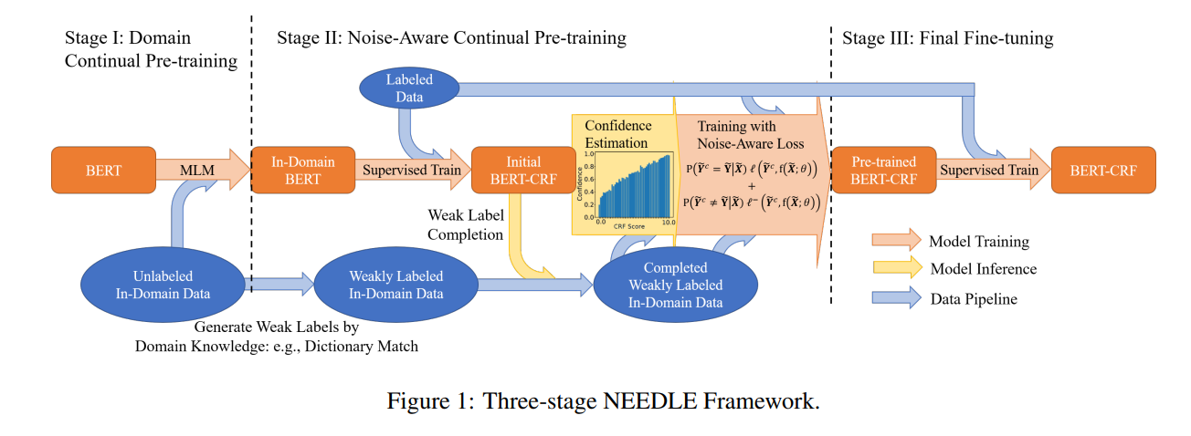

Slide 9
NEEDLE framework
STAGE I :
Domain continual masked language model pre-training on the large in-domain unlabelled data was conducted. The masked language model have parameters from the encoder and the classification head which are initialized from open-domain pretrained huge masked language models like BERT & RoBERTa.

Slide 10
NEEDLE framework
Stage II :
Knowledge base is used to convert in-domain unlabeled data to weakly labeled data.We then conduct another continual pre-training over both weakly and strongly labeled data, in conjunction with proposed weak label completion procedure and noise-aware loss functions, which can handle the ‘incompleteness’ and ‘noisy labeling’ of weak labels.

Slide 11




In-completeness & Noise Removal
Model Predicted Label
Corrected weak Label
Original Weak Label
Confidence of weak Label

Slide 12



Formula for calculating confidence of weak label :
Initial Assumption
Label Prediction of CRF Model is based on viterbi decoding score
Calculated by histogram binning

Slide 13
NEEDLE framework
Stage III :
Since the previous two sections prevent the models to overfit in the biased or noisy data, it also prevents the model to fit in the strongly labelled data. So we will finally fine tune the models over strongly labelled data, to make better predictions.

Slide 14
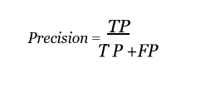
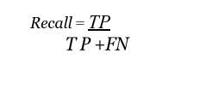

EVALUATION METRICS
Precision :
Recall :
F1 score :

Slide 15
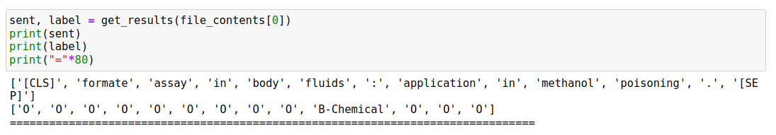
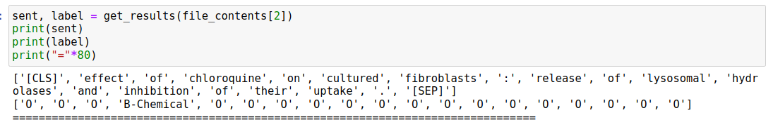
RESULTS

Slide 16
THANK YOU

