Slide 1
How to make the generation better?
Better encoding methods
Better Decoding methods
We can also make them faster using techniques like flash attention etc.

Slide 2
Problems:
Evaluation metrices are not that good
Encoding in itself is not that good to produce good results
Decoding is not coherent, fluent e.g Continuations with greedy decoding (43%) far exceeds that of humans (0.5%), computed over prefixes drawn from a validation corpus.
With the Transformer language model (x6), the set of next token greedy predictions on a held-out validation set had roughly 40% fewer unique tokens than the ground-truth tokens (11.6k vs. 18.9k) and overproduced frequent tokens it basically means that encoding and decoding in itself is not that good.

Slide 3
Problems with current methods :
Such behavior has been linked to generations being judged as dull by humans because rare words can add engaging specificity as human preferences better correlates with the balance between the diversity and the coherence aspects of the generated texts.
For this we can use methods like truncation sampling methods such as nucleus and typical decoding improve sample quality with more diverse samples compared to direct sampling, but at the expense of poor coherence and undesired topic drift.
Also, I found out that searching for the probable sequences always results in short and repetitive texts, which further motivated recent efforts to improve generation via revised learning objectives.

Slide 4
What’s the problem:
What happening is there is a huge gap between the what model is learning and what model is outputting. So we need better methods to make the model learn more robustly so that the generation is at par with the training data.
Deterministic Decoding: Two widely used deterministic decoding approaches are greedy search and beam search. At each time step, beam search forms new hypotheses by appending each token in the vocabulary to each existing hypothesis, scoring the resulting sequences
Stochastic Decoding : To sample from a model-dependent distribution at each step e.g. The nucleus sampler instead restricts sampling to the smallest set of tokens with total mass above a threshold

Slide 5
Sequence likelihood calibration (SLiC)
The likelihood of model generated sequences are calibrated to better align with reference sequences in the model’s latent space.
Many effective heuristics have been proposed during training and decoding to combat the problem of uncalibrated sequence likelihood.
Label smoothing prevents the network from becoming over-confident towards the observed target because since the gold target represents just one of many possibilities. It has been observed that increasing number of decoding candidates past a certain point leads to worse quality for beam search.
Problems:
Since the lack of observed target sequences in MLE training is the root problem, solutions involving learning with multiple sequence candidates have been proposed to directly address it.
1) reinforcement learning with sequence-level rewards
2) two-stage systems that generate and rerank candidates.
3) multi-task learning with sequence-level losses.

Slide 6
Benefits of SLiC:
Its is adding a third stage of sequence likelihood calibration (SLiC) after the pretraining and fine-tuning stages for conditional language generation. The calibration process decodes candidates from the fine-tuned model, and continues training to align their sequence likelihood according to their similarity to the target sequence in the model’s latent space.
Proposed a sequence likelihood calibration (SLiC) stage that consistently improves model quality, exceeding or matching state-of-the-art results on abstractive summarization, generative question answering, question generation and data-to-text generation tasks.
Proposed a novel calibration similarity metric between model decodes and targets measured in the model’s latent space rather than resorting to external metrics or human feedback.
SLiC eliminates the need for popular decoding heuristics, such as beam size optimization, length normalization and repetition prevention for the calibrated models.
SLiC has persistent significant benefits on model performance even as the number of model parameters scales up. Under the same inference budget, smaller calibrated models might outperform larger counterparts by decoding more candidates.
It basically calculates two losses namely 1) Calibration loss 2) Regularization loss

Slide 7
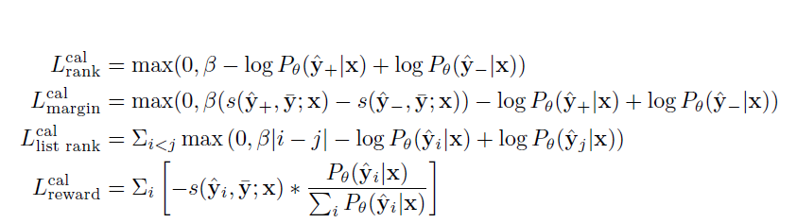
Calibration loss consists of 4 losses :
1) Rank loss optimizes the ranking order of positive and negative candidate pairs ^y+; ^y- uniformly sampled from
2) Margin loss maximizes the sequence probability gap of positive and negative candidate pairs.
3) List-wise rank loss optimizes the ranking orders of a list of candidates, where i; j are positions of ^yi; ^yj in the set {^y}m sorted by s(^y; y; x).
4) Expected reward loss (or expected minimum risk) maximizes the expected similarity of a list of candidates.
Note : similarity function, uses models’ latent states at decoder output representation s(^y; y; x) by which they are suggesting that instead of using cosine/bert similarity rely on model itself.

Slide 8
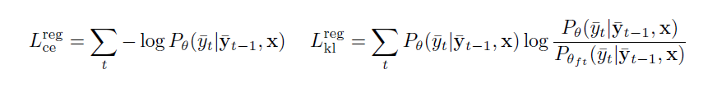
REGULARIZATION LOSS:
We consider two alternate types of regularization loss reg to prevent models from deviating significantly from their fine-tuned MLE objective:
Cross entropy is the standard fine-tuning MLE objective
KL divergence directly minimizes the probability distribution distance between the calibrated model and the fine-tuned model at each token on observed target sequence. The regularization losses are both on token level.

Slide 9
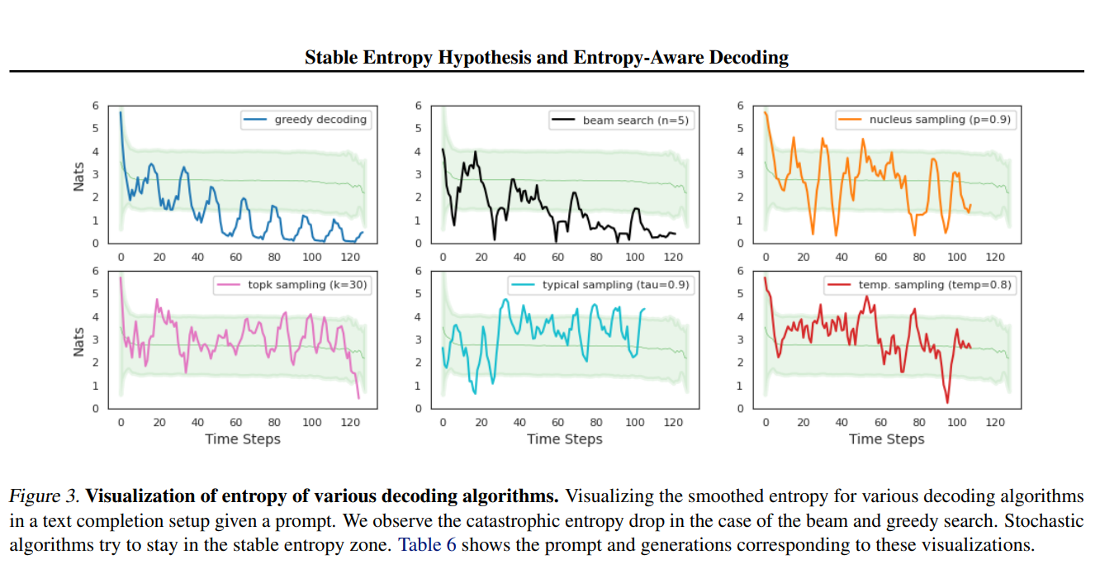
How to make any decoding algorithm better:
For Human like generation: stable narrow entropy zone exists across models
We measure entropy zone violations using three metrics
1) Entropy lower-bound violation ratio (ELVR) measures the ratio of instances when smoothed entropy falls below the lower bound of the stable entropy zone.
2) Entropy upper-bound violation ratio (EUVR) measures the ratio of instances where smoothed entropy is larger than the upper bound of the stable entropy zone.
3) Entropy violation ratio (EVR), is the sum of the two ratios and measures the ratio of instances when entropy falls outside either the lower or the upper bound.

Slide 10
1) Upper-bound violation of the stable entropy zone indicates that the model is less certain about its prediction. In such scenarios, chances of miscalibration are high; i.e., the most probable token might not be the “correct” token so in such cases we resort to sampling from the conditional distribution.
2) For lower-bound violations, we wait until N consecutive violations, as entropy drop at any time-step might be due to the presence of multi-token words, abbreviations, or other tokenization quirks. we back off N steps to the index when it was last above the threshold. At that index, we ignore the current most likely token and select the next highest-ranked token. We continue executing the backoff strategy until we select a token that does not lead N consecutive steps of entropy lower-bound violations.
3) So here we can apply backoff according to us also to change the algorithm a little bit.

Slide 11
Unlikelihood Training:
The phenomenon of neural text generation being degenerate, or producing repetitive and uninteresting outputs, has been attributed to several potential causes, though the exact reason is not yet fully understood. Some of the proposed explanations include :
(i) A by-product of the model architecture, e.g. the Transformer architecture preferring repeats
(ii) An intrinsic property of human language rather than a modeling deficiency.
(iii) A training objective relying on fixed corpora cannot take into account the real goal of using the Language.
While low perplexity in the limit should lead to predicting the correct next target word, there are two major flaws of the likelihood objective:
(a) It pays relatively little attention to the argmax or the top of the ranked list of next token probabilities, instead optimizing the likelihood of the entire distribution.
b) It is not focused on optimizing sequence generation, only on producing the next token and any imperfection in next token prediction leads to error accumulation that is not addressed by likelihood training.

Slide 12
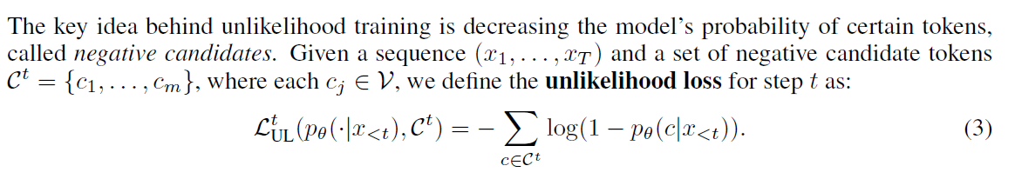
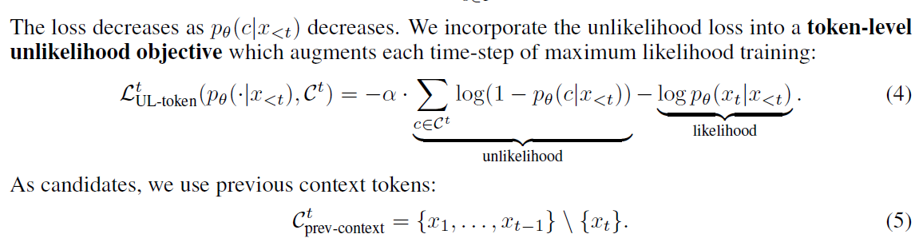

Slide 13
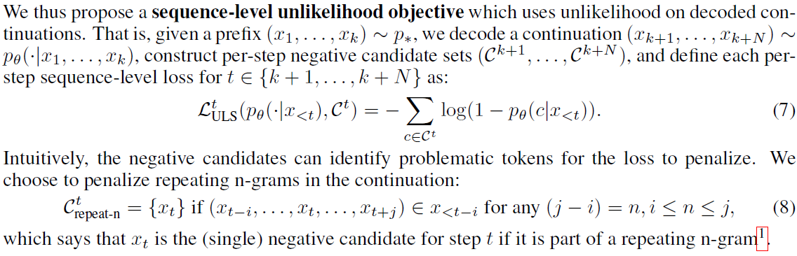

Slide 14

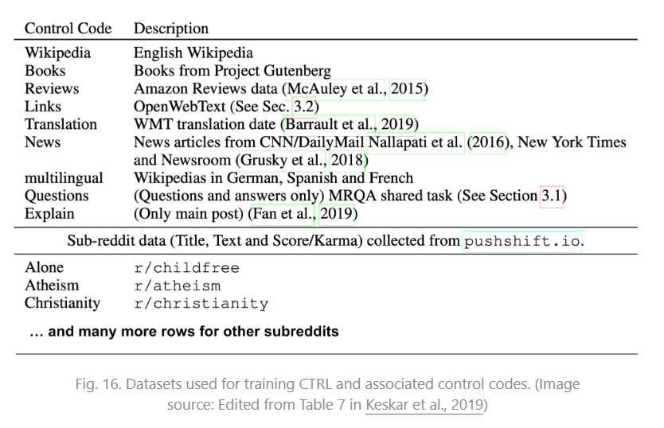
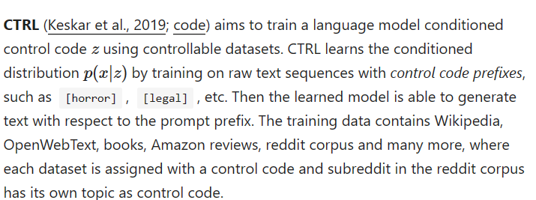
CTRL: A CONDITIONAL TRANSFORMER LANGUAGE MODEL FOR CONTROLLABLE GENERATION
Allows for conditioning the generation of text on control codes, which are used to specify desired attributes or styles of the generated text.
Control codes can vary in various ranges as users can influence the style, content, or other characteristics of the generated text

Slide 15
Decoding techniques:
Truncation sampling:
Methods such as nucleus, decoding improve sample quality with more diverse samples compared to direct sampling, but at the expense of poor coherence and undesired topic drift.
Learning to Decode for Future Success : How to incorporate different properties into the decoder different properties of the future output sequence:
Sequence length: the approach provides the flexibility of controlling the output length, which in turns addresses sequence models’ bias towards generating short sequences
Mutual information between sources and targets: the approach enables modeling the bidirectional dependency between sources and targets at each decoding timestep, significantly improving response quality on a task of conversational response generation.
The properties can also take the form of the BLEU and ROUGE scores, yielding consistent improvements in machine translation and summarization, yielding the state-of-the-art result on the IWSLT German-English translation task.

Slide 16
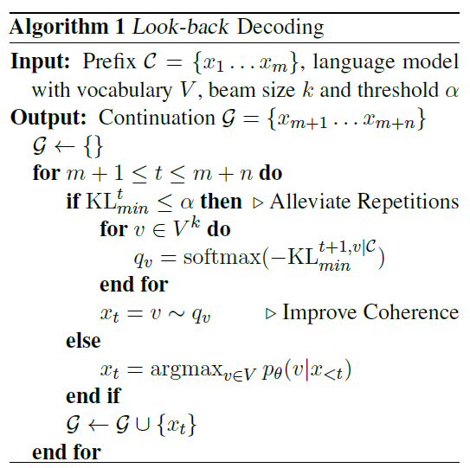
Look back Decoding:
It is an improved decoding algorithm that leverages the Kullback–Leibler divergence to track the distribution distance between current and historical decoding steps. By restricting the next token probability distribution within a plausible distance to the history and preventing such as undesired repetitions and unnatural topic drifts.
Look-back is able to generate more fluent and coherent text, outperforming other strong decoding methods significantly in both automatic and human evaluations.
Coherent generation, the probability distribution should not be too close to history to guarantee diversity, but relatively close to prefix to maintain coherence.
There are two commonly observed degeneration problems in open-ended text generation: repetition and incoherence.

Slide 17
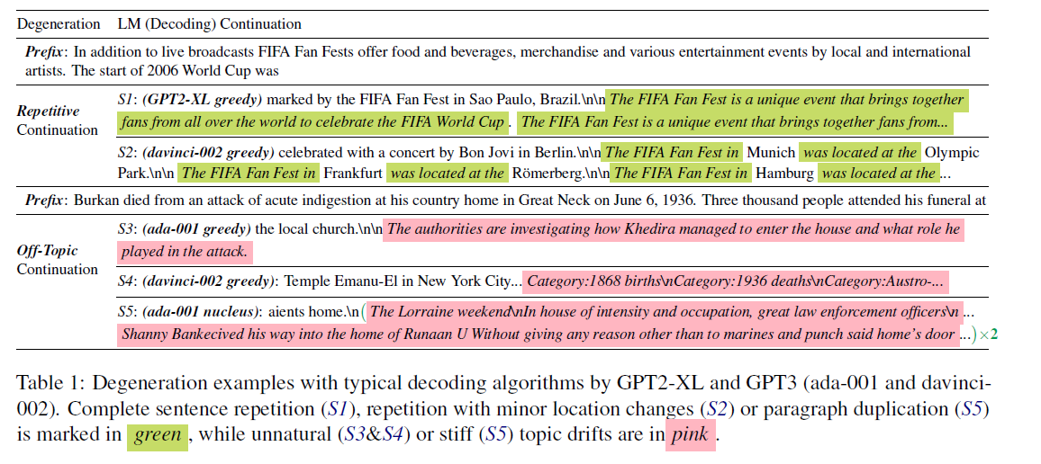

Slide 18
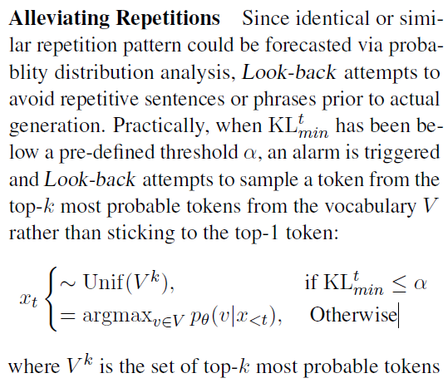
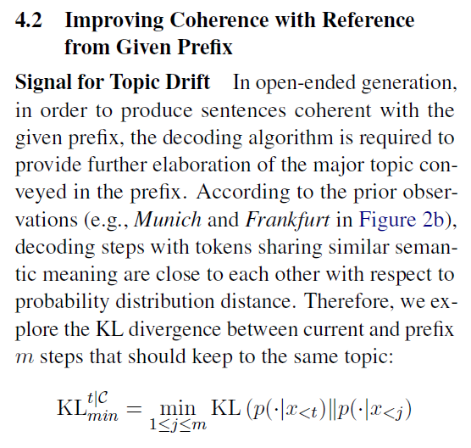
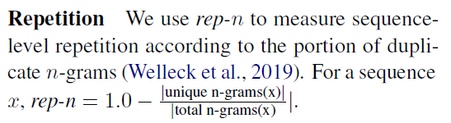
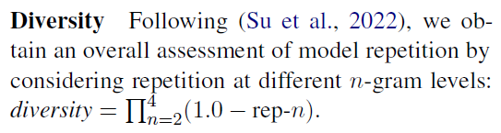
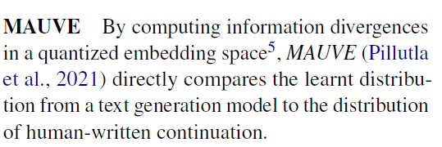
Evaluation Metrics:

Slide 19
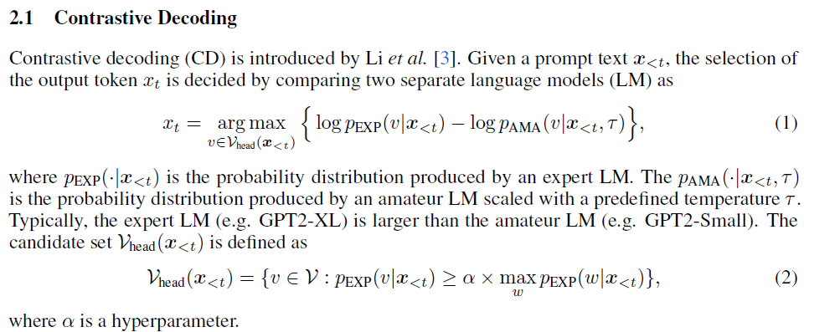
Contrastive Search And Contrastive Decoding :

Slide 20
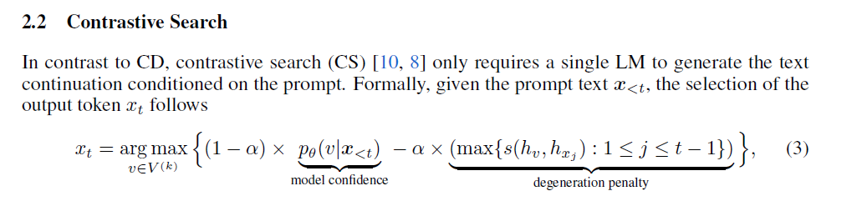
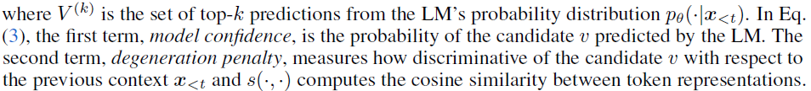

Slide 21
Guided Decoding:
PROBLEMS IN GENERAL : for the same input, several correct outputs are possible; nonetheless, the generated output is often compared to a single human reference, given the lack of annotated data.
WHY IT WORKS : Regular methods have a lack of inductive bias for the network to learn discourse structure or global coherence beyond local patterns
Model learns to balance these discriminators by initially weighing them uniformly, then continually updating its weights by comparing the scores the system gives to its own generated continuations and to the reference continuation.
Most standard decoding strategies sample tokens according to the predicted probability, with no additional information. Our preferences on topic or sentiment can be baked into the candidate ranking function to guide the sample generation by altering the candidate ranking score. The ranking score for token selection at each decoding step can be set as a combination of LM log-likelihood and a set of desired feature discriminators.

Slide 22

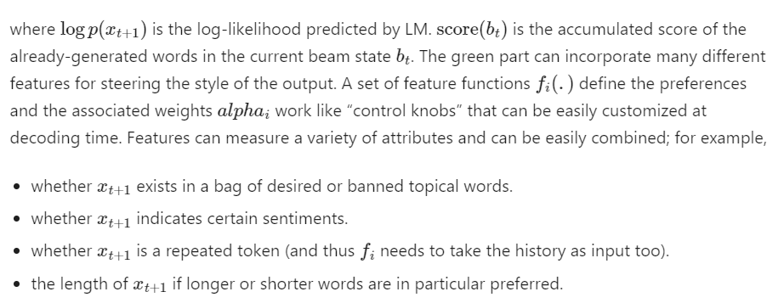

Slide 24
Resources:

