Slide 1
Probabilistic Neural Networks
Probabilistic Neural Networks (PNNs) are a scalable alternative to classic back-propagation neural networks in classification and pattern recognition applications.
They do not require the large forward and backward calculations that are required by standard neural networks. They can also work with different types of training data.
These networks employ the concept of probability theory to minimize the mis-classifications when applied to a classification problem.

Slide 2
Probabilistic Neural Networks
A probabilistic neural network (PNN) is a sort of feedforward neural network used to handle classification and pattern recognition problems.
In the PNN technique, the parent probability distribution function (PDF) of each class is approximated using a Parzen window and a non-parametric function.
The PDF of each class is then used to estimate the class probability of fresh input data, and Bayes’ rule is used to allocate the class with the highest posterior probability to new input data.
With this method, the possibility of misclassification is lowered. This type of ANN was created using a Bayesian network and a statistical approach known as Kernel Fisher discriminant analysis.

Slide 3
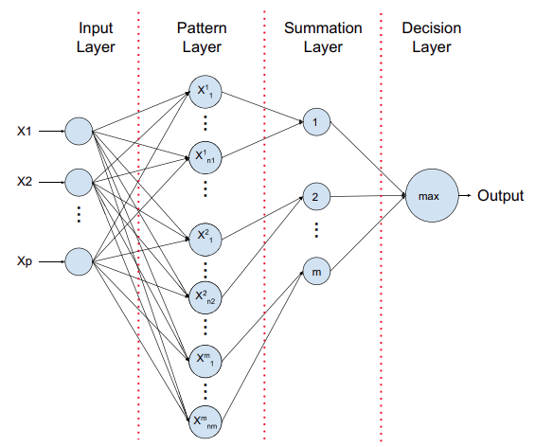
Structure of Probabilistic Neural Networks
The below is Specht’s basic framework for a probabilistic neural network (1990). The network is composed of four basic layers. Let’s understand them one by one.

Slide 4
Input Layer
Each predictor variable is represented by a neuron in the input layer. When there are N categories in a categorical variable, N-1 neurons are used. By subtracting the median and dividing by the interquartile range, the range of data is standardized. The values are then fed to each of the neurons in the hidden layer by the input neurons.

Slide 5
Pattern Layer
Each case in the training data set has one neuron in this layer. It saves the values of the case’s predictor variables as well as the target value. A hidden neuron calculates the Euclidean distance between the test case and the neuron’s center point, then uses the sigma values to apply the radial basis kernel function.

Slide 6
Summation Layer
Each category of the target variable has one pattern neuron in PNN. Each hidden neuron stores the actual target category of each training event; the weighted value output by a hidden neuron is only supplied to the pattern neuron that corresponds to the hidden neuron’s category. The values for the class that the pattern neurons represent are added together.

Slide 7
Decision Layer
The output layer compares the weighted votes accumulated in the pattern layer for each target category and utilizes the largest vote to predict the target category.

Slide 8
Algorithm of Probabilistic Neural Network
The training set’s exemplar feature vectors are provided to us. We know the class to which each one belongs. The PNN is configured as follows.
Input the file containing the exemplar vectors and class numbers.
Sort these into K sets, each of which contains one class of vectors.
Create a Gaussian function centered on each exemplar vector in set k, and then define the cumulative Gaussian output function for each k.

Slide 9
After we’ve defined the PNN, we can feed vectors into it and classify them as follows.
Read the input vector and assign the Gaussian function according to their performance in each category.
For each cluster of hidden nodes, compute all ‘Gaussian functional useful values’ at the hidden nodes.
Feed all of the Gaussian functional values from the hidden node cluster to the cluster’s single output node.
For each category output node, add all of the inputs and multiply by a constant.
Determine the most valuable of all the useful values added together at the output nodes.

Slide 10
Advantages and Disadvantages of Probabilistic Neural Networks
There are various benefits and drawbacks and applications of employing a PNN rather than a multilayer perceptron.
Advantages
Multilayer perceptron networks are substantially slower than PNNs.
PNNs have the potential to outperform multilayer perceptron networks in terms of accuracy.
Outliers aren’t as noticeable in PNN networks.
PNN networks predict target probability scores with high accuracy.
PNNs are getting close to Bayes’s optimum classification.

Slide 11
Disadvantages
When it comes to classifying new cases, PNNs are slower than multilayer perceptron networks.
PNN requires extra memory to store the mod.

Slide 12
Applications of Probabilistic Neural Network
Following can be the major applications of probabilistic neural networks
Probabilistic Neural Networks can be applied to class prediction of Leukemia and Central Nervous System Embryonal Tumors.
Probabilistic Neural Networks can be used to identify ships.
Management of sensor setup in a wireless ad hoc network can be done using a probabilistic neural network.
It can be applied to Remote-sensing image classification.
Character Recognition is also an important application of Probabilistic Neural Networks. There are many more applications of PNNs.

