Slide 1
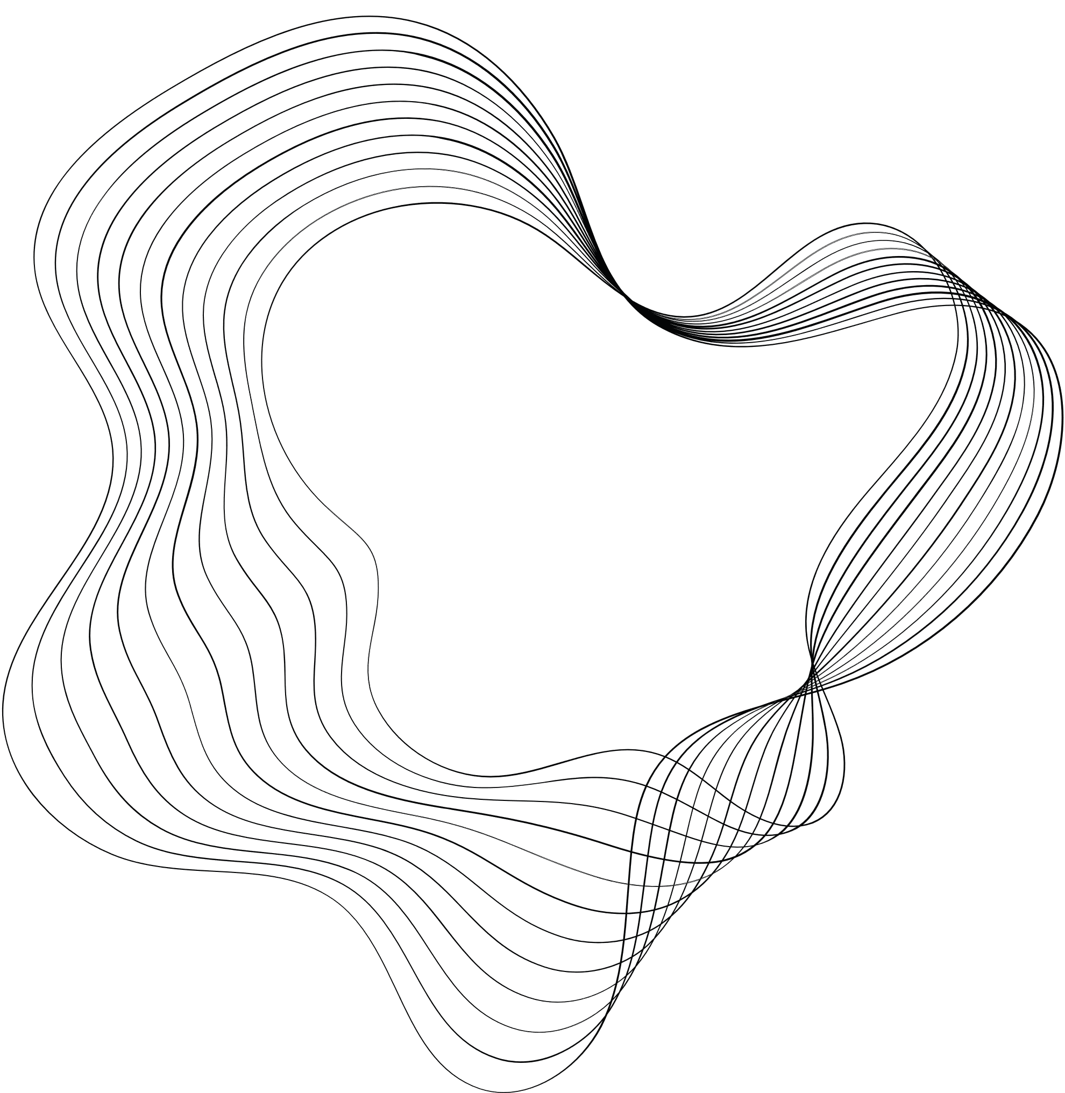

SOCIAL MEDIA APP
DESIGNED BY:
Enrollment:

Slide 2





OBJECTIVES
The objective of This project is to create a secure and user-friendly web platform for social interaction. Users can log in, create posts, engage with friends through likes and comments, and utilize real-time chat. The application focuses on privacy with customizable settings and ensures responsiveness across devices. Security measures include encryption, and scalability is considered. Notifications keep users informed, while analytics provide insights. The platform encourages positive interactions through feedback and moderation tools.

Slide 3

CONTENT
01
ABOUT PROJECT
02
PROJECT STACK
03
DATA DICTIONARY
04
DIAGRAM AND IMAGES
05
LIMITATION
06
FUTURE ENHANCEMENT & OUR GOALS
07
THANKYOU

Slide 4

ABOUT PROJECT
This project is a social media platform facilitating seamless communication with friends through features like creating posts, liking, commenting, and chatting.

Slide 5

PROJECT STACK
MongoDB is a NoSQL database that stores data in flexible, JSON-like documents. It offers scalability, high performance, and flexibility, making it suitable for handling various types of data in a social media application, such as user profiles, posts, comments, and likes.
The project stack includes React.js for frontend, Node.js with Express.js for backend, MongoDB for database, and Socket.IO for real-time communication, ensuring efficient development, scalability, and dynamic user interactions.
Node.js provides a runtime environment for executing JavaScript code outside a web browser, making it ideal for server-side development. Express.js, a minimalist web framework for Node.js, simplifies the creation of robust and scalable backend APIs.
Socket.IO: JavaScript library enabling real-time bidirectional communication between web clients and servers. Enhances interactivity and responsiveness, facilitating instant messaging, notifications, and live updates in social media applications.
Utilized for building dynamic and interactive user interfaces, React.js offers a component-based architecture that facilitates modular development and efficient UI rendering.
DATABASE
FRONTEND
SOCKET.IO
BACKEND

Slide 6
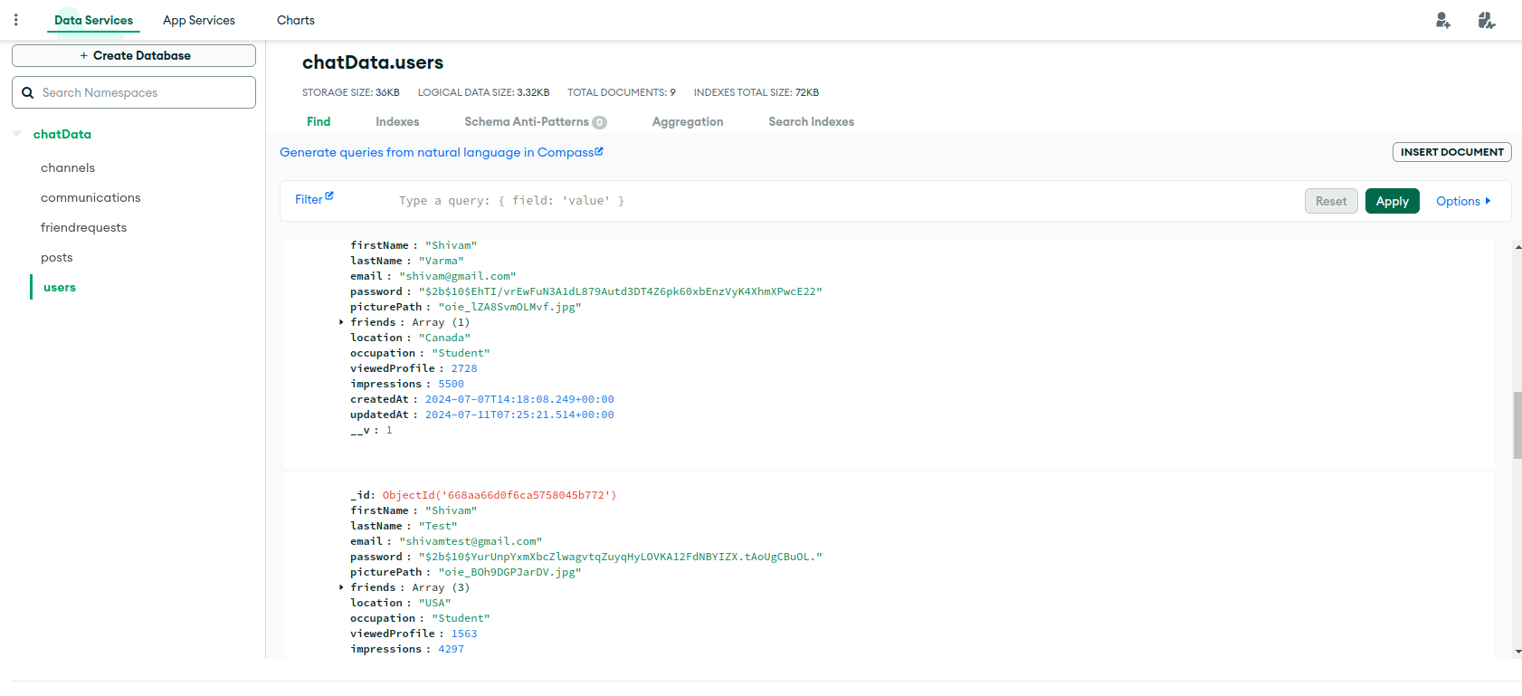

DATA DICTIONARY
STRATEGY N°3

Slide 7
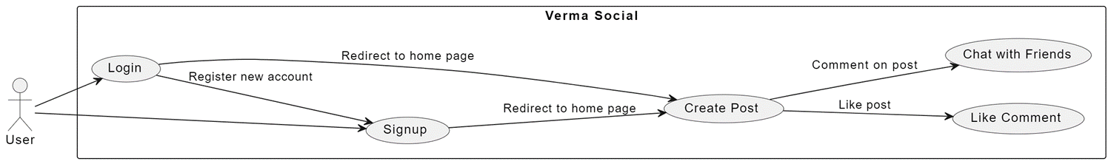
USE CASE DIAGRAM

Slide 8
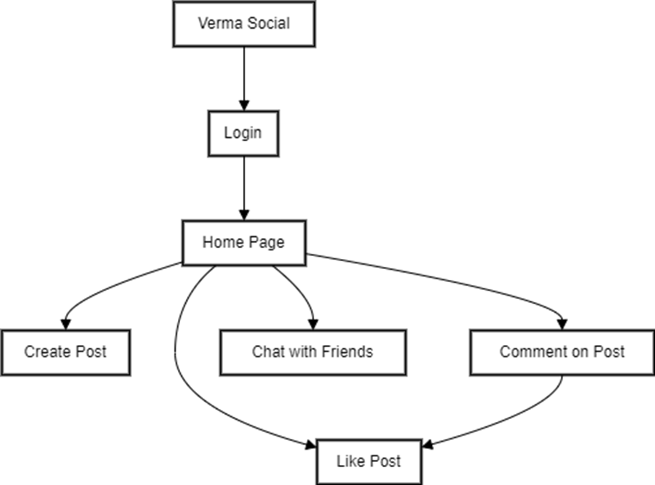
FLOWCHART DIAGRAM
Shivam Social

Slide 9
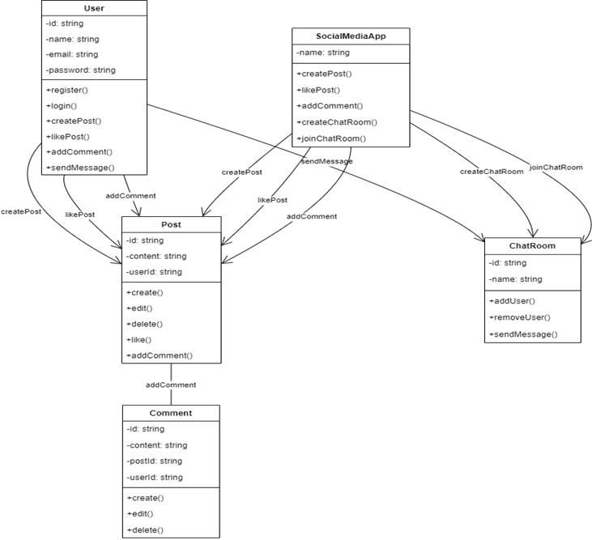
CLASS DIAGRAM

Slide 10
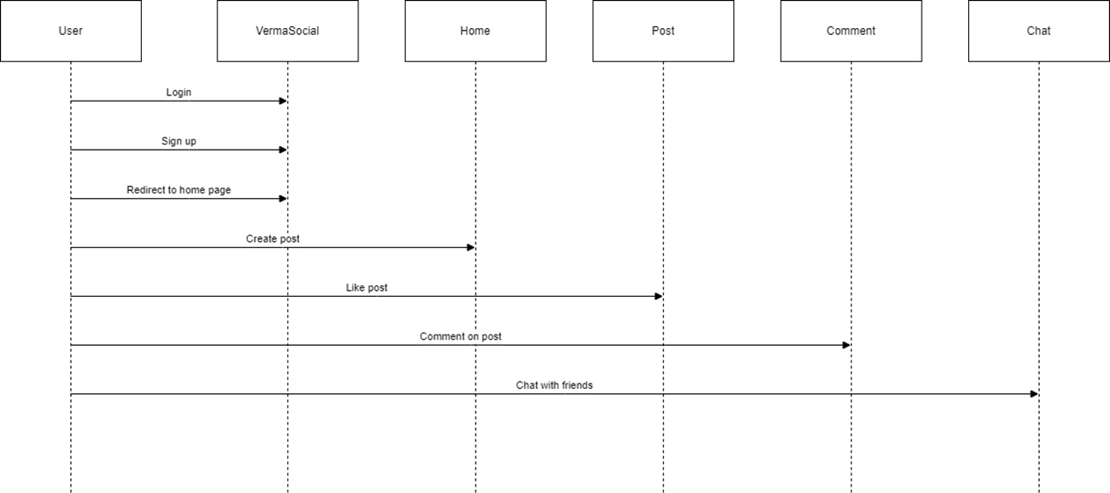
CLASS DIAGRAM

Slide 11
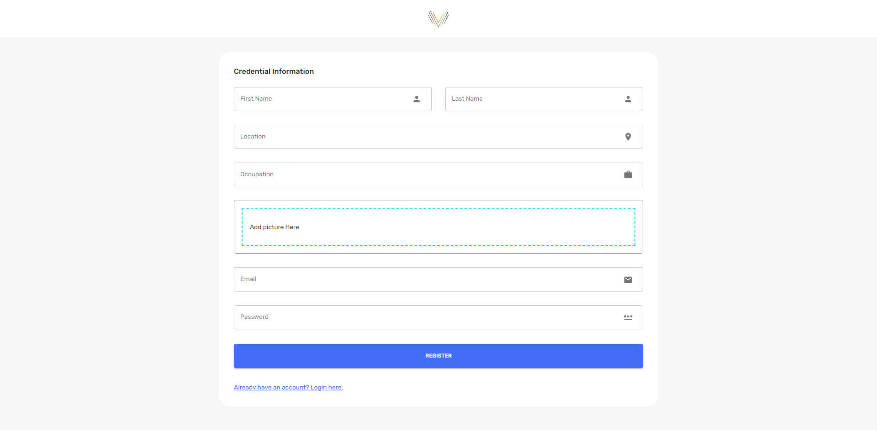
PROJECT IMAGES

Slide 12
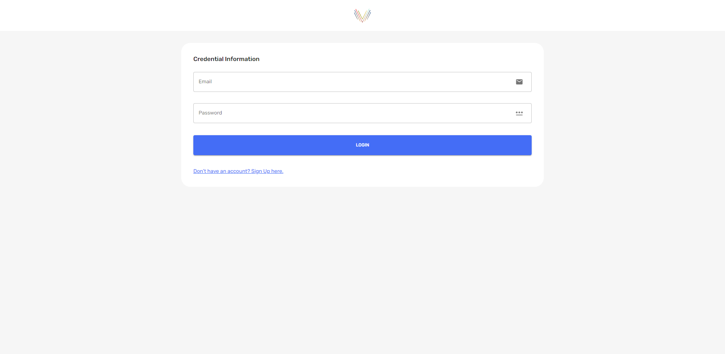
PROJECT IMAGES

Slide 13
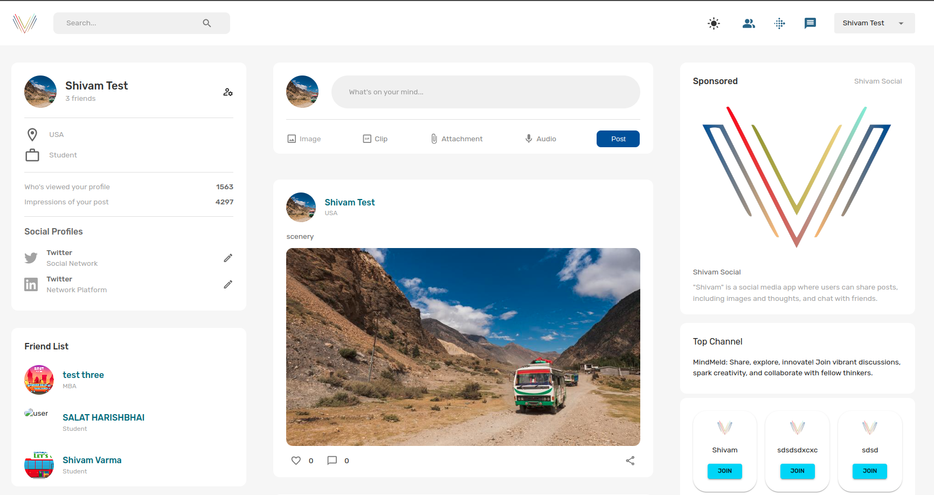
PROJECT IMAGES

Slide 14
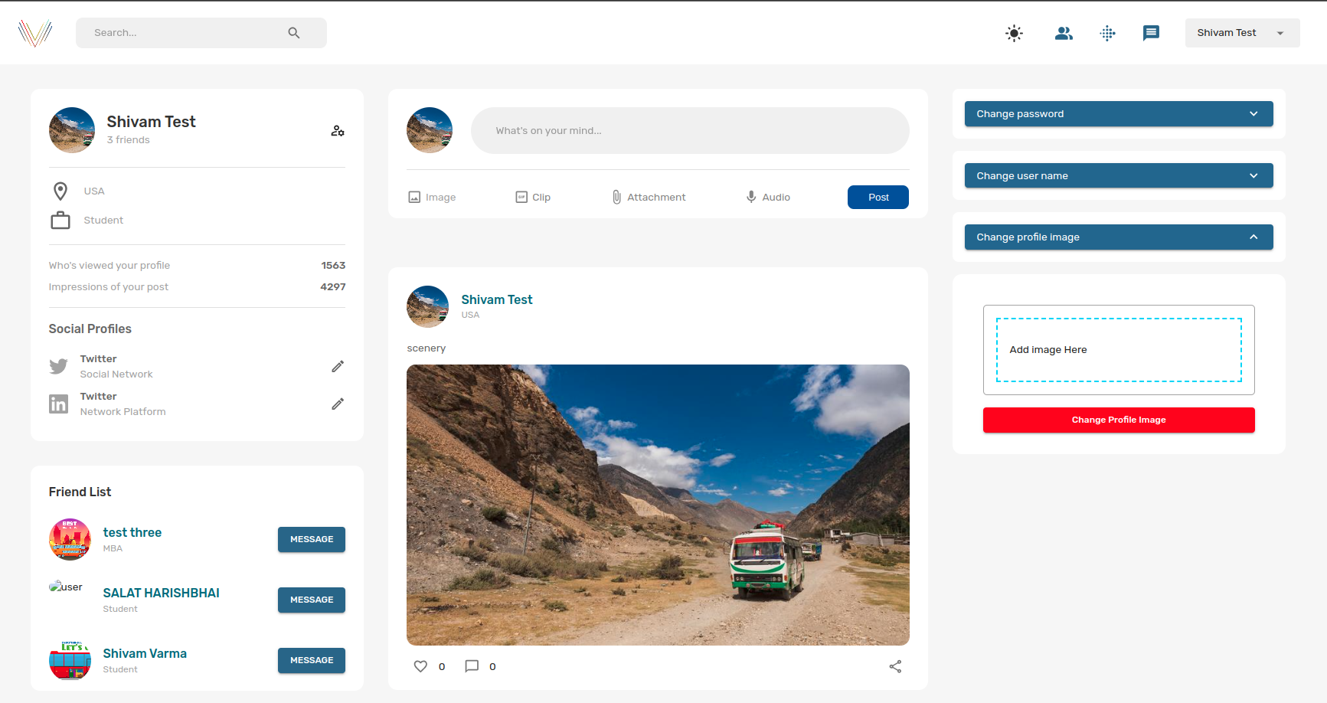
PROJECT IMAGES

Slide 15
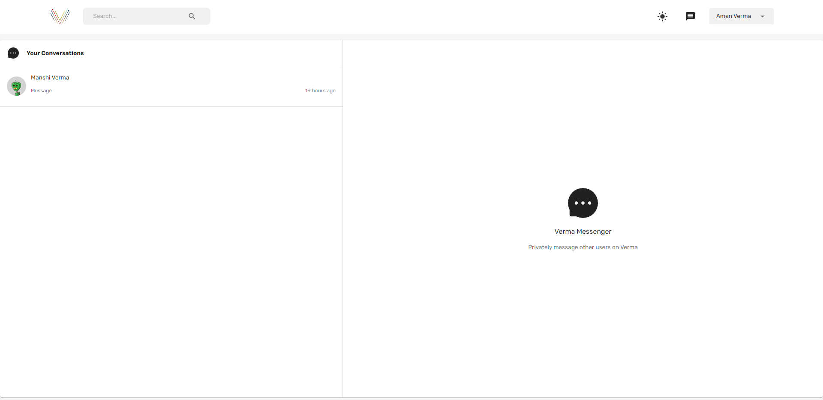
PROJECT IMAGES

Slide 16
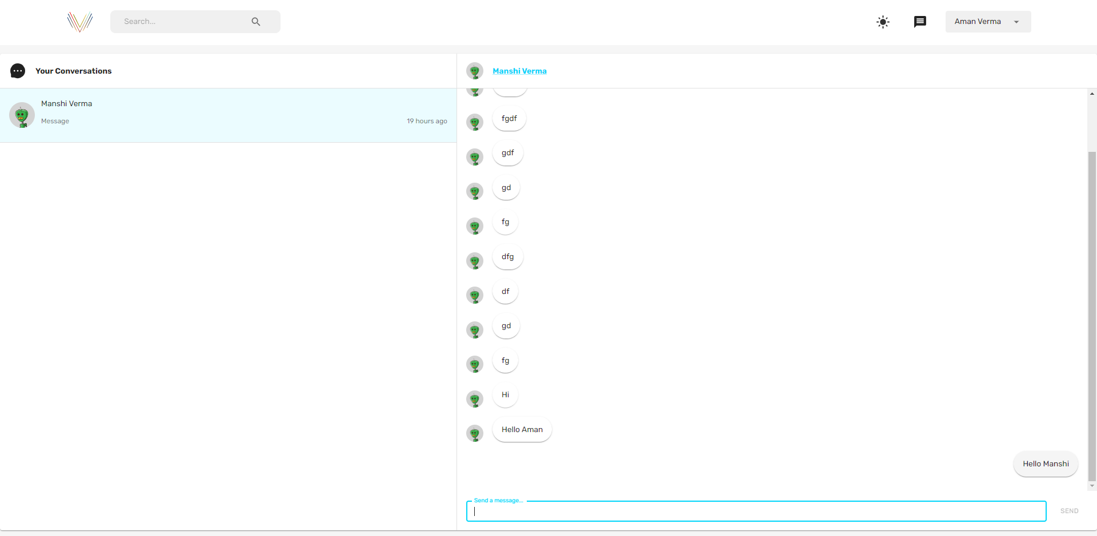
PROJECT IMAGES

Slide 17
LIMITATION
Scalability: MERN stack may struggle to handle increased user load efficiently as the application grows.
Security: Robust security measures must be implemented separately to protect user data from various threats.
Real-time Communication: Ensuring efficient real-time chat functionality can be challenging, especially at scale.

Slide 18
LIMITATION
Maintenance Complexity: Managing application can become complex as the codebase grows, coordination across multiple technologies and frameworks.
lacked full support for multi-document transactions. Flexibility can lead to data consistency issues in complex schemas
memory-intensive; entire dataset may need to fit in RAM for optimal performance

Slide 19
FUTURE ENHANCEMENT & OUR GOALS
1
2
3
Enhanced User Experience: Continuously improving user interface design and incorporating user feedback to enhance user engagement and satisfaction.
Global Expansion: Scaling the application to reach a wider audience by expanding to new geographical regions and supporting multiple languages and cultures.
Global Expansion: Scaling the application to reach a wider audience by expanding to new geographical regions and supporting multiple languages and cultures.

Slide 20
FUTURE ENHANCEMENT & OUR GOALS
4
Integration of Advanced Features: Introducing innovative features such as AI-powered content recommendations, augmented reality (AR) filters for photos/videos, or blockchain-based identity verification for enhanced security and trust.

Slide 21

THANKYOU
Success is not just about reaching the destination, but also about enjoying the journey.

