Slide 1
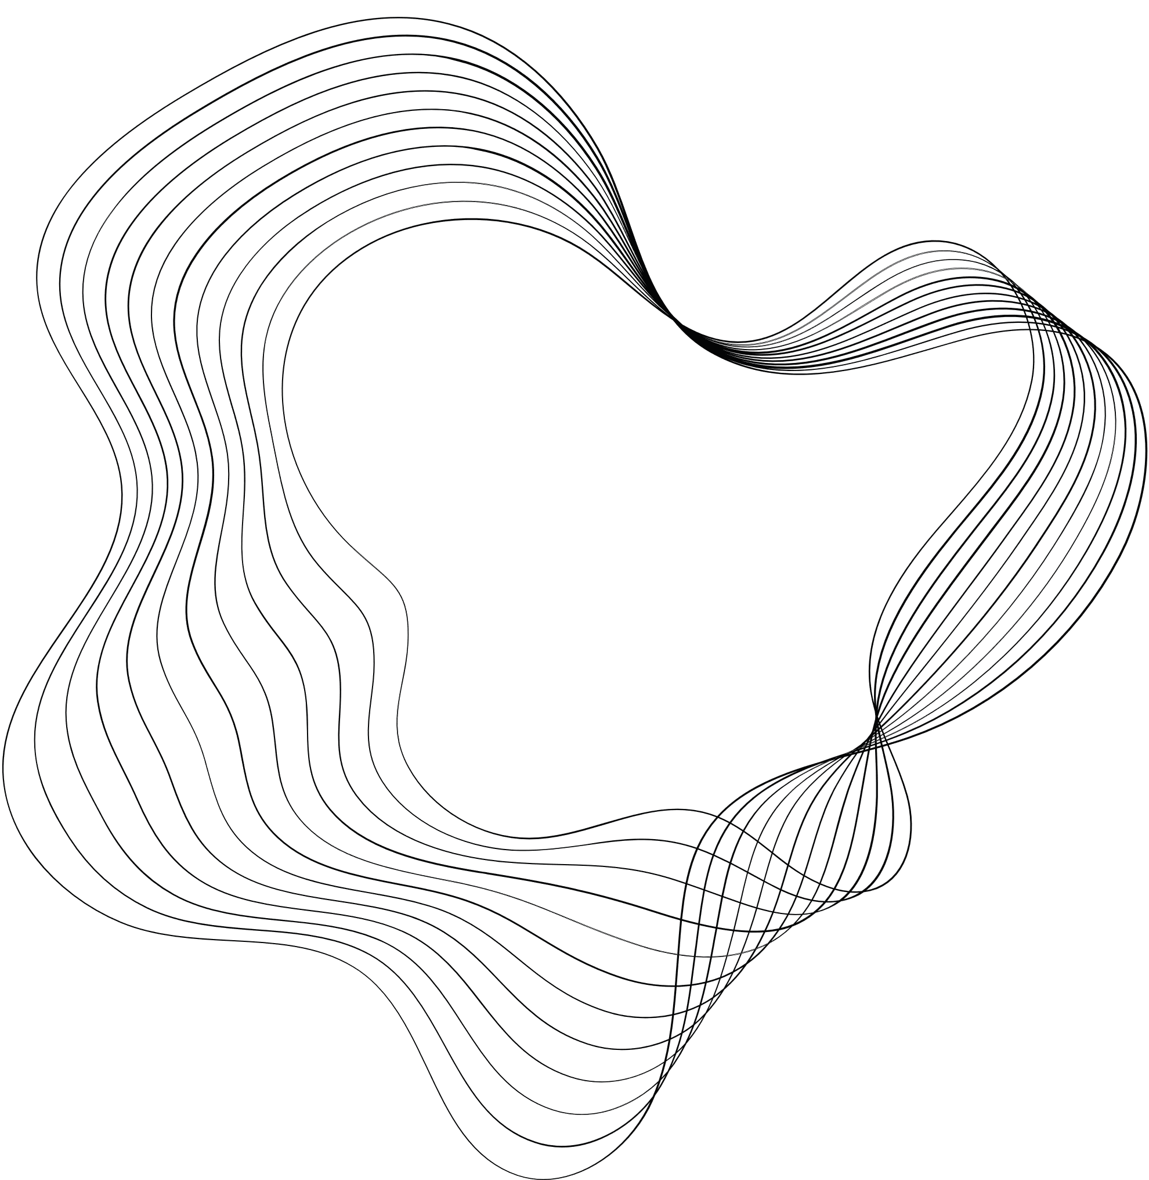

SOCIAL MEDIA APP
DESIGNED BY:
Enrollment:

Slide 2





OBJECTIVES
The objective of This project is to create a secure and user-friendly web platform for social interaction. Users can log in, create posts, engage with friends through likes and comments, and utilize real-time chat. The application focuses on privacy with customizable settings and ensures responsiveness across devices. Security measures include encryption, and scalability is considered. Notifications keep users informed, while analytics provide insights. The platform encourages positive interactions through feedback and moderation tools.

Slide 3

CONTENT
01
ABOUT PROJECT
02
PROJECT STACK
03
DATA DICTIONARY
04
DIAGRAM AND IMAGES
05
LIMITATION
06
FUTURE ENHANCEMENT & OUR GOALS
07
THANKYOU

Slide 4

ABOUT PROJECT
This project is a social media platform facilitating seamless communication with friends through features like creating posts, liking, commenting, and chatting.

Slide 5
PROJECT STACK
The project stack includes React.js for frontend, Node.js with Express.js for backend, MongoDB for database, and Socket.IO for real-time communication, ensuring efficient development, scalability, and dynamic user interactions.
React JS
Usage:
We used React to build the frontend of our ChatApp.
Implementation:
BrowserRouter: For handling client-side routing and navigation.
MUI: For designing responsive and visually appealing user interfaces.
socket.io-client: For enabling real-time communication between the client and server.
Yup and Formik: For form validation and management.
google-map-react: For integrating Google Maps to enable location sharing.
Moment: For managing and displaying dates and times.
Redux: For maintaining a consistent application state across different components.

Slide 6
NodeJS
Usage:
We used NodeJS to develop the backend server of our ChatApp.
Implementation:
ExpressJS: To create a RESTful API and handle HTTP requests and responses.
Multer: For handling file uploads, such as user profile pictures and chat attachments.
Bcrypt: For hashing passwords to ensure secure user authentication.
Body-parser: To parse incoming request bodies for easy data handling.
Cors: To enable secure cross-origin requests.
Dotenv: For managing environment variables securely.
Helmet: For enhancing the security of the application by setting various HTTP headers.
Socket.io: To enable real-time, bidirectional communication between clients and server.
Nodemon: For automatically restarting the server during development when file changes are detected.

Slide 7
MongoDB
Usage:
We used MongoDB as the database for our ChatApp.
Implementation:
Mongoose: For creating schemas and interacting with MongoDB.
Document-Oriented Storage: To store user data, chat messages, and other relevant information in a flexible and scalable manner.

Slide 8
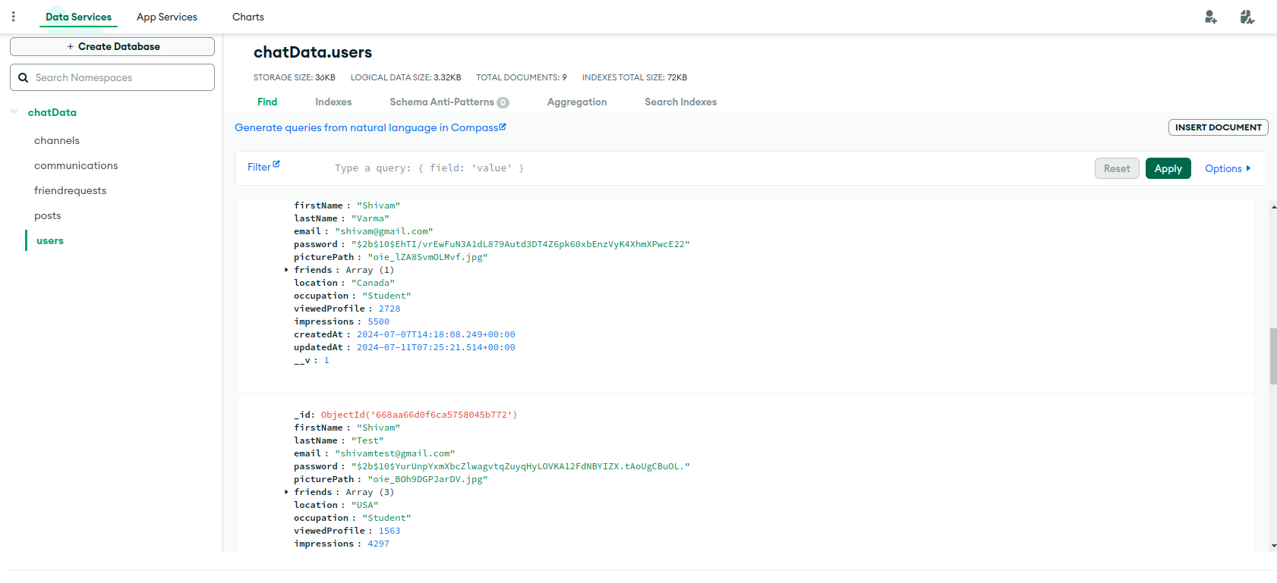

DATA DICTIONARY
STRATEGY N°3

Slide 9
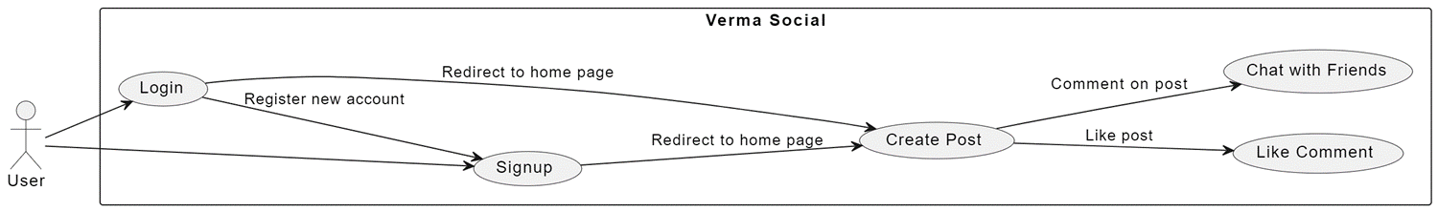
USE CASE DIAGRAM

Slide 10
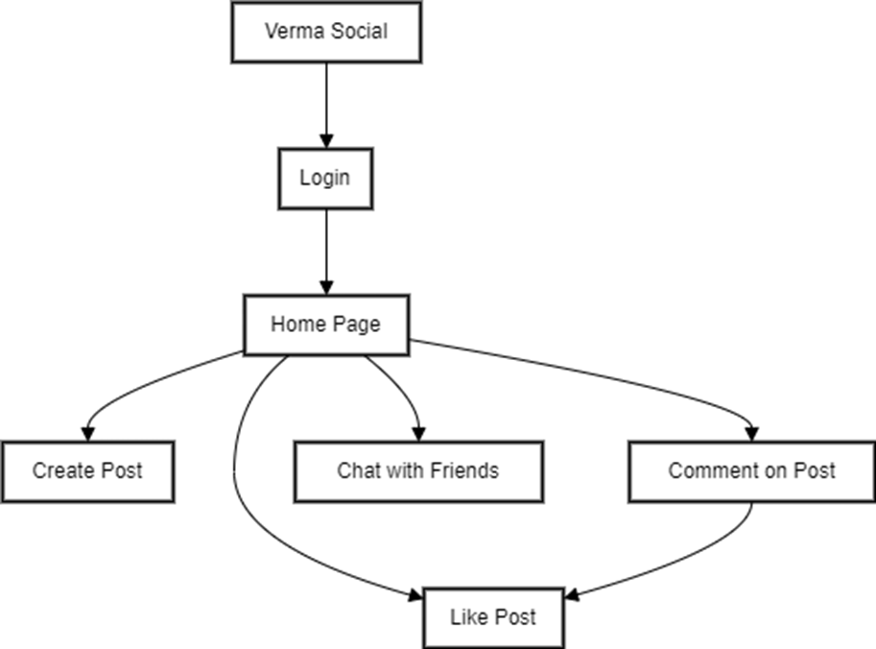
FLOWCHART DIAGRAM
Shivam Social

Slide 11
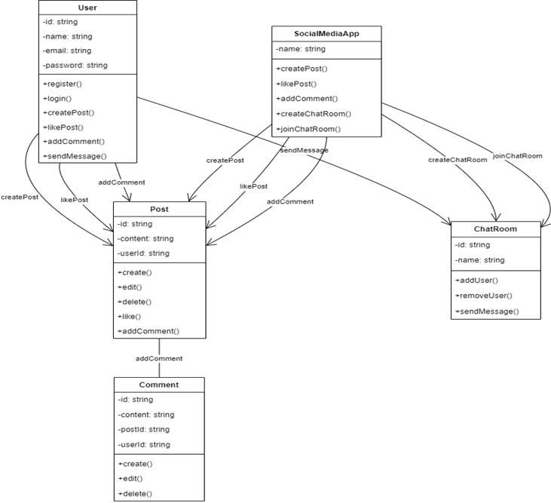
CLASS DIAGRAM

Slide 12
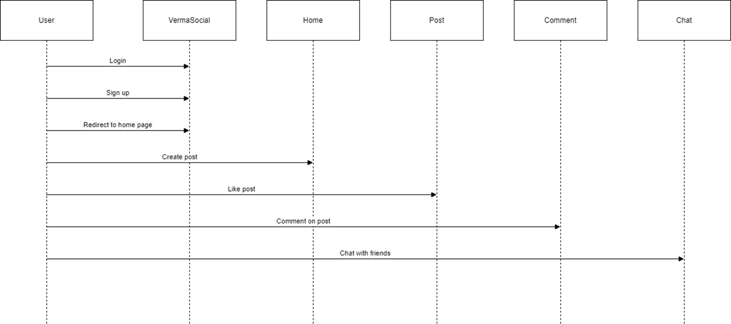
CLASS DIAGRAM

Slide 13
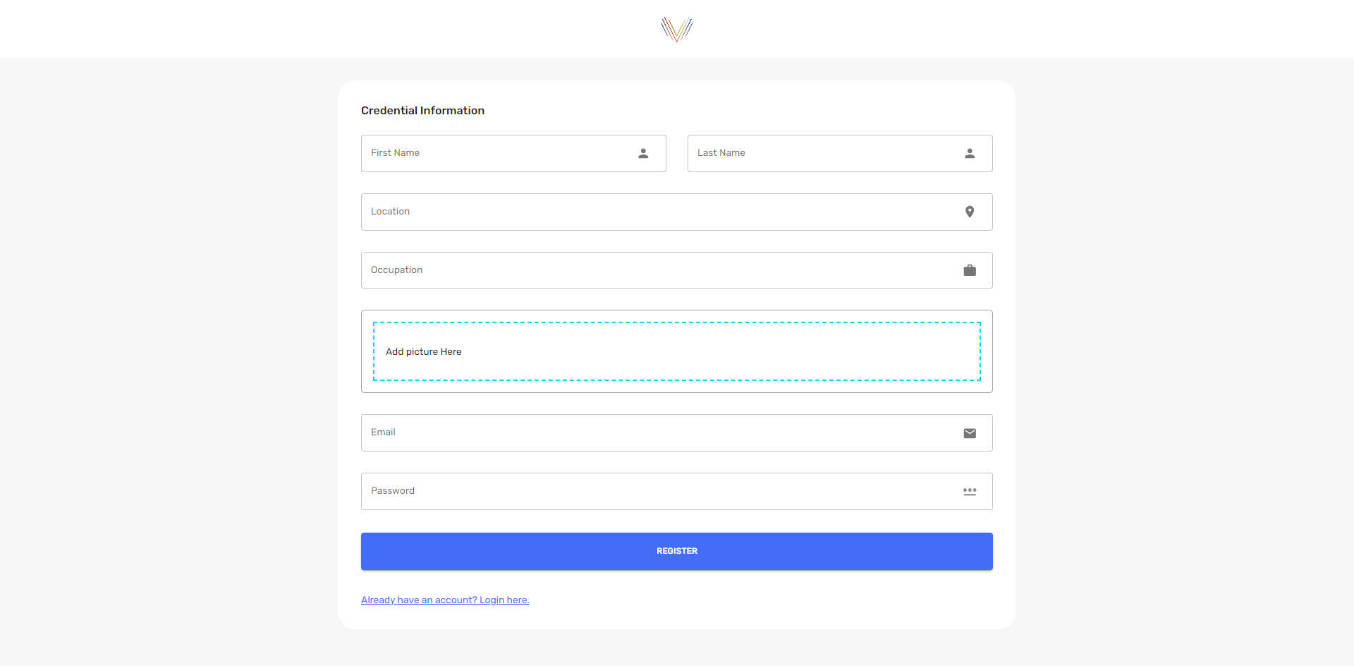
PROJECT IMAGES

Slide 14
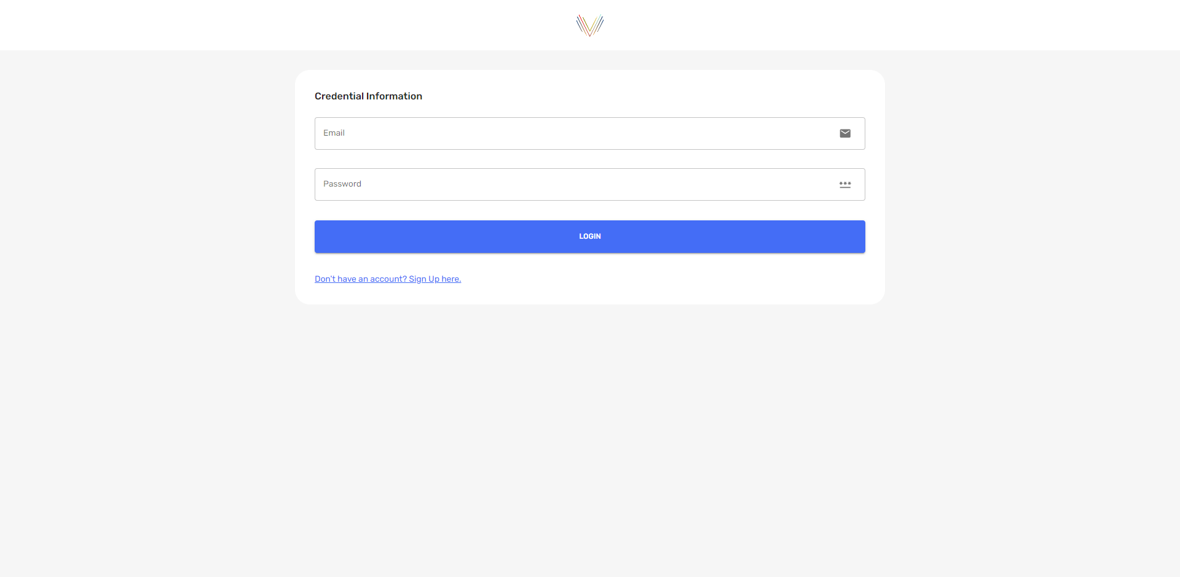
PROJECT IMAGES

Slide 15
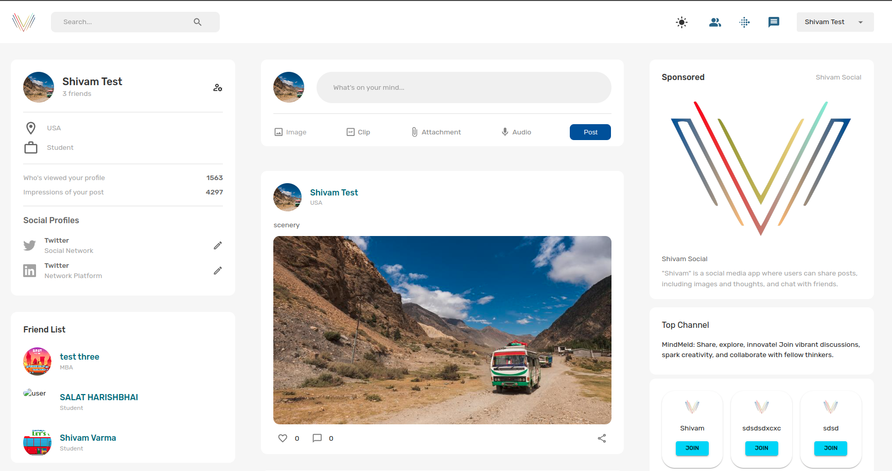
PROJECT IMAGES

Slide 16
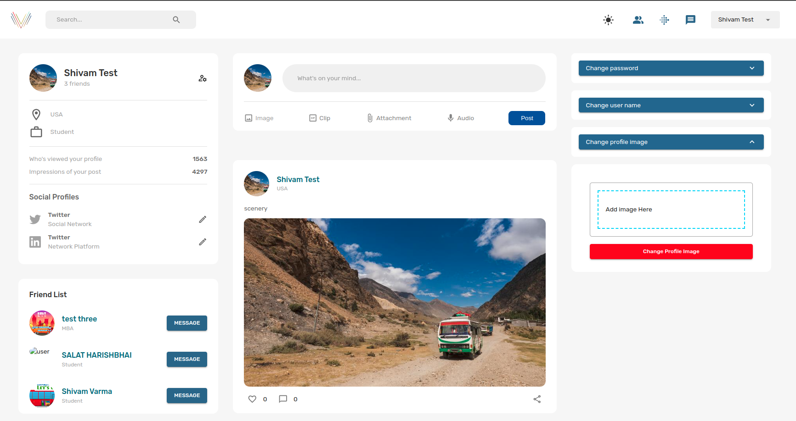
PROJECT IMAGES

Slide 17
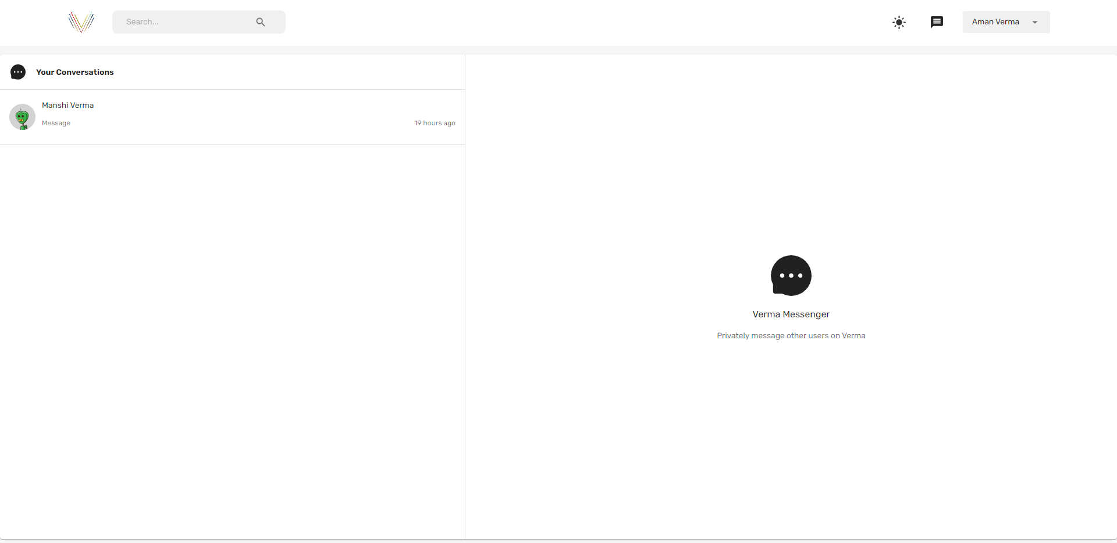
PROJECT IMAGES

Slide 18
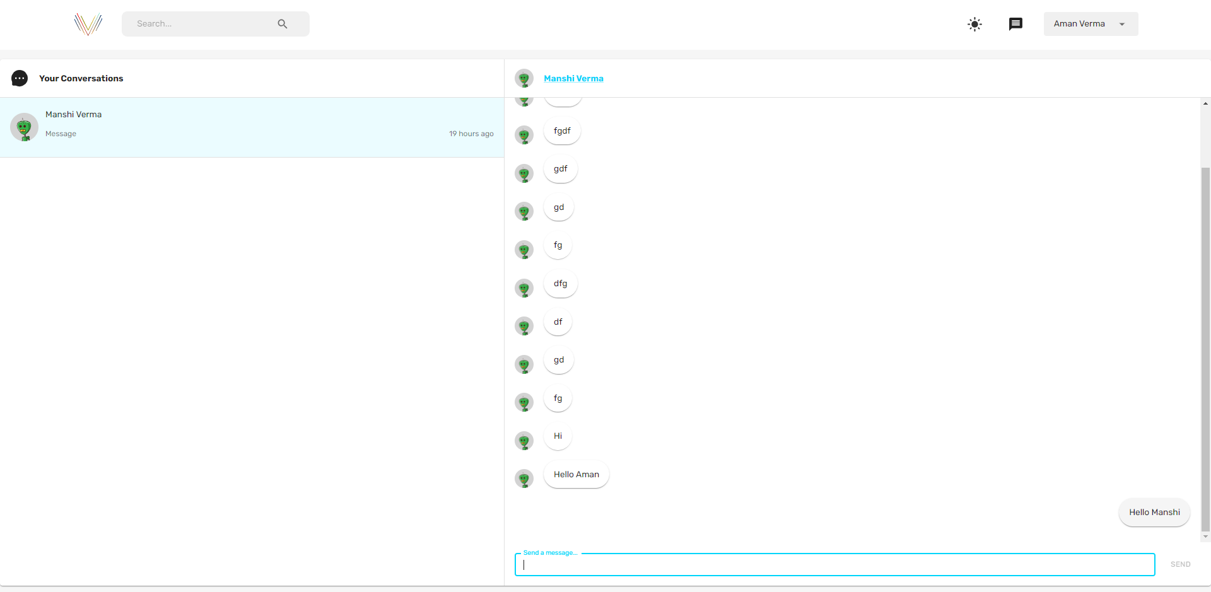
PROJECT IMAGES

Slide 19
LIMITATION
Scalability: MERN stack may struggle to handle increased user load efficiently as the application grows.
Security: Robust security measures must be implemented separately to protect user data from various threats.
Real-time Communication: Ensuring efficient real-time chat functionality can be challenging, especially at scale.

Slide 20
LIMITATION
Maintenance Complexity: Managing application can become complex as the codebase grows, coordination across multiple technologies and frameworks.
lacked full support for multi-document transactions. Flexibility can lead to data consistency issues in complex schemas
memory-intensive; entire dataset may need to fit in RAM for optimal performance

Slide 21
FUTURE ENHANCEMENT & OUR GOALS
1
2
3
Enhanced User Experience: Continuously improving user interface design and incorporating user feedback to enhance user engagement and satisfaction.
Global Expansion: Scaling the application to reach a wider audience by expanding to new geographical regions and supporting multiple languages and cultures.
Global Expansion: Scaling the application to reach a wider audience by expanding to new geographical regions and supporting multiple languages and cultures.

Slide 22
FUTURE ENHANCEMENT & OUR GOALS
4
Integration of Advanced Features: Introducing innovative features such as AI-powered content recommendations, augmented reality (AR) filters for photos/videos, or blockchain-based identity verification for enhanced security and trust.

Slide 23

THANKYOU
Success is not just about reaching the destination, but also about enjoying the journey.

