Slide 1
Project Presentation on Online Examination System By Thakare Pranoti Kamalakar (Roll No. 19) Chavan Mamta Eknath (Roll No. 20) Ahire Nalini Ashok (Roll No. 21) Musale Vaishnavi Kishor (Roll No. 54) T. Y. B. Sc. (Computer Science)

Slide 2
INDEX
Introduction
System Analysis
Requirement Analysis
System Design
Implementation System
System Testing
Conclusion

Slide 3
Introduction
In online examination system, exams are conducted through specific institute. This process is done by using internet. It needs less hard work for conducting exams. Compare to the earlier situation, it was necessary to prepare the question papers physically and distribute them to the examination centers. But with this system, question papers can be created in digital format and distributed as per requirement.

Slide 4
System Analysis
Existing System :
The Existing System is the entry of humans into the digital world. The information of students already registered in this system is kept safe. One month registration details of students are required to be maintained but it is difficult to do the details manually. This requires a lot of manpower. It also causes loss of money and time.
Scope and Limitations :
Offline exams are very time consuming.
In this existing system the exams are done only manually.
It is very difficult to save or maintain question paper from damage.
Due to change in environment, it becomes difficult for the students who are far away to reach the exam center.

Slide 5
Requirement Analysis
Functional Requirement :
The teacher will be able to add new questions in the exam.
The examination system will maintain different subject for exam.
The teacher can decide start time and end time of exam.
The system will be able to analyze exam.
Performance Requirements:
The software shall support use of multiple users at a time.
There are no other specific performance requirements that will affect development.
The system shall take as less time as possible to provide service to the administrator or the staff.

Slide 6
Software / Hardware Specification
Hardware Requirements:
For the server:
Processor: Standard processor with a speed of 1.6 GHz or more.
RAM: 256 MB RAM or more
Hard Disk: 3 GB or more.
For the Client:
Processor: Standard Processor with a speed of 1.6 GHz or more.
RAM: 256 MB RAM or more.
Hard Disk: 3 GB or more.

Slide 7
Software Requirements:
For the Server:
Operating System: Linux
Frontend: PHP, CSS, HTML, JavaScript
Backend: PostgreSQL (Version 8)
Server: Apache Tomcat
For the Client:
Operating System: Linux
Browsers: Any

Slide 8
Data Dictionary
Sr No. | Table Name | Description
1. | User Table | Student table contains first name, middle name, last name, user name, email, password, age, mobile no., address
2. | Test Table | Test table contains test id, subject id, test name, total no of questions.
3. | Subject Table | Subject Table contains subject id and subject name.
4. | Question Table | Question Table contains question id, test id, question description, option1, option2, option3, option4, true option.
5. | User Answer Table | User answer table contains session id, test id, question description, option1, option2, option3, option4, true answer, and your answer.
6. | Result Table | Result Table contains login, test id, test date, and score

Slide 9
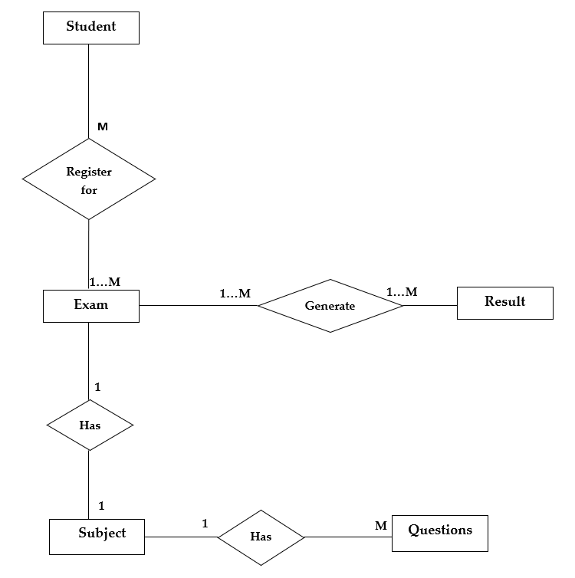
System Diagram
ER Diagram :

Slide 10
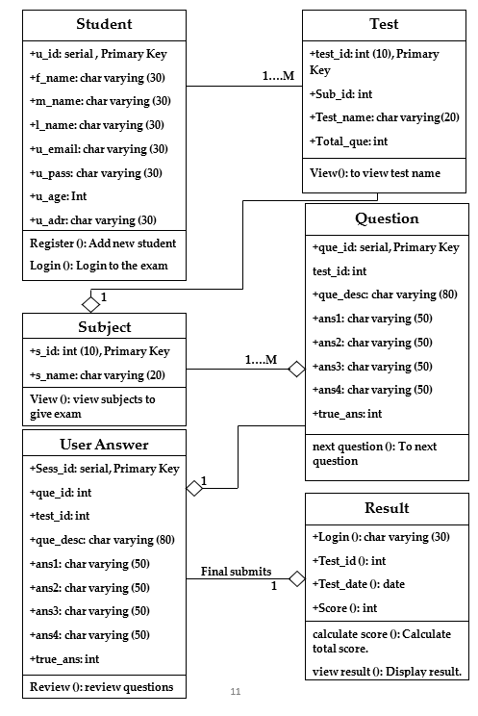
Class Diagram :

Slide 11
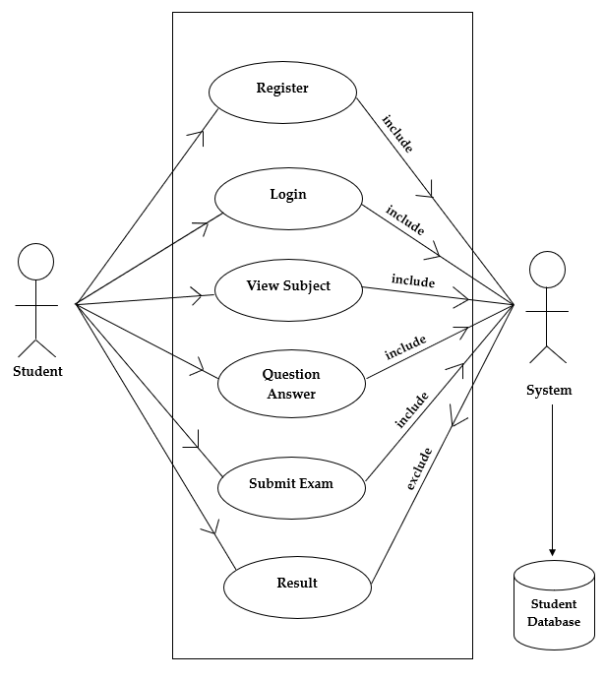
Use Case Diagram :

Slide 12
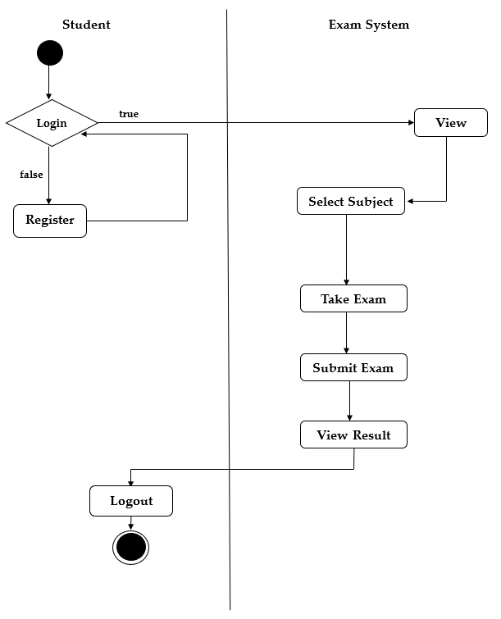
Activity Diagram :

Slide 13
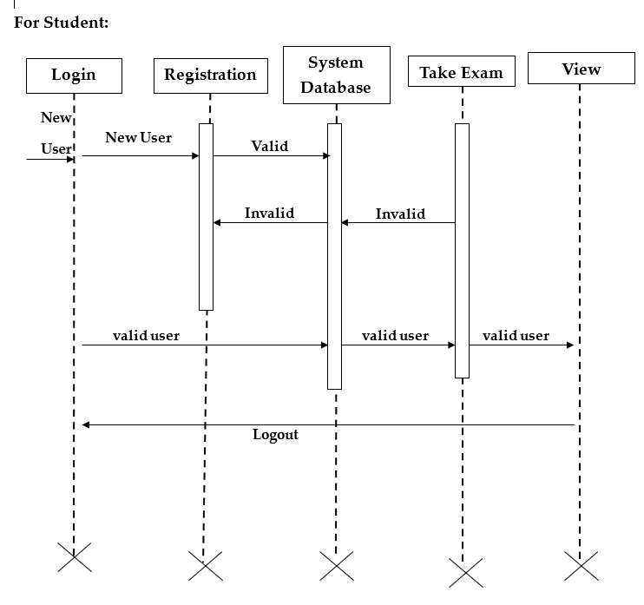
Sequence Diagram :

Slide 14
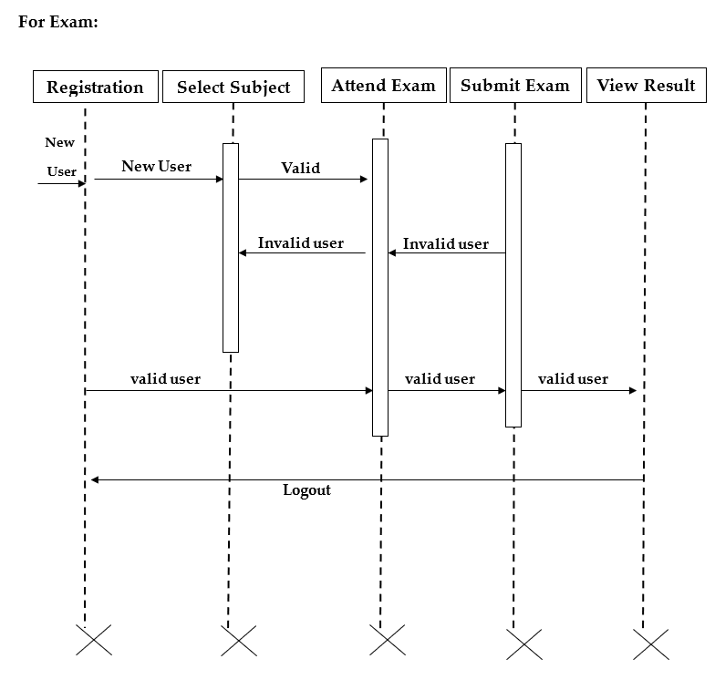

Slide 15
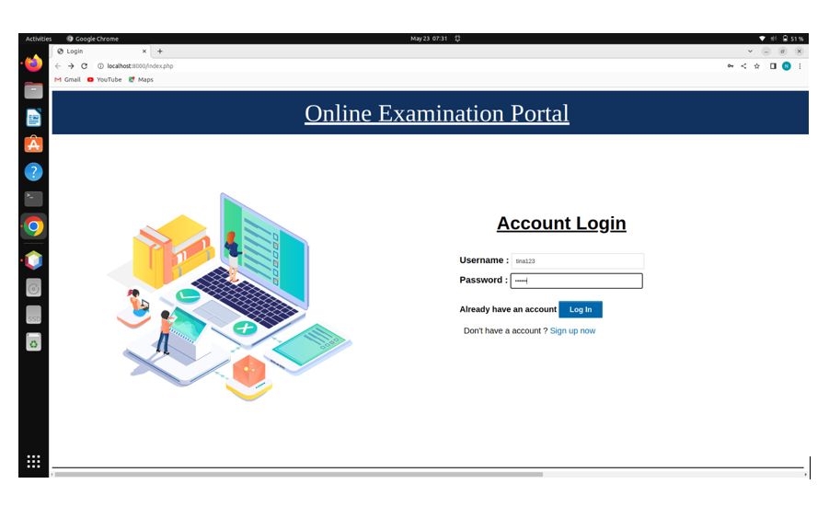
Implementation System

Slide 16
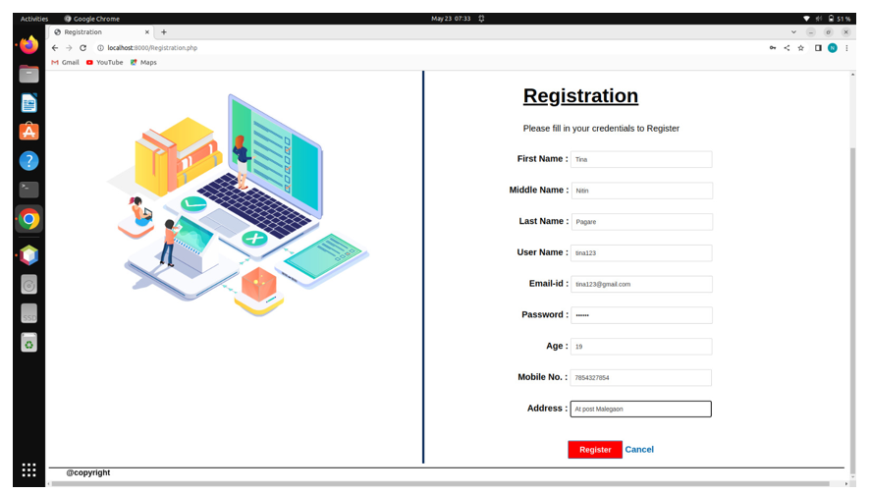

Slide 17
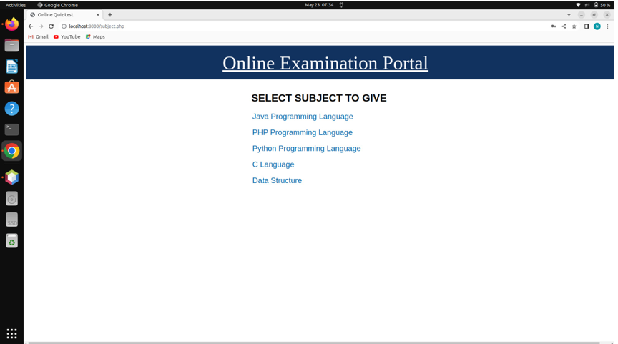

Slide 18
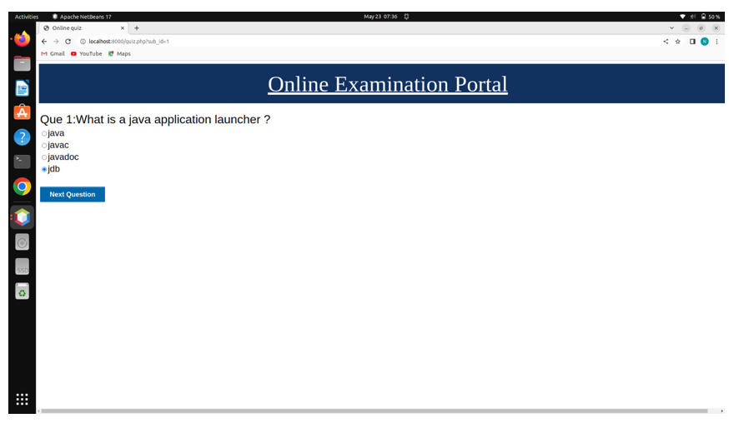

Slide 19
System Testing
System Analysis is the process that decomposes a system into its component pieces for the purpose of defining how well those components interact to accomplish the set requirements. System design is the process of designing the elements of a system such as the architecture, modules and components, the different interfaces of those components and the data that goes through that system.
The purpose of the system design process is to provide sufficient detailed data and information about the system and its system elements to enable the implementation consistent with architectural entities as defined in models and views of the system architecture.

Slide 20
Conclusion
Our project is only a humble venture to satisfy the needs to manage their project work. Several user-friendly coding has also adopted. This package shall prove to be a powerful package in satisfying all the requirements of the Examination System.
The objective of software planning is to provide a frame work that enables our team to make reasonable estimates made within a limited time frame at the beginning of the software project and should be updated regularly as the project progresses.
So, for getting desire result within the time limits. The project can be completed with proper planning.

Slide 21
Future Plan
We will host the platform on online servers to make it accessible worldwide.
We can improve the services & we can add more Services.
The project can be further extended by allowing the large database.

Slide 22
Thank You !

