Slide 1
Project Presentation on
Gym Management System
By
Pawar Pratiksha Dilip(Roll no. 40)
Shete Ruchika Manoj(Roll no. 41)
Vadnere Dhanashree Mukesh(Roll no. 42)
Pawar Mansi Nitin(Roll no. 85)
T.Y.B.Sc.(Computer Science)

Slide 2
Outline
Introduction
Existing System
Requirement
Data Dictionary
System Diagrams
Input/Output Screens
Testing
Future Plan
Conclusion

Slide 3
Introduction
This project is about online GYM Management system. It includes a software of gym and health club .It easily communicates both you and your members. It provides a facility to store the data of trainers and it also stores in it. Services provided by gyms are also handled by these systems. The purpose of this system is to develop software it helps to store records of customers. This system helps to manage class, membership, receive payments. It is simple and effective way for customer to know about their gym.

Slide 4
Existing System
In Gym management system if we take the current system and compared it with the proposed system it is far behind. Every work in existing system is manual and done on paper for which more man power is needed. It is really hard to manage such complicated system. In this system keeping record of customer and handling it is difficult. When we want information of particular customer it needed a lot of time. It is time consuming system. It does not have a proper system to make announcement. In this important information can be missed while writing on page. It is in efficient and slow to search

Slide 5
Requirement
Software requirements: -
For the server: -
Operating System: Linux.
Frontend: PHP, CSS, JavaScript.
Backend: PostgreSQL (Version 8).
Server: Apache 2, Wamp Server, Zamp Server(any).
For the client: -
Operating System: Linux.
Browsers: any.
Hardware requirements: -
For the server: -
Processor: Standard processor with a speed of 1.6GHz or more.
RAM 256 MB RAM or more.
Hard Disk:3GB or more.
For the client: -
Processor: Standard processor with a speed of 1.6 GHz or more.
RAM: 256 MB RAM or more.
Hard Disk: 3 GB or more.

Slide 6
Data Dictionary
Sr No | Table Name | Description
1. | User Table | User table contains user_id, user_name, user_pass, user_email, contact_no, user_add, pics and details.
2. | Admin Table | Admin table contains admin_id, admin_name, admin_pass, pics and details
3. | Trainer Table | Trainer table contains trainer_id, trainer_name, trainer_add, trainer_email, trainer_salary, pics and details.
4. | Equipment Table | Equipment table contains equipment_id, equipment_name, equipment_quantity, pics and details.
5. | Batch Table | Batch table contains batch_no, batch_time and details
6. | Bill Table | Bill table contains bill_id, bill_amt and details.

Slide 7
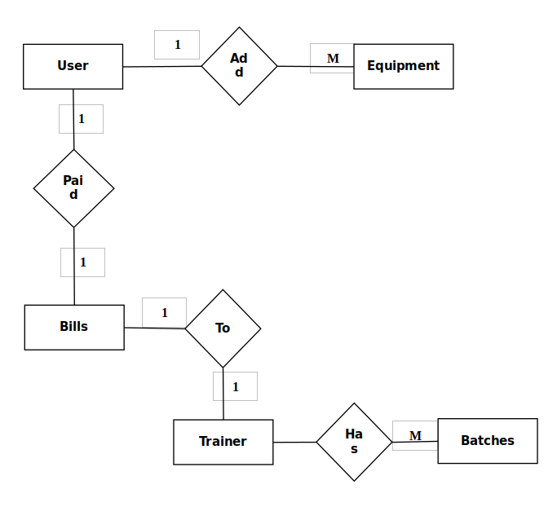
System Diagram
ER Diagram

Slide 8
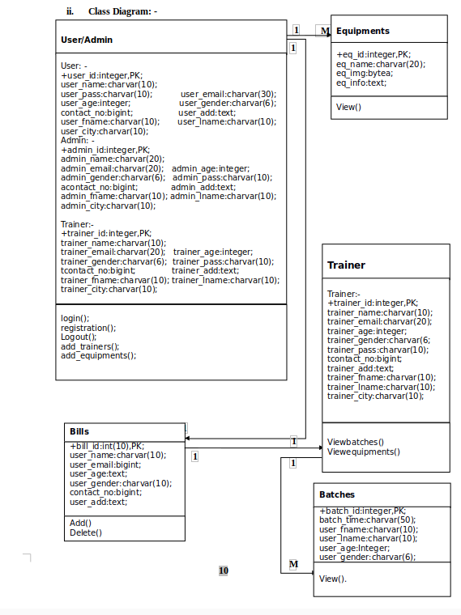
System Diagram
Class Diagram

Slide 9
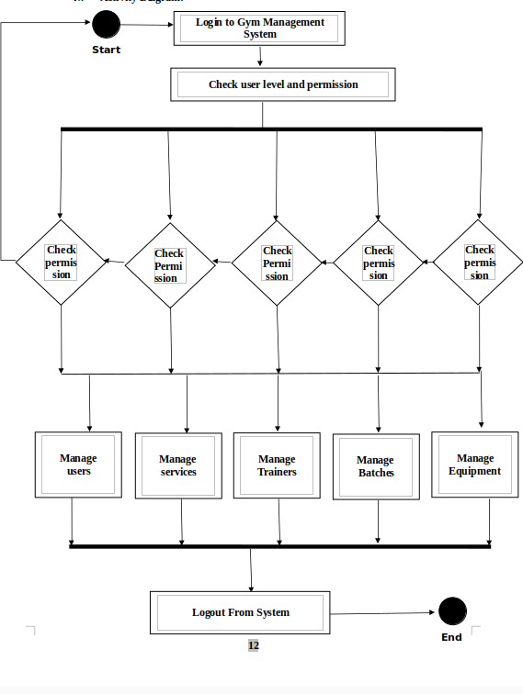
System Diagram
Activity Diagram

Slide 10
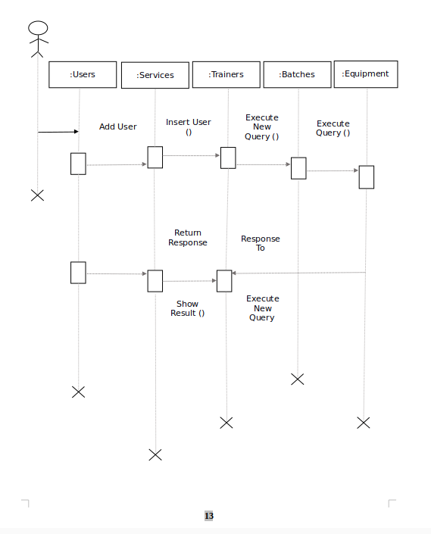
System Diagram
Sequence Diagram

Slide 11
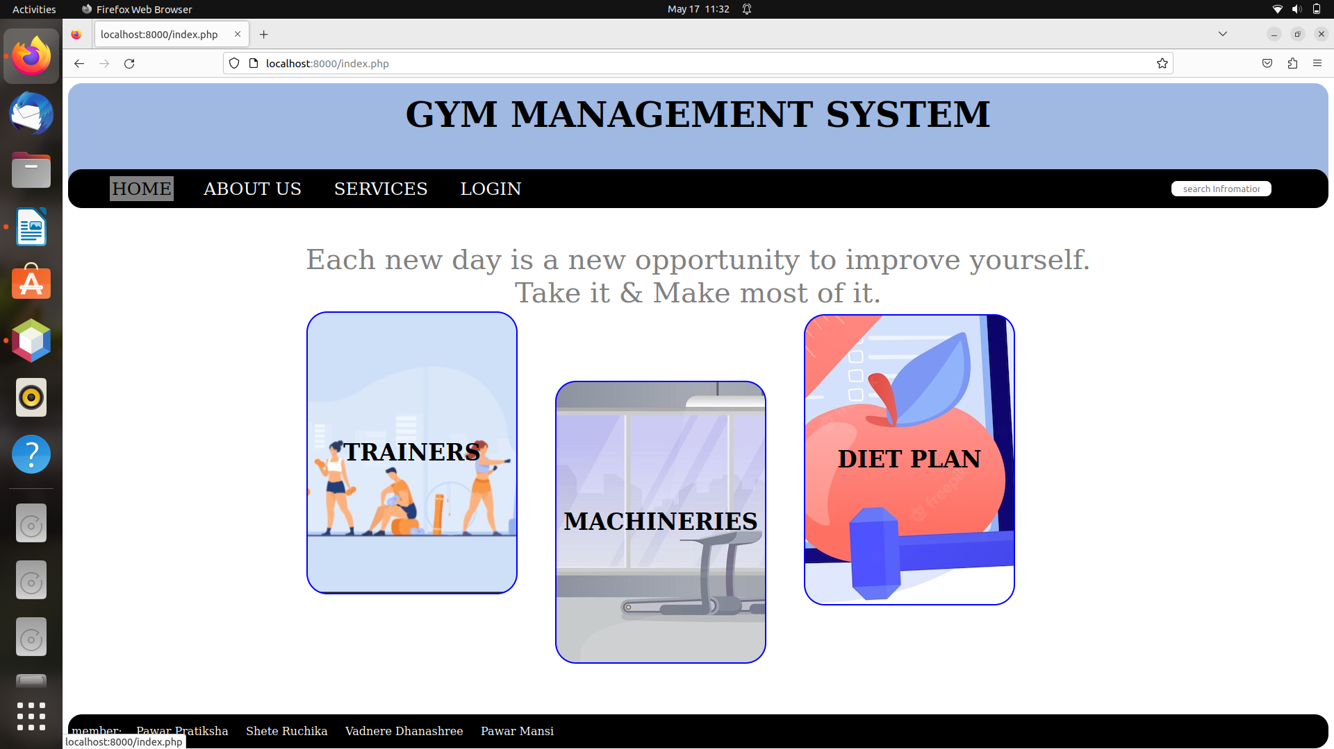
Screen

Slide 12
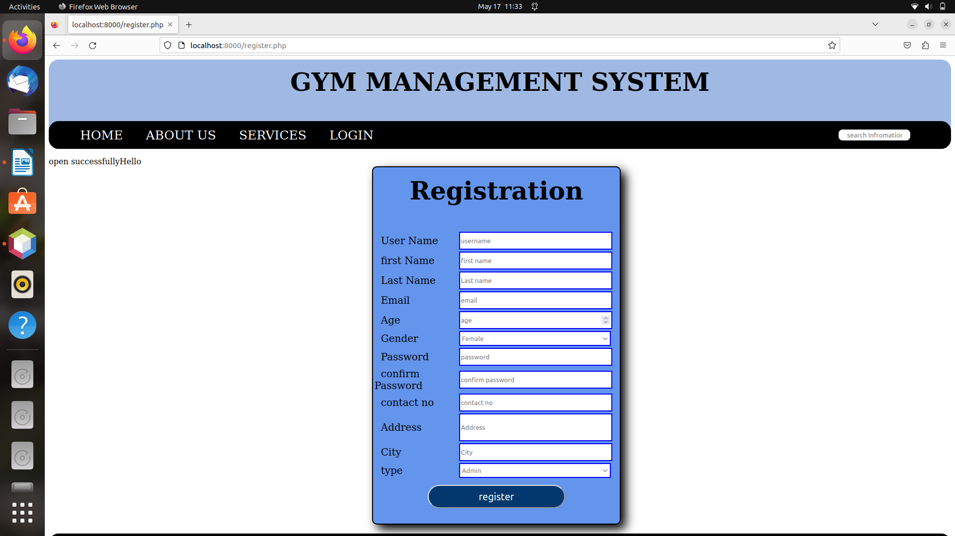
Screen

Slide 13
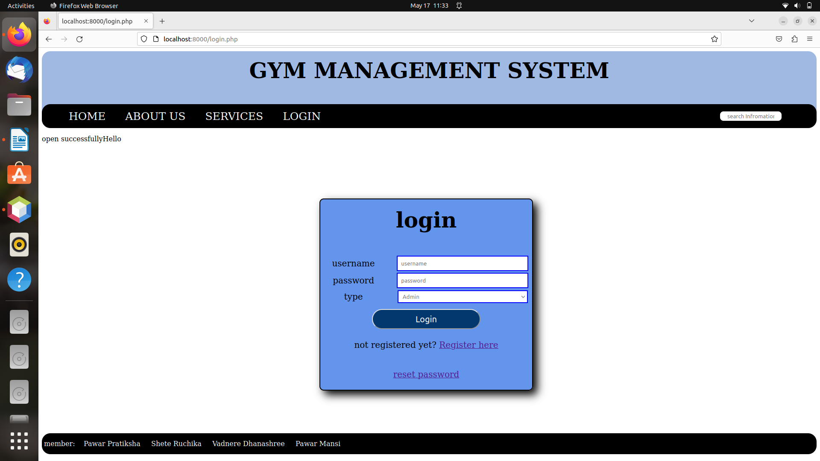
Screen

Slide 14
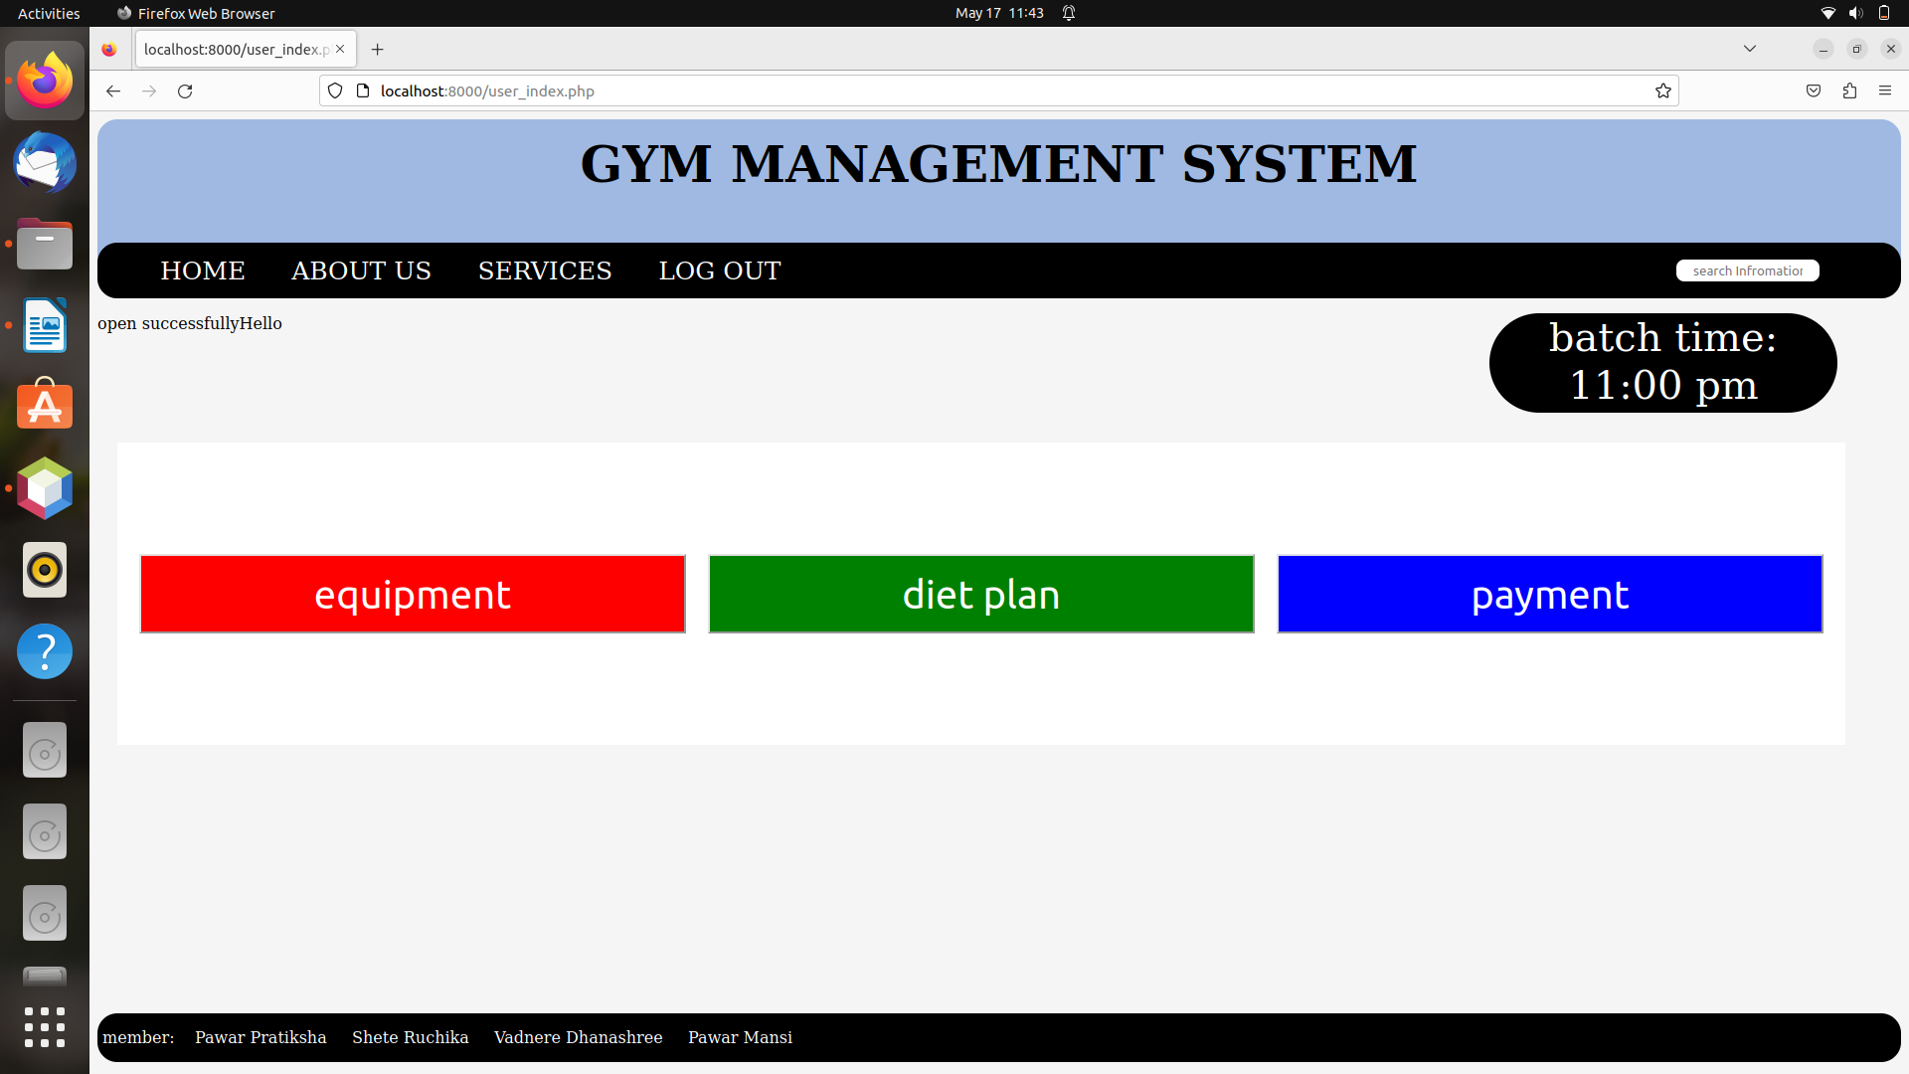
Screen

Slide 15
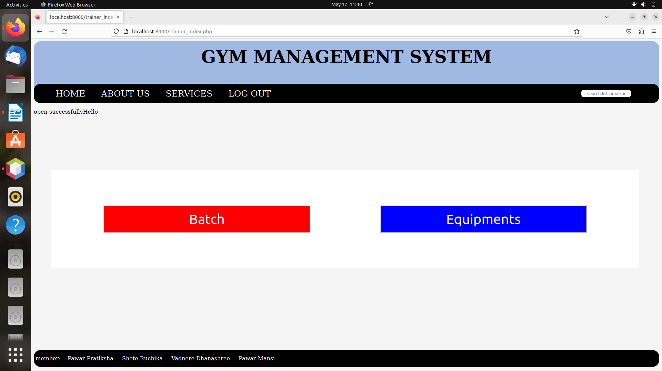
Screen

Slide 16
Testing
White-box Testing
In this testing user can see the detail information about the equipments which are available in the gym. User can also see the diet plan they need diet plan can be display by the users need.user can done payment.
Trainer can see all the batches which they assigned to either it is male batch or female batch. And can also view their information .Trainer can see the detail information about the equipments which are available in the gym.

Slide 17
Future Plan
We will host the platform on online servers to make it accessible worldwide.
we will add online payment options.
We can improve the servers and we can add more services.
The project can be further extended by allowing the large database.

Slide 18
Conclusion
Our project is only a humble venture to satisfy the needs to manage their work. Several user friendly coding have also adopted. This package shall prove to be powerful package in satisfying all the requirements of the Gym Management System.
The objective of software planning is to provide a frame work that enables our team to make reasonable estimates made within a limited time frame at the beginning of the software project and should be updated regularly as the project progress

Slide 19
Thank You !

