Slide 1
Project
Presentation
On
Online System for Farm
By
Nikam Varuna Avinash(Roll No.27)
Sawant Gayatri Shivaji(Roll N0.51)
Sawant Vasudha Hemant(Roll No.52)
Nikam Pooja Nanaji(Roll No.53)
T.Y.B.sc(Computer Science)

Slide 2
Outline
Introduction
Existing System
Requirement
Data Dictionary
System Diagram
Input/Output Screens
Testing
Future Plan
Conclusion

Slide 3
Introduction
Accurate and easy to use online system for farm are of fundamental importance for successful operational forming. However still today many farmers do not know about various technology as well fertilizers. In particular for small to medium-size form and for multifunctional farming if a form is well managed in appropriate manner, then the farmer can get much profit. The growth of the global population coupled with a decline in natural resources. Environmental conditions lead to food security becoming a major concern, these problems are motivators. In order to meet the current global needs of humidity, new solutions and technology are constantly being implemented. So, this online system for farm is very useful to lead the farming systems.

Slide 4
Existing System
This type of all system is informed that can be used for various farming process. It satisfies the farmer requirement. The System is easy to understand by the farmers. Be easy to operate for everyone. Have a good user interface and be expandable. Arrange and Schedule with proper time and management. It is the study of farmer as a producer of food and other raw materials. Who occupies a strategic position in the economic like of a country farm. Online system for farm gives thrust and direction to farming improvement by providing useful information to farmers.

Slide 5
Requierement
Software requirements:
Operating System: Linux
User Interface: PHP, CSS, JavaScript
Database: : PostgreSQL (Version 8)
Document Tool:Ms Office
Hardware Requirement:
Processor: Standard processor with a speed of 1.6 GHz or more
RAM: 256 MB RAM or more
Hard Disk: 3 GB or more
Keyboard:Standard keyboard
Monitor:Standard Color Monitor

Slide 6
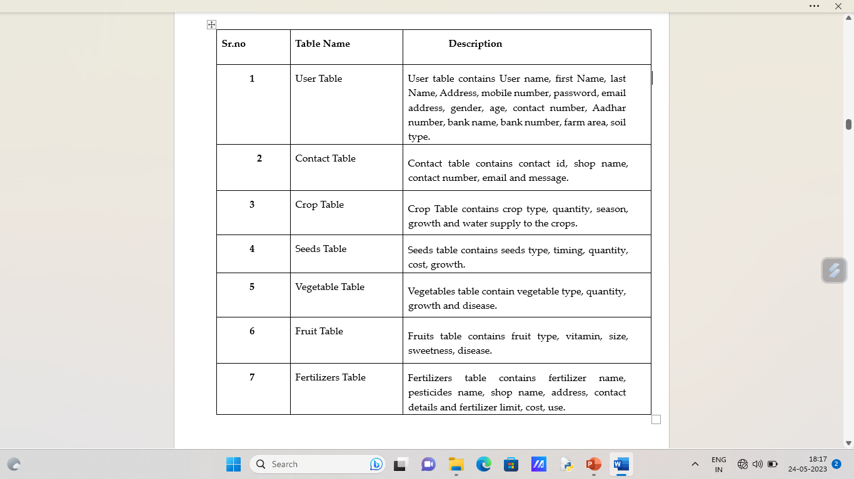
Data Dictionary

Slide 7
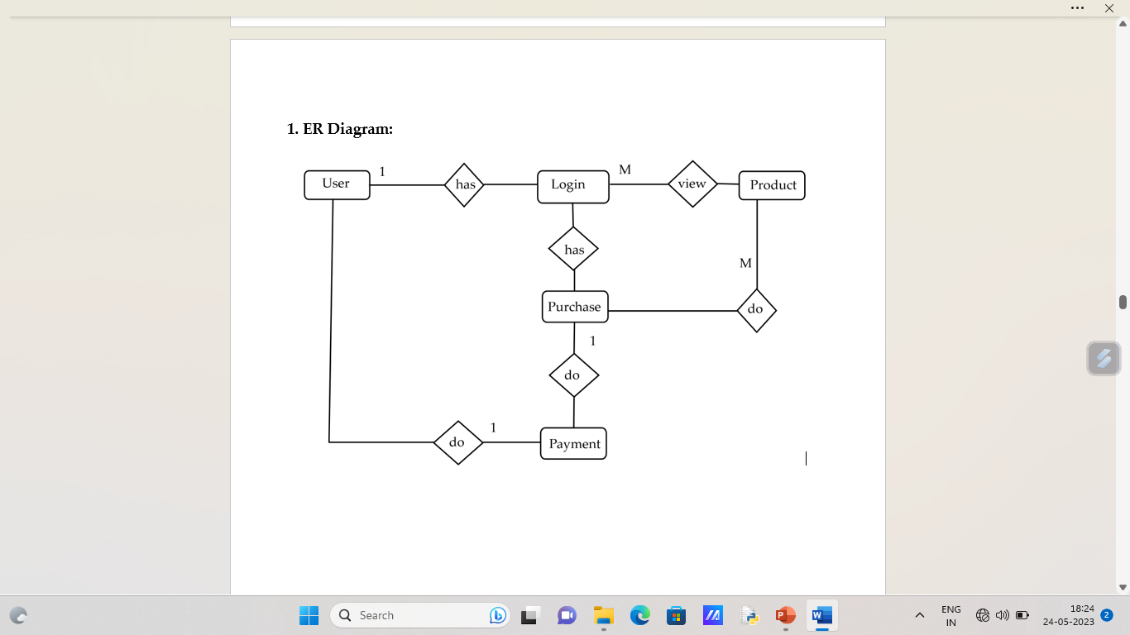
System Diagram

Slide 8
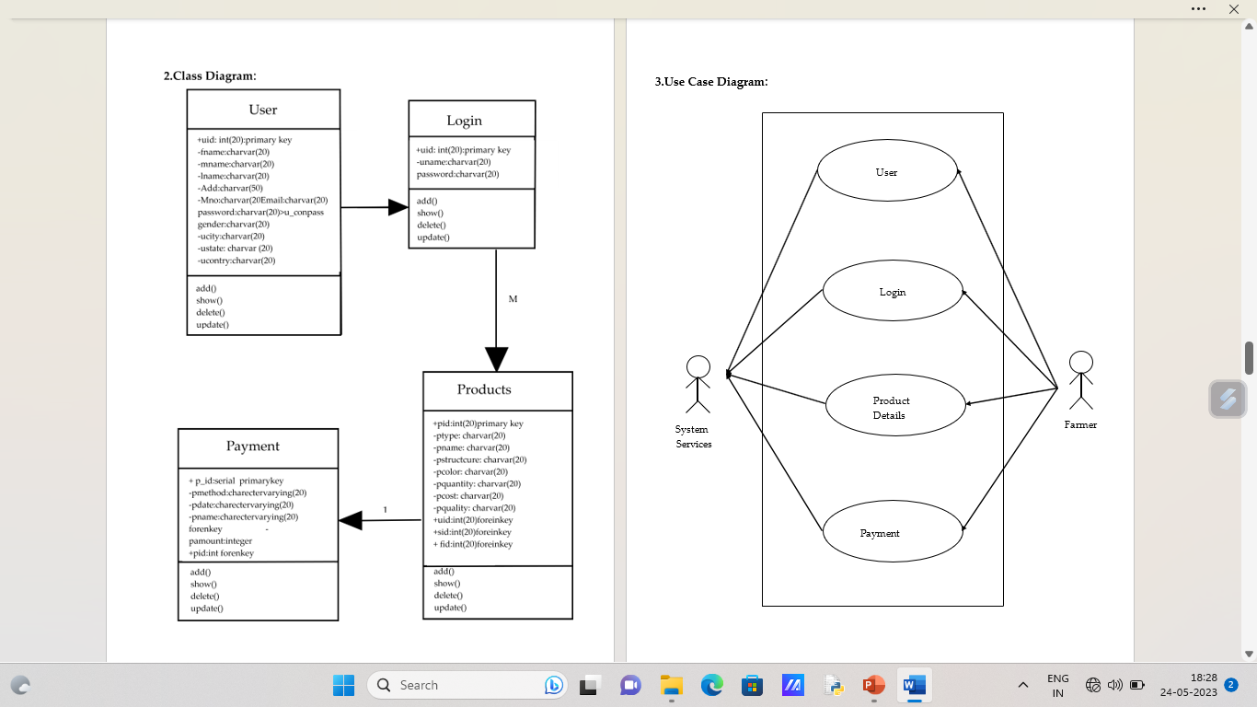

Slide 10
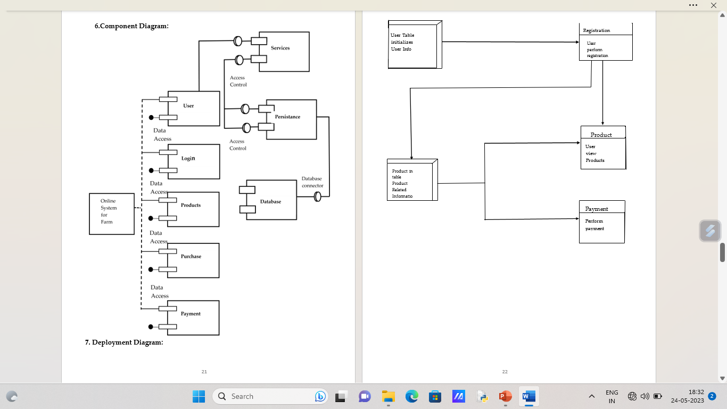

Slide 11
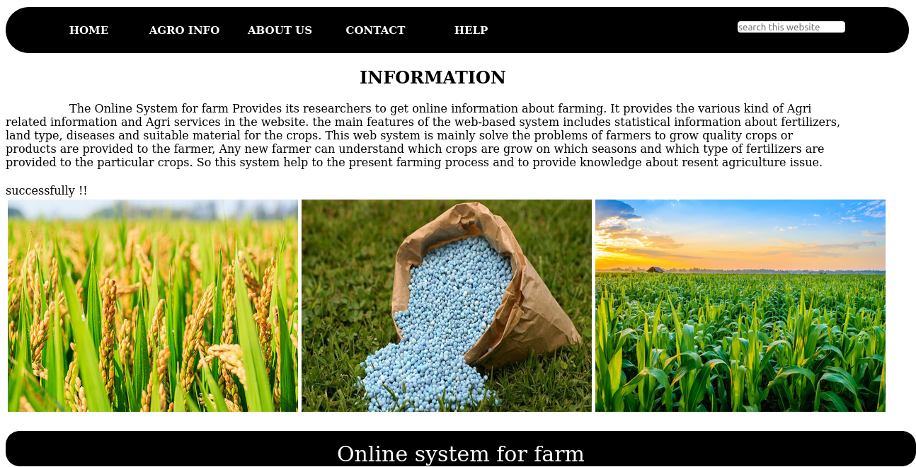
Screen

Slide 12
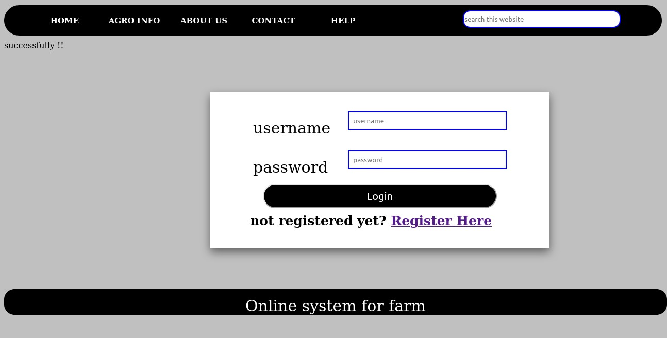

Slide 13
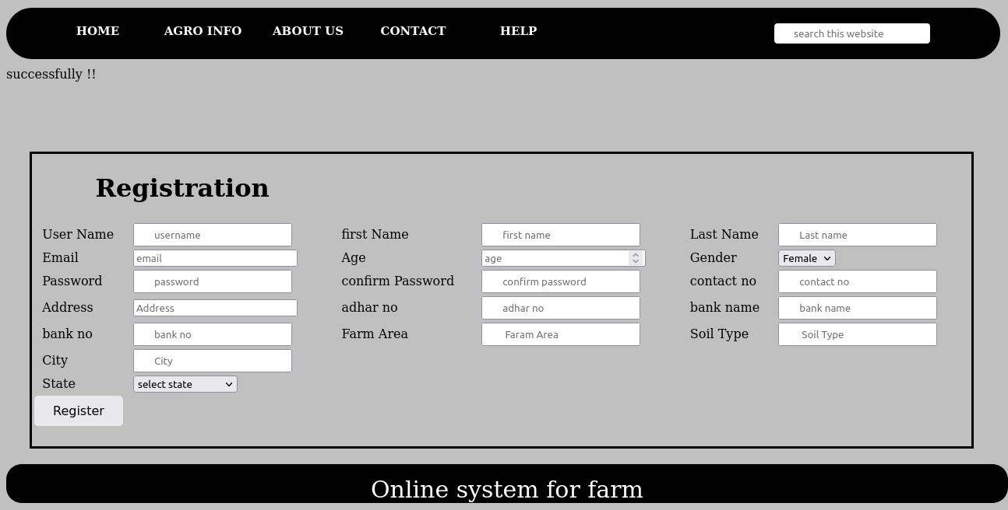

Slide 14
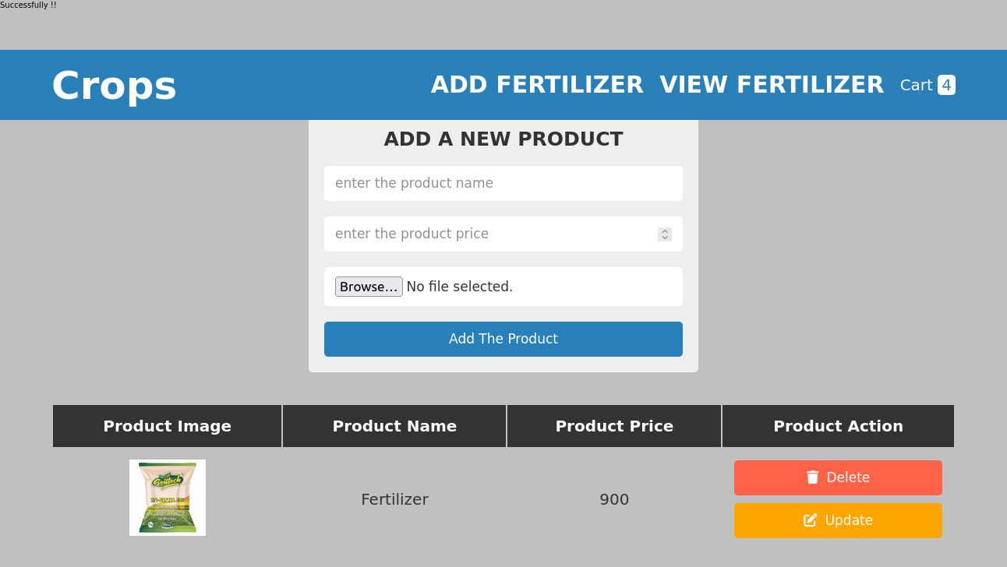

Slide 15
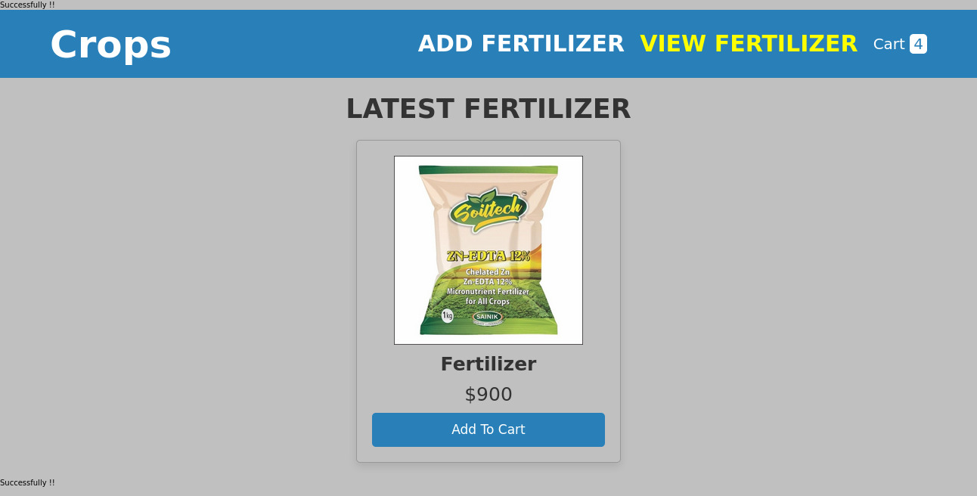

Slide 16
TESTING
System testing of software or hardware is testing conducted on a complete, integrated system to evaluate the system's compliance with its specified requirements. System testing falls within the scope of black-box testing, and as such, should require no knowledge of the inner design of the code or logic. As a rule, system testing takes, as its input, all of the "integrated" software components that have passed integration testing and also the software system itself integrated with any applicable hardware system(s). The purpose of integration testing is to detect any inconsistencies between the software units that are integrated together (called assemblages) or between any of the assemblages and the hardware. System testing is a more limited type of testing: it seeks to detect defects both within the "inter-assemblages" and also within the system as a whole. System testing is performed on the entire system in the context of a Functional Requirement Specification(s) (FRS) and/or a System Requirement Specification (SRS). System testing tests not only the design, but also the behaviour and even the believed expectations of the customer. It is also intended to test up to and beyond the bounds defined in the software/hardware requirements specification(s).

Slide 17
Future Plan
We will host the platform on online servers to make it accessible worldwide.
We will add online payment options.
We can improve the servers and we can add more services

Slide 18
Conclusion
Our project is only a humble venture to satisfy the needs to manage their work. Several user friendly coding have also adopted. This package shall prove to be powerful package in satisfying all the requirements of the Online System For Farm.The objective of software planning is to provide a frame work that enables our team to make reasonable estimates made within a limited time frame at the beginning of the software project and should be updated regularly as the project progress.So for getting result within the time limits. The project can be completed with proper planning.

Slide 19
Thanks You!

