Slide 1

#HumseFarakPadtaHai www.road-safety.co.in
The NorthCap University
Alpha-Beta

Slide 2
Parking Assist
#HumseFarakPadtaHai www.road-safety.co.in
Car Monitoring
Contemplate OBD
Constant Tracking of Position
Notify the user

Slide 3
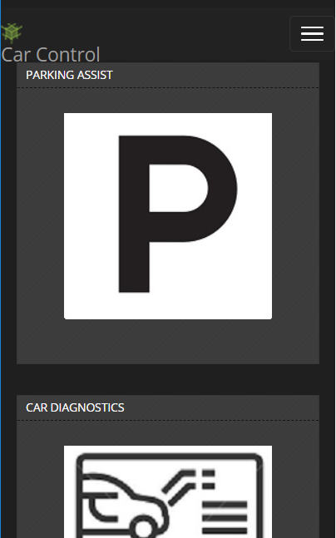
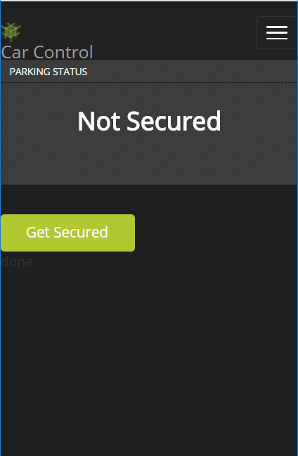
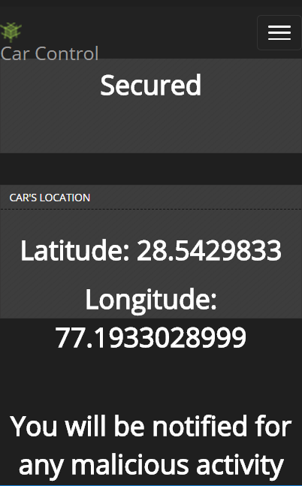
Parking Assist
#HumseFarakPadtaHai www.road-safety.co.in

Slide 4
Car Diagnostics
#HumseFarakPadtaHai www.road-safety.co.in
Real Time Monitoring
Maintains Log
Rash Driving, Car Servicing
Important Alerts

Slide 5
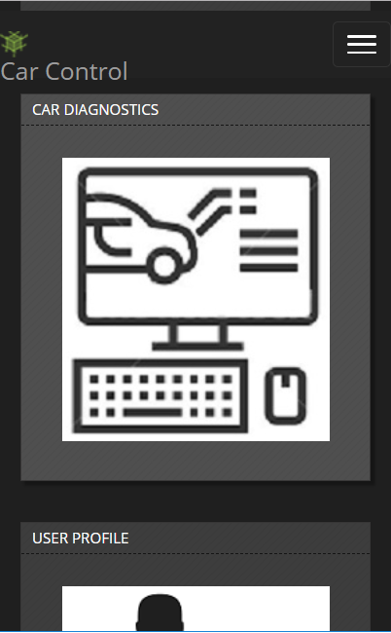
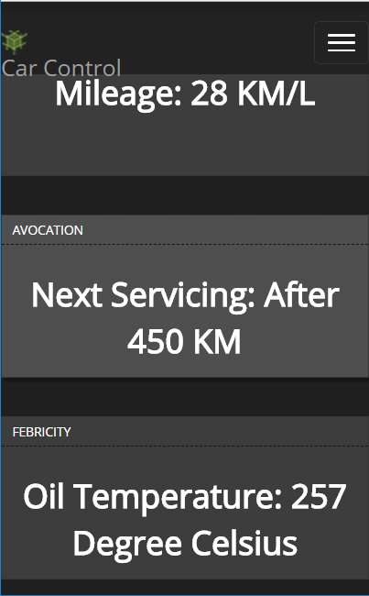
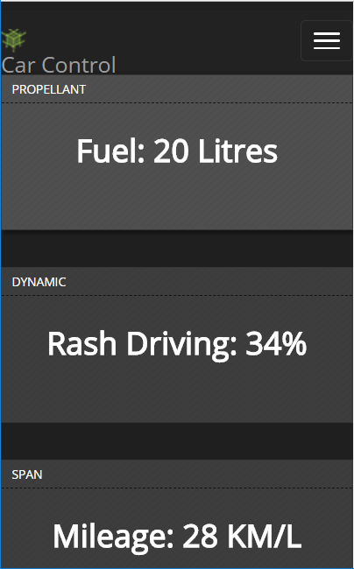
Car Diagnostics
#HumseFarakPadtaHai www.road-safety.co.in

Slide 6
User Profile
#HumseFarakPadtaHai www.road-safety.co.in
Sophisticated Rating System
Effects Resale Car
Promises Better Insurance

Slide 7
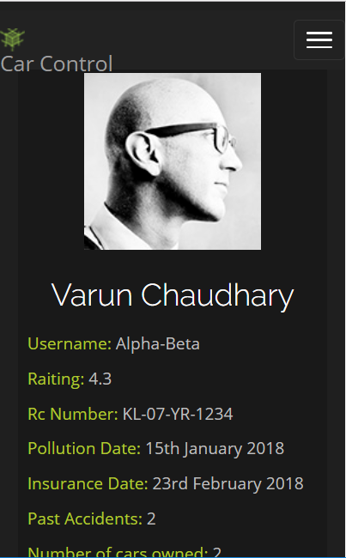
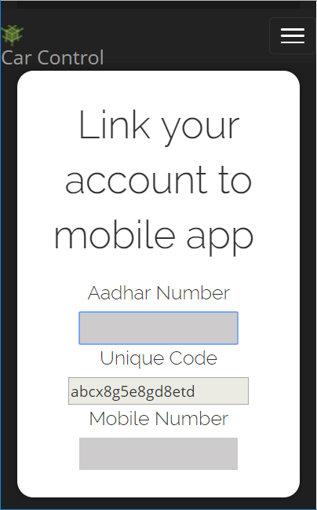
User Profile
#HumseFarakPadtaHai www.road-safety.co.in

Slide 8
Overall Impact
#HumseFarakPadtaHai www.road-safety.co.in
Increased Security
A whole new social network
Benefits to 3rd party company

Slide 9
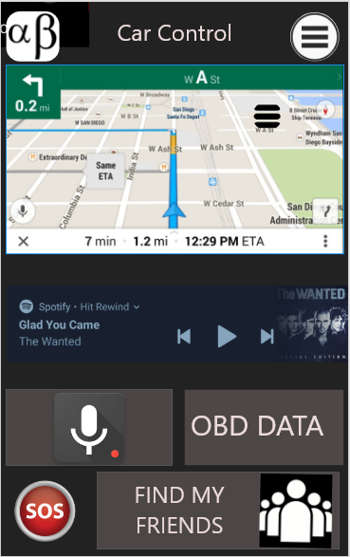
Activities to be conducted in next Quarter
#HumseFarakPadtaHai www.road-safety.co.in
Driver Friendly Interface
“Find my friends”
Intelligent Navigation
Smart Notifications
Seatbelt- Safe Start
SOS

Slide 10
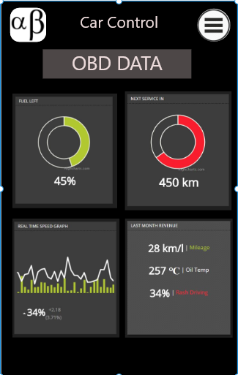
Activities to be conducted in next Quarter
#HumseFarakPadtaHai www.road-safety.co.in
Driver Friendly Interface
“Find my friends”
Intelligent Navigation
Smart Notifications
Seatbelt- Safe Start
SOS

Slide 11
#HumseFarakPadtaHai www.road-safety.co.in
Thank You

