Slide 1


Robust Applications
with Resilience4j
Varun Airi

Slide 2
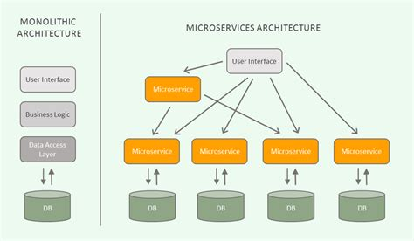
Microservice Mesh
Issues
Rate Limiting
Indefinite Waits
Resource Starvation
Network
Instability

Slide 3
Options
Netflix Hystrix
Command Based Pattern
Integrate with pre Java 8 Applications
Provides ready solutions for most of the problems
Compile time dependencies on multiple other libraries.
Resilience4j
Higher order Decorator functions over Java 8 Functional Interfaces , Lambdas
Combine as many decorators as required for a function.
CircuitBreakers can even extend to response time SLAs for method calls.
Integrates well with Reactive APIs/ Libraries

Slide 4
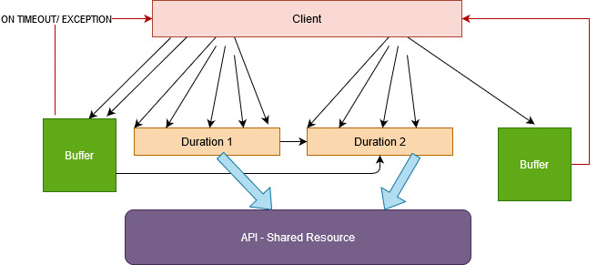
Rate Limiter
Limit the number of calls in each duration
3rd Party APIs restrictions
Cost considerations
Resource optimizations

Slide 5
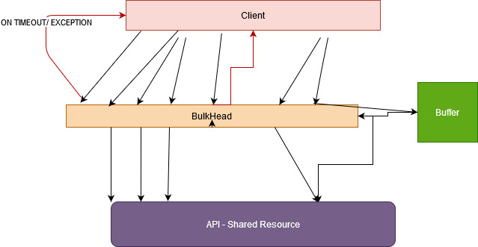
BulkHead
Limit the number of resources at client side used for a call
Avoids catastrophic failures
Limits the resource used up by a failing call.
Compartmentalize the problem
Bulkheads are
Semaphore based
ThreadPool Based

Slide 6
Retry
Recover from a failed call by retriggering it after a duration
Client
Overcome Network Glitches
Handle Resource Contention over a shared Resource
Exponential Backoff helps stagger the requests to have a better chance of success.
Fallback method
Retry 1
Retry 2
Retry 3
Shared Resource

Slide 7
TimeLimiter
Recover from a SLOW / UNRESPONSIVE CALL
Client
Provides functionality for Time Outs
Allows to stop infinite waits , hung threads etc
TimeLimiter
Shared Resource

Slide 8
Circuit Breaker
Fail FAST on set threshold and avoid overwhelming the system in trouble
Moves between 3 States: Closed, Open and Half Open
Major Properties:
Sliding Window: Count or Time Based
minimumNumberOfCalls
failureRateThreshold
waitDurationInOpenState:

Slide 9

Client
Circuit
Breaker
API
Closed
Open
Half Oepn
Closed

Slide 10
Design of Resilience4J APIs
Config Objects
Code/ Custom Props
Config Objects
Properties
Registry Objects
Registry Objects
Registry Objects (Custom Config)
AOP Inject
Lookup by Name
Name=“ckt”
Lookup by Name
Name=“ckt-123”
Lookup by Name
Name=“ckt”
Lookup by Name
Name=“ckt-123”
Circuit Breaker
Circuit Breaker
Circuit Breaker
Circuit Breaker
Circuit Breaker
Circuit Breaker

Slide 11
Why Resilience 4J
Spring Boot Integration
Works well with All kinds of applications
Provides Decorators that can be clubbed together, such that we can apply more than one configurations likle
Bulkhead and Circuit Braker
OR Rate Limiter with Ckt Breaker
OR any combinations of Retry, Ckt Breaker, Rate Limiter, Bulk head
Time Limiter and ThreadPool Based Bulk heads work on Completable Futures as they need to be able to interrupt a thread
Java 8 based

Slide 12
Questions

Slide 13
Links And Resources
https://github.com/resilience4j/resilience4j-spring-cloud2-demo
https://github.com/resilience4j/resilience4j-spring-boot2-demo

