Slide 1
FINMENTOR AI - MULTIAGENT FINANCIAL
ADVISORY PLATFORM
Under the Guidance of
Dr. Saleema J.S
Head of the Department
Department of Data Science & Statistics
Submitted by:
Roshan Varghese, 2448046
Varun Dsouza, 2448059

Slide 2
Multiagent Financial Advisory Platform
In modern times there are different asset classes to appreciate capital of an individual. Capital market is one such proven way.
NIFTY-50 which is the benchmark index of top 50 companies in India has generated a return of 10% CAGR. Where as many small cap companies have generated a hefty return of 15% to 18% in the same time.
FinMentor AI MVP is a standalone web application designed to provide basic financial education and advisory services to Indian retain investors.
The chatbot is designed to build sophisticated portfolio based on an investors risk perception.
In addition to building portfolio, the application is capable of educating new investors and giving summary of annual reports.

Slide 3
Problem Statement
THE FINANCIAL LITERACY GAP IN INDIA
Only 27% of Indian adults are financially literate (NCFE Survey 2023)
Retail investors lack personalized guidance
Traditional financial advisors are expensive (₹5000-10000/consultation)
Generic investment apps don't educate users
Information overload - 5500+ stocks on BSE, where to start?
Real-World Impact:
Poor investment decisions due to lack of knowledge
Missed wealth creation opportunities
Emotional investing (panic selling, FOMO buying)
No understanding of risk-return tradeoffs
Target Users: Young professionals (20-45) entering capital markets

Slide 4
Why Existing Solutions Fall Short
Robo-Advisors (Zerodha Coin, Groww):
Automated portfolio suggestions
No educational component
One-size-fits-all approach
No conversational interface
Financial Chatbots (MoneyBot, Fina):
Answer basic questions
Limited to FAQs
No portfolio building capability
No context awareness
Human Financial Advisors:
Personalized advice
Expensive (₹5000+/session)
Not scalable
Not available 24/7
THE GAP: No solution combines education + advisory + personalization + 24/7 availability + affordable cost

Slide 5
Project Objectives
Primary Objective: Build an AI-powered financial mentor that democratizes financial advisory through multi-agent intelligence
Specific Objectives:
1. EDUCATE: Provide interactive financial literacy education
Answer "What is P/E ratio?", "How does SIP work?"
Adaptive explanations (beginner → advanced)
2. INFORM: Deliver real-time, personalized market insights, Live stock prices, fundamentals and explain market movements in simple language.
3. ADVISE: Generate data-driven portfolio recommendations based on user's risk tolerance, Sector-diversified, equal-weight strategy.
4. INNOVATE: Leverage multi-agent AI architecture, utilize specialized agents for different tasks that are coordinated through intelligent routing.

Slide 6
What makes Finmentor Unique?
Investor education: Any individual new to the stock market can solve any of their doubts with the help of Finmentor.
Portfolio building: Curated portfolios are built for new investors based on their risk appetite.
Fundamental analysis: Deep understanding of annual reports of 5500 companies listed on the Bombay Stock Exchange (BSE).
Forum: To build an ecosystem for new investors by providing a platform to interact with other investors for free. A user-friendly platform that will give new investors a platform to share their views and ideas. (Planned)

Slide 7
Literature Review - Multi-Agent Systems in Finance
1. Multi-Agent Trading Systems
Reference: Xiao et al. (2024) - "TradingAgents: Multi-agents
LLM financial trading framework"
Key Findings:
Specialized agents outperform single-agent systems
Agent collaboration improves decision accuracy by 23%
LLM-based agents can process unstructured financial data
https://arxiv.org/abs/2412.20138
2. RAG for Financial QA
Reference: Choi et al. (2025) - "FinDER: Financial dataset for
question answering and evaluating RAG"
Key Findings:
RAG improves factual accuracy in financial responses
Retrieval-based methods reduce hallucinations
Domain-specific knowledge bases essential
https://arxiv.org/abs/2504.15800
3. LLM-Based Portfolio Recommendations
Reference: Lopez-Lira, A., Scheer, M., & Schwenkler, G. (2024) - "Using Large Language Models for Financial Advice"
Key Findings:
LLMs can generate implementable portfolio recommendations with specific securities and weights
Foundation models generate portfolios more sensitive to investor characteristics than fine-tuned models
https://papers.ssrn.com/sol3/papers.cfm?abstract_id=4850039
4. GenAI and Retail Investor Behavior
Reference: Cao, S., Jiang, W., & Wang, J. (2024) - "Generative AI and Investor Processing of Financial Information"
Key Findings:
Nearly 50% of retail investors already use GenAI for financial information processing
GenAI enhances ability to process complex financial information quickly
More sophisticated investors leverage GenAI for complex tasks more effectively
https://papers.ssrn.com/sol3/papers.cfm?abstract_id=5053905

Slide 8
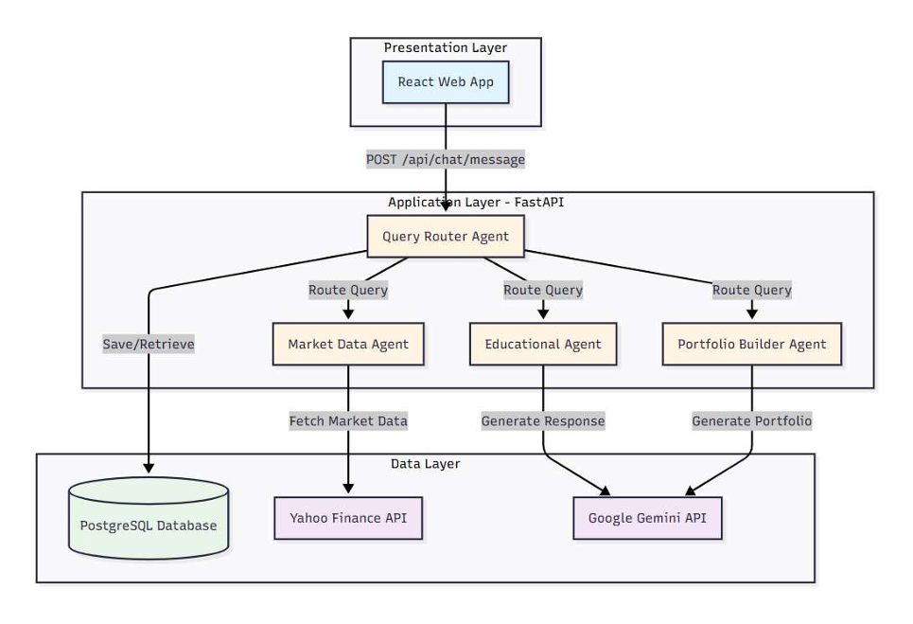
System Architecture
Frontend Layer: React web application
Application layer: Fast API with python.
Data layer: Sources
  Yahoo Finance - Free, real-time Indian market data
  Angel One - 538 financial terms scraped for education
  Alpha Vantage - Rate limits too restrictive
  NSE Direct API - Requires commercial license

Slide 9
System Functionalities
USER AUTHENTICATION & MANAGEMENT
Secure registration with email/password
JWT-based session management (24-hour tokens)
Password encryption using bcrypt
User profile storage (risk tolerance, goals)
INTELLIGENT CONVERSATIONAL INTERFACE
Natural language query processing
Context-aware responses
Conversation history tracking
Session management across multiple chats
FINANCIAL EDUCATION
538+ financial terms and definitions
Adaptive explanations (beginner → advanced)
Covers: Stocks, Mutual Funds, Trading, Tax, Risk
Interactive Q&A on financial concepts
REAL-TIME MARKET DATA
Live stock prices (Yahoo Finance)
Fundamental metrics (P/E ratio, Market Cap)
52-week high/low, Trading volume
Simple explanations of market movements
PORTFOLIO RECOMMENDATION ENGINE
Risk-based portfolio generation (Low/Medium/High)
Equal-weight allocation strategy
Sector diversification (max 2 stocks/sector)
5-8 stock recommendations with rationale
CONVERSATION HISTORY & MEMORY
Save all user interactions
Retrieve past conversations
Maintain context within session
Track user's learning progress

Slide 10
Multi-Agent Design - The 4 Core Agents
QUERY UNDERSTANDING AGENT (Router)
Role: Traffic controller of the system
Function: Classify user intent → route to specialist
Technology: Prompt-based classification with Gemini
Example:
"What is P/E ratio?" → Educational Agent
"Show me RELIANCE price" → Market Data Agent
"Build me a portfolio" → Portfolio Builder Agent
EDUCATIONAL CONTENT AGENT
Role: Financial literacy teacher
Function: Explain concepts in simple language
Knowledge Base: 538 terms from Angel One + Gemini
Capabilities:
Stocks, mutual funds, SIP, trading basics
Adaptive explanations (beginner → advanced)
Contextual follow-up questions
MARKET DATA AGENT
Role: Real-time market information provider
Function: Fetch & explain stock data
Data Source: Yahoo Finance API (yfinance library)
Provides:
Current price, P/E ratio, Market cap
52-week high/low, Volume
Simple interpretation for beginners
PORTFOLIO BUILDER AGENT
Role: Investment advisor
Function: Generate diversified portfolio recommendations
Strategy: Equal-weight allocation (5-8 stocks)
Algorithm:
Input: Risk tolerance (Low/Medium/High)
Process: Select from 30-50 quality stocks
Output: Sector-diversified, equal-weight portfolio
Constraint: Max 2 stocks per sector

Slide 11
Technology Stack
Component/Framework | Technology or Feature
Frontend (Web) | React + Vite + Tailwind CSS
Backend Framework | FastAPI (Python 3.9+)
Database | PostgreSQL 14+
ORM | SQLAlchemy
Authentication | JWT (PyJWT library)
LLM Framework | Google Gemini API (REST calls)
Agent Framework | LangChain
Market Data | yfinance Python library
Deployment | Heroku / Railway / Render (free tier)
Version Control | Git + GitHub
DSPy | Structured reasoning AI framework (introduced 2023)
Backend Framework: FastAPI (Python 3.10+)
Reason: Async support, fast, auto-generates API docs
Database: PostgreSQL
AI/ML Components:
Google Gemini API (gemini-1.5-flash) - Free tier, Query classification, response generation
LangChain - Agent orchestration framework
DSPY – Structured Reasoning AI Framework
Security:
Passwords: bcrypt hashing with salt
API Authentication: JWT tokens
Environment variables for API keys

Slide 12
Data Collection & Processing (EDA)
Data Source: Angel One Financial Glossary
Method: Web scraping with Python (BeautifulSoup)
Dataset Statistics:
Total Terms: 538 financial terms
Columns: term, definition, url, source
Data Quality: 100% complete (no missing values)
Duplicates: Removed during preprocessing
Key Topics Covered (Word Cloud Analysis):
Most Frequent: FINANCE, TRADING, TAXES, CREDIT, INSURANCE, STOCK, OPTION, FUTURE
This forms our Educational Agent's knowledge base
Content Analysis:
Average Term Length: 15 characters
Average Definition: 784 characters
Consistency: 95% definitions 700-900 chars
Distribution:
• Banking & Finance: 28%
• Trading Instruments: 24%
• Tax & Legal: 18%
• Investment Products: 30%

Slide 13
Thank You

