Slide 1





Big Data and Hadoop Developer
Lesson 3—Hadoop Architecture
Copyright 2014, Simplilearn, All rights reserved
Copyright 2014, Simplilearn, All rights reserved

Slide 2



Objectives
By the end of this lesson, you will be able to:
Describe the use of Hadoop in commodity hardware
Explain the various configurations and services of Hadoop
Differentiate between regular file system and Hadoop Distributed File
System (HDFS)
Explain HDFS architecture

Slide 3
Key Terms
Some key terms used while discussing Hadoop Architecture:
Commodity hardware: PCs which can be used to make a cluster
Cluster: Interconnection of systems in a network
Node: Commodity servers interconnected through a network device

Slide 4
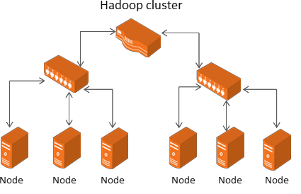
Hadoop Cluster Using Commodity Hardware
Hadoop supports the concept of distributed architecture.
The diagram represents the nodes connected and installed with Hadoop.
The number of nodes in a rack depends on the network speed.
Uplink from rack to node is 3 to 4 Gb/s.
Uplink from rack to rack is 1 Gb/s.

Slide 5
Hadoop Configuration
Standalone, pseudo distributed, and fully distributed are three modes of Hadoop configuration.
Modes of Hadoop configuration
Pseudo distributed mode
Standalone mode
Fully distributed mode
Individual Hadoop services run in an individual JVM, but on a single machine.
Hadoop services run in different JVMs, but belong to one cluster.
All Hadoop services
run in a
single JVM, on a
single machine.

Slide 6
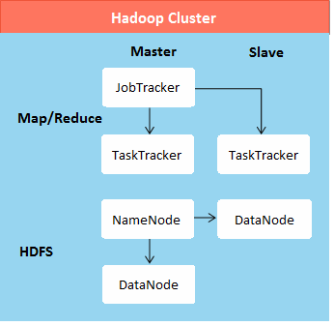
Hadoop Core Services
The core services of Hadoop are:
NameNode
DataNode
JobTracker
TaskTracker
Secondary NameNode

Slide 7



Apache Hadoop Core Components
Hadoop HDFS and Hadoop MapReduce are the core components of Hadoop.

Slide 8
Hadoop Core Components—HDFS
The key features of Hadoop HDFS are as follows:
provides high-throughput access to data blocks;
provides limited interface for managing the file system to allow it to scale; and
creates multiple replicas of each data block and distributes them on computers throughout the cluster to enable reliable and rapid data access.

Slide 9
Hadoop Core Components—MapReduce
The key features of Hadoop MapReduce are as follows:
performs distributed data processing using the MapReduce programming paradigm;
allows to possess user-defined map phase, which is a parallel, share-nothing processing of input (MapReduce paradigm); and
the aggregating the output of the map phase, which is a user-defined, reduces phase after a map process.

Slide 10
Regular File System vs. HDFS
A simple comparison between regular file system and HDFS is summarized below:
Regular File System
HDFS
Each block of data is small in size; approximately 51 bytes
Each block of data is very large in size; 64MB by default
Large data access suffers from disk I/O problems; mainly because of multiple seek operation
Reads huge data sequentially after a
single seek

Slide 11
HDFS—Characteristics
The basic characteristics of HDFS that make it popular are:
High fault-tolerance
High throughput
Suitable for applications with large data sets
Suitable for applications with streaming access to file system data
Can be built on commodity hardware and heterogeneous platforms

Slide 12
HDFS—Key Features
Some key features of HDFS:
HDFS creates multiple replicas of each data block and distributes them on computers throughout a cluster to enable reliable and rapid access.
HDFS is the storage system for both input and output of the MapReduce jobs. Hadoop file URL is to be specified like hdfs://filename.
Block storage meta data controls the physical location of the block and replication within the
cluster.
Each block is replicated to a small number of physically separate machines.

Slide 13
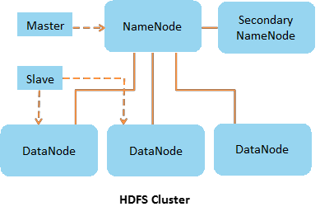
HDFS Architecture
HDFS architecture can be summarized as follows:
NameNode and the Secondary NameNode services constitute the master service. DataNode service is the slave service.
The master service is responsible for accepting a job from clients and ensures that the data required for the operation will be loaded and segregated into chunks of data blocks.
HDFS exposes a file system namespace and allows user data to be stored in files. A file is split into one or more blocks stored and replicated in DataNodes. The data blocks are then distributed to the DataNode systems within the cluster. This ensures that replicas of the data are maintained.

Slide 14
HDFS Operation Principle
The HDFS components comprise different servers like NameNode, DataNode, and Secondary
NameNode.
NameNode Server (single instance)
Maintains the file system name
DataNode Server (multiple instances)
Associated with data storage
Secondary NameNode Server (single instance)
Not exactly a hot backup of the
space
Manages the files and directories in the file system tree
Stores information in the namespace image and the edit log
NameNode knows the data nodes on which all the blocks for a given file exist
NameNode is a critical one point
failure node
places in the file system
Reports to NameNode periodically with lists of blocks they store
Stores and retrieves blocks when referred by clients or NameNode
Servers read, write requests, performs block creation, deletion, and replication upon instruction from NameNode
actual NameNode server
Used for recovery of NameNode in case of NameNode failure
Keeps namespace image through edit log periodically
Namespace image lags behind, so total recovery is impossible

Slide 15
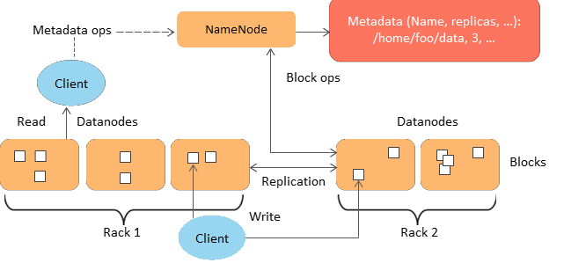
HDFS
HDFS is the place where data is stored and Hadoop operations are performed via HDFS.

Slide 16
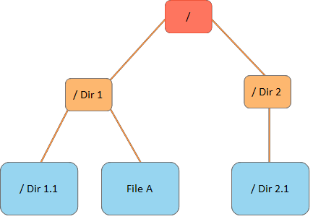
File System Namespace
Some points related to file system
namespace of HDFS:
HDFS exposes a file system namespace and allows user data to be stored in files.
HDFS has a Hierarchical file system with directories and files.
HDFS supports operations like create, remove, move, rename etc.
The NameNode maintains the file system and records any change to meta information.

Slide 17
NameNode Operation
The HDFS namespace is stored by NameNode.
Namespace
Transaction log
In memory meta data
Entire filesystem namespace
NameNode uses a transaction
Centralizes and manages file
including mapping of blocks to files and file system properties is stored in a file FsImage
Stored in NameNode’s local filesystem
log called the EditLog to record every change that occurs to the filesystem meta data
For example, creating a new file
Stored in the NameNode’s local filesystem
system metadata in memory
Maps blocks to DataNodes, filenames, and so on
Metadata size limited to available RAM of NameNode
Prefers modest number of large files instead of large number of small files

Slide 18
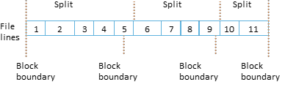
Data Block Split
Each file is split into one or more blocks stored and replicated in
DataNodes.
DataNodes manage names and locations of file blocks, which are 64MB
each by default.
For large files the block size is increased to 128MB to decreases the pressure on the NameNode's memory. This potentially decreases the amount of parallelism that can be achieved, as the number of blocks per file decreases.
Each map tasks operates on one block, if there are tasks lesser than nodes in the cluster, jobs will run slower than they could. The larger the individual files involved or the more files involved in the average MapReduce job, the less of an issue this is.

Slide 19
Benefits of Data Block Approach
Benefits of data block approach are as follows:
simplified replication;
fault tolerance and reliability; and
shielding users from storage subsystem details.

Slide 20
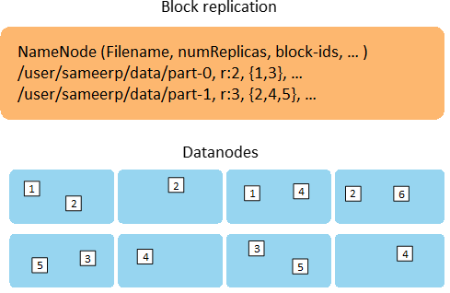
HDFS—Block Replication Architecture
HDFS represents the unstructured data in the form of data blocks.
Default size of the blocks is 64 MB; but block size can be reset.
HDFS performs block replication on multiple data nodes so that if any error on one DataNode Server exists, the JobTracker service will resubmit the job to another DataNode Server.

Slide 21
Replication Method
Each file is split into a sequence of blocks. All blocks in the file except the last are of the same size.
 | Namespace
Blocks are replicated for fault tolerance. Block replication factor is usually configured at cluster level but can also be configured at file level.
 | Transaction log
The NameNode receives a Heartbeat and a BlockReport from each DataNode in the cluster. BlockReport contains all the blocks on a DataNode.
 | In memory meta data
An application can specify the number of replicas of the file needed: replication factor of the file. This information is stored in the NameNode.

Slide 22

Data Replication Topology
Suggested replication topology
1st replica placed on same node as client;
2nd replica placed on different rack from 1st rack; and
3rd replica placed on same rack as 2nd rack, but on a different node.

Slide 23
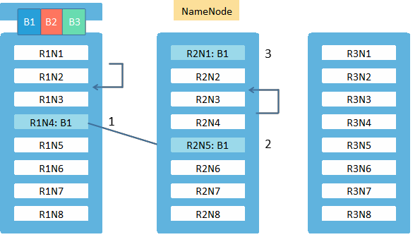
Data Replication Representation
Hadoop cluster is represented through the chart:

Slide 24
HDFS Access
HDFS provides following access mechanisms:
java API for application;
Python access and C language wrapper for Java API is also available;
web GUI;
HTTP browser; and
FS Shell.

Slide 25

Business Scenario
Olivia Tyler is the EVP of IT operations with Nutri Worldwide Inc. has decided to use HDFS for storing Big Data. She will be using HDFS shell to store the data in Hadoop file system and execute various commands on it.
The demos in the subsequent screens illustrate how to do basic command line operations on HDFS.

Slide 26

Demo
Create a new directory in HDFS. Store a text file in the directory and view its contents

Slide 27


Quiz

Slide 28

QUIZ 1
What are the two major components of Hadoop cluster?
a. Hadoop file system, TaskTracker
b.
MapReduce, Hadoop file system
c.
JobTracker, MapReduce
d.
JobTracker, TaskTracker

Slide 29

QUIZ 1
What are the two major components of Hadoop cluster?
a. Hadoop file system, TaskTracker
b.
MapReduce, Hadoop file system
c.
JobTracker, MapReduce
d.
JobTracker, TaskTracker
Answer: b.
Explanation: The two major components of Hadoop cluster are MapReduce and Hadoop File System.

Slide 30
QUIZ 2
Which of the following services run in the Master node of Apache Hadoop in cluster mode (fully distributed mode)?
a. JobTracker
b.
TaskTracker
c.
JobTracker, MapReduce
d.
JobTracker, TaskTracker

Slide 31
QUIZ 2
Which of the following services run in the Master node of Apache Hadoop in cluster mode (fully distributed mode)?
a. JobTracker
b.
TaskTracker
c.
JobTracker, MapReduce
d.
JobTracker, TaskTracker
Answer: a.
Explanation: JobTracker service runs in the Master node of Apache Hadoop in cluster mode.

Slide 32
QUIZ 3
Which are the single instance critical tasks?
a. NameNode, DataNode
b.
JobTracker, DataNode
c.
JobTracker, NameNode
d.
NameNode, Secondary NameNode

Slide 33
QUIZ 3
Which are the single instance critical tasks?
a. NameNode, DataNode
b.
JobTracker, DataNode
c.
JobTracker, NameNode
d.
NameNode, Secondary NameNode
Answer: c.
Explanation: Only one tracker takes care of task trackers and MapReduce jobs and only one NameNode keeps block information like metadata for allocated storage on the data nodes.

Slide 34
QUIZ 4
How is NameNode failure tackled?
a. Secondary NameNode is switched on as NameNode
b.
Secondary NameNode automatically starts working as NameNode
c.
From Secondary NameNode image backup primary NameNode is recreated
d.
Another NameNode in cluster with replication works as main NameNode

Slide 35
QUIZ 4
How is NameNode failure tackled?
a. Secondary NameNode is switched on as NameNode
b.
Secondary NameNode automatically starts working as NameNode
c.
From Secondary NameNode image backup primary NameNode is recreated
d.
Another NameNode in cluster with replication works as main NameNode
Answer: c.
Explanation: NameNode failure is tackled by taking an image backup of the NameNode from Secondary NameNode and incorporating it into a new NameNode machine.

Slide 36
QUIZ 5
Which of the following services are used by MapReduce programs?
a. JobTracker and TaskTracker
b.
TaskTracker
c.
NameNode
d.
Secondary NameNode

Slide 37
QUIZ 5
Which of the following services are used by MapReduce programs?
a. JobTracker and TaskTracker
b.
TaskTracker
c.
NameNode
d.
Secondary NameNode
Answer: a.
Explanation: JobTracker and TaskTracker are used by the MapReduce programs to perform its functionalities.

Slide 38
QUIZ 6
Which of the following statements best describes how a large (100 GB) file is stored in HDFS?
The file is replicated three times by default. Each copy of the file is stored on a
separate DataNode.
The master copy of the file is stored on a single DataNode. The replica copies are
divided into fixed-size blocks, which are stored on multiple data nodes.
The file is divided into fixed-size blocks, which are stored on multiple data nodes.
c. Each block is replicated three times by default. Multiple blocks from the same file might reside on the same DataNode.
The file is divided into fixed-size blocks, which are stored on multiple data nodes.
Each block is replicated three times by default. HDFS guarantees that different blocks from the same file are never on the same DataNode.
a.
b.
d.

Slide 39
QUIZ 6
Which of the following statements best describes how a large (100 GB) file is stored in HDFS?
The file is replicated three times by default. Each copy of the file is stored on a
separate DataNode.
The master copy of the file is stored on a single DataNode. The replica copies are
divided into fixed-size blocks, which are stored on multiple data nodes.
The file is divided into fixed-size blocks, which are stored on multiple data nodes.
c. Each block is replicated three times by default. Multiple blocks from the same file might reside on the same DataNode.
The file is divided into fixed-size blocks, which are stored on multiple data nodes.
Each block is replicated three times by default. HDFS guarantees that different blocks from the same file are never on the same DataNode.
a.
b.
d.
Answer: d.
Explanation: The file is divided into fixed-size blocks, which are stored on multiple data nodes. Each block is replicated three times by default. HDFS guarantees that different blocks from the same file are never
on the same DataNode.

Slide 40
QUIZ 7
Which of the following describes how a client reads a file from HDFS?
a.
The client queries the NameNode for the block location(s). The NameNode returns the block
location(s) to the client. The client reads the data directly off the DataNode(s).
b.
The client queries all DataNodes in parallel. The DataNode that contains the requested data responds
directly to the client. The client reads the data directly off the DataNode.
c. The client contacts the NameNode for the block location(s).
d.
The NameNode contacts the DataNode that holds the requested data block. Data is transferred from the DataNode to the NameNode, and then from the NameNode to the client.

Slide 41
QUIZ 7
Which of the following describes how a client reads a file from HDFS?
a.
The client queries the NameNode for the block location(s). The NameNode returns the block
location(s) to the client. The client reads the data directly off the DataNode(s).
b.
The client queries all DataNodes in parallel. The DataNode that contains the requested data responds
directly to the client. The client reads the data directly off the DataNode.
c. The client contacts the NameNode for the block location(s).
d.
The NameNode contacts the DataNode that holds the requested data block. Data is transferred from the DataNode to the NameNode, and then from the NameNode to the client.
Answer: c.
Explanation: The client contacts the NameNode for the block location(s). NameNode then queries the data nodes for block locations. The data nodes respond to the NameNode, and NameNode redirects the client to the DataNode that holds the requested data block(s).The client then reads the data directly off the DataNode.

Slide 42
QUIZ 8
Which of the following are valid statements? (Choose two)
a.
HDFS is optimized for storing a large number of files smaller than the HDFS block size.
b.
HDFS has the characteristic of supporting a "write once, read many" data access
model.
HDFS is a distributed file system that replaces ext3 or ext4 on Linux nodes in a Hadoop cluster.
c.
d.
HDFS is a distributed file system that runs on top of native OS file systems and is well- suited for storage of very large data sets.

Slide 43
QUIZ 8
Which of the following are valid statements? (Choose two)
a.
HDFS is optimized for storing a large number of files smaller than the HDFS block size.
b.
HDFS has the characteristic of supporting a "write once, read many" data access
model.
HDFS is a distributed file system that replaces ext3 or ext4 on Linux nodes in a Hadoop cluster.
c.
d.
HDFS is a distributed file system that runs on top of native OS file systems and is well- suited for storage of very large data sets.
Answer: b and d.
Explanation: HDFS has a characteristic of supporting a “Write once, read many” data access model and a distributed file system that runs on top of native OS well suited to storage of very large datasets.

Slide 44
QUIZ 9
The NameNode uses RAM for the following purpose:
a. To store the file contents in HDFS
b.
To store filenames, list of blocks, and other meta information
c.
To store the edits log that keeps track of changes in HDFS
d.
To manage distributed read and write locks on files in HDFS

Slide 45
QUIZ 9
The NameNode uses RAM for the following purpose:
a. To store the file contents in HDFS
b.
To store filenames, list of blocks, and other meta information
c.
To store the edits log that keeps track of changes in HDFS
d.
To manage distributed read and write locks on files in HDFS
Answer: b.
Explanation: NameNode uses RAM to store filenames, list of blocks, and other meta information.

Slide 46
QUIZ 10
You need to move a file titled weblogs into HDFS. You are not allowed to copy the file. You know you have ample space on your data nodes. Which action should you take to relieve this situation and store more files in HDFS?
a.
Increase the block size on all current files in HDFS
b.
Increase the block size on your remaining files
c. Decrease the block size on your remaining files
d.
Increase the amount of memory for the NameNode

Slide 47
QUIZ 10
You need to move a file titled weblogs into HDFS. You are not allowed to copy the file. You know you have ample space on your data nodes. Which action should you take to relieve this situation and store more files in HDFS?
a.
Increase the block size on all current files in HDFS
b.
Increase the block size on your remaining files
c. Decrease the block size on your remaining files
d.
Increase the amount of memory for the NameNode
Answer: c.
Explanation: It is recommended to decrease the block size on your remaining files.

Slide 48

Summary
Let us summarize the topics covered in this lesson:
Hadoop works on three configurations, namely, standalone mode, pseudo-distributed mode, and fully distributed mode.
The two core components of Apache Hadoop are HDFS and MapReduce.
The HDFS layer contains NameNode, Secondary NameNode, and DataNode.
HDFS can be used to handle to handle big-data sets with its inherent features of fault tolerance, high throughout and streaming data access.

Slide 49

Thank You
Copyright 2014, Simplilearn, All rights reserved
Copyright 2014, Simplilearn, All rights reserved

