Slide 1
AI-Powered Multilingual Job Assistance Chatbot for PGRKAM Platform
CSE7101- Capstone Project
Review-1
Batch Number: CSE_15
Under the Supervision of,
Dr. Vishwanath Y
School of Computer Science and Engineering
Presidency University
Roll Number | Student Name
20221CSE0372 20221CSE0442 20221CSE0440 | Varun Bantia Prathyusha K Venkatashiva Reddy
Name of the Program: School of Computer Science and Engineering
Name of the HoD: Dr. Asif Mohammed and Dr. Blessed Prince
Name of the Program Project Coordinator: Dr. Jayavadivel Ravi and Mr.Muthuraju V
Name of the School Project Coordinators: Dr. Sampath A K , Dr. Geetha A

Slide 2
Problem Statement Number:
Organization: Government of Punjab
Category (Hardware / Software / Both) : Software
Problem Description : The requirement set is given below: 1. To build a smart chatbot on top of Large Language Model (LLM)- driven chatbots like ChatGPT that uses transformers like GPT3. The aim is to assist the user through a digital assistant to provide answers to all queries the user and reduce the time and effort while navigating to any part of the PGRKAM digital platform. 2. The system should be able to intelligently addresses text and voice queries in Punjabi/English/Hindi around job search, skill development and foreign counseling along with recommending jobs based on the candidate’s preference. A multilingual screen reading module could be added for better query handling. 3. The app will also be able to maintain candidates’ history and preferences to add a level of personalization for better recommendations. Expected Outcome User should be able to chat/read/listen and discover any information pertaining to job, skill development or foreign counseling on smartphone or laptop computer

Slide 3
Content
Problem Statement
Objectives
Background and Related work for title Selection
Analysis of Problem Statement
Innovation or Novel Contributions
Git-hub Link
Timeline of the Project
References

Slide 4
Problem Statement
The PGRKAM platform provides multiple modules for job seekers and employers, but lacks a guided mechanism to help users quickly find relevant information. Users have to manually navigate through different sections, which is time-consuming and inefficient, especially for those with limited digital literacy.

Slide 5
Objectives
1. Develop a smart AI chatbot using GPT-based Large Language Models (LLMs)
2. Support multilingual interactions in Punjabi, Hindi, and English
3. Enable both voice and text-based queries
4. Provide personalized job recommendations based on user profile and history
5. Seamlessly integrate with the existing PGRKAM web and mobile platforms

Slide 6
Background and Related work for title Selection
Background: Many government and private employment portals face a navigation challenge where users struggle to find relevant services quickly. AI-driven chatbots have proven effective in reducing search times and improving user satisfaction.
Related Work:
ChatGPT and similar LLMs demonstrate natural language understanding that can power context-aware job search assistants.
Platforms like Naukri.com and LinkedIn use recommendation engines for job matching.
Multilingual voice assistants (Google Assistant, Alexa) show high adoption among diverse user groups

Slide 7
Analysis of Problem Statement
Technology Stack Components:
Frontend: Android Studio (Java/Kotlin), XML UI
Backend: Java
AI Model: OpenAI GPT-3/GPT-4 APIs
Database: Firebase Firestore
Speech-to-Text: Google Speech API
Text-to-Speech: Android TTS
Multilingual Translation: Google Translate API

Slide 8
Analysis of Problem Statement (contd...)
Software and Hardware Requirements:
Software:
- Android Studio
- Java
- Firebase
- OpenAI GPT API
Hardware:
- Android Smartphone (min Android 8.0)
- Development PC (min 8GB RAM)

Slide 9
Innovation or Novel Contributions
First multilingual AI chatbot for a state employment portal in Punjab.
Seamless voice and text integration for better accessibility.
Personalization layer that learns from candidate preferences and browsing history.
Screen reading module in multiple languages for visually challenged users.
AI intent recognition to direct users to the exact portal section instantly.

Slide 10
Github Link
https://github.com/varunbantia/SmartChatbotApp

Slide 11
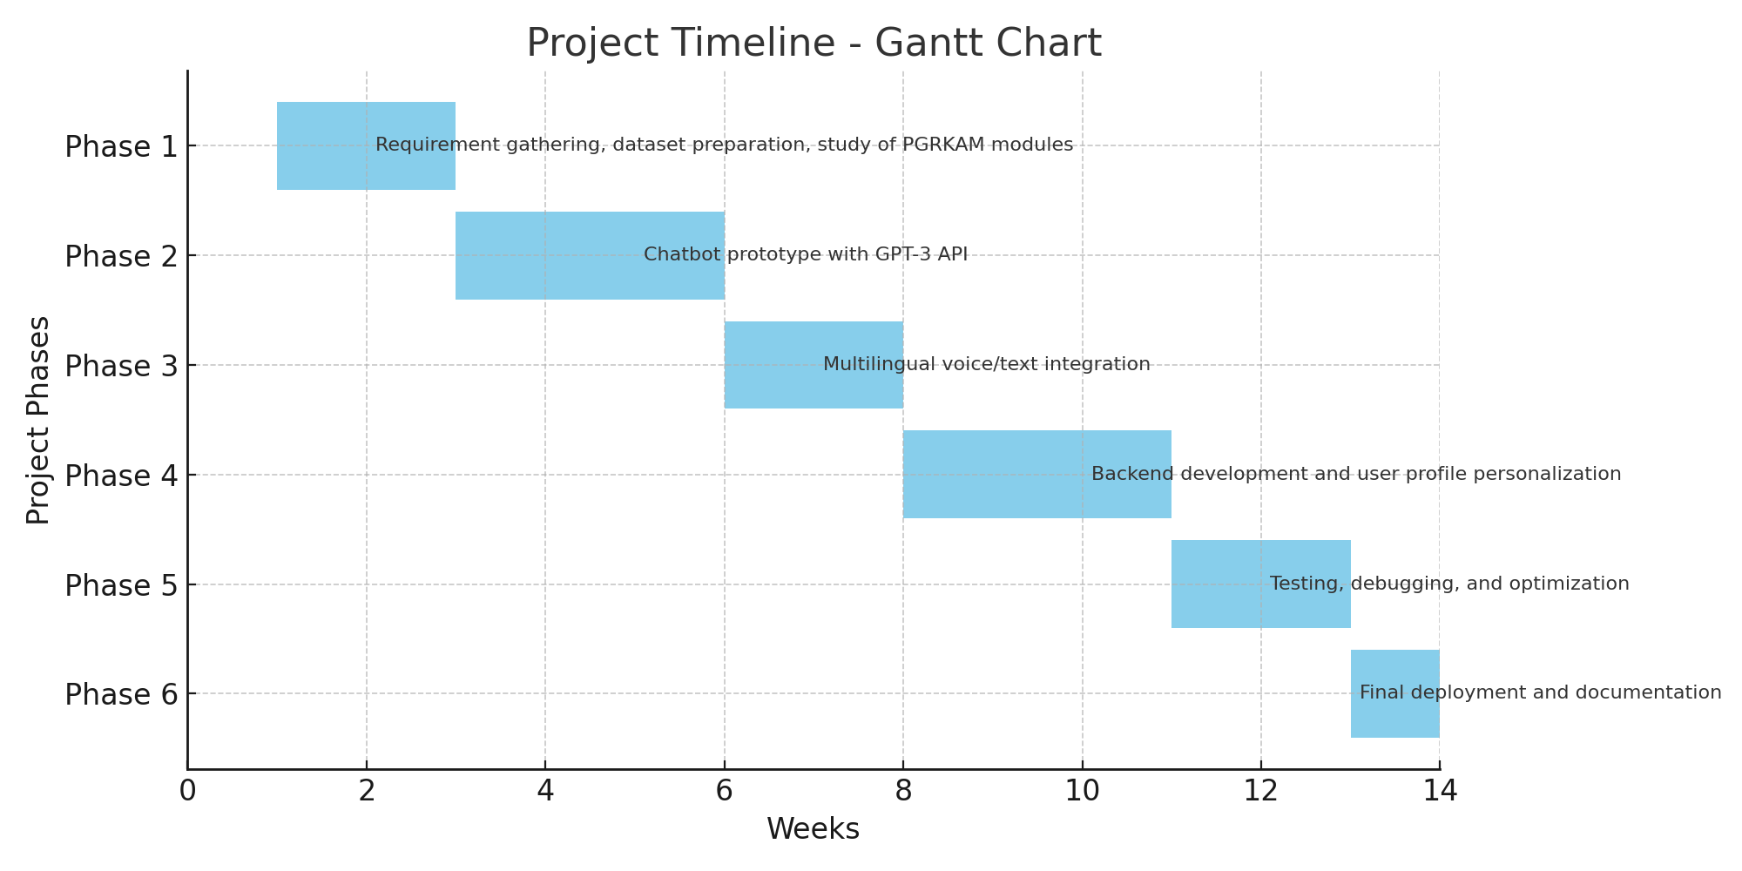
Timeline of the Project (Gantt Chart)

Slide 12
References (IEEE Paper format)
[1] A. Vaswani et al., “Attention Is All You Need,” Advances in Neural Information Processing Systems, 2017. [2] T. Brown et al., “Language Models are Few-Shot Learners,” NeurIPS, 2020. [3] Google Cloud, “Speech-to-Text API Documentation,” 2023. [4] S. J. Russell and P. Norvig, Artificial Intelligence: A Modern Approach, 4th ed., Pearson, 2021.

Slide 13


