Slide 1
Development of a Digital Mental Health and Psychological Support System for Students in Higher Education
CSE7302- University Project
Review-1
Batch Number: CSE_08
Under the Supervision of,
Mr Jerrin Joe Francis
School of Computer Science and Engineering
Presidency University
Roll Number | Student Name
20221CSE0372 20221CSE0442 20221CSE0440 | Varun Bantia Prathyusha K Venkatashiva Reddy
Name of the Program: School of Computer Science and Engineering
Name of the HoD: Dr. Asif Mohammed and Dr. Blessed Prince
Name of the Program Project Coordinator: Dr. Jayavadivel Ravi and Mr.Muthuraju V
Name of the School Project Coordinators: Dr. Sampath A K , Dr. Geetha A

Slide 2
Problem Statement Number:
Organization: Government of Jammu and Kashmir
Category (Hardware / Software / Both) : Software
Problem Description : Mental health issues among students in higher education are rising due to academic pressure, career uncertainty, financial stress, social challenges, and rapid lifestyle changes. Many students experience anxiety, depression, stress, and burnout, yet existing mental health support systems in colleges and universities are often insufficient. Traditional counseling services are limited by long waiting times, lack of trained professionals, fixed schedules, and social stigma, which discourages students from seeking help. As a result, early signs of psychological distress frequently go unnoticed, negatively affecting students’ academic performance, personal well-being, and overall quality of life.
Current support mechanisms are largely reactive, offering assistance only after problems become severe, and they lack continuous monitoring and personalized care. There is minimal integration of self-help resources, peer support, and technology-driven insights that could enable early intervention. This creates a gap between students’ mental health needs and the support available to them. Therefore, there is a strong need for a digital mental health and psychological support system tailored for higher education students, one that ensures accessibility, confidentiality, early detection, and timely intervention to promote long-term well-being and academic success.

Slide 3
Content
Problem Statement
Objectives
Background and Related work for title Selection
Analysis of Problem Statement
Innovation or Novel Contributions
Git-hub Link
Timeline of the Project
References

Slide 4
Problem Statement
Students in higher education are increasingly affected by mental health challenges such as stress, anxiety, depression, and burnout, driven by academic pressure, career uncertainty, financial constraints, and social factors. However, existing mental health support systems in educational institutions are often inadequate, difficult to access, and limited by long waiting times, insufficient counseling resources, lack of personalization, and social stigma. As a result, many students do not seek timely help, leading to undetected and worsening psychological issues that adversely impact their academic performance, well-being, and overall development.
There is a lack of a unified, accessible, and proactive digital platform that can provide continuous mental health monitoring, early identification of psychological distress, confidential support, and timely professional intervention for students in higher education. This gap highlights the need for an effective digital mental health and psychological support system that can deliver scalable, personalized, and stigma-free mental health services, ensuring improved student well-being and a supportive academic environment.

Slide 5
Objectives
To design and develop a digital mental health and psychological support system specifically tailored to the needs of students in higher education.
To provide accessible, confidential, and stigma-free mental health support through a user-friendly digital platform.
To enable early identification and continuous monitoring of students’ mental health conditions using self-assessment and data-driven tools.
To offer personalized self-help resources, coping strategies, and mental wellness programs based on individual student needs.
To facilitate timely access to professional counseling and psychological support through digital consultations and referrals.
To promote awareness and mental health literacy among students, encouraging proactive self-care and help-seeking behavior.
To support educational institutions in understanding mental health trends and improving student well-being through aggregated insights while maintaining data privacy.

Slide 6
Background and Related work for title Selection
Background: Mental health has become a major concern in higher education as students increasingly face psychological challenges such as stress, anxiety, depression, and burnout due to academic pressure, social adjustments, financial constraints, and career-related uncertainty. These mental health issues negatively impact students’ academic performance, retention, and overall well-being. Traditional counseling services in educational institutions often struggle to meet growing demand because of limited resources, long waiting times, and stigma associated with seeking help. With the rapid growth of digital technology and widespread smartphone usage among students, digital platforms have emerged as a viable means to provide accessible, confidential, and continuous mental health support.
Related Work:
Development of mobile applications focused on stress management, meditation, and mindfulness, which help students manage daily anxiety but offer limited clinical support.
Use of mood tracking and self-assessment tools that allow users to monitor emotional patterns, though many lack intelligent analysis or early warning mechanisms.
Implementation of Cognitive Behavioral Therapy (CBT)-based digital interventions, shown to reduce symptoms of anxiety and depression when used consistently.
Adoption of online counseling and tele-therapy platforms, providing remote access to mental health professionals, especially during and after the COVID-19 pandemic.

Slide 7
Analysis of Problem Statement
Technology Stack Components:
Frontend: Android Studio (Java/Kotlin), XML UI
Backend: Java
AI Model: OpenAI GPT-3/GPT-4 APIs
Database: Firebase Firestore
Speech-to-Text: Google Speech API
Text-to-Speech: Android TTS
Multilingual Translation: Google Translate API

Slide 8
Analysis of Problem Statement (contd...)
Software and Hardware Requirements:
Software:
- Android Studio
- Java
- Firebase
- OpenAI GPT API
Hardware:
- Android Smartphone (min Android 8.0)
- Development PC (min 8GB RAM)

Slide 9
Innovation or Novel Contributions
Integration of an AI-driven mental health support system specifically tailored for higher education students within a single Android application.
Real-time conversational psychological support using advanced language models to provide empathetic, context-aware responses.
Multimodal interaction combining text, voice input (speech-to-text), and audio responses (text-to-speech) for improved accessibility.
Multilingual mental health support, enabling students from diverse linguistic backgrounds to access psychological assistance comfortably.
Confidential and stigma-free digital platform that encourages students to seek help without fear of judgment.
Scalable and institution-ready architecture that can complement existing counseling services while maintaining data privacy and security.
Early mental health risk identification through continuous interaction patterns and self-assessment data.

Slide 10
Github Link
https://github.com/varunbantia/mental-health-system

Slide 11
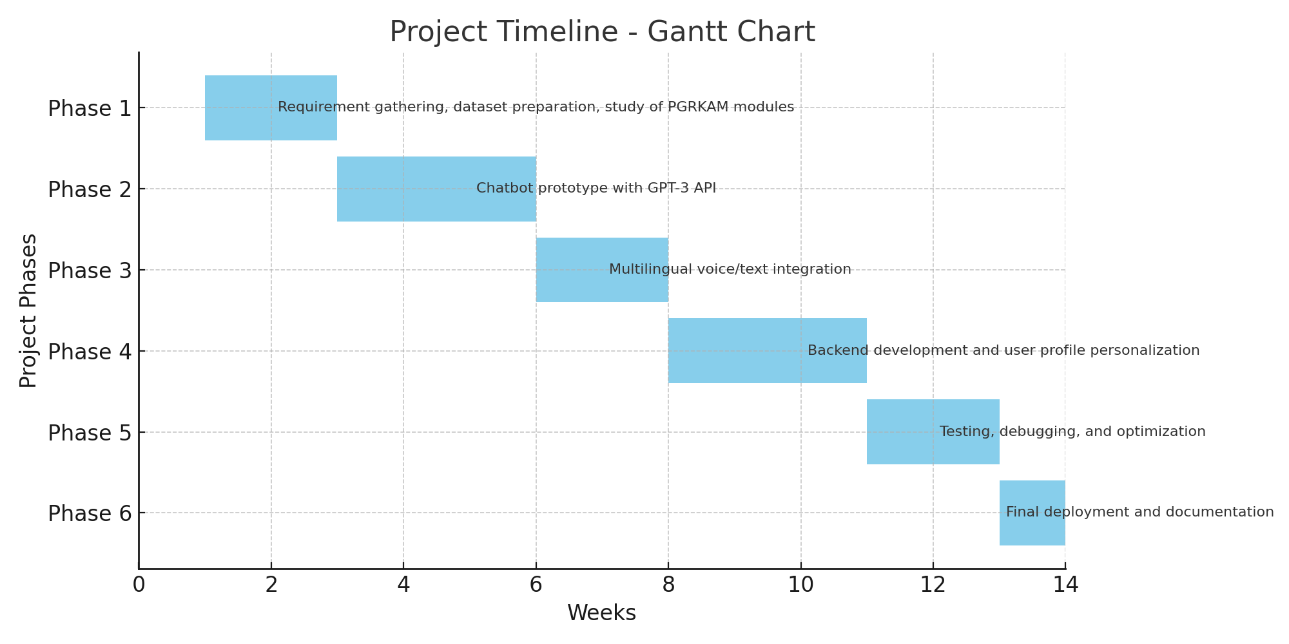
Timeline of the Project (Gantt Chart)

Slide 12
References (IEEE Paper format)
World Health Organization (WHO). Mental health of students in higher education. WHO Publications, 2021.
Eisenberg, D., Hunt, J., & Speer, N. “Mental health in American colleges and universities: Variation across student subgroups.” Journal of Nervous and Mental Disease, 2013.
Auerbach, R. P. et al. “Mental disorders among college students in the World Health Organization World Mental Health Surveys.” Psychological Medicine, 2016.
Firth, J., et al. “The efficacy of smartphone-based mental health interventions for depressive symptoms.” World Psychiatry, 2017.
Inkster, B., Sarda, S., & Subramanian, V. “An empathy-driven, conversational artificial intelligence agent for digital mental health.” JMIR Mental Health, 2018.
Torous, J., & Roberts, L. W. “Needed innovation in digital health and smartphone applications for mental health.” JAMA Psychiatry, 2017.
Karyotaki, E., et al. “Effectiveness of internet-based cognitive behavioral therapy for depression.” Psychological Medicine, 2018.
Google Cloud. Speech-to-Text API Documentation, 2023.
Firebase. Cloud Firestore Documentation, Google Developers, 2023.
OpenAI. GPT-3 and GPT-4 Technical Reports, OpenAI, 2020–2023.

Slide 13


