Slide 1
Development of a Digital Mental Health and Psychological Support System for Students in Higher Education
CSE7302- University Project
Review-2
Batch Number: CSE_08
Under the Supervision of,
Mr Jerrin Joe Francis
School of Computer Science and Engineering
Presidency University
Roll Number | Student Name
20221CSE0372 20221CSE0442 20221CSE0440 | Varun Bantia Prathyusha K Venkatashiva Reddy
Name of the Program: School of Computer Science and Engineering
Name of the HoD: Dr. Asif Mohammed and Dr. Blessed Prince
Name of the Program Project Coordinator: Dr. Jayavadivel Ravi and Mr.Muthuraju V
Name of the School Project Coordinators: Dr. Sampath A K , Dr. Geetha A

Slide 2
Abstract
The increasing prevalence of mental health concerns among university students highlights the need for accessible, confidential, and stigma-free support systems. Traditional counseling services often face limitations such as delayed availability, social stigma, and resource constraints, which can prevent timely intervention. This project proposes an Android-based AI-powered mental health chatbot designed to provide early emotional support and guidance for students. The application supports both anonymous and authenticated login, allowing users to seek help without identity disclosure. User interactions are analyzed through a severity-aware conversational framework to identify varying levels of psychological distress and respond appropriately.
The system offers AI-guided first-aid support through coping strategies and empathetic conversations, along with a confidential booking module for accessing on-campus counselors or mental health helplines. Additionally, the application includes a psychoeducational resource hub featuring mental wellness materials and a moderated peer support platform to encourage safe community interaction. Built with strong ethical safeguards such as privacy preservation, mandatory disclaimers, and non-clinical response constraints, the proposed solution aims to complement existing mental health services in educational institutions by improving accessibility, reducing stigma, and enabling early intervention.

Slide 3
Objectives
To design and develop a safe, confidential, and easy-to-use digital mental health support system for students in higher education, allowing them to identify and monitor their mental well-being through simple self-assessment tools.
To provide personalized mental wellness support by offering self-help resources, practical coping strategies, and guided wellness activities, while also enabling timely access to professional counseling through digital referrals and appointments.
To encourage mental health awareness and early help-seeking behavior among students, while allowing educational institutions to understand overall mental health trends using anonymous and privacy-preserving insights to improve student support services.

Slide 4
Existing Methods and Drawbacks
Existing Methods
University Counseling Services – On-campus psychologists and wellness centers – Examples: University Counseling Centers, Student Wellness Cells – Limited working hours and long waiting times
Mental Health Mobile Applications – Meditation, mood tracking, and self-help apps – Examples: Headspace, Calm, Wysa, Youper – Mostly static content with limited personalization
Online Forums and Peer Support Groups – Anonymous discussion platforms – Examples: Reddit (r/SuicideWatch, r/depression), 7 Cups – Often unmoderated and unsafe
Drawbacks of Existing Systems
• Lack of anonymity, leading to hesitation in seeking help • Stigma and fear of judgment among students • No real-time or 24/7 support • Poor early detection of severe mental health risks • Limited personalized guidance • Risk of misinformation in peer platforms

Slide 5
Proposed Method & Feasibility Study
Proposed Method
Android-based AI mental health chatbot for students
Supports anonymous and secure login
Severity-based analysis of user messages
Provides coping strategies, self-help resources, and crisis guidance
Enables confidential counselor/helpline booking
Includes psychoeducational content and moderated peer support
Feasibility Study
Technical: Uses Android Studio and scalable AI technologies
Operational: Simple UI with 24/7 accessibility
Economic: Low-cost, reduces burden on counseling services
Ethical: Privacy-focused, anonymous use, safe escalation mechanisms

Slide 6
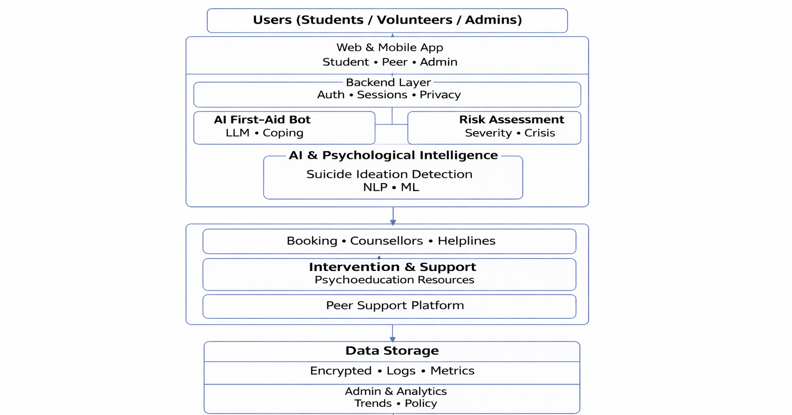
Architecture Diagram

Slide 7
Modules
User Authentication Module
Login, Sign Up, and Anonymous Access
Ensures privacy and stigma-free usage
AI Chatbot Module
Interactive mental health conversations
Severity-based response and guidance
Risk Assessment Module
Analyzes user inputs to detect distress levels
Triggers appropriate support or escalation
Resource Management Module
Provides self-help content (audio, video, guides)
Supports offline access where required
Counseling & Helpline Module
Confidential appointment booking
Quick access to emergency support
Peer Support Module
Moderated student-to-student interaction
Safe and supportive community engagement

Slide 8
Hardware and Software Details
Hardware Requirements
Android Smartphone
Minimum 4 GB RAM
Stable Internet Connection
Standard Server or Cloud Infrastructure
Software Requirements
Android Studio (App Development)
Android OS (Version 8.0 or above)
Java / Kotlin (Application Logic)
XML (User Interface Design)
Backend Framework (Flask / Node.js)
Database (Firebase / MongoDB)
AI / NLP Models for text analysis

Slide 9
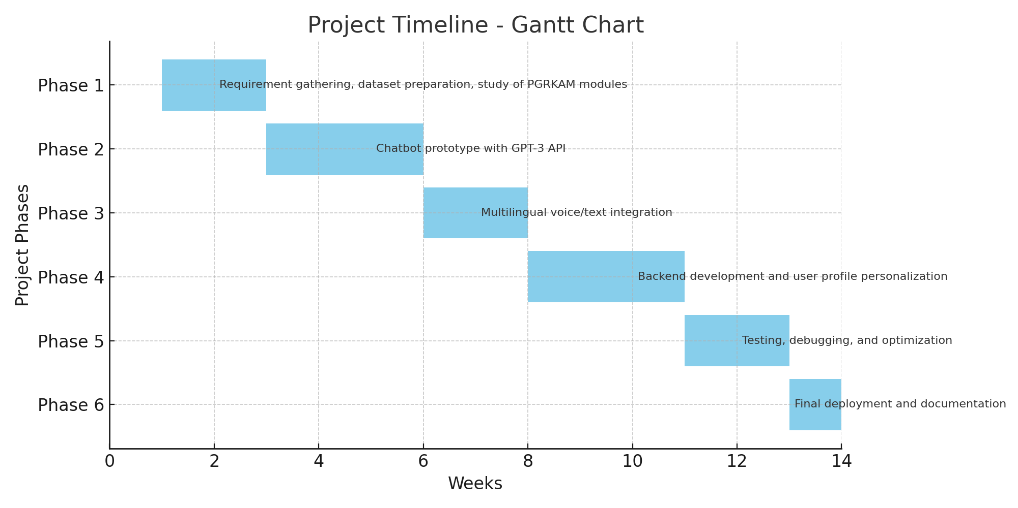
Timeline of the Project (Gantt Chart)

Slide 10
References (IEEE Paper format)
[1] World Health Organization, “Mental health of students in higher education,” WHO Publications, 2021.
[2] R. P. Auerbach et al., “Mental disorders among college students in the World Health Organization World Mental Health Surveys,” Psychological Medicine, 2016.
[3] J. Firth et al., “The efficacy of smartphone-based mental health interventions for depressive symptoms,” World Psychiatry, 2017.
[4] B. Inkster, S. Sarda, and V. Subramanian, “An empathy-driven, conversational artificial intelligence agent for digital mental health,” JMIR Mental Health, 2018.
[5] K. Nikhileswar, L. Sphoorthi, D. Vishal, and S. Fathimabi, “Suicide ideation detection in social media forums,” IEEE International Conference on Smart Electronics and Communication (ICOSEC), 2021.
[6] P. Olla et al., “Deploying a mental health chatbot in higher education: The development and evaluation of Luna,” Computers, 2025.

Slide 11


