Slide 1
Development of a Digital Mental Health and Psychological Support System for Students in Higher Education
CSE7302- University Project
Review-4
Batch Number: CSE_08
Under the Supervision of,
Mr Jerrin Joe Francis
School of Computer Science and Engineering
Presidency University
Roll Number | Student Name
20221CSE0372 20221CSE0442 20221CSE0440 | Varun Bantia Prathyusha K Venkatashiva Reddy
Name of the Program: School of Computer Science and Engineering
Name of the HoD: Dr. Asif Mohammed and Dr. Blessed Prince
Name of the Program Project Coordinator: Dr. Jayavadivel Ravi and Mr.Muthuraju V
Name of the School Project Coordinators: Dr. Sampath A K , Dr. Geetha A

Slide 2
Alogrithm Details
Safety-First Message Processing
Input: User message M
Output: Safe response OR Safety intervention
Step 1: Receive user message M
Step 2: Send M to SafetyManager
Step 3: SafetyManager calls ML model:
score = predict(M)
Step 4: If score >= 0.5 then
Mark as HIGH RISK
Block ChatGPT API call
Return Safety Response (helpline message)
Else
Mark as SAFE
Forward message to ChatGPT API
Step 5: Display response to user

Slide 3
Alogrithm Details
Appointment Booking Algorithm
Step 5: If slot is already booked then
Show "Slot Unavailable"
Ask user to select another slot
Else
Proceed to booking
Step 6: Create booking object:
(userId, counsellorId, date, time, status)
Step 7: Store booking in database
Step 8: Send confirmation to user
Step 9: Update slot as booked
End
Input: User details, selected date/time
Output: Booking confirmation or failure
Step 1: User selects counsellor/service
Step 2: User chooses date and time slot
Step 3: Validate input:
- Check internet connectivity
- Check required fields
Step 4: Check slot availability from database

Slide 4
Alogrithm Details
Community Algorithm
Selection: User writes a post and selects a category (e.g., Anxiety, Stress).
Screening: System automatically scans the post for high-risk words using CrisisDetectionUtils.
Anonymization: User chooses to post using their real name or as an "Anonymous Peer."
Publishing: The post is saved to the Cloud Firestore and assigned a pending or approved status.
Engagement: Other students interact in real-time by adding "Support" (hearts) or "Replies."
Regulation: Users can Report inappropriate content, which immediately flags and hides the post from the community feed.

Slide 5
Source Code Details
Safety-First Message Processing
Threshold-Based Filtering: The system uses a strict 0.5 risk threshold.
Classification Workflow:
User sends a message.
CustomSafetyClassifier (TFLite/Offline ML) generates a Risk Score (0.0 to 1.0).
Score < 0.5: Message is "Safe" $\rightarrow$ Sent to ChatGPT.
Score $\ge$ 0.5: Message is "High-Risk" $\rightarrow$ Blocked immediately.
Code Highlight (Prediction Logic):
java
// Local ML Inference Logic
public SafetyResult analyzeMessage(String message) {
// 1. Hand over raw text to Offline ML Model
float riskScore = customClassifier.predict(message);
// 2. Threshold Check (Safety Threshold = 0.5)
if (riskScore >= 0.5f) {
// [HIGH-RISK] Block communication and trigger Crisis Protocol
return new SafetyResult(false, riskScore, "Blocked by ML");
}
// [SAFE] Proceed to AI conversational engine
return new SafetyResult(true, riskScore, "Safe to process");
}
The Challenge: ML models sometimes misinterpret short, common greetings (e.g., "Hi", "Hello") as risky due to training data noise.
The Solution: An Optimization Layer that whitelists common greetings to ensure a smooth user experience.
Code Highlight (Whitelisting):
java
// Prevents ML False Positives on simple greetings
private boolean isCommonGreeting(String message) {
String clean = message.toLowerCase().trim();
// Regex check for variations of Hi/Hello
if (clean.matches("h+i+|hello|hey|hlo|hola")) {
return true; // Bypass ML for instant "Safe" result
}
return false;
}

Slide 6
Source Code Details
Immediate Action: When the Safety Manager blocks a message, the system swaps the AI response with a static Crisis Intervention Message.
Resource Delivery: Instantly provides local verified helpline numbers (iCall, NIMHANS, etc.).
Code Highlight (Intervention Payload):
java
public String getSafetyResponseMessage() {
return "I noticed you might be going through a difficult time. " +
"You're not alone, and support is available.\n\n" +
"🆘 Verified Helplines:\n" +
"• Vandrevala Foundation: 1860-2662-345\n" +
"• NIMHANS Crisis Line: 080-46110007\n\n" +
"Support is just a call away.";
}
Asynchronous Processing: ML analysis happens on a background thread to prevent UI freezing.
Speed: Inference time is tracked in milliseconds (typically < 50ms) to ensure the chatbot feels "alive" and responsive.
Result Reporting:
java
// Performance Tracking
long inferenceTime = System.currentTimeMillis() - startTime;
String details = String.format("ML Score: %.3f, Latency: %dms",
riskScore, inferenceTime);
Log.d("SAFETY_AUDIT", details);

Slide 7
Source Code Details
Booking Implementation
Privacy-First Design: The system never stores the raw Firebase UID in the booking record.
Mechanism: Uses SHA-256 Hashing to obfuscate user identity.
Code Highlight (Security Logic):
java
// Identity Obfuscation via SHA-256
public String hashUid(String uid) {
MessageDigest digest = MessageDigest.getInstance("SHA-256");
byte[] hash = digest.digest(uid.getBytes(StandardCharsets.UTF_8));
// Converting hash bytes to Secure Hex format
StringBuilder hex = new StringBuilder();
for (byte b : hash) {
hex.append(String.format("%02x", b));
}
return hex.toString();
}
Object-Oriented Design: Uses a POJO (Plain Old Java Object) compatible with Firestore automatic mapping.
State Management: Built-in support for pending, confirmed, and cancelled status flags.
Code Highlight (Data Schema):
java
public class Booking {
private String bookingId; // Human-readable ID (MNM-XXXX)
private String userRef; // Hashed Student ID (Privacy)
private String status; // Lifecycle: pending | confirmed | cancelled
@ServerTimestamp
private Timestamp createdAt; // Backend-driven Audit Trail
public Booking() {} // Required for Firebase mapping
}

Slide 8
Source Code Details
Date Constraints: Uses DateValidatorPointForward to automatically block past dates in the calendar.
Time Slot Logic: Interactive Material Chips for intuitive selection of appointment windows.
Code Highlight (Constraint Logic):
java
// Restricting date selection to future only
CalendarConstraints constraints = new CalendarConstraints.Builder()
.setValidator(DateValidatorPointForward.now())
.build();
MaterialDatePicker<Long> picker = MaterialDatePicker.Builder.datePicker()
.setTitleText("Select Appointment Date")
.setCalendarConstraints(constraints)
.build();

Slide 9
Source Code Details
Community Implementation
1. The Data Structure (Post.java)
Show this to explain how a Post is stored in the cloud.
java
public class Post {
private String postId;
private String content; // The main text
private String status; // pending | approved | flagged
private int supportCount; // Hearts/Likes
private int replyCount; // Number of replies
private boolean isAnonymous; // User privacy switch
}
2. The Submission Logic (CreatePostActivity.java)
This shows the Crisis Check before saving the post.
java
// Logic during Post Submission
String postContent = edtContent.getText().toString();
// STEP 1: Crisis Word Search
if (CrisisDetectionUtils.hasCrisisKeywords(postContent)) {
// REDIRECT: Immediately send student to HELPLINE
redirectToCrisisHelpline();
} else {
// STEP 2: Save to Firebase
repository.createPost(new Post(postContent, isAnonymous));
}

Slide 10
Source Code Details
Community Implementation
3. Engagement Logic (PeerSupportRepository.java)
This shows the Atomic Increment logic which ensures data accuracy.
java
// Logic for Real-time Engagement
public void supportPost(String postId) {
db.collection("posts")
.document(postId)
// Atomic Update: Prevents "Race Conditions"
.update("supportCount", FieldValue.increment(1));
}
4. Moderation & Safety (PeerSupportRepository.java)
This shows how the Reporting System works to hide content.
java
// Logic for Flagging Harmful Content
public void reportPost(Report report) {
String id = reportsRef.document().getId();
reportsRef.document(id).set(report);
// IMMEDIATE MITIGATION: Update post status to flagged
postsRef.document(report.getPostId()).update("status", "flagged");
// Result: Post is filtered OUT from the public feed instantly!
}

Slide 11
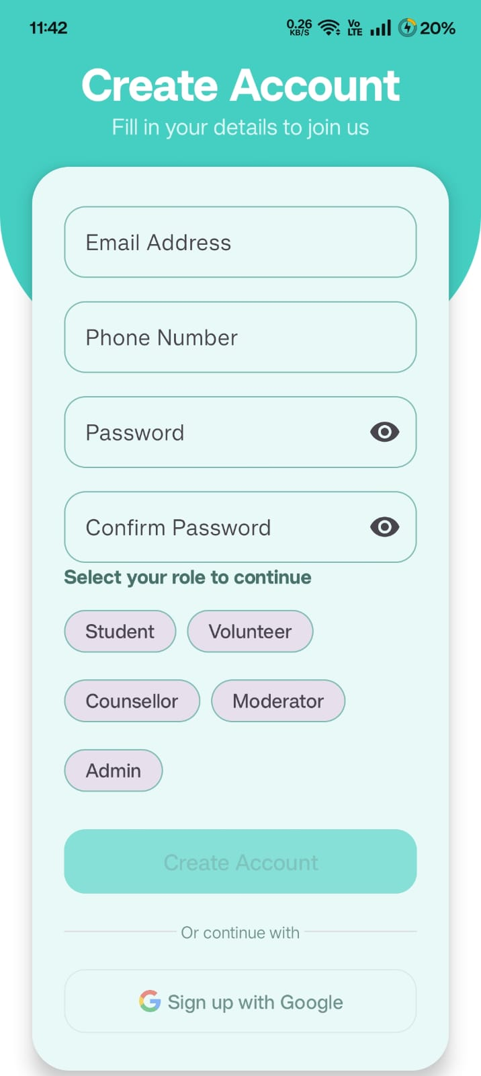
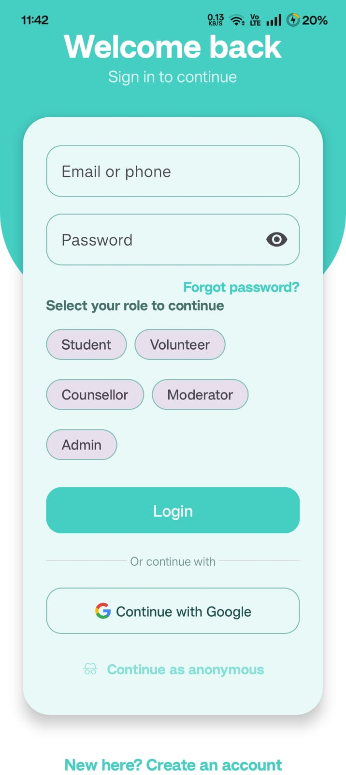
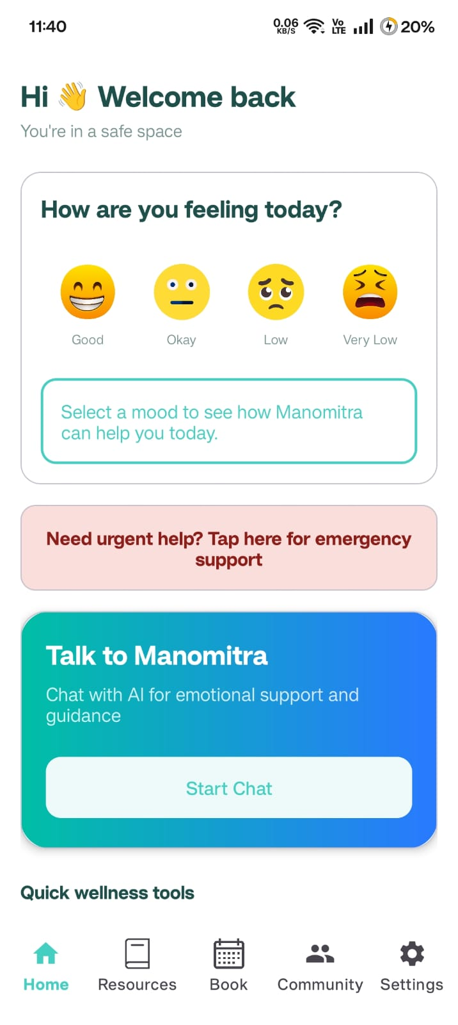
Results
Sign Up Page
Login Page
Home Page

Slide 12
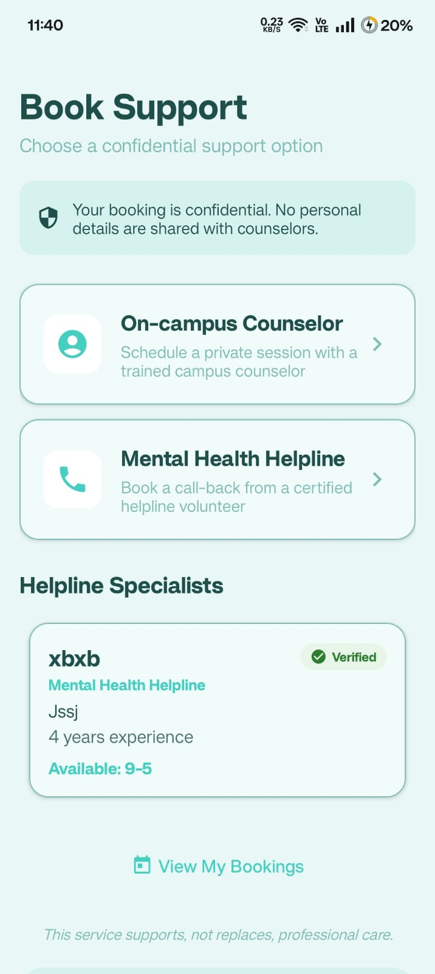
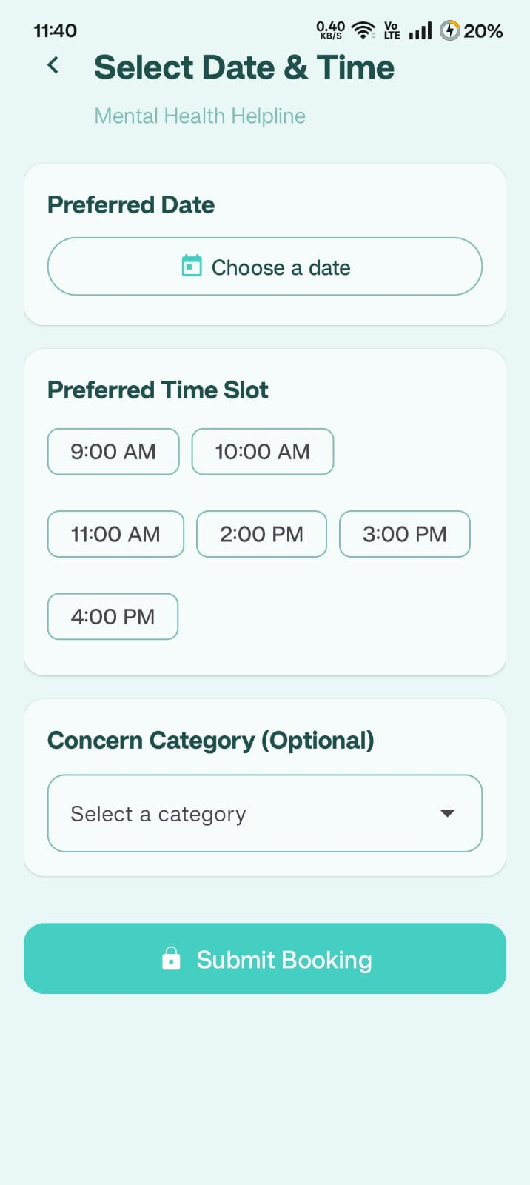
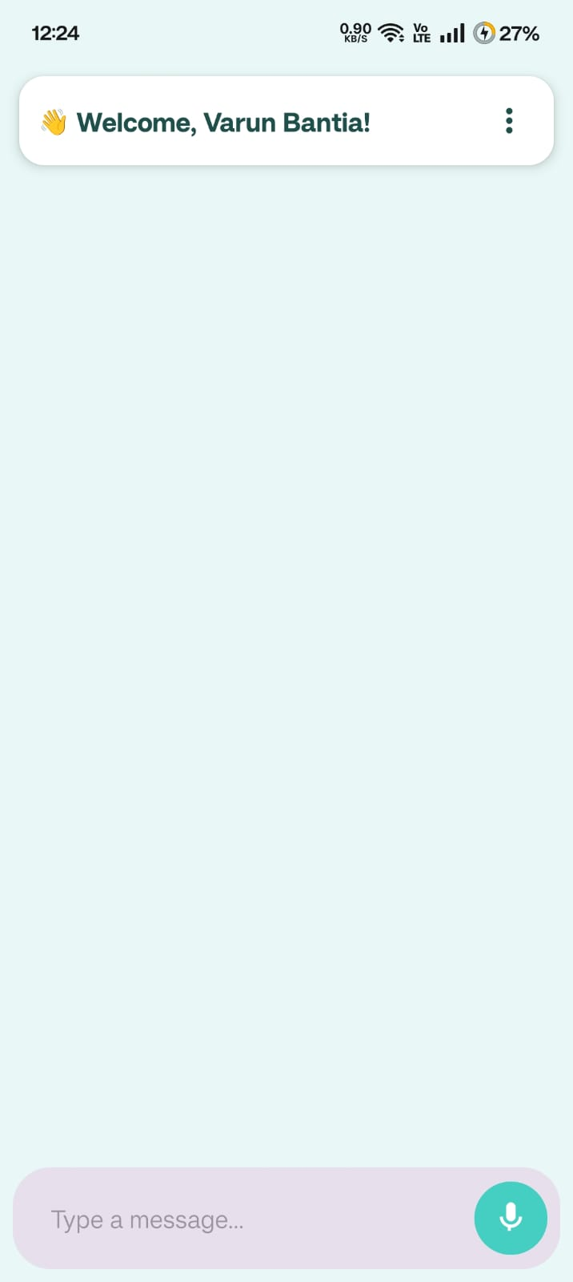
Results
Booking Page
Booking Page
Chatbot Page

Slide 13


