Slide 1
Development of a Digital Mental Health and Psychological Support System for Students in Higher Education
CSE7302- University Project
Review-5
Batch Number: CSE_08
Under the Supervision of,
Mr Jerrin Joe Francis
School of Computer Science and Engineering
Presidency University
Roll Number | Student Name
20221CSE0372 20221CSE0442 20221CSE0440 | Varun Bantia Prathyusha K Venkatashiva Reddy
Name of the Program: School of Computer Science and Engineering
Name of the HoD: Dr. Asif Mohammed and Dr. Blessed Prince
Name of the Program Project Coordinator: Dr. Jayavadivel Ravi and Mr.Muthuraju V
Name of the School Project Coordinators: Dr. Sampath A K , Dr. Geetha A

Slide 2
Problem Statement
Students in higher education are increasingly affected by mental health challenges such as stress, anxiety, depression, and burnout, driven by academic pressure, career uncertainty, financial constraints, and social factors. However, existing mental health support systems in educational institutions are often inadequate, difficult to access, and limited by long waiting times, insufficient counseling resources, lack of personalization, and social stigma. As a result, many students do not seek timely help, leading to undetected and worsening psychological issues that adversely impact their academic performance, well-being, and overall development.
There is a lack of a unified, accessible, and proactive digital platform that can provide continuous mental health monitoring, early identification of psychological distress, confidential support, and timely professional intervention for students in higher education. This gap highlights the need for an effective digital mental health and psychological support system that can deliver scalable, personalized, and stigma-free mental health services, ensuring improved student well-being and a supportive academic environment.

Slide 3
Objectives
To design and develop a digital mental health and psychological support system specifically tailored to the needs of students in higher education.
To provide accessible, confidential, and stigma-free mental health support through a user-friendly digital platform.
To enable early identification and continuous monitoring of students’ mental health conditions using self-assessment and data-driven tools.
To offer personalized self-help resources, coping strategies, and mental wellness programs based on individual student needs.
To facilitate timely access to professional counseling and psychological support through digital consultations and referrals.
To promote awareness and mental health literacy among students, encouraging proactive self-care and help-seeking behavior.
To support educational institutions in understanding mental health trends and improving student well-being through aggregated insights while maintaining data privacy.

Slide 4
Source Code Details
Safety-First Message Processing
Threshold-Based Filtering: The system uses a strict 0.5 risk threshold.
Classification Workflow:
User sends a message.
CustomSafetyClassifier (TFLite/Offline ML) generates a Risk Score (0.0 to 1.0).
Score < 0.5: Message is "Safe" $\rightarrow$ Sent to ChatGPT.
Score $\ge$ 0.5: Message is "High-Risk" $\rightarrow$ Blocked immediately.
Code Highlight (Prediction Logic):
java
// Local ML Inference Logic
public SafetyResult analyzeMessage(String message) {
// 1. Hand over raw text to Offline ML Model
float riskScore = customClassifier.predict(message);
// 2. Threshold Check (Safety Threshold = 0.5)
if (riskScore >= 0.5f) {
// [HIGH-RISK] Block communication and trigger Crisis Protocol
return new SafetyResult(false, riskScore, "Blocked by ML");
}
// [SAFE] Proceed to AI conversational engine
return new SafetyResult(true, riskScore, "Safe to process");
}
The Challenge: ML models sometimes misinterpret short, common greetings (e.g., "Hi", "Hello") as risky due to training data noise.
The Solution: An Optimization Layer that whitelists common greetings to ensure a smooth user experience.
Code Highlight (Whitelisting):
java
// Prevents ML False Positives on simple greetings
private boolean isCommonGreeting(String message) {
String clean = message.toLowerCase().trim();
// Regex check for variations of Hi/Hello
if (clean.matches("h+i+|hello|hey|hlo|hola")) {
return true; // Bypass ML for instant "Safe" result
}
return false;
}

Slide 5
Source Code Details
Immediate Action: When the Safety Manager blocks a message, the system swaps the AI response with a static Crisis Intervention Message.
Resource Delivery: Instantly provides local verified helpline numbers (iCall, NIMHANS, etc.).
Code Highlight (Intervention Payload):
java
public String getSafetyResponseMessage() {
return "I noticed you might be going through a difficult time. " +
"You're not alone, and support is available.\n\n" +
"🆘 Verified Helplines:\n" +
"• Vandrevala Foundation: 1860-2662-345\n" +
"• NIMHANS Crisis Line: 080-46110007\n\n" +
"Support is just a call away.";
}
Asynchronous Processing: ML analysis happens on a background thread to prevent UI freezing.
Speed: Inference time is tracked in milliseconds (typically < 50ms) to ensure the chatbot feels "alive" and responsive.
Result Reporting:
java
// Performance Tracking
long inferenceTime = System.currentTimeMillis() - startTime;
String details = String.format("ML Score: %.3f, Latency: %dms",
riskScore, inferenceTime);
Log.d("SAFETY_AUDIT", details);

Slide 6
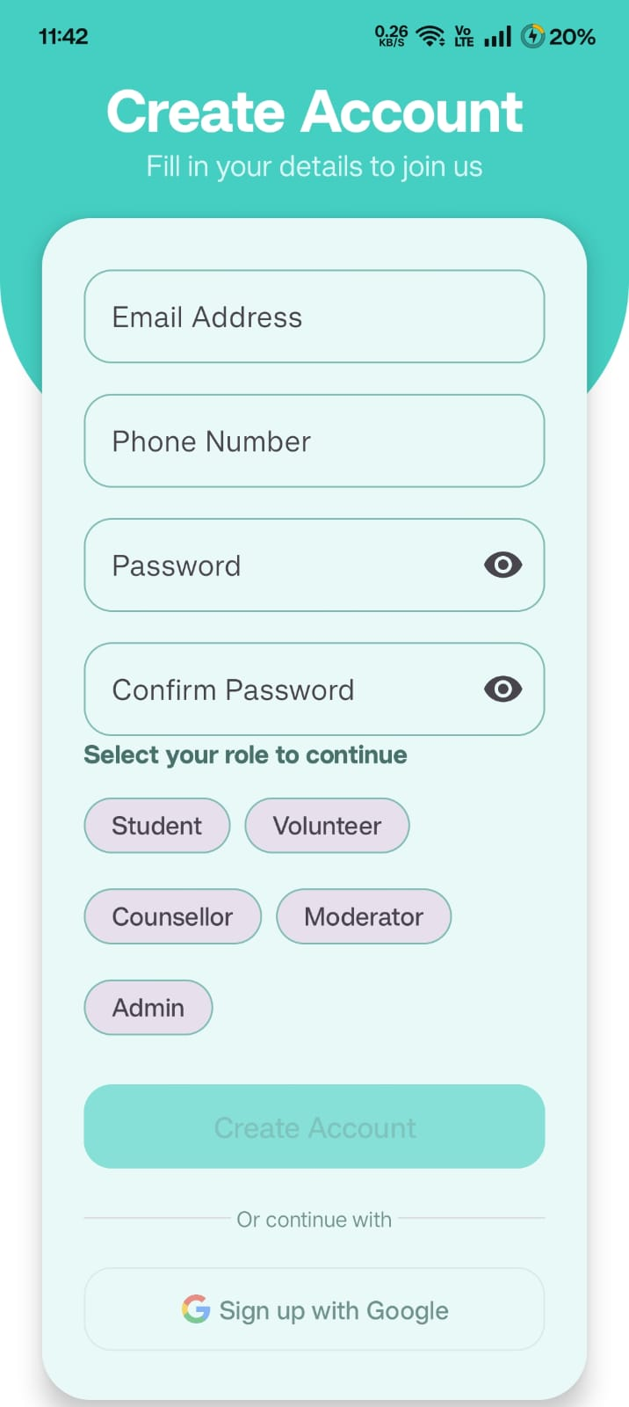
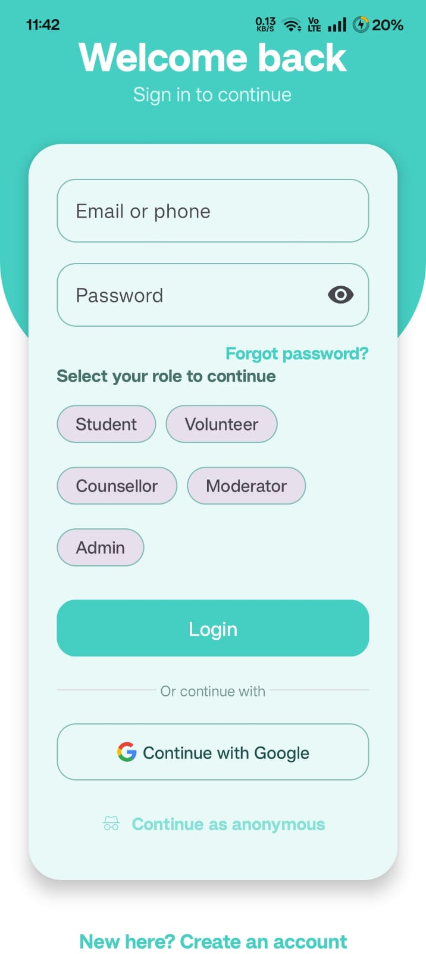
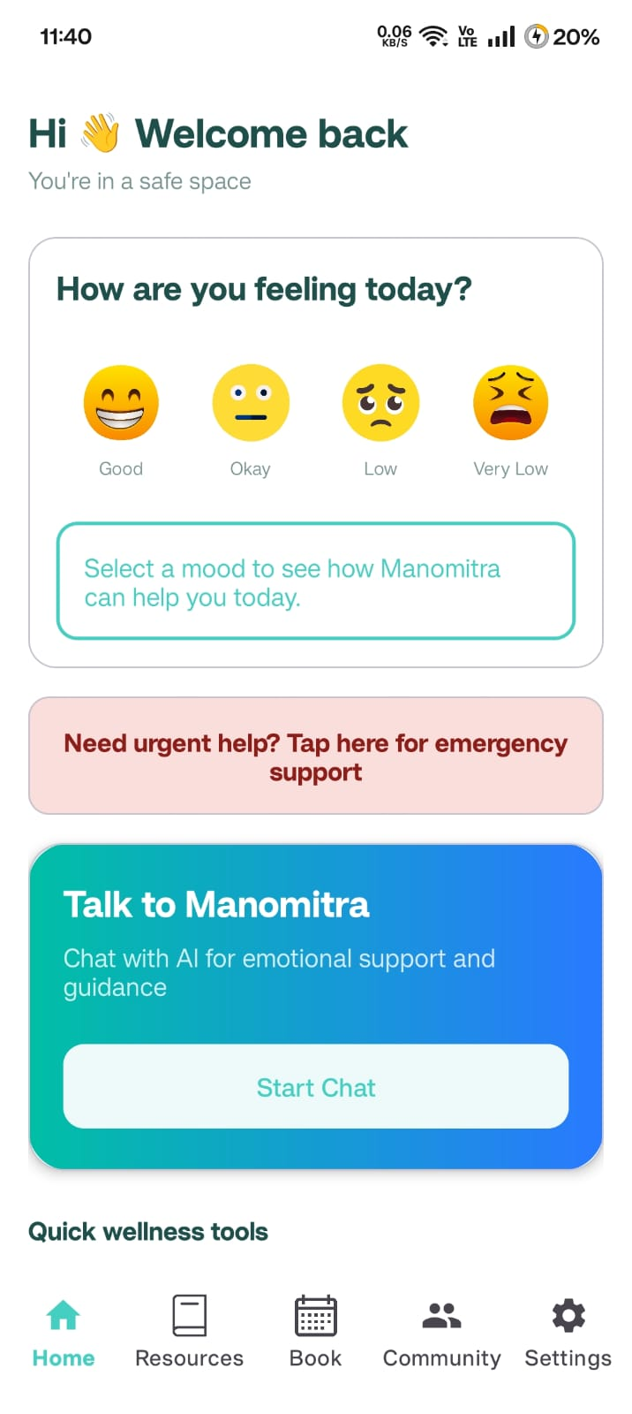
Results
Sign Up Page
Login Page
Home Page

Slide 7
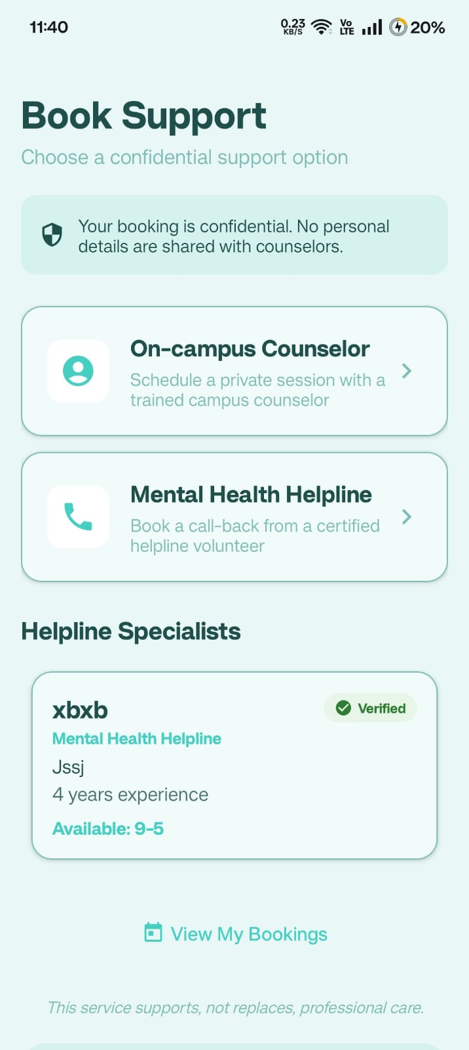
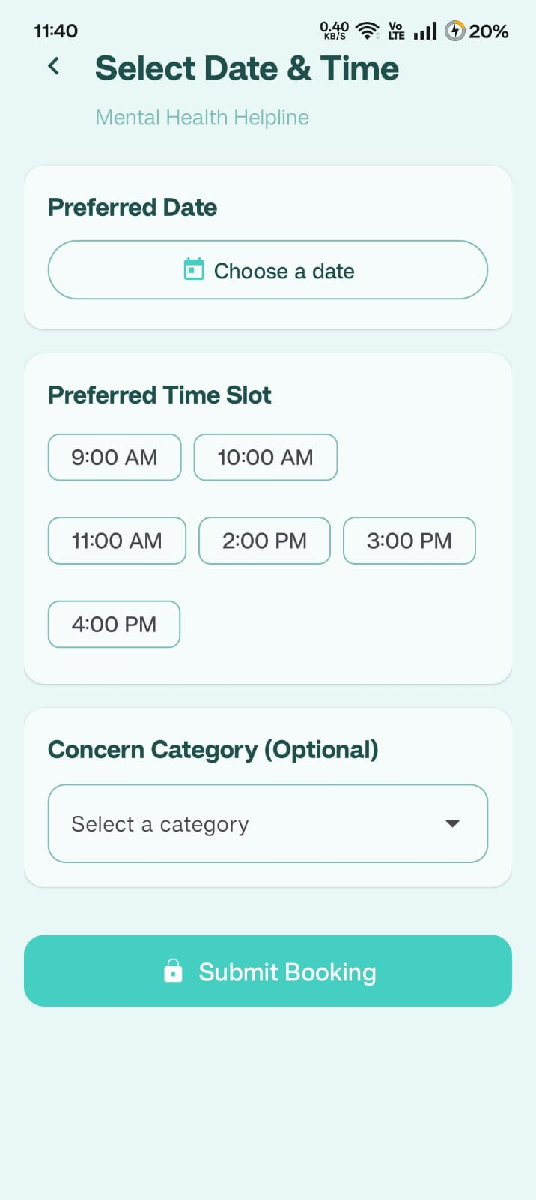
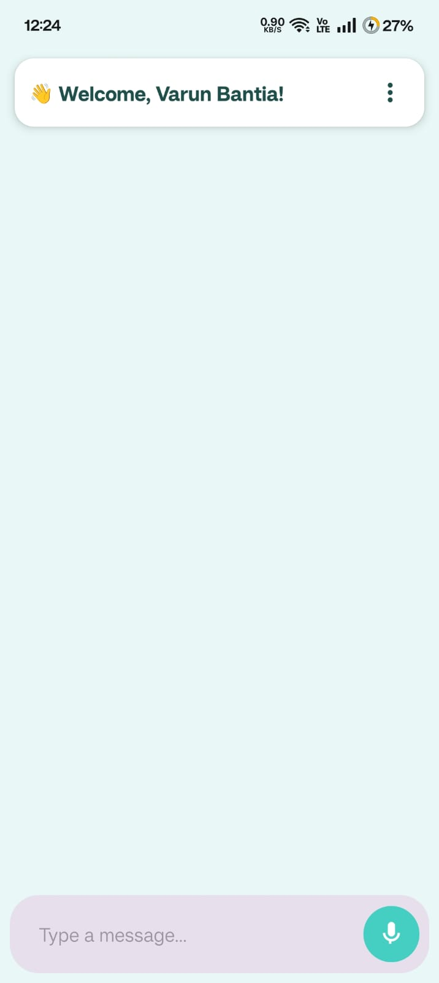
Results
Booking Page
Booking Page
Chatbot Page

Slide 8
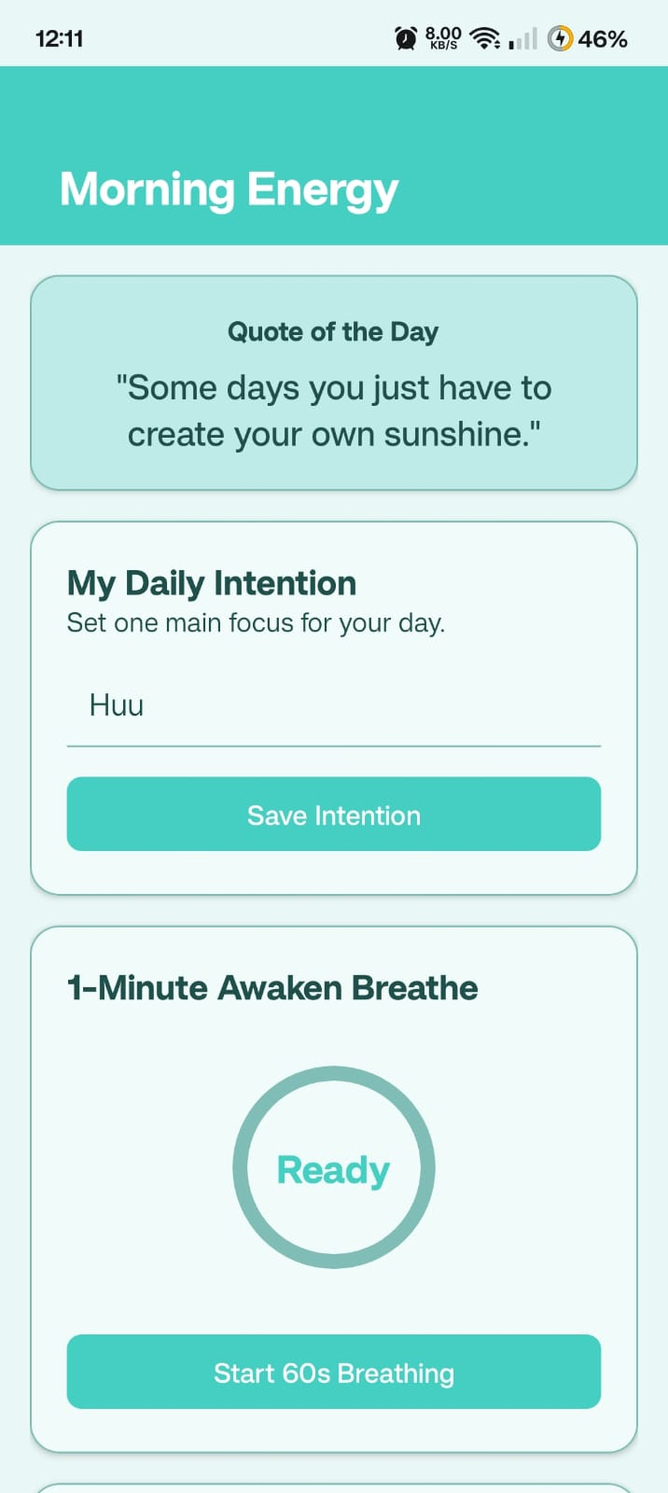
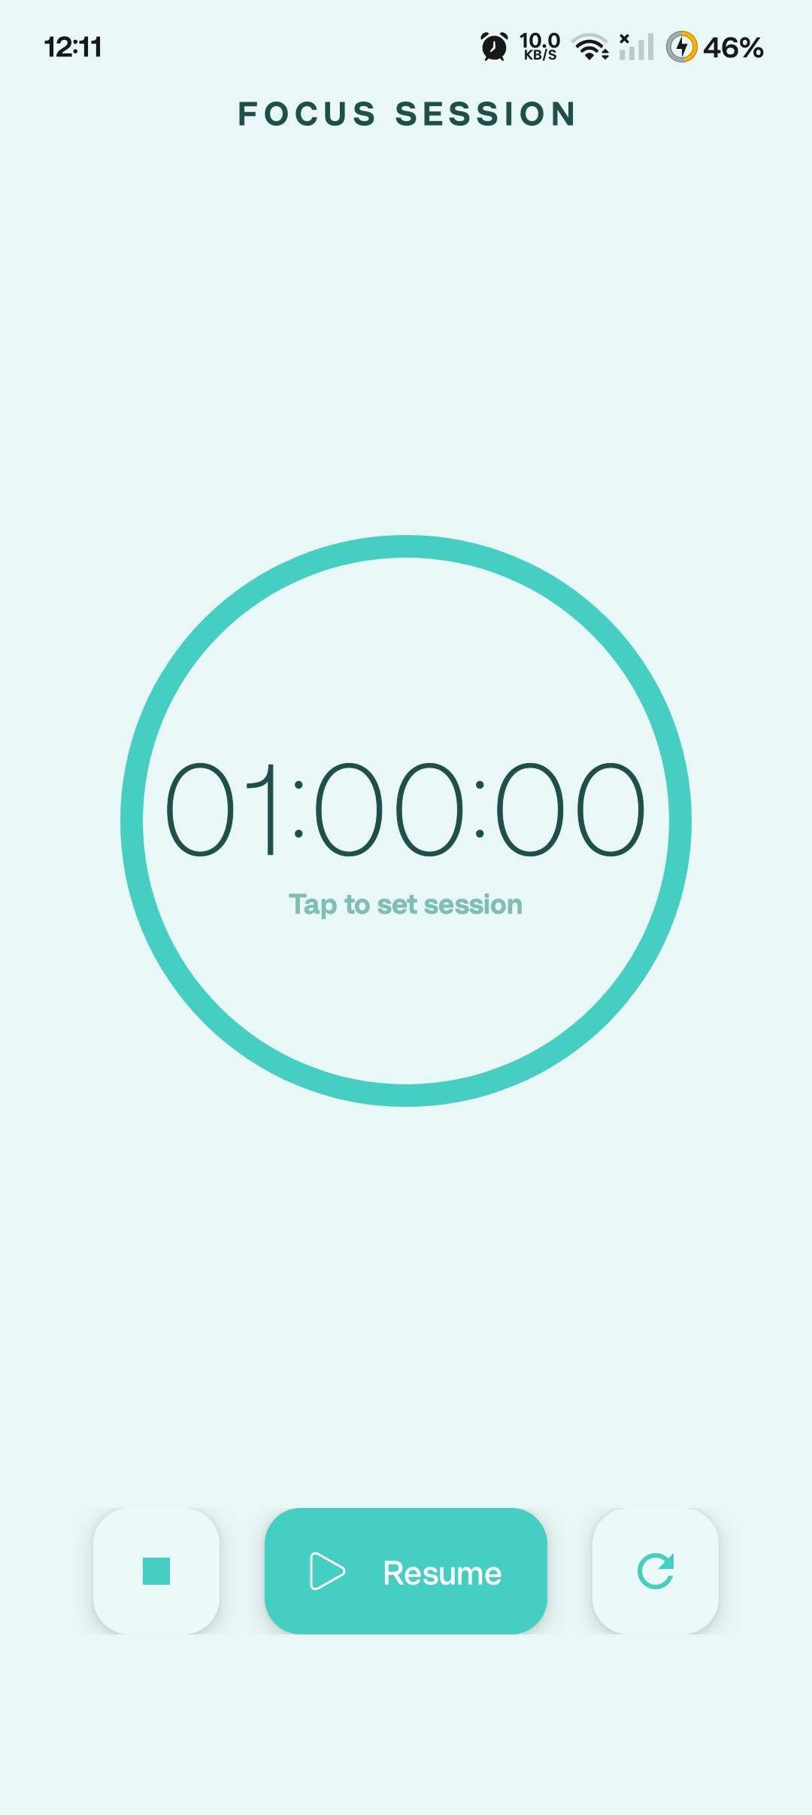
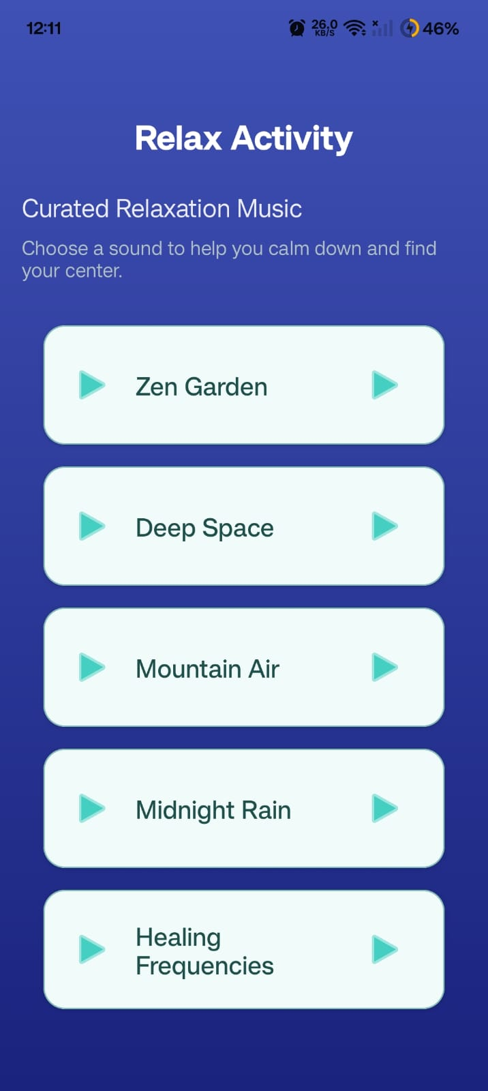
Results
Morning Routine
Focus Session
Relax Page

Slide 9
Innovation or Novel Contributions
Integration of an AI-driven mental health support system specifically tailored for higher education students within a single Android application.
Real-time conversational psychological support using advanced language models to provide empathetic, context-aware responses.
Multimodal interaction combining text, voice input (speech-to-text), and audio responses (text-to-speech) for improved accessibility.
Multilingual mental health support, enabling students from diverse linguistic backgrounds to access psychological assistance comfortably.
Confidential and stigma-free digital platform that encourages students to seek help without fear of judgment.
Scalable and institution-ready architecture that can complement existing counseling services while maintaining data privacy and security.
Early mental health risk identification through continuous interaction patterns and self-assessment data.

Slide 10
Github Link
https://github.com/varunbantia/mental-health-system

Slide 11


