Slide 1
Clever Investor Platform
Product & Org Proposal
Prepared for Luke Babich & Ben Mizes · March 2026
Varun Raghavan
CONFIDENTIAL

Slide 2
STRUCTURE
What this proposal covers
01
Situation
04
Product Proposal
Where Clever Offers is today — what mystery shopping revealed
Scrappiest path to validation, consumer experience, data schema + AI
02
The Gap
05
Org & Resources
5 UX gaps, structural conflict of interest, competitive benchmarks
Team constraints, what to protect, how to staff and sequence
03
The Hypothesis
06
Open Questions
What the Investor Platform could be — and why it's the right bet
What I'd want to explore with you in this session

Slide 3
METHODOLOGY
Key assumptions & how I prepared
What I did
What I'm assuming
What I'd still want to know
— Mystery shopped cleveroffers.com end-to-end
— No formal market research — the thesis is grounded in Clever's first-hand experience with sellers, investors, and agents
— Conversion rate from submit → investor offer accepted (current baseline)
— Spoke with 2 Clever-connected agents (Luke Smith, Jacob Mkhitarian) — 17 and 12 min calls
— Hiring timelines of 4–12 weeks are realistic, not optimistic
— Who owns the early investor-matching work and what's been built
— Mystery shopped InvestorLift and HomeLight Simple Sale
— AMP is P1 and fully protected — no pull from that team
— Whether any investor relationships have yielded repeat transactions
— Reviewed Luke's async answers on team structure, growth signals, and investor relationships
— Flat hiring cost assumed by role type (PM ~$160K, Eng ~$180K, fully loaded)
— ATLAS enterprise fire drills are unpredictable — I've treated that team as unavailable

Slide 4
SITUATION — CURRENT STATE
What the seller experience actually looks like today
Homepage
Property + address
Contact gate
"Offers on the way"
Agent calls
In-person visit
Zip → See Cash Offers
Low friction, clean UX
Name/email/phone required before anything shown
No timeline. No dashboard. No status.
Not investors. No context. No account.
Required before any investor sees property
⚠ Conversion chokepoint
⚠ Dead zone
⚠ Channel conflict
⚠ Visit bottleneck
Contact required before value shown
No persistence. No seller account.
Agent incentive is to convert to listing
Adds 1–2 weeks before investor sees property
First-hand finding:
Both mystery-shopped agents spent the first 2 minutes on investor options, then 15+ minutes pitching traditional listings. The platform promises cash offers — sellers get agent calls, then silence. There is no Clever account to land on after submission.

Slide 5
COMPETITIVE CONTEXT
The market has already solved pieces of this
Clever Offers
HomeLight Simple Sale
InvestorLift
WHAT CLEVER OWNS
BEST CONSUMER COMP
BEST INVESTOR-SIDE COMP
✓ Trusted consumer brand (4.9★, 3,400+ reviews)
✓ Named investor network surfaced to seller
✓ AI buy-box matching — investor sets criteria
✓ 18,000+ agent network, validated seller funnel
✓ Explicit investor vs. agent path choice
✓ 5M+ investors, $30B+ offers made
→
✓ 30% of revenue — growing 250% YoY
✓ Structured intake call feeds pricing model
✓ AI deal scoring + in-app negotiation
✗ No buy-box matching, no investor platform
✓ No in-person visit before investor sees property
✓ Live marketplace visible before sign-up
✗ Experience ends at submission
✗ Smaller agent network than Clever
✗ B2B only — no consumer-safe experience
Consumer trust — missing the backend
Right consumer model — weaker network
Best matching intelligence — no B2C layer

Slide 6
THE HYPOTHESIS
This isn't about a new product.
It's about building the intelligence layer
C
Consumer trust
Clever already owns the seller relationship
the front-end already promises.
Clever already has what HomeLight and InvestorLift lack: a trusted consumer brand, a validated seller funnel, and 18,000 agents. The gaps are entirely on the investor side — no buy-box matching, no structured intake, no platform behind the promise. The Investor Platform closes that gap.
H
HomeLight model
Parallel paths, named network, structured intake
IL
InvestorLift intelligence
Buy-box matching, AI scoring, in-app negotiation
= Clever Investor Platform
InvestorLift-style backend · Clever's consumer front-end

Slide 7
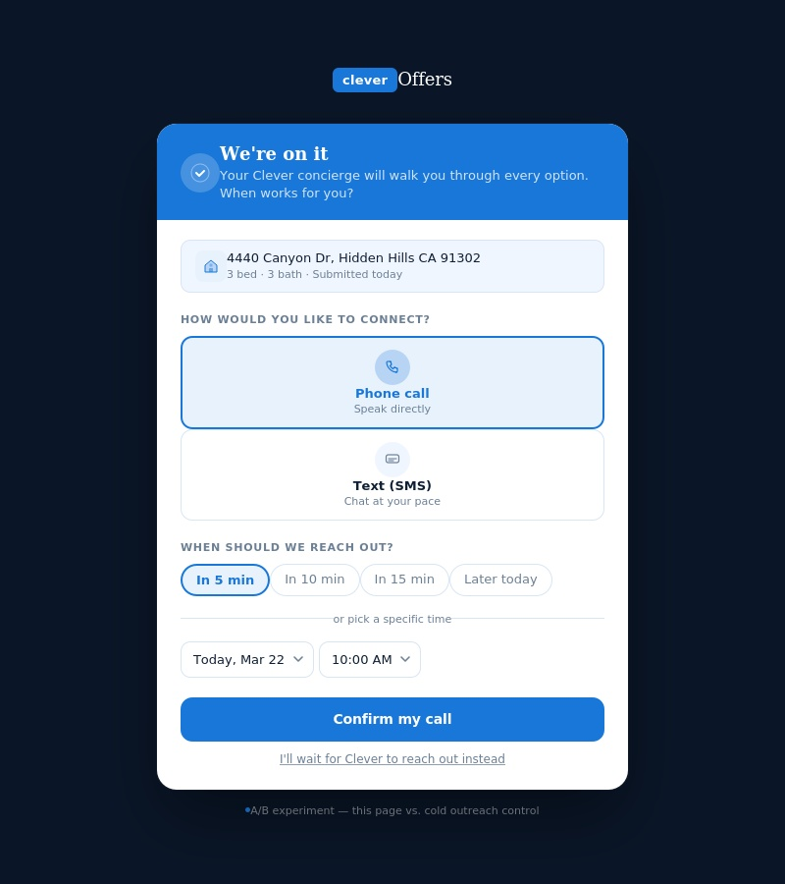
PRODUCT PROPOSAL — REC 1
Rec 1: Replace the dead zone with a scheduling moment
Current — what sellers receive today
Proposed: seller-scheduled
✗ "Cash offers are on the way!" — no timeline
✓ Channel selection
Phone or SMS
✗ CX assigns agent (seller unaware)
✓ Quick-time chips
5 / 10 / 15 min / later today
✗ Unclear voicemail + cold text introduction
→
✓ Date + time picker
Specific scheduling
✗ Two agent intros, no context on who or why
✓ Concierge pre-briefed
Preferences sent ahead of call
✗ No Clever account to land on
✓ Account created
First persistent identity layer
A/B Experiment: Control (cold outreach) vs. Test A (scheduled · phone only) vs. Test B (scheduled · channel choice) — primary metric: submit → concierge connection rate
↗ Interact live: clever-concierge-scheduling.html

Slide 8
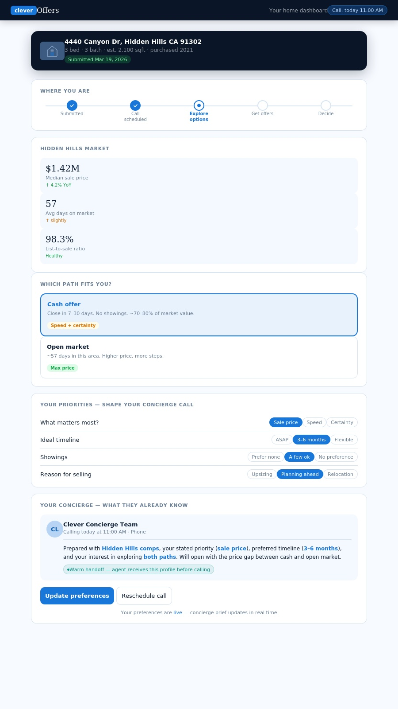
PRODUCT PROPOSAL — REC 2
Rec 2: Give sellers a place to land and a reason to engage
Personalized home card
Address, submitted date, property details — the seller sees their home, not a generic confirmation
5-step progress tracker
Submitted → Call scheduled → Explore options → Get offers → Decide. Seller always knows where they are
Local market snapshot
Median price, avg DOM, list-to-sale ratio for their zip. Educates before the concierge call
Interactive path comparison
Cash offer vs. open market — side-by-side with local estimates. Seller selects preference
Preference module → agent brief
Priority, timeline, showing comfort, reason for selling. Selections generate a structured brief the concierge inherits
Foundation, not a feature — creates the first persistent Clever seller account. Every future feature lives here.
↗ Interact live: clever-seller-dashboard.html

Slide 9
STRATEGIC CONTEXT
This isn't a Clever Offers feature.
It's the account layer that makes Clever a platform.
Clever's business model ends at the referral across every product line. The post-submit account layer — seller identity, preferences, market context — has direct compounding value beyond Offers.
Agent Matching
CORE BUSINESS
Clever Pro
LENDER CHANNEL
Seller preferences (timeline, priority, path) make every agent match warmer and more informed. Same data schema, same infrastructure — zero additional build required.
Seller account data — mortgage balance, timeline, reason for selling, financial priority — is mortgage pre-qualification signal. Raw leads become enriched pipeline for lender partners.
Now:
Cold lead → agent call with no context
Now:
Raw contact passed to lender with no intent data
Clever Title
CLOSING SERVICES
Gravy / Lifecycle
LONG-TERM LOYALTY
A seller who has a dashboard and a progress tracker is a natural place to introduce title and escrow mid-journey — at the Get Offers stage, not as a cold pitch at close.
The Gravy acquisition was about owning the pre-purchase journey. A seller dashboard is the same thesis applied to the sell side — Clever holding the relationship across the journey, not just at the transaction.
Now:
Title introduced at close — unfamiliar, cold, last minute
Now:
Clever exits after referral — no post-transaction relationship

Slide 10
PRODUCT PROPOSAL — INTELLIGENCE LAYER
Seller preferences become structured data — LLM turns data into a brief
seller_profile
seller_preferences
market_context
seller_id · address · property_type
path_preference (investor | open_market | undecided)
zip · median_sale_price · avg_days_on_market
beds · baths · est_sqft · purchase_year
primary_priority · ideal_timeline
list_to_sale_ratio · yoy_price_change
improvements[ ] · est_mortgage_balance
showing_comfort · reason_for_selling
investor_activity_score
channel_preference · concierge_scheduled_at
path_card_clicks[ ] — behavioral signal
comparable_cash_offer_range[ ]
time_on_page · sections_viewed[ ]
open_market_estimate_range[ ]
path_card_clicks[ ] — behavioral signal no CRM captures today
↓ LLM
Agent brief (LLM output):
"Varun is a 3bd/3ba homeowner in Hidden Hills who purchased in 2021 and has made meaningful improvements (landscaping, garage office, patio). He's planning ahead for aging parents — no urgency. He leaned toward cash offers but listed sale price as his top priority, which is a tension worth surfacing early. Local market: median $1.42M, 57 DOM. Cash offer range: $980K–$1.15M vs. open market $1.35M–$1.48M. Lead with the price gap and let him decide."

Slide 11
PRODUCT PROPOSAL — INVESTOR PLATFORM
The scrappiest path to validating the investor matching hypothesis
Phase 1
Phase 2
Phase 3
Month 1–2 · Loveable
Month 3–4 · +ANVIL
Month 5+ · Full build
Structured intake + manual routing
Buy-box matching + algorithmic routing
Competing offers dashboard
→ Agent collects property package via structured Loveable form (photos, details, timeline)
→ ANVIL builds investor buy-box scoring — adjacent to existing match models
→ Seller sees competing offers forming in real time — side by side with open market estimate
→ Clever platform routes to curated investor shortlist — no agent personal lists
→ Property intake auto-routes to investors whose buy-box criteria match
→ In-platform negotiation layer (vs. agent-mediated verbal relay)
→ Investor responses tracked in Airtable/Sheets (not yet version-controlled)
→ Seller dashboard surfaces: 'X investors reviewing your home'
→ Agent shifts from bottleneck → advisor: in the loop on offers, not generating them
→ Validation metric: do structured packages generate more investor responses than ad-hoc agent outreach?
→ Validation metric: does buy-box matching increase offer volume per submission?
→ Validation metric: submit → offer acceptance rate vs. control
Key constraint: Phase 1 and 2 require no tech allocation from AMP, ATLAS, or Agent HQ. Phase 3 requires ANVIL partial and a dedicated new pod.

Slide 12
RESOURCE ALLOCATION
What to protect, what to borrow, what to build
AMP
PROTECT
ANVIL
PHASE 2 ONLY
P1 — fully staffed. Zero pull. This is the engine. Do not touch.
Named as intended Phase 2 partner for buy-box scoring — adjacent to existing match models. Not committed until capacity confirmed in live session. If unavailable, buy-box logic is an early engineering hire deliverable.
ATLAS
PROTECT
Growth
1 SPRINT
Too stretched + enterprise fire drill risk. Unavailable for net-new work.
Funnel instrumentation for the A/B experiment only. One shared sprint with Ben's team.
Agent HQ
PROTECT
NEW POD
BUILD
Understaffed due to attrition. Fix the backfill first. Don't add scope.
Mandate: Offers investor matching + post-submit account layer (cross-product). 1 PM, Month 1. Engineers gated on Phase 1 signal: 15%+ investor response lift OR 3 investor matches in 30 days. Reporting structure: open question for live session.
Phase 1 requires zero pull from any existing pod — Loveable + dedicated PM only. Engineering gated on signal: 15%+ investor response lift OR 3 investor matches in 30 days. ANVIL capacity and new pod reporting structure are open questions for the live session.

Slide 13
RECOMMENDATION
The call.
1
Rec 1: Ship the scheduling screen now
3
Start Phase 1 investor intake with Loveable
It's Loveable-executable, requires no tech allocation, and directly fixes the highest-friction point in the current flow. It also creates the first seller account — the foundation for everything else.
Replace the agent personal-list blast with a structured property package and a platform-owned investor routing layer. No new tech team required for Month 1. Signal within 6–8 weeks.
2
Rec 2: Build the seller dashboard in parallel
4
Gate Phase 2 on Phase 1 signal
The preference module generates the data schema. The LLM turns it into agent briefs. The A/B experiment runs itself. This is the concierge upgrade that makes warm handoffs systematic — not dependent on individual agent quality.
Only pull ANVIL and fund the new pod when Phase 1 shows offer volume improvement. Don't build the matching engine on a hypothesis — build it on evidence.

Slide 14
LIVE SESSION AGENDA
What I'd want to dig into with you
The early investor-matching work
10 min
New pod sequencing
10 min
Who owns it, what's been built, what's worked and what hasn't. I want to build on what exists, not past it.
Does this start under Ben's team for Phase 1 and graduate at Phase 2, or does it need dedicated ownership from Month 1?
Pressure-test the Phase 1 scope
10 min
What's been tried and didn't work
10 min
Does the structured intake + Loveable routing proposal fit the Offers team's actual capacity? What am I missing about current dependencies?
What has Clever already tested on Offers that didn't land? That signal is as valuable as what did.
ANVIL capacity and the Phase 2 gate
10 min
Reactions and open curveballs
10 min
Is ANVIL available for Phase 2 buy-box scoring, or does that need to be an early engineering hire? This changes how I'd sequence the pod build.
Where am I wrong? What assumptions are off? What's the thing you're not sure I understand yet about how Clever actually works?

