Slide 1
Coursera Capstone IBM Applied Data Science Capstone
Opening a New Pizza Shop in Bangalore, Karnataka By: Varun Behera October 2019

Slide 2
BUSINESS PROBLEM
Objective: Select the best locations in the city of Bangalore, Karnataka to open a new pizza shop.
This project aims to provide solutions to answer the business question:
In the city of Bangalore, Karnataka, if a Pizza franchise is looking to open a new pizza outlet, where would you recommend that they open it?

Slide 3
DATA
Data required:
List of neighborhoods in Bangalore.
Latitude and longitude coordinates of those neighborhoods.
Venue data, particularly data related to Pizza places.
Sources of data
The data is stored in a Wikipedia page having the link as below: https://en.wikipedia.org/wiki/List_of_neighbourhoods_in_Bangalore
Geocoder package for latitude and longitude
Foursquare API for venues

Slide 4
METHODOLOGY
Web scraping Wikipedia page for extracting neighborhoods list
Get latitude and longitude coordinates using Geocode
Use Foursquare API to get venue data of each neighborhood
Group data by neighborhood and taking the mean of the frequency of occurrence of each venue category
Filter venue category by Pizza Places
Perform clustering on the data by using k-means clustering
Visualize the clusters in a map using Folium

Slide 5
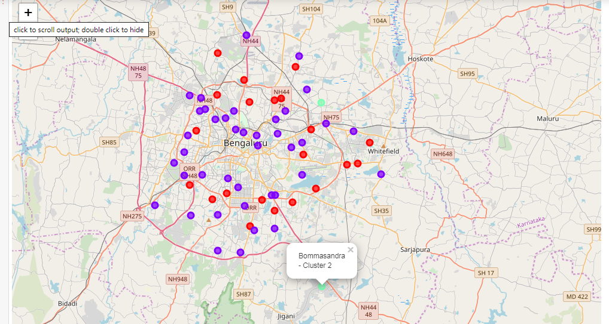
RESULT
Categorized the neighborhoods into 3 clusters :
Cluster 0: Neighborhoods with
high number of Pizza Places.
Cluster 1: Neighborhoods with low number to
no existence of Pizza Places
Cluster 2: Neighborhoods with moderate
concentration of Pizza Places

Slide 6
OBSERVATION
Most of the pizza shops are concentrated in the Northern and Eastern area of Bangalore city, with the highest number in cluster 0 and moderate number in cluster 2.
On the other hand, cluster 1 is having the lowest no of pizza places in the neighborhoods.
This represents a great opportunity and high potential areas in opening new pizza palace as there is very little to no competition from existing pizza places.
Meanwhile, pizza palace in cluster 0 are likely suffering from intense competition due to oversupply and high concentration of pizza shops.

Slide 7
RECOMMENDATION
Open new pizza places in neighborhoods in cluster 1 with little to no competition
Can also open in neighborhoods in cluster 2 with moderate competition if have unique selling propositions to stand out from the competition
Avoid neighborhoods in cluster 1, already high concentration of pizza places and intense competition

Slide 8
THANK YOU

