Slide 1
Agentic AI
-Varun Raste

Slide 2
What is an AI Agent?
Uses an LLM as the reasoning engine.
Interacts with external tools and APIs.
Maintains context using memory.
Can make decisions without predefined workflows.
Iteratively improves until the objective is achieved.

Slide 3
Characteristics of an AI Agent
Autonomy: Executes tasks with minimal human intervention.
Reasoning: Breaks complex problems into smaller steps.
Tool Usage: Calls APIs, databases, or external software.
Memory: Remembers previous interactions and state.
Goal-Oriented: Plans actions to maximize task success.

Slide 4
Agentic AI
Extends beyond simple prompt-response interactions.
Dynamically selects the next best action.
Can recover from failures and retry tasks.
Coordinates multiple tools to solve problems.
Suitable for long-running, complex workflows.

Slide 5
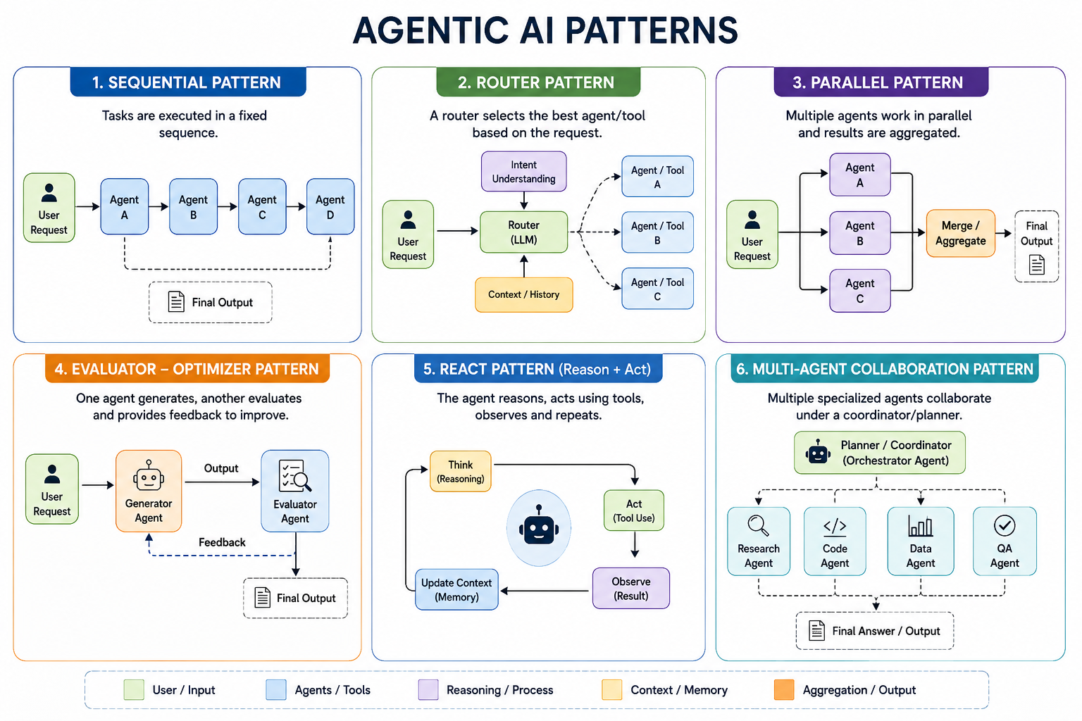

Slide 6
Agentic Design Principles
Define a clear objective for the agent.
Equip the agent with relevant tools.
Maintain memory for continuity.
Include feedback and evaluation loops.
Ensure safety through guardrails and permissions.

Slide 7
What is the ReAct Pattern?
Alternate between reasoning and action.
Use observations to guide the next step.
Continue until the goal is achieved.
Reduce hallucinations through tool usage.
Suitable for search, QA, and troubleshooting.

Slide 8
ReAct Workflow
Receive user query.
Think about the next action.
Execute a tool.
Observe the result.
Repeat until the final answer.

Slide 9
Why ReAct?
Improves factual accuracy.
Enables dynamic decision-making.
Handles multi-step problems naturally.
Integrates seamlessly with external systems.
Provides interpretable reasoning traces.

Slide 12
When to Use Agentic AI
Multi-step reasoning problems.
Tasks requiring external tools.
Long-running workflows. Dynamic decision-making.
Autonomous business automation.

Slide 13
Agentic AI vs Traditional LLM
Traditional LLM | Agentic AI
Single response | Multi-step execution
No planning | Goal-driven planning
Limited context | Memory enabled
No tool usage | Tool orchestration
Static workflow | Adaptive workflow

