Slide 1
Transformers LLM
Varun Raste
Data Scientist , IBM

Slide 2
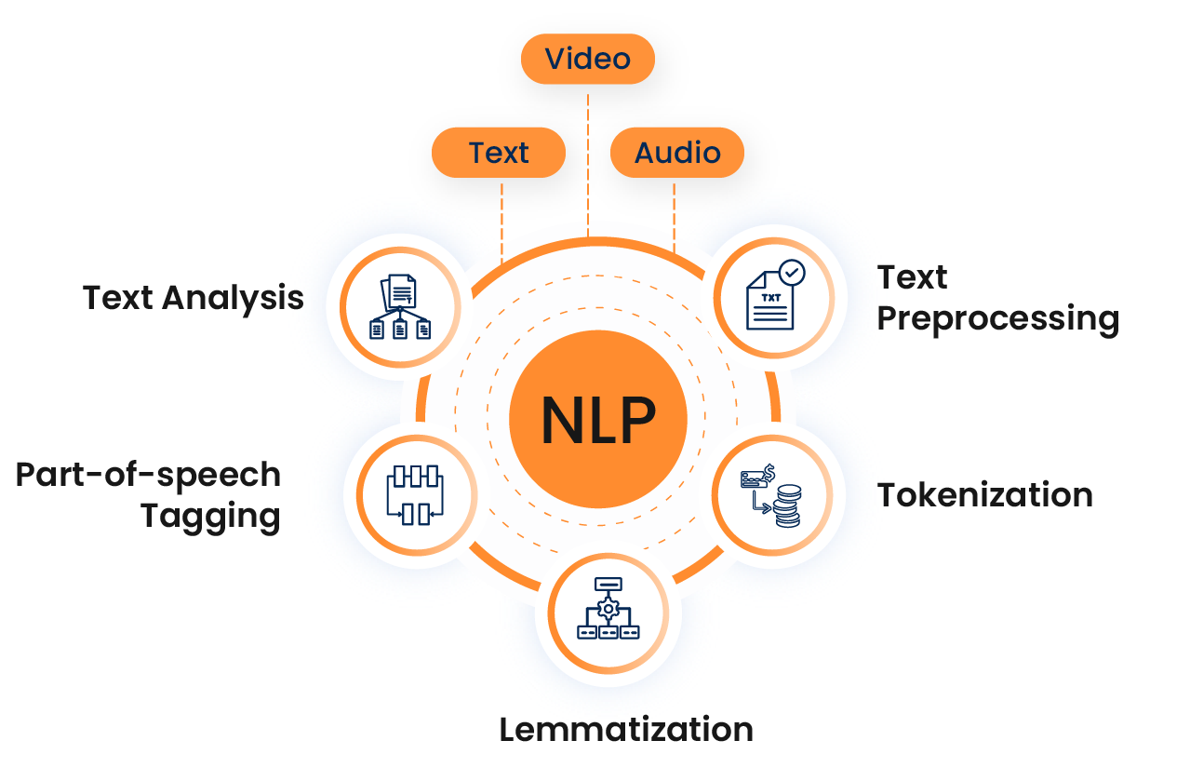
What is NLP and Why Text Is Hard
NLP teaches computers to work with human language
Humans understand meaning naturally
Computers only understand numbers
Language has ambiguity and context
Same word can have many meanings

Slide 3
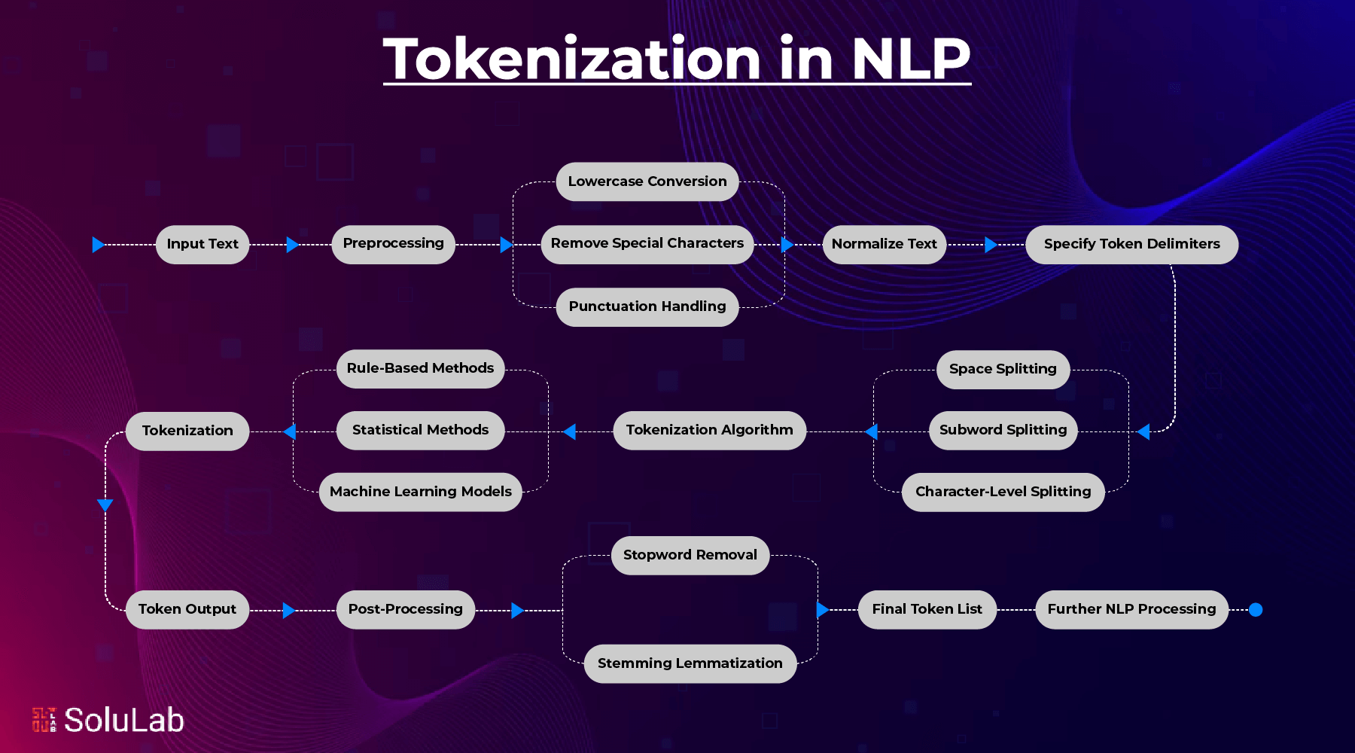
Raw Text → Tokens
Models cannot read raw text
Text is split into smaller units called tokens
Tokens are words or word pieces
Tokenization is the first step
Models work only with tokens
Tokenizer_Demo

Slide 4
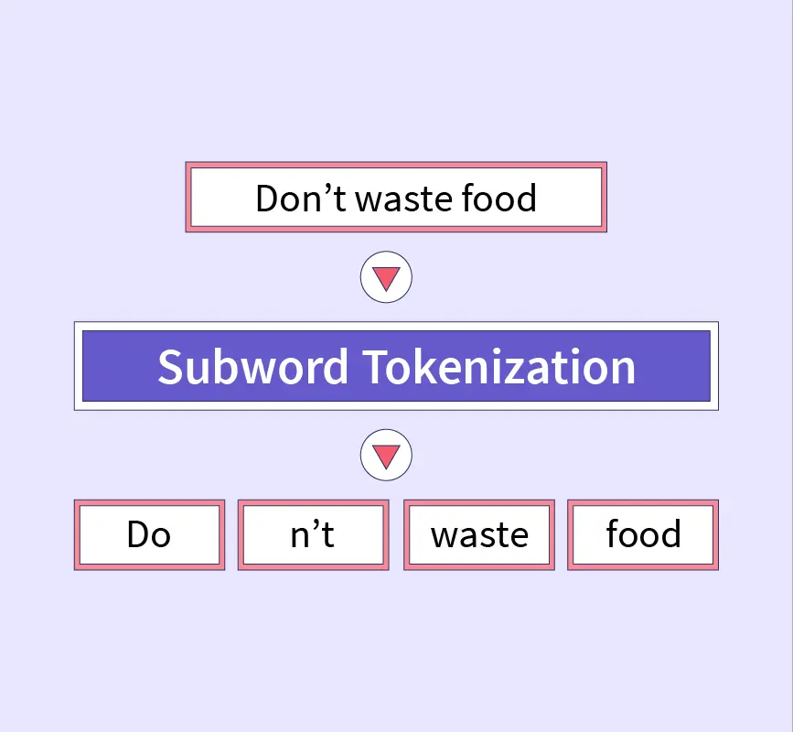
Subword Tokenization
Words are split into smaller parts
Common pieces are reused
Helps handle unknown words
Keeps vocabulary size small
Example: unbelievable → un + believe + able

Slide 5
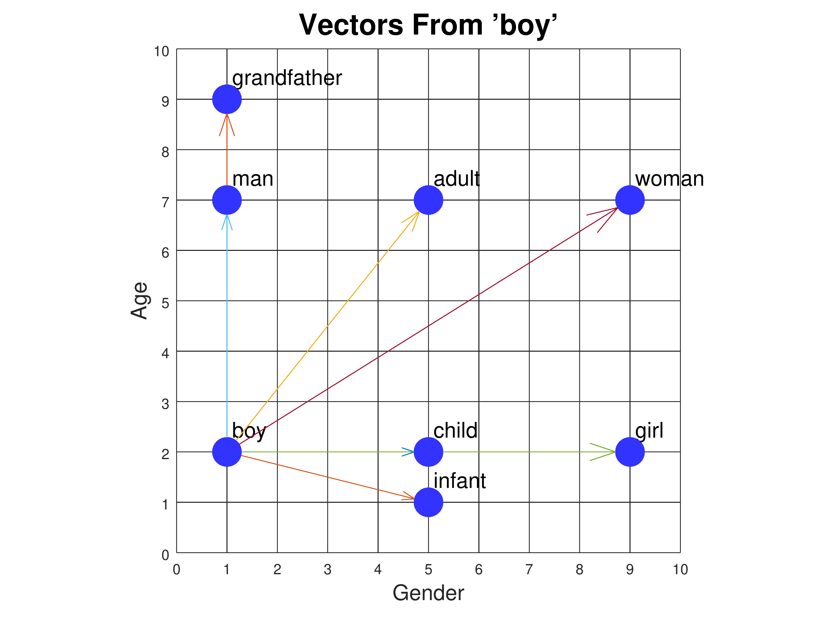
Embeddings
Embeddings are numerical representations of words
They convert text into numbers machines understand
Each word is represented as a vector
Similar words have similar embeddings
Embeddings capture meaning and context
WordEmbedding_Demo

Slide 6

What Is a Transformer
A Transformer is a neural network architecture designed specifically to handle sequential data like text.
Unlike older models, a Transformer processes all tokens in a sentence at the same time.
It uses a mechanism called attention to decide which words are important for understanding context.
This allows the model to capture long-range relationships between words.
Transformers form the foundation of modern large language models
transformer_demo

Slide 7
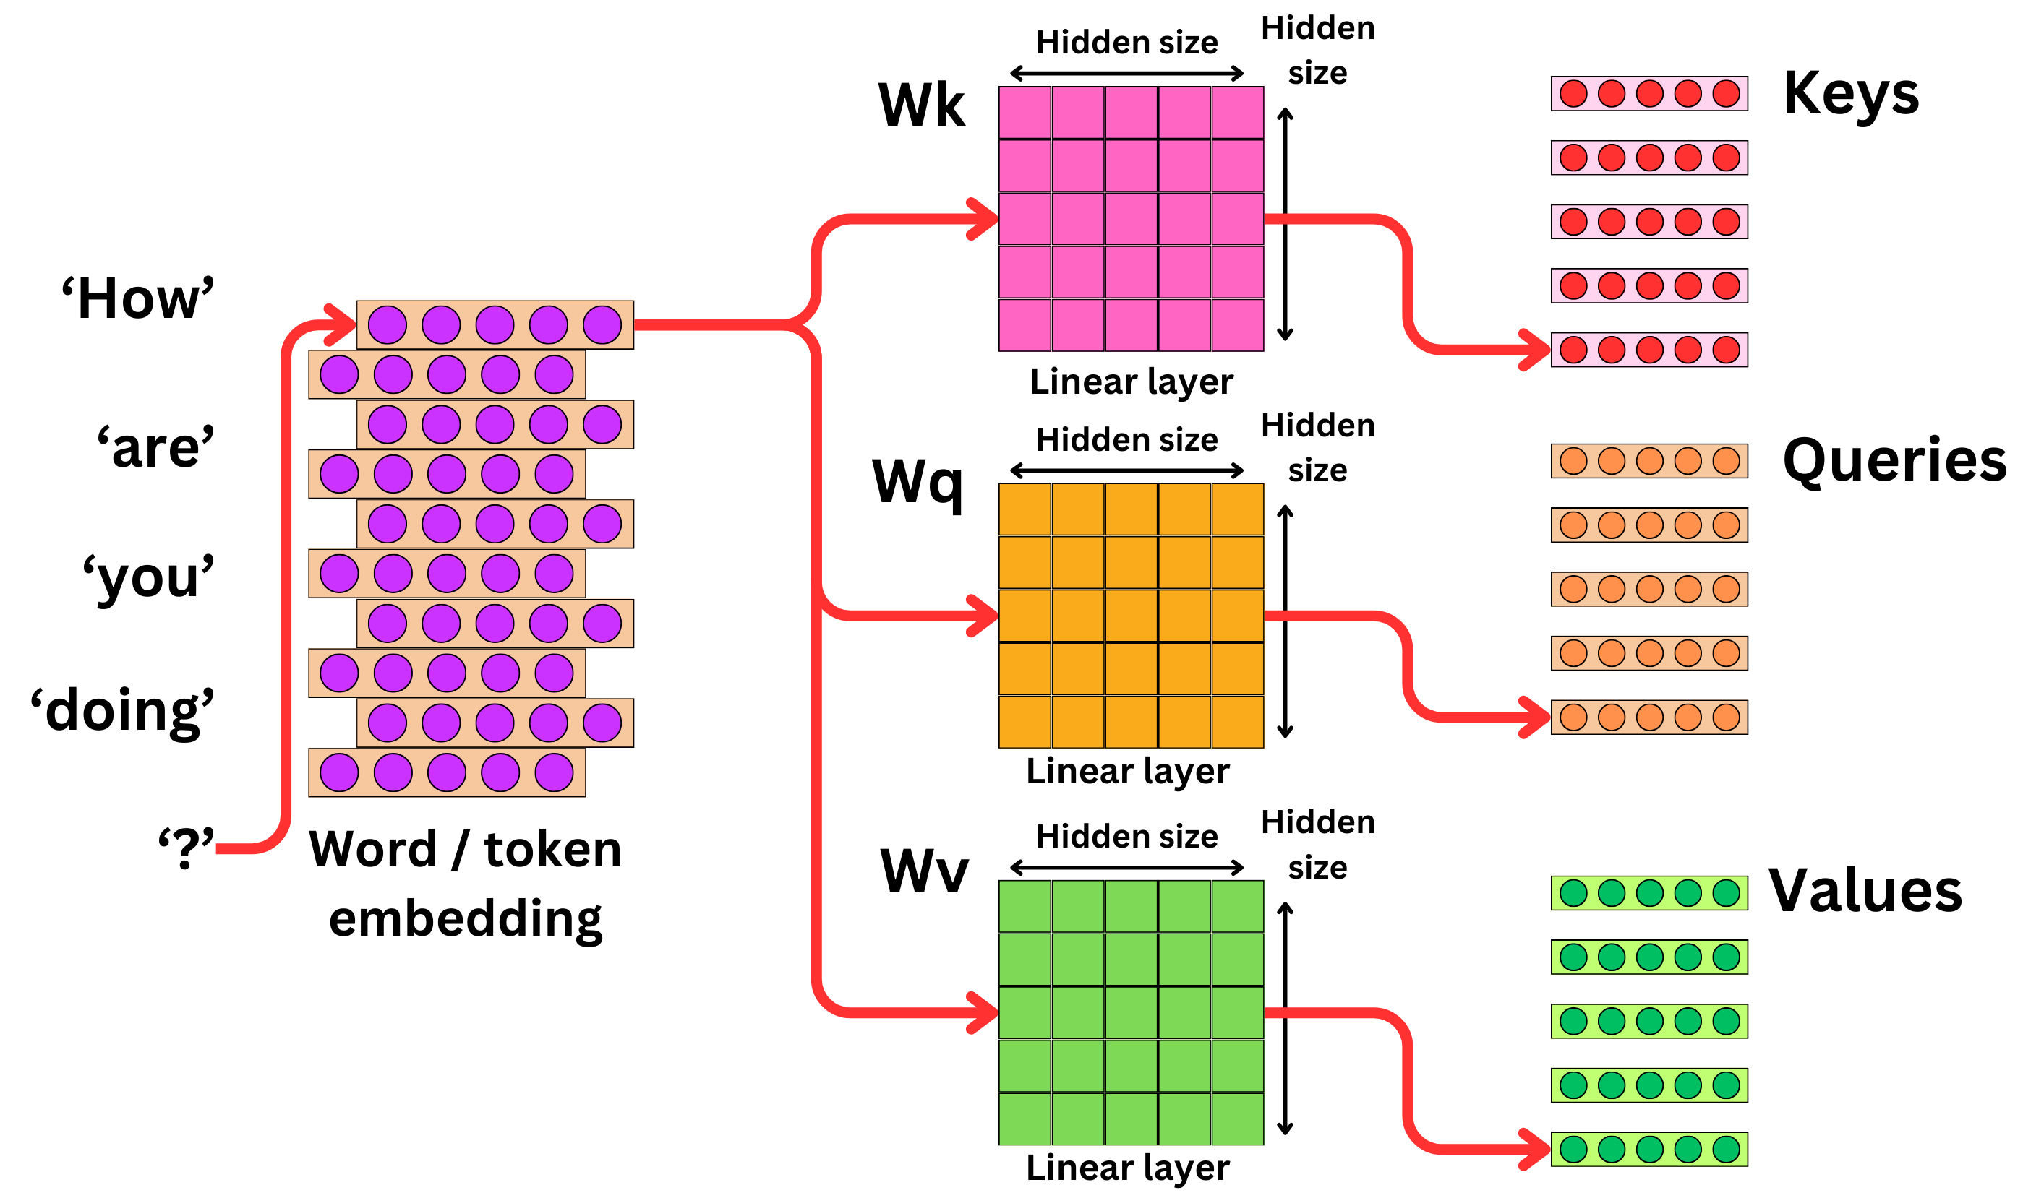
Self Attention
Self-attention allows each token to look at every other token in the sequence at the same time.
For each token, the model creates three vectors called Query, Key, and Value using linear transformations.
Attention scores are computed by comparing Queries with all Keys using dot products.
These scores are normalized to decide how much focus each token should give to others.
A weighted sum of Values produces a context-aware representation for each token.
Transformer_demo_v1

Slide 8
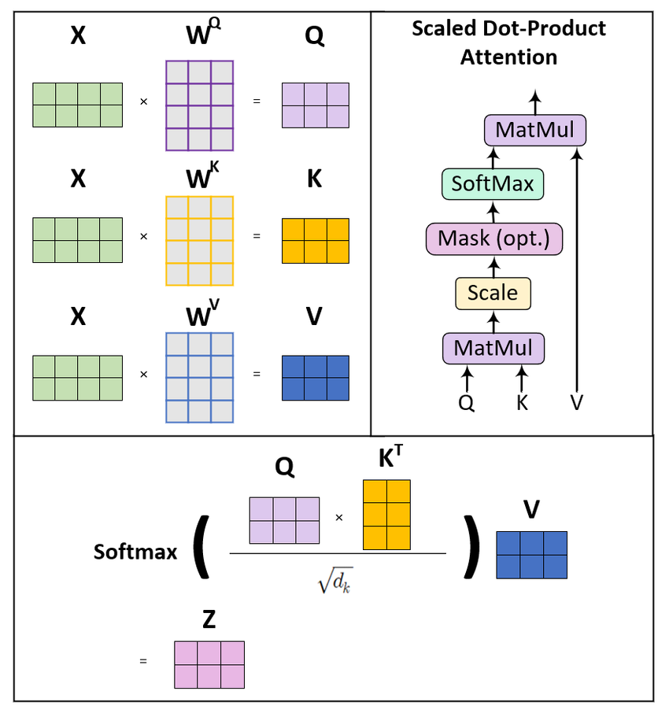
Key Value & Query matrix
🟦 Query (Q)
Generated from the current word.
Represents the information this word wants.
Used to compare against all Keys.
Acts like a search request.
🟩 Key (K)
Generated from every word in the sentence.
Describes what information each word contains.
Queries are matched against Keys.
Determines relevance.
🟥 Value (V)
Contains the actual information to be shared.
Combined using attention weights.
Values form the final output.
Not used for matching, only for aggregation.
⚙️ How Attention is Computed
Query is compared with all Keys using dot product.
Scores are normalized using softmax.
Values are weighted and summed.
Output is a context-aware word representation.
Transformer_demo_v1

Slide 9
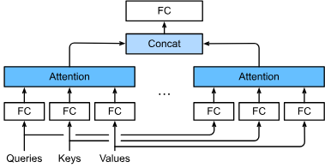
Multi-Head attention
Multi-Head Attention allows the model to focus on different parts of the sentence simultaneously.
Instead of a single attention operation, multiple attention “heads” run in parallel.
Each head learns a different type of relationship such as syntax, semantics, or long-range dependency.
Outputs from all heads are concatenated and projected back to a single representation.
This improves expressiveness without increasing sequence length
transformer_demo

Slide 10
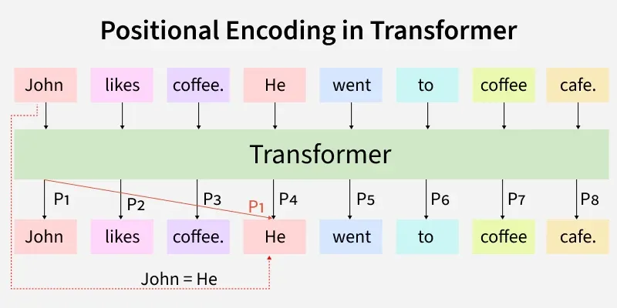
Positional Encoding
Transformers process all tokens in parallel and do not have inherent word order.
Positional encodings inject information about token position into embeddings.
Typically implemented using sine and cosine functions of different frequencies.
These encodings are added directly to word embeddings.
This allows the model to distinguish between “dog bites man” and “man bites dog”.
transformer_demo

Slide 11
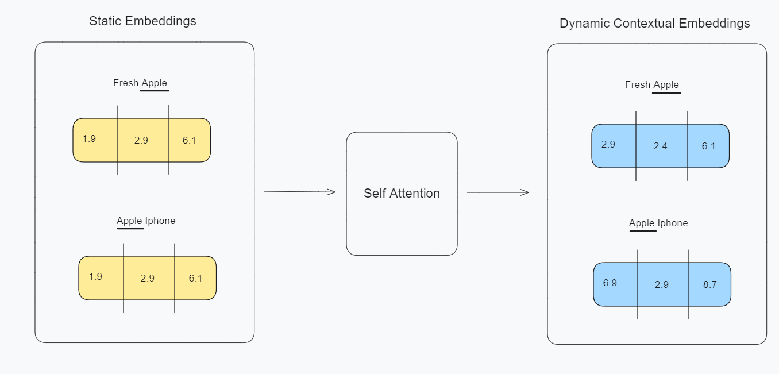
Contextual Embeddings
Contextual embeddings generate different vectors for the same word based on context.
Unlike Word2Vec or GloVe, meaning is not fixed per word.
Example: bank in “river bank” vs “bank account” gets different embeddings.
Generated using deep models like Transformers.
This enables true semantic understanding in modern NLP systems.
transformer_demo

Slide 12
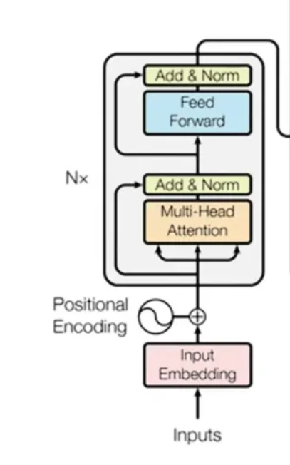
Encoder Architecture
The Encoder reads the entire input sequence at once.
It converts tokens into context-aware representations.
Uses self-attention to relate every word with every other word.
Positional encodings inject word order information.
Encoder outputs are rich embeddings used for understanding tasks.
Typical use-cases
Text classification
Named Entity Recognition
Semantic search
Sentence embeddings.
transformer_demo

Slide 13
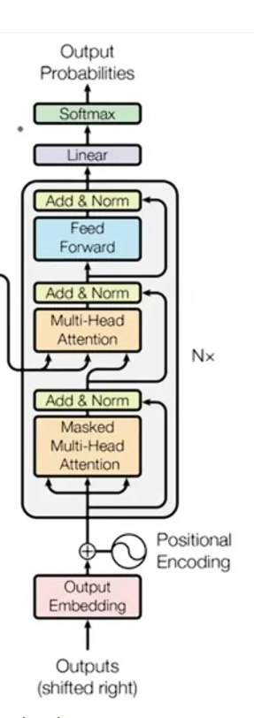
Decoder Architecture
The Decoder generates text token by token.
Uses masked self-attention to prevent seeing future tokens.
Attends to encoder outputs using cross-attention.
Learns how to generate coherent and fluent sequences.
Each output depends on previously generated tokens.
Typical use-cases
Text generation
Translation
Summarization
Chatbots
transformer_demo

Slide 14
BERT vs GPT
Aspect | BERT | GPT
Architecture | Encoder-only | Decoder-only
Attention Type | Bidirectional | Unidirectional (causal)
Training Objective | Masked Language Modeling | Next Token Prediction
Strength | Language understanding | Language generation
Reads Text | Entire sentence at once | Left-to-right only
Typical Tasks | Classification, NER, Search | Chat, Writing, Code
Output Style | Embeddings | Generated text

Slide 15
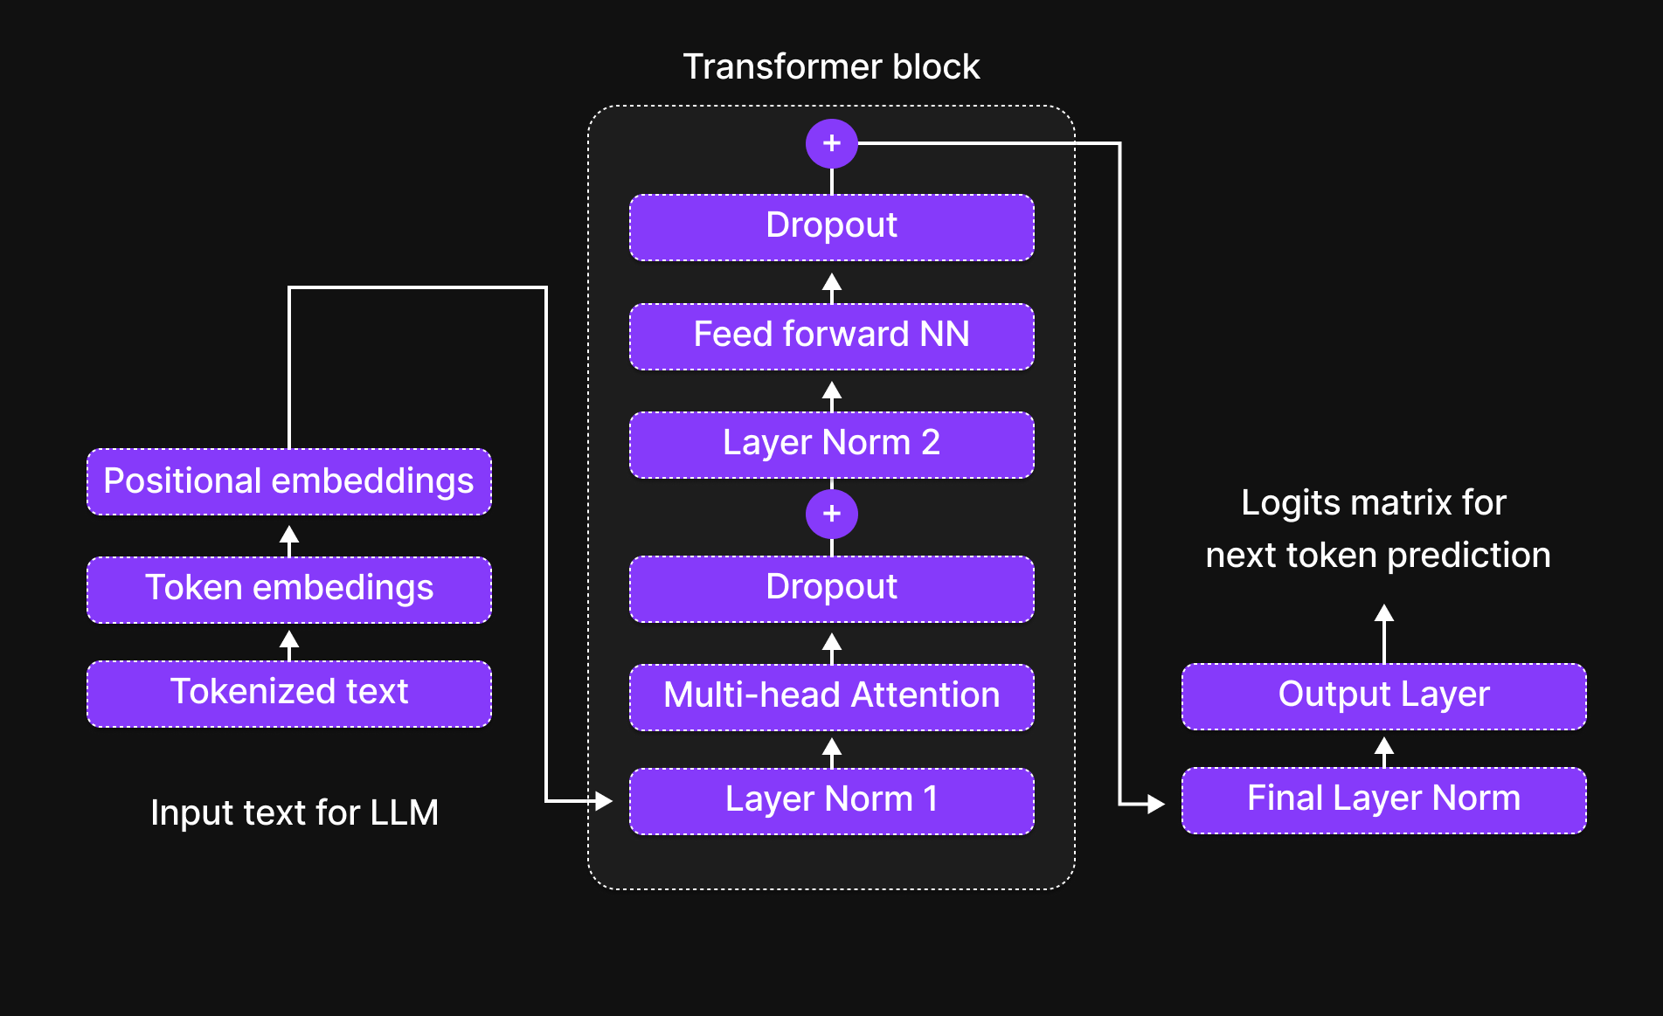
Forward Pass Overview
The forward pass is the complete journey of data from input tokens to output scores inside the Transformer.
Tokens are first converted into embeddings so that the model can work with numbers instead of text.
These embeddings pass through multiple layers that gradually refine the information.
Each layer improves the model’s understanding of context and relationships between words.
The final output of the forward pass is a set of raw scores called logits.

Slide 16
Logits and Next Token Prediction
Logits are numerical scores produced by the model for every possible token in the vocabulary.
A higher logit value means the model believes that token is more likely to come next.
Logits are not probabilities and cannot be interpreted directly by humans.
A softmax function converts logits into probabilities that sum to one.
The model uses these probabilities to choose the next token.

Slide 17
Text Generation
The model generates text one token at a time instead of generating a full sentence at once.
After each prediction, the new token is appended to the input sequence.
The expanded sequence is passed through the model again.
This process repeats until a stopping condition is met.
Continuous repetition creates fluent and coherent text.

Slide 18
Pipeline API vs Low-Level API
The pipeline API provides a simple interface that hides many implementation details.
It is ideal for demonstrations, prototypes, and learning experiments.
The low-level API exposes tokenization, model inputs, and outputs.
This gives developers more control over performance and behavior.
Production systems typically rely on low-level APIs.

Slide 19
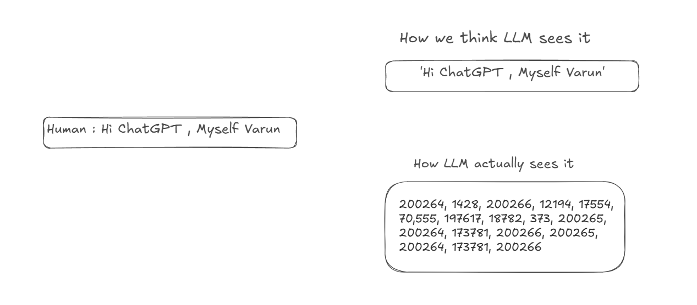
Text data : Through lense of LLM
Text is unstructured — no fixed format or schema
LLMs don’t "read" text like humans do
Text is first tokenized into smaller units (words, subwords)
Each token is converted into vectors (numerical form)
These vectors capture semantic meaning and context
Vectors flow through multiple layers in the model
Final output is based on pattern recognition in vector space

Slide 20
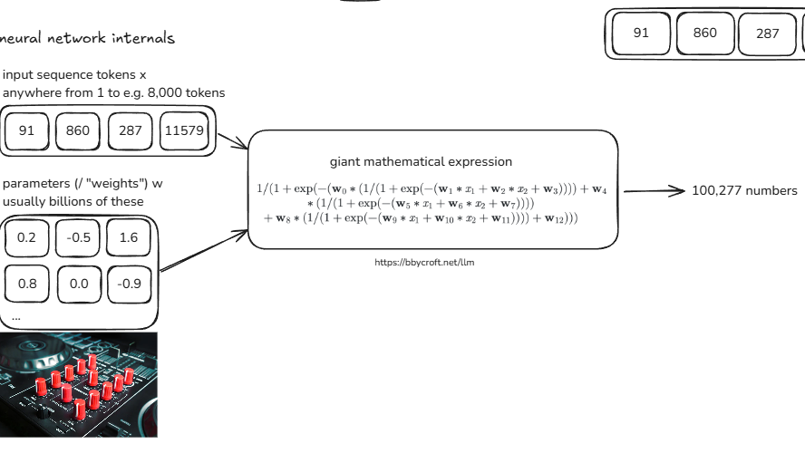
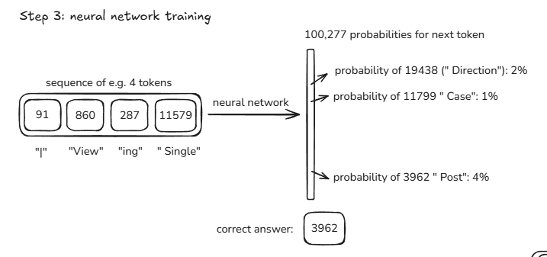
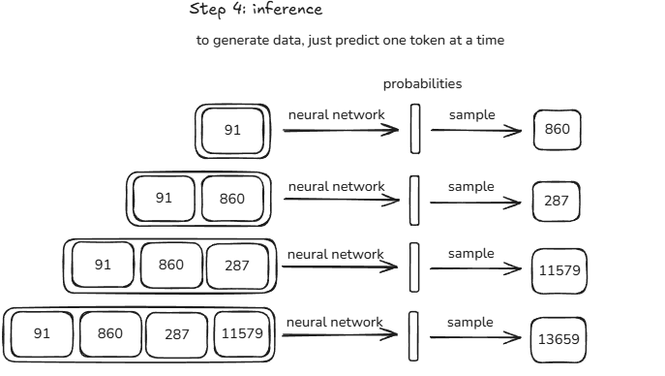
LLM Internals
Source : https://karpathy.ai/

Slide 21
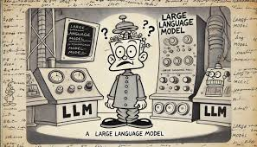
Interesting Facts about LLM
🧠 LLMs are not fact-checkers — they generate, not verify
🔁 Every response is unique — no fixed output for same input
🎭 They can hallucinate — may create fake info with confidence
➗ Don’t “calculate” like a calculator — rely on pattern memory
📚 Learn from massive data, not real-time experiences
🧮 Use statistical correlations, not reasoning or logic
🔧 Not intelligent by nature — just rigorously trained models

Slide 22
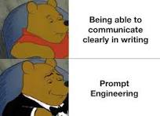
Prompt Engineering
🛠️ Acts as the instruction manual for LLMs
🎯 Helps steer output toward desired goals
📈 Boosts accuracy, relevance, and reliability of responses
🧩 Enables complex tasks like summarization, coding, Q&A
🔍 Small changes in prompts can lead to big output differences
🧠 Bridges human intent with model interpretation
⚙️ Foundation for building apps with LLMs (RAG, agents, etc.)

Slide 23
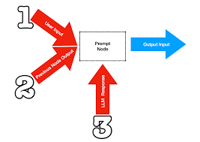
Prompt Drift
🔄 Prompt drift happens when model responses slowly go off-topic
🧠 LLM loses focus from the original instruction over long interactions
📉 Reduces output quality, accuracy, and coherence
📝 Caused by unclear prompts or extended dialogues
✅ Use few-shot examples, system prompts, or re-anchoring to fix it
🧩 Important in long-form chats, coding, and content generation
🔁 Reset or reframe the prompt periodically to regain control
Source : https://cobusgreyling.medium.com/prompt-drift-4873f37c43c8

Slide 24
Memory-Efficient Inference
Large language models require significant memory to run.
GPUs offer faster inference but are costly and limited.
CPUs are slower but more widely available.
Quantization reduces numerical precision to save memory.
Techniques like 8-bit loading enable efficient inference.

Slide 25
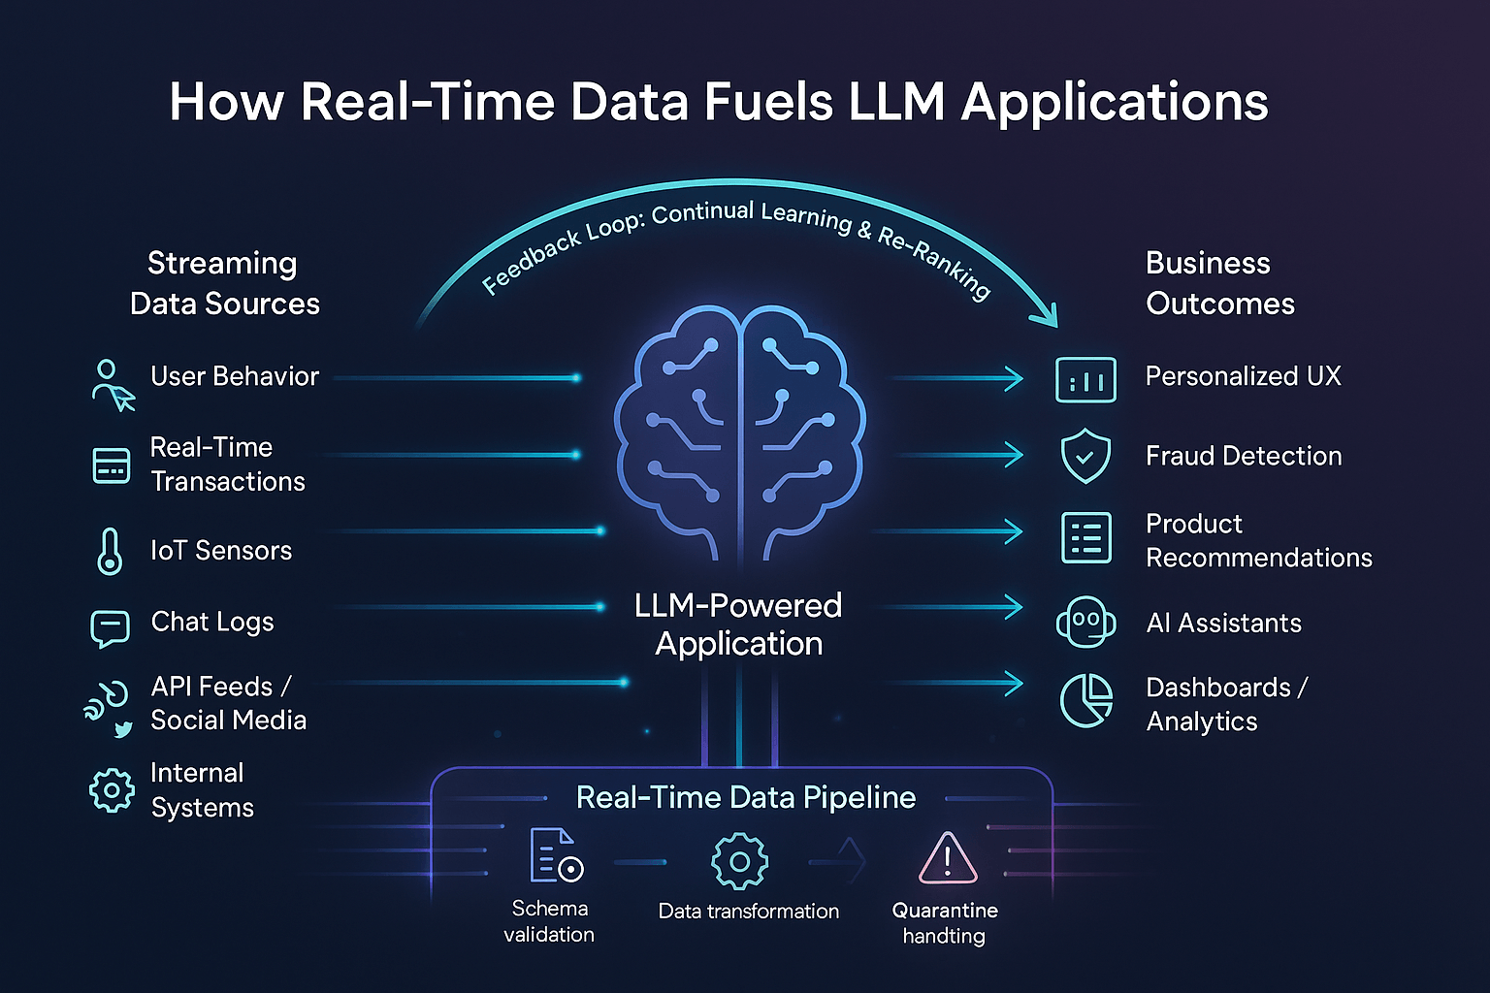
Real-World Use Cases

Slide 26

What Is Hugging Face
Hugging Face is an open-source platform for working with modern AI models.
It provides tools to use, train, and share Transformer models easily.
Hugging Face makes complex models accessible with simple APIs.
It is widely used in research, industry, and education.
Many popular LLMs are available through Hugging Face.

Slide 27

Hugging Face Model Hub
The Model Hub is a repository of pre-trained models.
Models are shared for tasks like text generation and classification.
Each model comes with documentation called a model card.
Users can download models with just a few lines of code.
This avoids training large models from scratch.

