Slide 1
Introduction to NLP
Varun Raste
Data Scientist

Slide 2
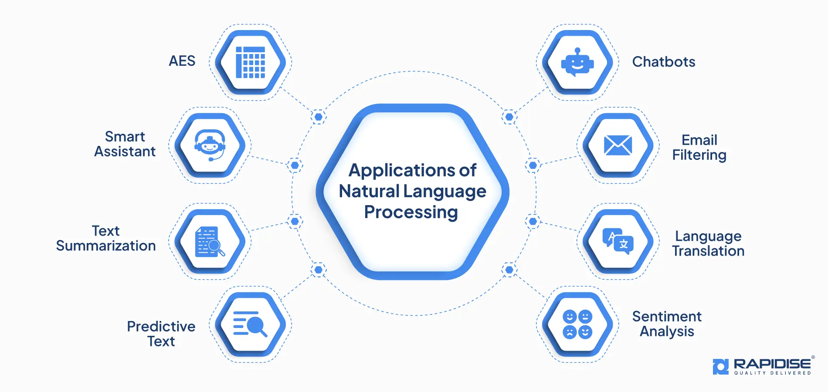
Introduction to NLP
Natural Language Processing (NLP) focuses on enabling machines to read, understand, and generate human language.
It deals with both written text and spoken language, making it central to modern AI systems.
NLP converts unstructured language data into structured representations.
Common applications include chatbots, search engines, recommendation systems, and document analysis.
The ultimate goal is to extract meaning, not just words.
All the images in PPT are taken from internet , author doesn’t claim rights*

Slide 3
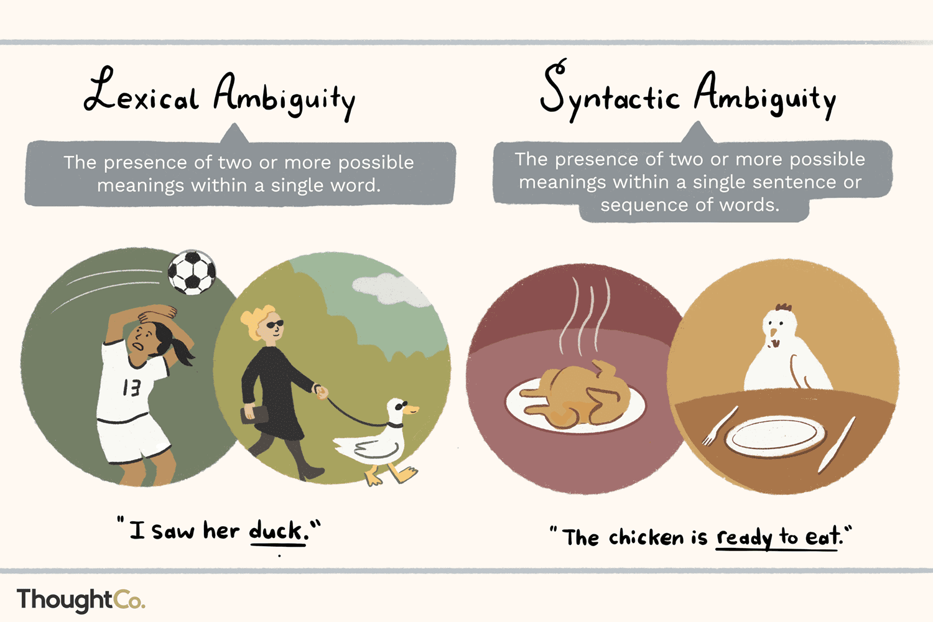
Why NLP Is Challenging
Human language is inherently ambiguous and context-driven.
The same word can mean different things depending on usage and sentence structure.
Grammar rules often break in real-world text such as social media or chats.
Sarcasm, slang, abbreviations, and spelling errors make NLP harder.
Machines must learn patterns without explicit linguistic rules.
All the images in PPT are taken from internet , author doesn’t claim rights*

Slide 4
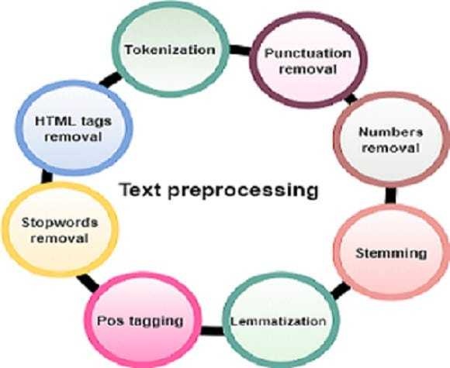
Text Processing
Real-world text data is noisy, inconsistent, and unstructured.
Preprocessing removes unnecessary elements like punctuation and extra spaces.
Text normalization ensures consistency across documents.
Stopword removal helps reduce low-information words.
Preprocessing improves model efficiency and accuracy.
All the images in PPT are taken from internet , author doesn’t claim rights*

Slide 5
Text Processing – Normalization , Stemming , lemmatization
Different forms of the same word increase feature space unnecessarily.
Normalization helps group similar words under a common representation.
This step directly impacts search quality and model performance.
Aspect | Stemming | Lemmatization
Core Idea | Cuts word suffixes mechanically | Uses linguistic rules & vocabulary
Output | May produce invalid words | Produces valid dictionary words
Speed | Very fast | Slower than stemming
Accuracy | Lower | Higher
Example | running → runn | running → run
Usage | Search, indexing | Semantic analysis, NLP models

Slide 6
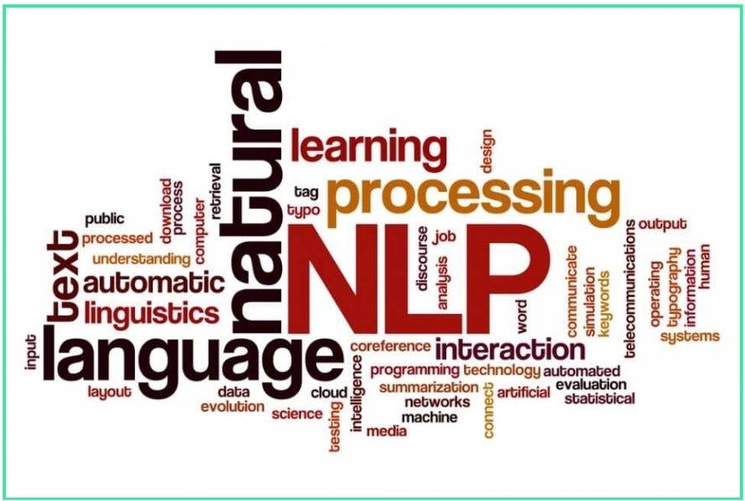
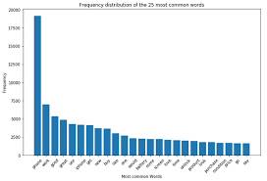
Text Visualization & EDA – Wordcloud & Top-K words
WordCloud visualizes word frequency intuitively.
Larger words indicate higher occurrence.
Useful for quick thematic understanding.
Best suited for exploration, not metrics.
Lists most common words numerically.
Helps identify stopwords and domain terms.
Enables frequency-based filtering decisions.
More precise than WordCloud.

Slide 7
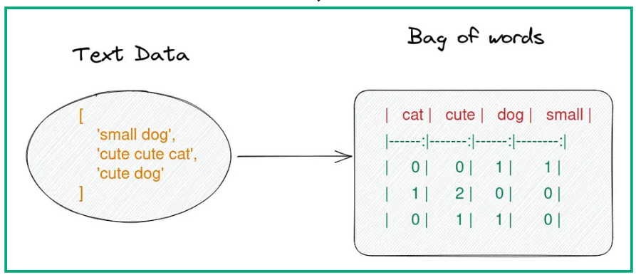
Vectorization - Bag of Words
Bag of Words converts text into numeric count vectors.
Each unique word becomes a feature column.
Word order and context are ignored.
Simple and interpretable representation.
Suffers from high dimensionality and sparsity.
All the images in PPT are taken from internet , author doesn’t claim rights*

Slide 8
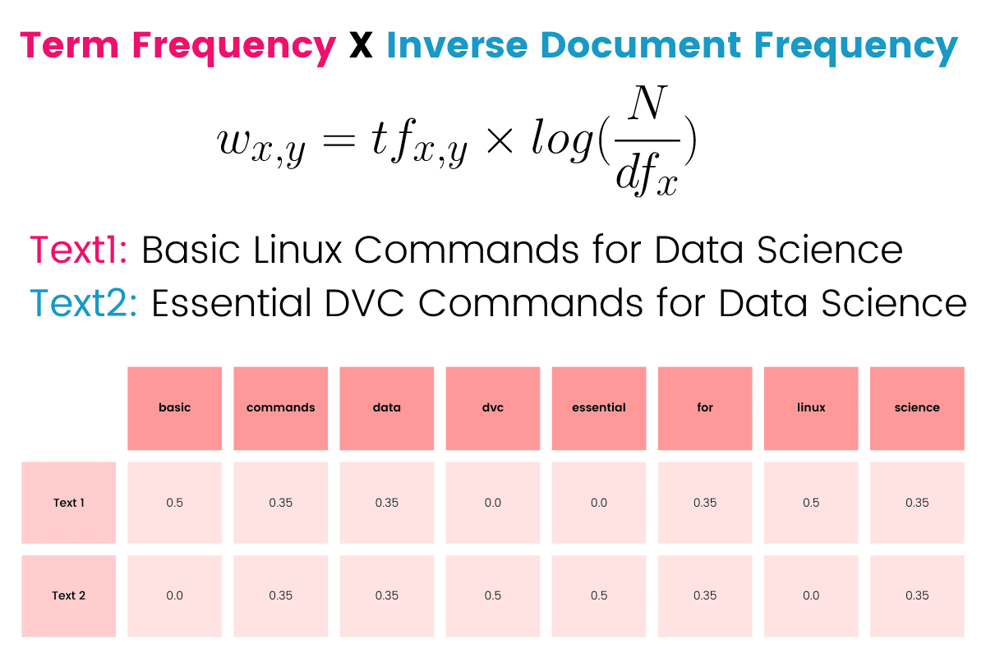
Vectorization - Term Frequency Inverse Document Frequency
TF measures how often a word appears in a document.
IDF reduces the weight of common words across corpus.
Combines local importance with global rarity.
Produces more informative features than BoW.
Widely used in information retrieval systems.
All the images in PPT are taken from internet , author doesn’t claim rights*

Slide 9
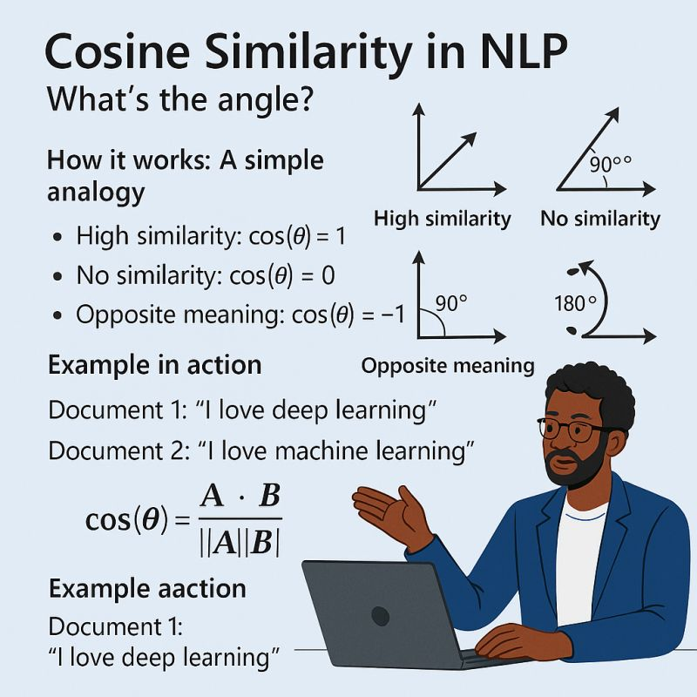
Cosine Similarity
Measures similarity based on angle between vectors.
Focuses on direction rather than magnitude.
Useful when vector lengths vary.
Common metric for text similarity tasks.
Works well with TF-IDF and embeddings.
All the images in PPT are taken from internet , author doesn’t claim rights*

Slide 10
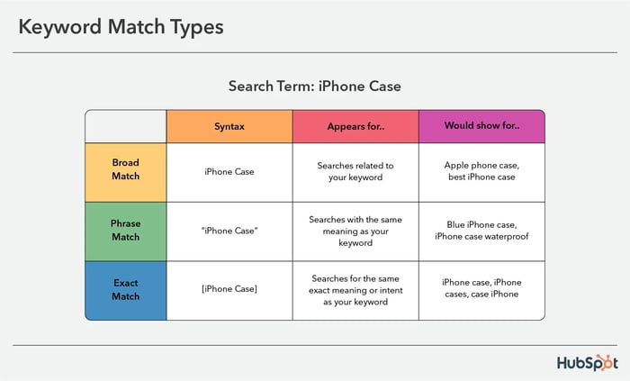
Search Methods –Keyword Search
Retrieves documents based on exact word matches.
Easy to understand and debug.
Performs well for structured queries.
Fails when synonyms or paraphrases are used.
Traditional search engines rely heavily on it.
All the images in PPT are taken from internet , author doesn’t claim rights*

Slide 11
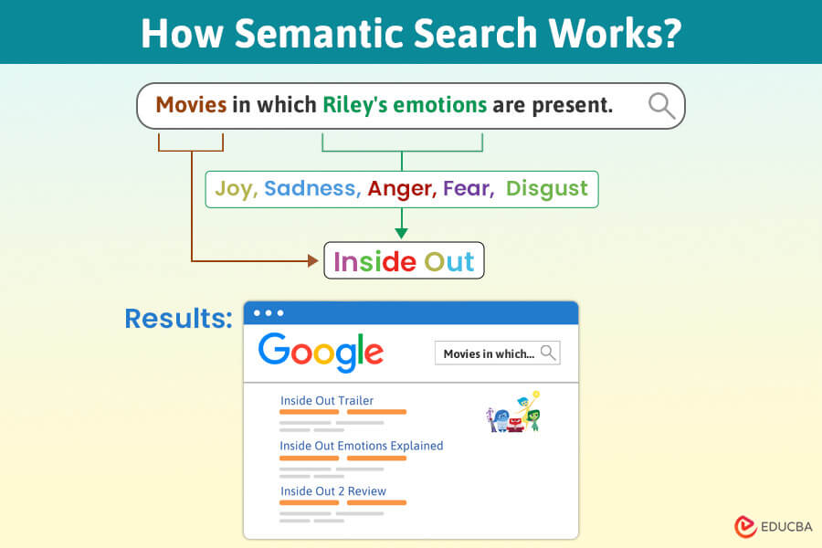
Search Methods –Semantic Search
Understands intent rather than exact wording.
Uses embeddings to capture semantic meaning.
Handles paraphrases and synonyms naturally.
Retrieves conceptually relevant results.
Used in modern AI-powered search systems.
All the images in PPT are taken from internet , author doesn’t claim rights*

Slide 12
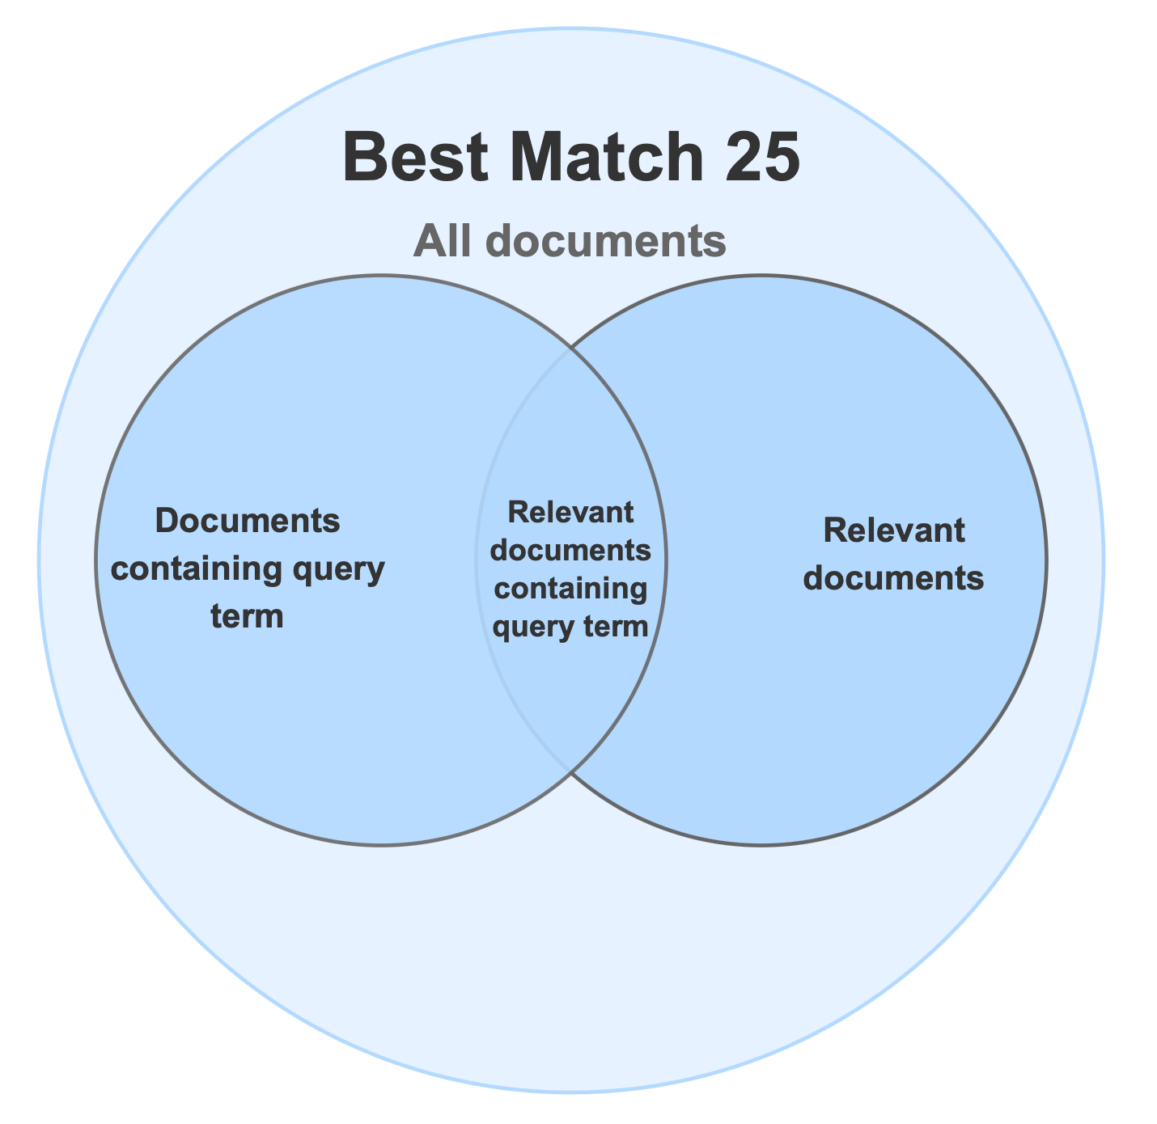
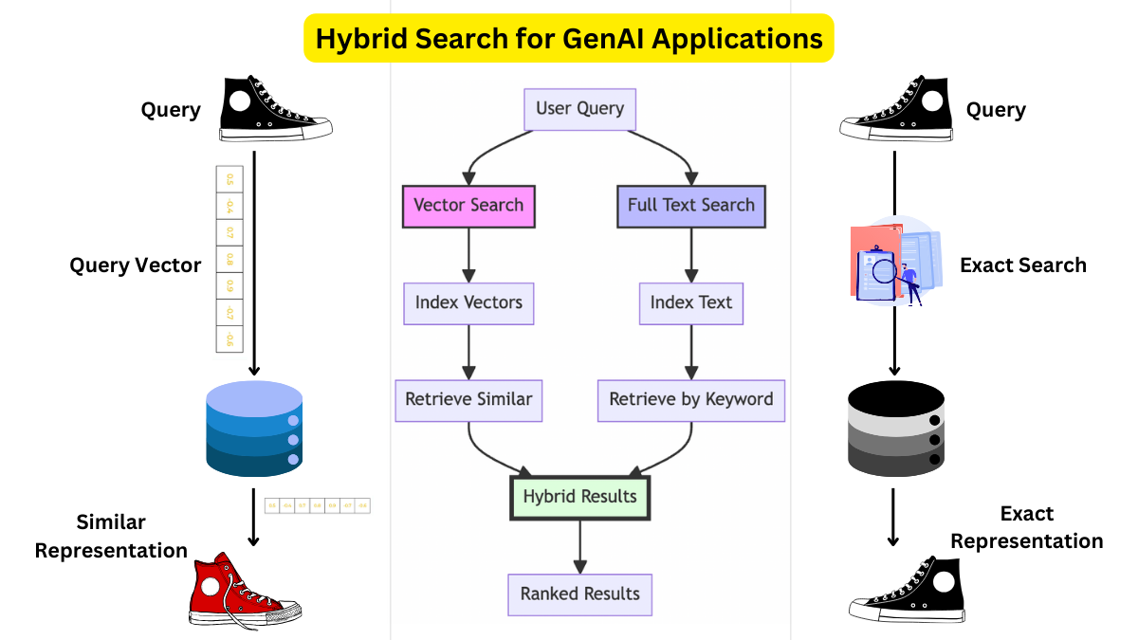
BM25 vs Hybrid Search
Aspect | BM25 Search | Hybrid Search
Search Type | Lexical (keyword-based) | Keyword + Semantic
Core Idea | Rank documents using term frequency and rarity | Combine exact match with meaning
Handles Synonyms | ❌ No | ✅ Yes
Handles Paraphrases | ❌ Poorly | ✅ Effectively
Uses Embeddings | ❌ No | ✅ Yes
Interpretability | High (easy to debug) | Medium (fusion logic involved)
Performance | Fast and efficient | Slightly slower but more accurate
Typical Use Case | Traditional search engines, logs | Modern AI search, RAG systems
All the images in PPT are taken from internet , author doesn’t claim rights*

