Slide 1
Innovative 3D morphology and shape fabrications applied to art forms on stone carvings

Slide 2
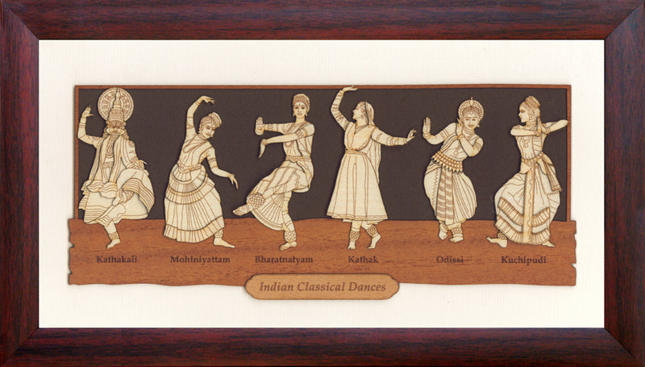
Epitome
The dance is one of the highest forms of representation of divine powers in Indian art and it is seen in the portrayal of Lord Shiva’s role as Nataraja, the lord of dance.
His dance symbolized an ecstasy of motion, the rhythm of which holds the universe together, perpetuating the cosmic activities of Creation, Preservation and Destruction.
The Indian aesthetic tradition implies close relationship between the visual and performing arts, particularly dance, which has always played an important part in India’s religious and social life.

Slide 3
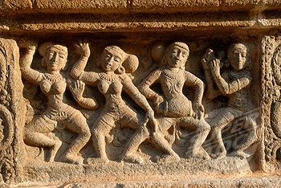
Case Study
Traditionally, Indian dance is a display of grace in motion and rhythm.
One can easily recognize the profound influence exerted by the classical art of dance on sculpture.
Frozen in stone, there is a display of movements of every part of the human frame from head to toe.
Working though rhythmic body swings, the dancer creates a vocabulary of hand gestures, of eyes as well as facial expressions for the portrayal of moods, emotions, sentiments, actions and ideas.
The medium for recording data and information in the present world is paper, magnetic tapes, hard disks, pen drives, etc., whereas about 700 years ago or more, palm leaves, stones carvings were used for this purpose.
These are recognized as the key to knowledge in diverse fields that have been passed through generations.
Countries like India, Thailand, Philippines, and Indonesia became home to large collections of palm leaf manuscripts and stone carvings.

Slide 4
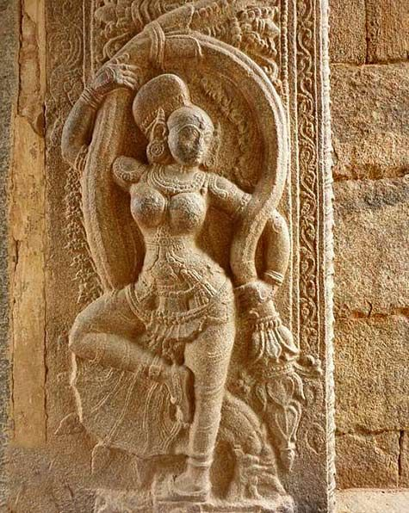
The dancer creates an ambience where the theme, the song and the rhythm all combine to produce a particular emotion or sentiment (rasa).
The stone-carving tradition in India is one of the richest in the world.
Guilds of masons and stone carvers have existed here since the 7th century B.C.
The skills were handed down as family lore from father to son, a practice prevalent in some parts of the country even today.

Slide 5
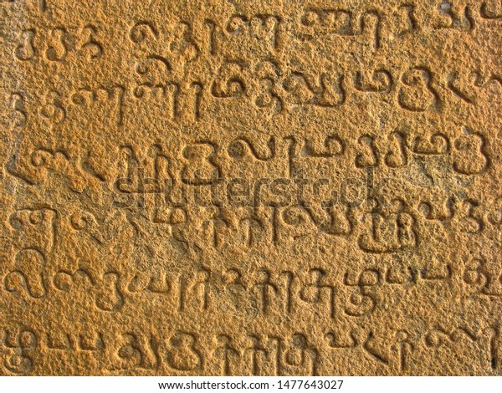
The Problem
All major temples of India-be it Puri, Konark, Khajuraho, Kailash Temple, or the Shore Temple at Mahabalipuram-illustrate the rich tradition of Indian stone carvings.
The sculptures found in the ancient and medieval temples of Bharatpur, Baroli, Ramgarh, Nagda, Ajmer, Chittor, Mandore, Jaisalmer, Bikaner, and Udaipur speak highly of the artistic skills of the Rajasthani stonecutters.
Today, it is in ruins but the grandeur of this masterpiece can still be experienced and enjoyed.
The popular South Indian recognized languages are Telugu, Tamil, Kannada, Malayalam, Tulu, etc. Telugu script, which is an offshoot of Brahmi script, has complex structural characteristics and makes character recognition a difficult task.

Slide 6
The Solution
It is high time for the UNESCO, UKRI, ICHR, Government of India, etc to take an important decision may be diplomatically sketched, to preserve and procure this culture and infinite treasure for the next generations to have a glimpse of this ancient marvels & attractions, in some manifested eternal forms, through rapidly evolutionary digitalization.
Using a 3D profiler to resolve the issues related to palm leaf manuscripts or the stone carvings may be expedited.
Recognition of compound characters is a challenging task to research.
To recognize the palm leaf text or stone carvings, novel concepts of 3D inherent feature, may be explored.

Slide 7
Previous / Existing Solution
Dr. Kimmels 3d Caricaturization (from 22 sec in the video)
Dr. Tao Jiang’s: 2D mesh generation followed by inflation to retrieve 3d content.

Slide 8
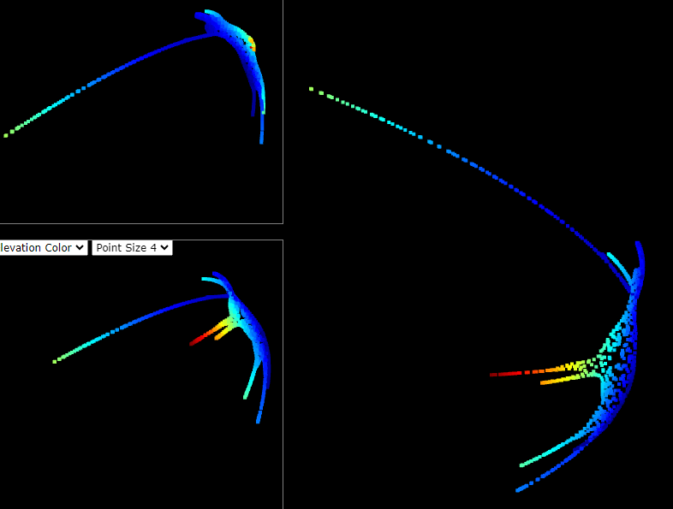
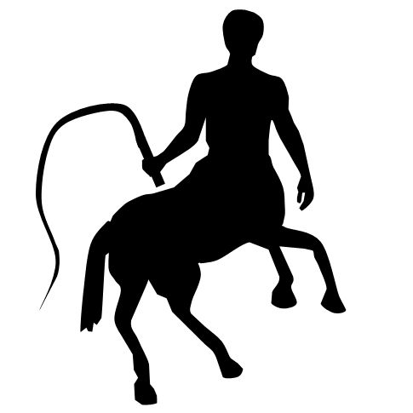
Pilots we conducted for the solution

Slide 9
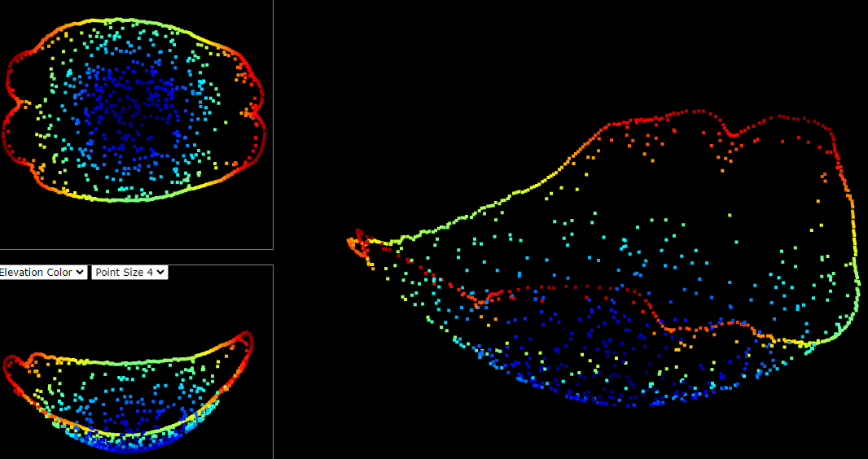
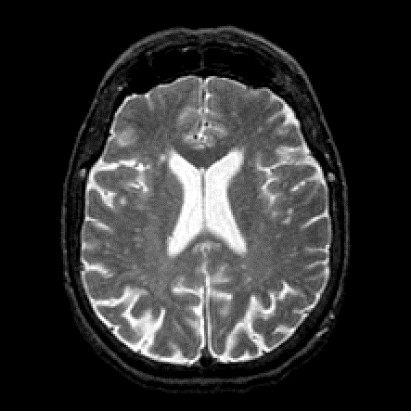
Competitive Advantage

