Slide 1
Loan Default Analysis
Using Exploratory Data Analysis to Identify Risky Loan Applicants

Slide 2
Problem Statement
The goal is to identify patterns that indicate loan default based on past data. This will help minimize credit loss by taking appropriate actions such as denying or adjusting loans for risky applicants.

Slide 3
Analysis Approach
1. Data Cleaning: Handle missing values and remove irrelevant columns.
2. Univariate Analysis: Explore distributions of key variables like loan status and interest rate.
3. Bivariate Analysis: Analyze relationships between loan status and variables such as loan amount and annual income.
4. Visualizations: Summarize key findings using plots.

Slide 4
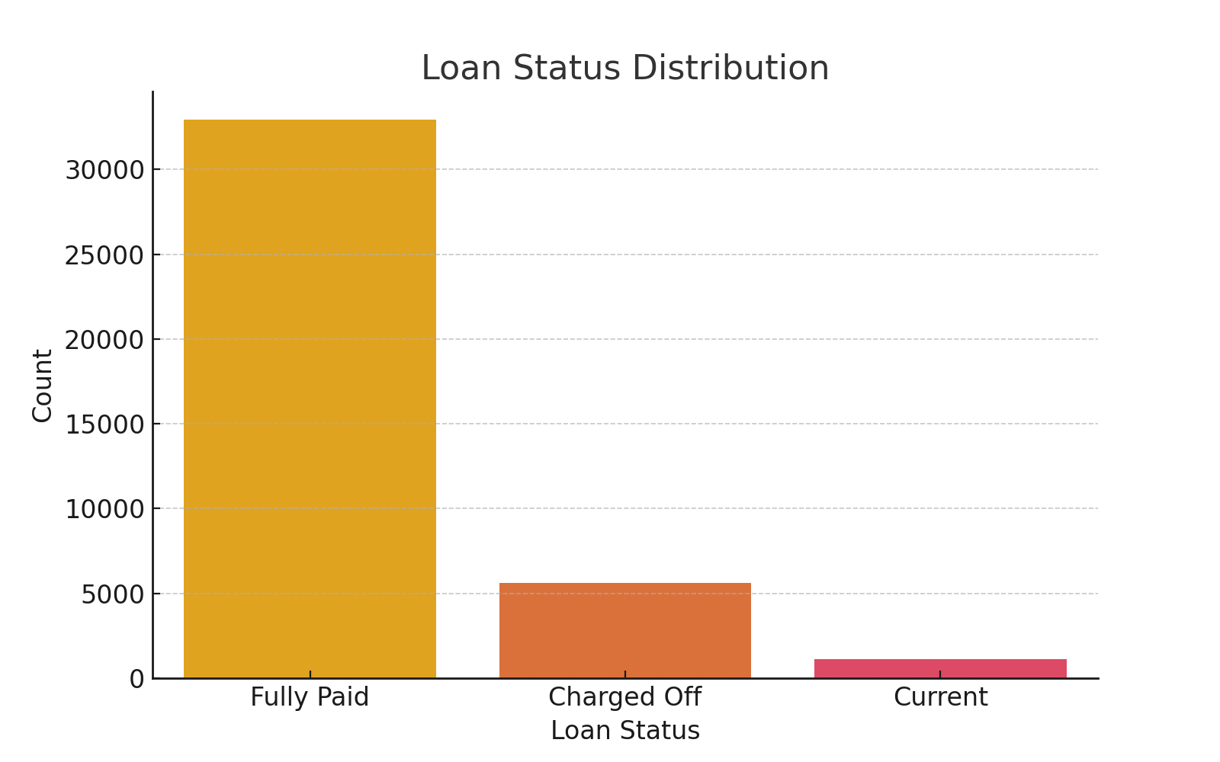
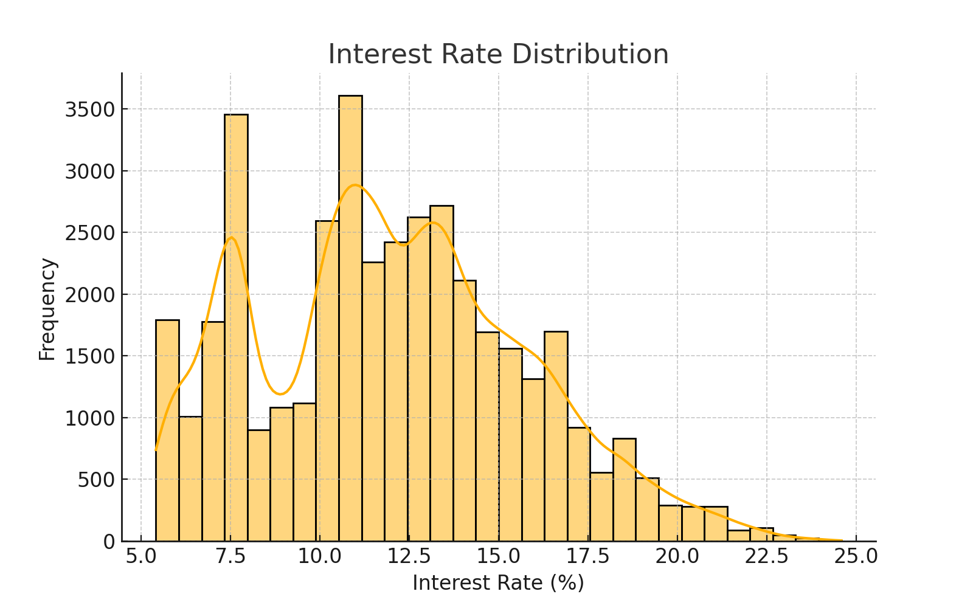
Univariate Analysis

Slide 5
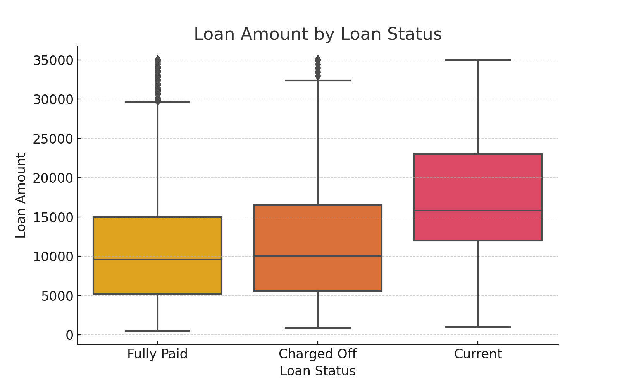
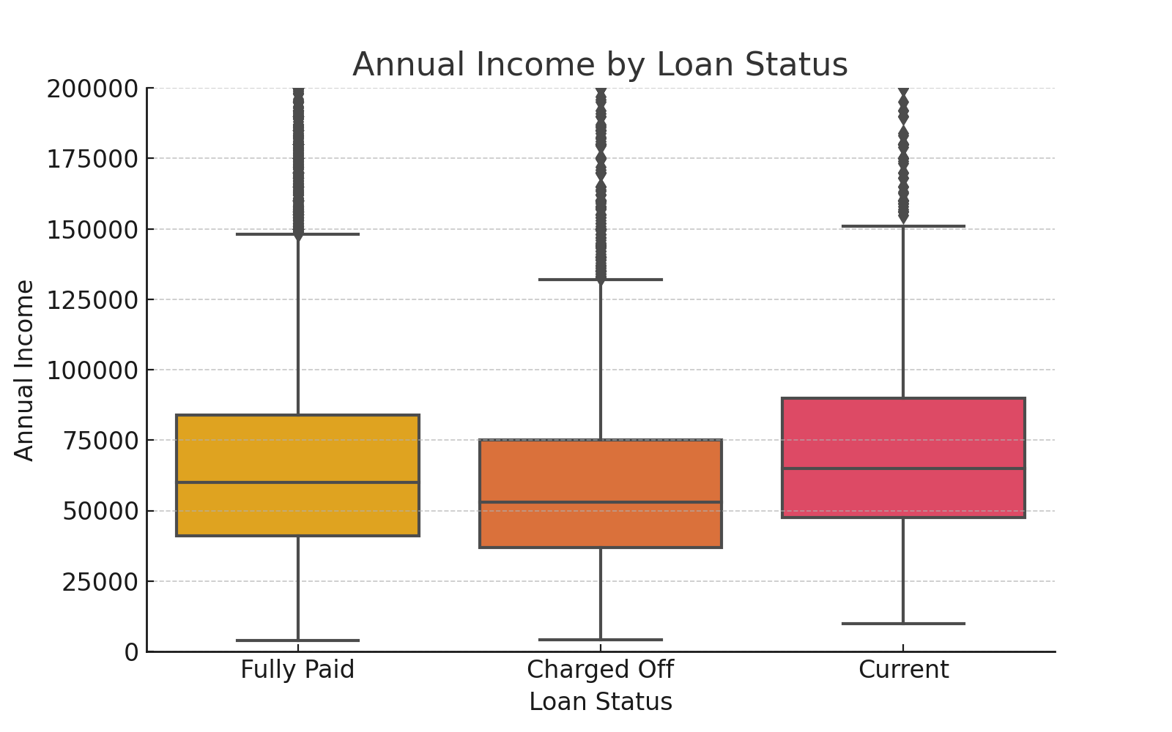
Bivariate Analysis

Slide 6
Key Findings
1. The majority of loans are 'Fully Paid', but a significant portion are 'Charged Off'.
2. Higher loan amounts tend to have a higher likelihood of being 'Charged Off'.
3. Borrowers with lower annual incomes are more likely to default on their loans.
4. Interest rates show variability but are generally higher for riskier loans.

