Slide 1
Media Analytics and Insights

Slide 2
1. Introduction
The Media Analytics ETL Platform processes and analyzes logs generated by set-top boxes to derive insights into viewer behavior and channel popularity. The system ingests raw log data in JSON format, enriches it with program metadata, and stores the processed data in Amazon Redshift for analysis. The pipeline is automated using Apache Airflow to ensure daily execution.
This document outlines the platform’s design, including the tools and technologies used, data flow, Redshift table schemas, scalability considerations, and future enhancements.

Slide 3
2. Data Pipeline Overview
2.1 Pipeline Objectives
Process raw log data and program metadata daily.
Clean, validate, and enrich the raw data.
Store processed data in Redshift for analytics and reporting.
Automate the entire pipeline using Airflow.
2.2 High-Level Architecture
Data Ingestion:
Source: JSON log files and program metadata in text format from the local filesystem.
Tool: Apache Spark reads and validates the data.
Data Transformation:
Enrichment: Join raw logs with program metadata.
Deduplication: Remove duplicate records.
Aggregation: Calculate minute-level viewership and user durations.
Data Loading:
Destination: Amazon Redshift with two tables:
Raw Data Table
Downstream Table
Automation:
Orchestrated by Airflow, which schedules and monitors the ETL pipeline daily.

Slide 4
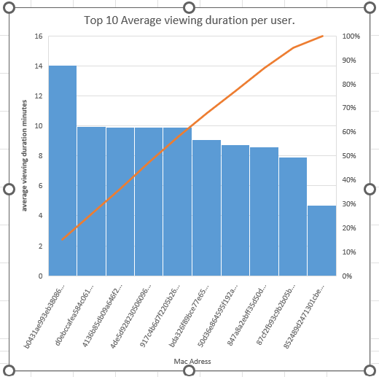
Average Viewing Duration per User
Insight:
This metric reveals user engagement on a per-user basis.
High average viewing durations may indicate deeply engaged viewers.

Slide 5
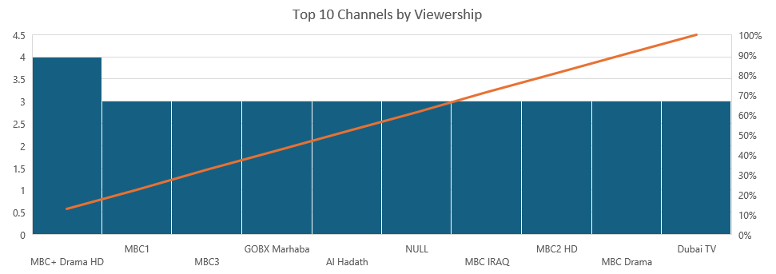
Top 10 Channels by Viewership
Highlights the top 10 channels based on total viewership seconds, providing key insights for advertisers and channel operators.

Slide 6
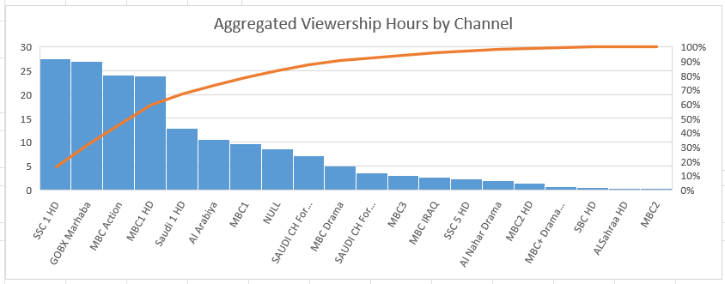
Aggregated Viewership Hours by Channel
Insight:
This table shows the total hours viewers spent watching each channel for a given date.
Channels like "SSC 1 HD" and "GOBX Marhaba" lead in total viewership hours, indicating high popularity.

Slide 7
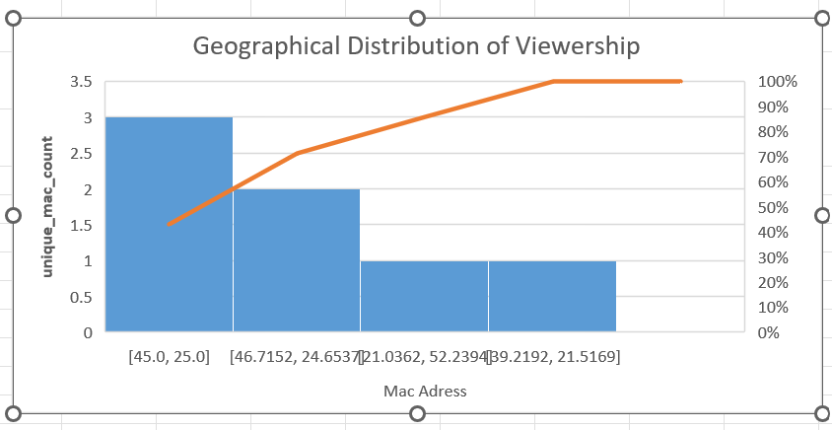

Geographical Distribution of Viewership

Slide 8
Insights
The location [45.0, 25.0] has the highest number of unique MAC addresses (3), indicating it might have the highest concentration of set-top boxes or viewers compared to other locations.
Locations like [46.7152, 24.6537] also show notable activity with 2 unique MAC addresses.
Potential Audience Density
Locations with higher counts (e.g., [45.0, 25.0] and [46.7152, 24.6537]) might be areas with a larger audience base or higher penetration of the service.
Areas with low counts (e.g., [21.0362, 52.2394] and [39.2192, 21.5169]) might need marketing efforts to expand viewership.
Content or Channel Popularity by Location:
By correlating this data with channel popularity (using another query), you could determine which channels or programs are most watched in specific geo-locations.

Slide 9
Network Optimization:
High-density locations like [45.0, 25.0] could require better network infrastructure to support the demand.
Low-density areas could indicate underutilized resources or regions with potential for expansion.

Slide 10
Geographical distribution of channels

Slide 11
Insights
Channel Reach Across Geo-Locations:
The channel "MBC+ Drama HD" has the widest reach, appearing in 4 distinct geo-locations, making it a standout channel in terms of geographical distribution
Other channels, like "MBC1", "MBC3", and "GOBX Marhaba", are widely available in 3 geo-locations each, indicating a good spread.
High Reach Channels:
Channels with higher geo-location numbers indicate broader regional penetration, making them prime candidates for advertising or promotional campaigns.

Slide 12
THANK YOU

