Slide 1
SQL Structured Query Language
Under Guidance:
Ms. AARTHI B
Presented By:
VARUNESH T

Slide 2
Project Titel:
Hotel Management
System

Slide 3
What is SQL?
Structured Query Language (SQL) is a domain-specific language used to manage data, especially in a relational database management system (RDBMS). It is particularly useful in handling structured data, i.e., data incorporating relations among entities and variables.

Slide 4
Why SQL?
It is essential for storing, updating, and retrieving large datasets efficiently, acting as the backbone for backend web development, business intelligence, and data analytics
Key reasons to use SQL include:
Handles huge data easily
Easy to read
Fast searching
Safe and reliable
Works with other tools

Slide 5
What is MySQL
MySQL is a widely used, open-source Relational Database Management System (RDBMS). It organizes and stores data in structured, table-like formats and uses Structured Query Language (SQL) to manage, query, and manipulate that data. It is the backbone for many dynamic websites and applications.
Key Features & Benefits
Open-Source
Cross-Platform

Slide 6
Why MySQL is important
It is used by web developers in websites for backend data storage and data processing solutions.
It is important to know about SQL for 2 reasons:
To get information from database.
To use it to create tables and organize data in database.

Slide 7
Project Objective
We need to focus on managing hotel operations efficiently by identifying regular customers to provide special offers and services, analyzing room booking details to improve room allocation and availability, and preparing payment and booking analysis reports for better decision-making. This helps the hotel improve its operational efficiency, maintain customer records systematically, enhance customer satisfaction, and provide better hospitality services. The system also ensures accurate management of room bookings, customer details, payments, and hotel staff operations, making the hotel more organized, customer-centric, and efficient in daily operations.

Slide 8
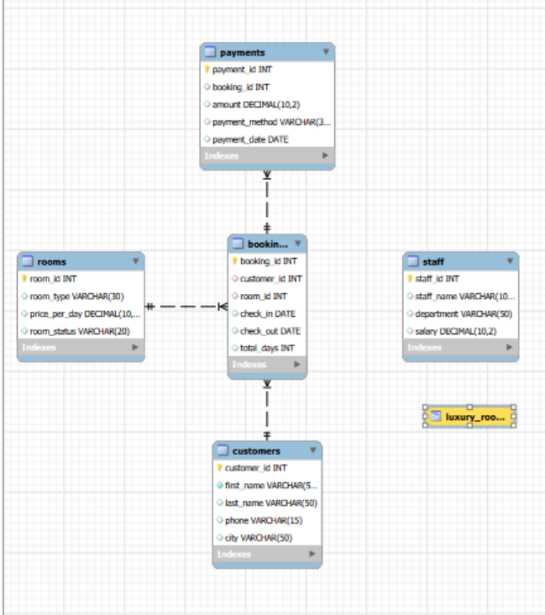
ENTITY RELATIONSHIP (ER) DIAGRAM

Slide 9
1. Write a query to create a Rooms table using suitable data types for room_id, room_type, price_per_day, and room_status. Implement primary key and check constraint so price must be greater than 0.
Query:
CREATE TABLE Rooms (
room_id INT PRIMARY KEY AUTO_INCREMENT,
room_type VARCHAR(30) NOT NULL,
price_per_day DECIMAL(10,2) CHECK(price_per_day > 0),
room_status VARCHAR(20)
);

Slide 10
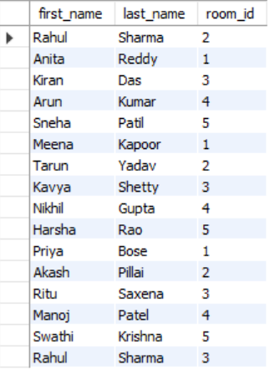
2. Write a query to display customers who booked rooms between room IDs 1 and 5 using Customers and Bookings tables.
Query:
SELECT c.first_name,
c.last_name,
b.room_id
FROM Customers c
INNER JOIN Bookings b
ON c.customer_id = b.customer_id
WHERE b.room_id BETWEEN 1 AND 5;
Output:

Slide 11

3. Write a query to identify total payments and total revenue from the Payments table.
Query:
SELECT COUNT(payment_id) AS total_payments,
SUM(amount) AS total_revenue
FROM Payments;
Output:

Slide 12
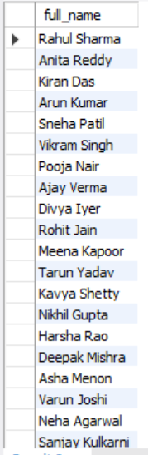
4. Write a query to display the full name of customers using CONCAT function.
Query:
SELECT CONCAT(first_name,' ',last_name) AS full_name
FROM Customers;
Output:

Slide 13
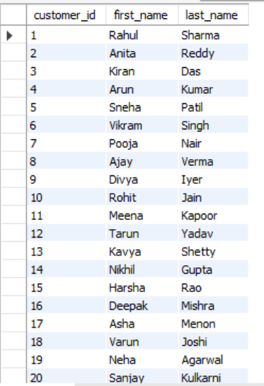
5. Write a query to display customers who have booked rooms using Customers and Bookings tables.
Query:
SELECT DISTINCT c.customer_id,
c.first_name,
c.last_name
FROM Customers c
INNER JOIN Bookings b
ON c.customer_id=b.customer_id
ORDER BY c.customer_id;
Output:

Slide 14
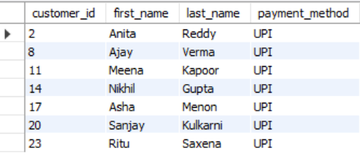
6. Write a query to identify customer first name and last name who paid using UPI.
Query:
SELECT c.customer_id,
c.first_name,
c.last_name,
p.payment_method
FROM Customers c
JOIN Bookings b
ON c.customer_id=b.customer_id
JOIN Payments p
ON b.booking_id=p.booking_id
WHERE p.payment_method='UPI’;
Output:

Slide 15
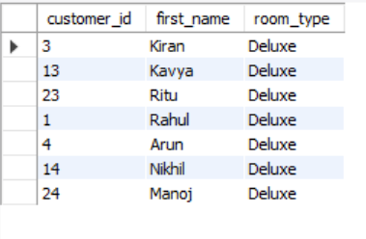
7. Write a query to identify customers who booked Deluxe rooms using GROUP BY and HAVING clause.
Query:
SELECT c.customer_id,
c.first_name,
r.room_type
FROM Customers c
JOIN Bookings b
ON c.customer_id=b.customer_id
JOIN Rooms r
ON b.room_id=r.room_id
GROUP BY c.customer_id,c.first_name,r.room_type
HAVING r.room_type='Deluxe’;
Output:

Slide 16

8. Write a query to identify whether hotel revenue crossed 100000 using IF clause.
Query:
SELECT SUM(amount) AS total_revenue,
IF(SUM(amount)>100000,
'Revenue Crossed 100000',
'Revenue Below 100000') AS revenue_status
FROM Payments;
Output:

Slide 17
9. Write a query to create and grant access to a new database user.
Query:
CREATE USER 'hoteladmin'@'localhost'
IDENTIFIED BY 'password';
GRANT ALL PRIVILEGES
ON *.* TO 'hoteladmin'@'localhost'
WITH GRANT OPTION;

Slide 18
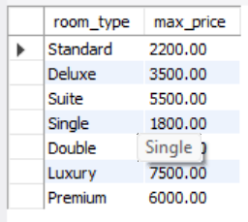
10. Write a query to find maximum room price for each room type.
Query:
SELECT room_type,
MAX(price_per_day) AS max_price
FROM Rooms
GROUP BY room_type;
Output:

Slide 19
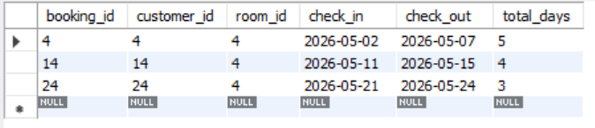
11. Write a query to improve search speed for Bookings table using INDEX.
Query:
CREATE INDEX idx_room_id
ON Bookings(room_id);
SELECT * FROM Bookings
WHERE room_id=4;
Output:

Slide 20
12. Write a query to display execution plan for Bookings table.
Query:
EXPLAIN
SELECT * FROM Bookings
WHERE room_id=4;
Output:

Slide 21
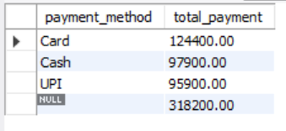
13. Write a query to calculate total payment by payment method using ROLLUP.
Query:
SELECT payment_method,
SUM(amount) AS total_payment
FROM Payments
GROUP BY payment_method WITH ROLLUP;
Output:

Slide 22
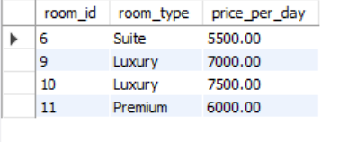
14. Write a query to create a view containing only luxury rooms.
Query:
CREATE VIEW luxury_rooms AS
SELECT room_id,
room_type,
price_per_day
FROM Rooms
WHERE price_per_day > 5000;
SELECT * FROM luxury_rooms;
Output:

Slide 23
15. Write a query to create a stored procedure that displays bookings between customer ID ranges.
Query:
DELIMITER //
CREATE PROCEDURE booking_range(
IN start_id INT,
IN end_id INT
)
BEGIN
SELECT c.first_name,
b.booking_id,
r.room_type
FROM Customers c
JOIN Bookings b
ON c.customer_id=b.customer_id
JOIN Rooms r
ON b.room_id=r.room_id
WHERE c.customer_id BETWEEN start_id AND end_id;
END //
DELIMITER ;
CALL booking_range(1,10);

Slide 24
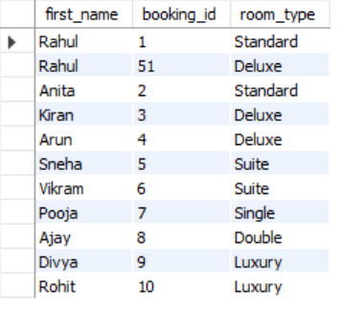
Output

Slide 25
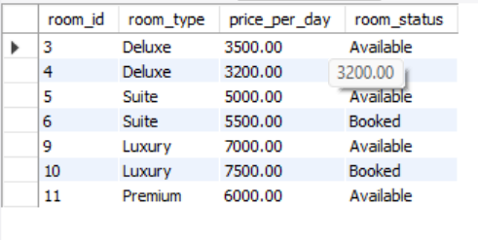
16. Write a stored procedure to display rooms whose price is greater than 3000.
Query:
DELIMITER //
CREATE PROCEDURE premium_rooms()
BEGIN
SELECT *
FROM Rooms
WHERE price_per_day > 3000;
END //
DELIMITER ;
CALL premium_rooms();
Output:

Slide 26
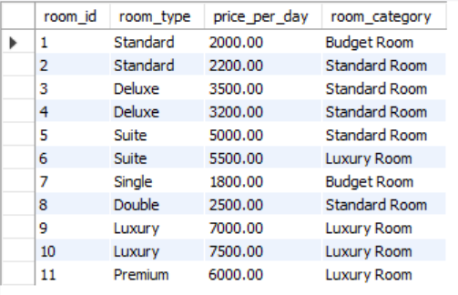
17. Write a query to categorize rooms into Budget, Standard, and Luxury categories.
Query:
SELECT room_id,
room_type,
price_per_day,
CASE
WHEN price_per_day <= 2000
THEN 'Budget Room'
WHEN price_per_day > 5000
THEN 'Luxury Room'
ELSE 'Standard Room'
END AS room_category
FROM Rooms;
Output:

Slide 27
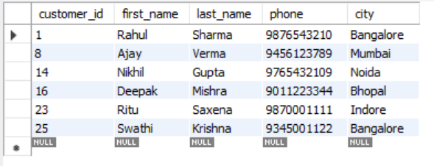
18. Write a query to extract customers whose last name ends with 'a'.
Query:
SELECT *
FROM Customers
WHERE last_name LIKE '%a’;
Output:

Slide 28
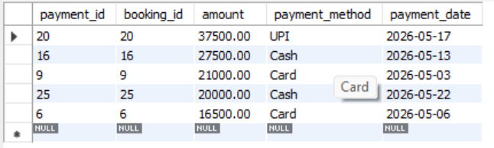
19. Write a query to display top 5 highest payments.
Query:
SELECT *
FROM Payments
ORDER BY amount DESC
LIMIT 5;
Output :

Slide 29
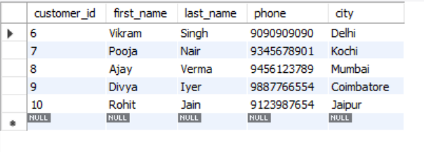
20. Write a query to display customer records using LIMIT and OFFSET.
Query:
SELECT *
FROM Customers
LIMIT 5 OFFSET 5;
Output:

