Slide 1
User-based nearest-neighbor collaborative filtering
Example
A database of ratings of the current user, Alice, and some other users is given:
Determine whether Alice will like or dislike Item5, which Alice has not yet rated or seen
 | Item1 | Item2 | Item3 | Item4 | Item5
Alice | 5 | 3 | 4 | 4 | ?
User1 | 3 | 1 | 2 | 3 | 3
User2 | 4 | 3 | 4 | 3 | 5
User3 | 3 | 3 | 1 | 5 | 4
User4 | 1 | 5 | 5 | 2 | 1

Slide 2
User-based nearest-neighbor collaborative filtering
Some first questions
How do we measure similarity?
How many neighbors should we consider?
How do we generate a prediction from the neighbors' ratings?
 | Item1 | Item2 | Item3 | Item4 | Item5
Alice | 5 | 3 | 4 | 4 | ?
User1 | 3 | 1 | 2 | 3 | 3
User2 | 4 | 3 | 4 | 3 | ?
User3 | 3 | 3 | 1 | 5 | 4
User4 | 1 | 5 | 5 | 2 | 1

Slide 3
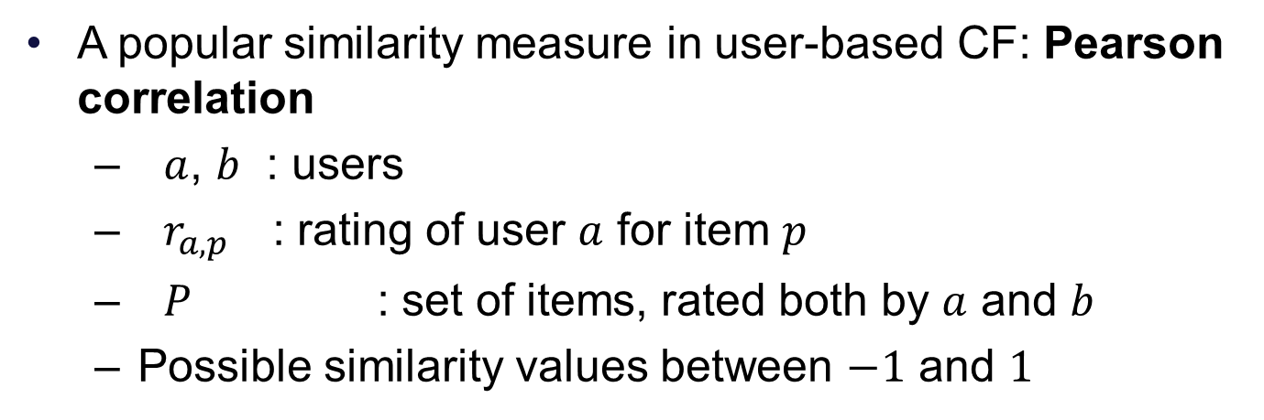
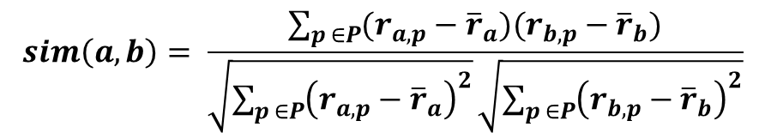
Measuring user similarity
 | Item1 | Item2 | Item3 | Item4 | Item5
Alice | 5 | 3 | 4 | 4 | ?
User1 | 3 | 1 | 2 | 3 | 3
User2 | 4 | 3 | 4 | 3 | 5
User3 | 3 | 3 | 1 | 5 | 4
User4 | 1 | 5 | 5 | 2 | 1
sim = 0,85
sim = 0,00
sim = 0,70
sim = -0,79

Slide 4
Pearson correlation
Takes differences in rating behavior into account
Works well in usual domains, compared with alternative measures
such as cosine similarity

Slide 5
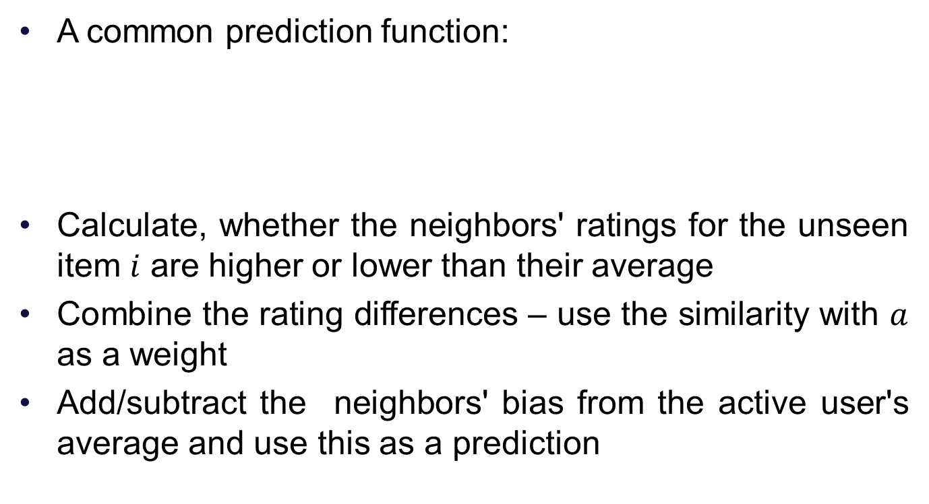
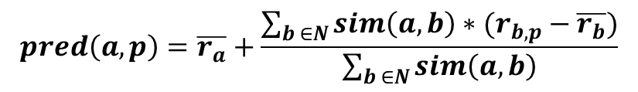
Making predictions

Slide 6
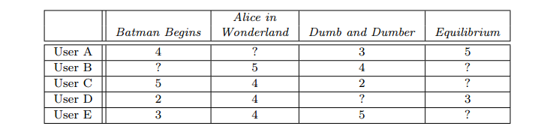
Example
Neighborhood of 2 (A and D)
C’s mean = 3.667
S(C,A) = 0.832
S(C,D)=-0.515

