Slide 1
A Faster Construction of Frequency Difference Consensus Trees
Varun Gupta

Slide 2
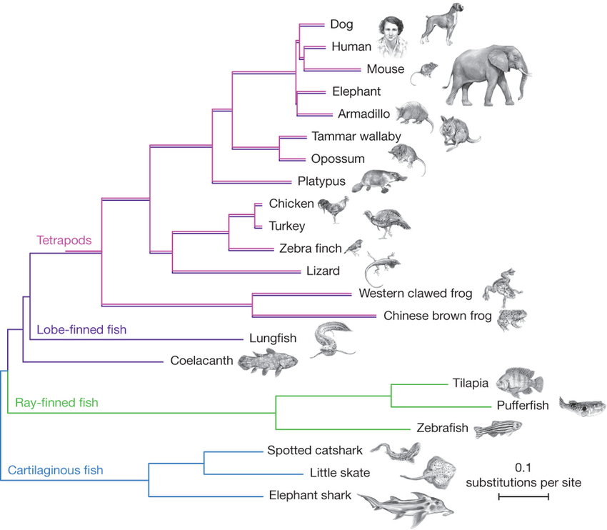
Phylogenetic tree
Notes:
Phylogenetic tree of jawed vertebrates. Note the root on the left, how every node has at least two children and the taxa at the leaves
The problem we’re concerned with is that given a bunch of phylogenetic trees with the same leafsets, how to we build a master tree or a consensus tree that summarises the branching information in all these trees.
There are a variety of rules following which we can come up with consensus trees, but we will be focusing on the frequency difference consensus tree.

Slide 3
Clusters
a
a
d
e
b
c
b
c
d
e
Notes:
Non empty subsets of the leafset are clusters
Every node in a phylogenetic tree has a cluster associated with it – give example from tree
{c, d, e} is a cluster, but does not belong to this tree
Clusters are compatible if – one is a subset of the other or they’re disjoint. That is, they shouldn’t overlap. So {a, b} is incompatible with T1 ({b, c}).
The two tree are incompatible because {a, b, c} is incompatible with {b, c, d, e}

Slide 4
Frequency difference consensus tree
2
1
2
2
1
1
e
a
2
2
2
2
a
b
c
d
e
a
d
e
d
2
b
c
c
b
c
d
e
a
b
a
b
c
d
e
Notes:
The four trees shown are the input trees
We assign a weight to each cluster equal to the number of trees it occurs in
The {a, b} cluster appears in trees 1 and 3
The {c, d, e} cluster only appears in tree 1
The {b, c} cluster appears in trees 2 and 4
Then all the other weights
A cluster appears in the fqd consensus tree if its weight is larger than all the clusters it is incompatible with
So w({a, b}) = 2 and w({b, c}) = 2, hence neither of them are in the fdct
{a, b, c} is incompatible with {c, d, e} and {b, c, d, e}, but both of those have smaller weight, so it appears

Slide 5
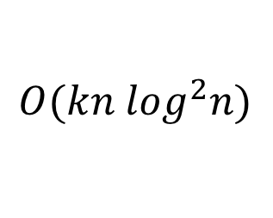
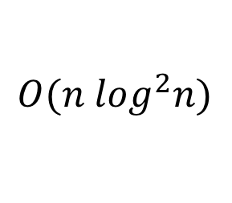



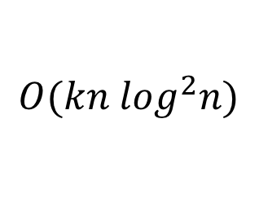
Frequency_Difference
$$O(f\left(n,k\right)+k∙g\left(n\right))$$
$$O(kn \log^{2}n)$$
Labelling
Filter_Clusters
$$f\left(n,k\right)$$
$$g\left(n\right)$$
$$O(kn \log^{2}n)$$
$$O(n \log^{2}n)$$
Notes:
Literature gives us an algorithm that splits the process of constructing this tree into two main bottlenecks – labelling and filtering. Labelling gives each cluster a weight, as seen on the previous slide. Filtering will be described in due course. It is further shown that the runtime of FD can be written as f(n) + k g(n) where f(n) = runtime of Labelling and g(n) = runtime of Filtering. The best known solution to the labelling step runs in kn log²n and the best known solution to filtering runs in n log²n, giving an overall runtime of kn log²n. The algorithms we have come up with solve these in kn log n and n log n time, giving an overall runtime of kn log n.

Slide 6
Labelling
Input: A set of trees {T₁, T₂, ..., T_{k}} with identical leafsets
Output: Every node is labelled such that nodes associated with the same cluster have the same labels and for any node u, id(u) is in the range [1, 2k |leafset|]

Slide 7
T₁:
7,6
T₂:
7,6
6,5
8,7
4,8
5,1
5,1
4,4
5,0
3,2
4,4
c
g
e
g
f
1,1
a
b
c
h
d
b
d
h
f
a
e
T₁|L’:
T₁|L’’:
T₂|L’:
T₂|L’’:
7
6
7
6
5
6
1
5
8
4
7
8
e
d
1
2
3
4
2
3
4
5
3
1
2
3
4
a
b
c
d
f
g
h
c
e
f
g
h
1
2
a
b
Notes:
Demonstrated on the above two trees
These trees have leafsets {a … h}
We divide this into two equal halves – {a … d} and {e … f}
For each of these we construct “restricted subtrees”
Take T₁ | L’. Contains all nodes that are lcas of these leaves, arranged in the same manner as the original tree.
Similarly we construct T₂ | L’.
We then recursively label these trees
Similarly, L’’ trees and labelling is done
Now we need to label T₁ and T₂
The {a, b} node is associated with the {a, b} node in T₁ | L’. It doesn’t have any leaves from L’’, so for that we give it 0. Thus we have created a label for this node, and this label uniquely identifies the leafset of the node.
Similarly for {c, d, f, g, h}
And label all of them
What’s left is to radix sort these pairs so that we can assign new ids.
Finally, note that we can counting sort the resulting ids to find the weight of each node.

Slide 8

Labelling
$$T\left(kn\right)=2T\left(\frac{kn}{2}\right)+O\left(kn\right)$$
$$T\left(kn\right)=O(kn\log{n})$$

Slide 9
Filter_Clusters
Input: Trees T_{A} and T_{B} with identical leafsets
Output: Set of nodes in T_{A} that don’t satisfy the frequency difference condition – these will be deleted.

Slide 10
Incompatibility
i
C = {a, b, c, f, g, h}
d
l
c
e
f
g
h
j
k
a
b
Notes:
We take the cluster {a, b, c, f, g, h} and compare it with the given tree. Notice that the clusters associated with the circled nodes are subsets of C. Such nodes for subsets of the tree. This allows us to define maximal compatible subtrees, which are subtrees that have no parent which is also a subset of C. These subtrees are identified by their roots, as circled.
Also notice that the root of the tree is the lca of the cluster as a whole.
Then the nodes in rectangles, which are proper ancestors of the rootsOfSubtrees and proper descendants of the lca are all incompatible with C

Slide 11
Filter_Clusters
i
f
d
l
b
g
c
e
f
g
h
j
k
c
j
l
k
i
e
h
a
b
a
d
Notes:
We take the cluster {a, b, c, f, g, h} and compare it with the given tree. Notice that the clusters associated with the circled nodes are subsets of C. Such nodes for subsets of the tree. This allows us to define maximal compatible subtrees, which are subtrees that have no parent which is also a subset of C. These subtrees are identified by their roots, as circled.
Also notice that the root of the tree is the lca of the cluster as a whole.
Then the nodes in rectangles, which are proper ancestors of the rootsOfSubtrees and proper descendants of the lca are all incompatible with C

Slide 12
Filter_Clusters
The incompatible nodes are stored in a Binary Tree
We make O(n) additions and O(n) deletions to this is BT
Each of these operations costs O(log n) time
Notes:
We take the cluster {a, b, c, f, g, h} and compare it with the given tree. Notice that the clusters associated with the circled nodes are subsets of C. Such nodes for subsets of the tree. This allows us to define maximal compatible subtrees, which are subtrees that have no parent which is also a subset of C. These subtrees are identified by their roots, as circled.
Also notice that the root of the tree is the lca of the cluster as a whole.
Then the nodes in rectangles, which are proper ancestors of the rootsOfSubtrees and proper descendants of the lca are all incompatible with C

Slide 13
Filter_Clusters
When recursing into side trees, we restrict T_{B} to the leafset of the side tree to ensure size of the trees is comparable
Weight information is maintained using dummy nodes
This takes O(n) time total for all side trees, given O(n log n) preprocessing time before Filter_Clusters is called
Notes:
We take the cluster {a, b, c, f, g, h} and compare it with the given tree. Notice that the clusters associated with the circled nodes are subsets of C. Such nodes for subsets of the tree. This allows us to define maximal compatible subtrees, which are subtrees that have no parent which is also a subset of C. These subtrees are identified by their roots, as circled.
Also notice that the root of the tree is the lca of the cluster as a whole.
Then the nodes in rectangles, which are proper ancestors of the rootsOfSubtrees and proper descendants of the lca are all incompatible with C

Slide 14

Filter_Clusters
$$T\left(n\right)=O\left(n log n\right)+\sum_{τ∈sideTrees(T_{A})}{T(\left|τ\right|)}$$
$$T\left(n\right)=O(n\log^{2}n)$$

Slide 15
Filter_Clusters
i
f
d
l
b
g
c
e
f
g
h
j
k
c
j
l
k
i
e
h
a
b
a
d
Notes:
We take the cluster {a, b, c, f, g, h} and compare it with the given tree. Notice that the clusters associated with the circled nodes are subsets of C. Such nodes for subsets of the tree. This allows us to define maximal compatible subtrees, which are subtrees that have no parent which is also a subset of C. These subtrees are identified by their roots, as circled.
Also notice that the root of the tree is the lca of the cluster as a whole.
Then the nodes in rectangles, which are proper ancestors of the rootsOfSubtrees and proper descendants of the lca are all incompatible with C

Slide 16
Filter_Clusters
We only delete each node once over all recursive calls
However, a single recursive call may have O(n) insertions
Thus we use a Brodal queue – O(1) inserts, O(log n) deletes
Ignoring the cost of deletes, processing time for a single recursive call is now O(n)
Notes:
We take the cluster {a, b, c, f, g, h} and compare it with the given tree. Notice that the clusters associated with the circled nodes are subsets of C. Such nodes for subsets of the tree. This allows us to define maximal compatible subtrees, which are subtrees that have no parent which is also a subset of C. These subtrees are identified by their roots, as circled.
Also notice that the root of the tree is the lca of the cluster as a whole.
Then the nodes in rectangles, which are proper ancestors of the rootsOfSubtrees and proper descendants of the lca are all incompatible with C

Slide 17
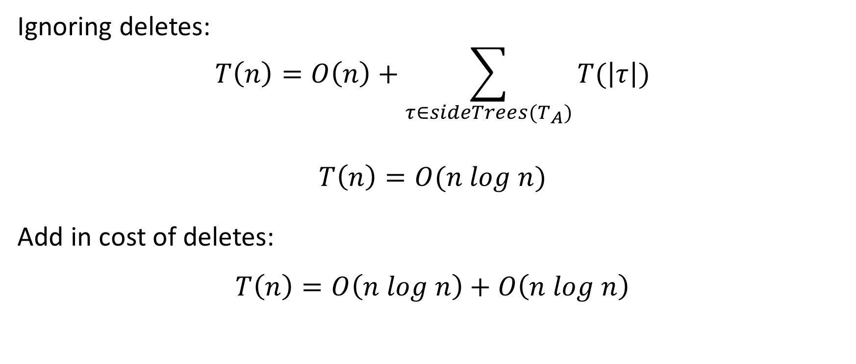
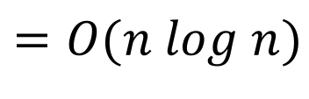
Filter_Clusters
Ignoring deletes:
$$T\left(n\right)=O\left(n\right)+\sum_{τ∈sideTrees(T_{A})}{T(\left|τ\right|)}$$
$$T\left(n\right)=O(n log n)$$
Add in cost of deletes:
$$T\left(n\right)=O\left(n log n\right)+O\left(n log n\right)$$
$$=O(n log n)$$

Slide 18

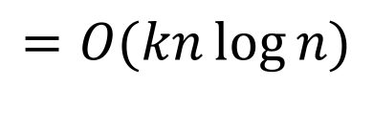
Frequency_Difference
$$T\left(n\right)=O\left(kn\log{n}+k∙n\log{n}\right)$$
$$=O(kn\log{n})$$

Slide 19
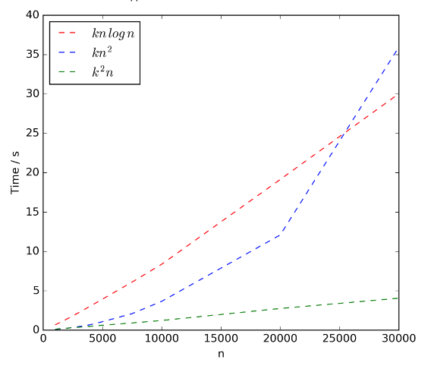
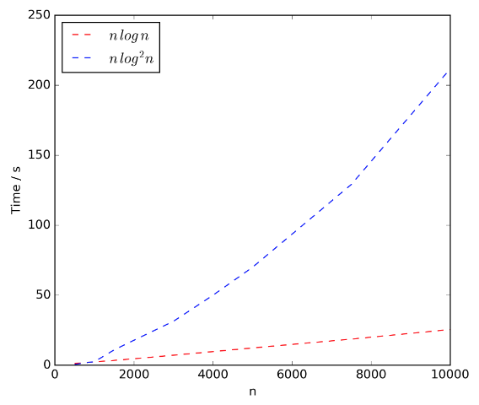
Experimental Results
Labelling
Filter_Clusters

Slide 20


Slide 21
References
Amemiya, Chris T., et al. "The African coelacanth genome provides insights into tetrapod evolution." Nature 496.7445 (2013): 311.

