Slide 1
A Faster Construction of Frequency Difference Consensus Trees
Varun Gupta

Slide 2
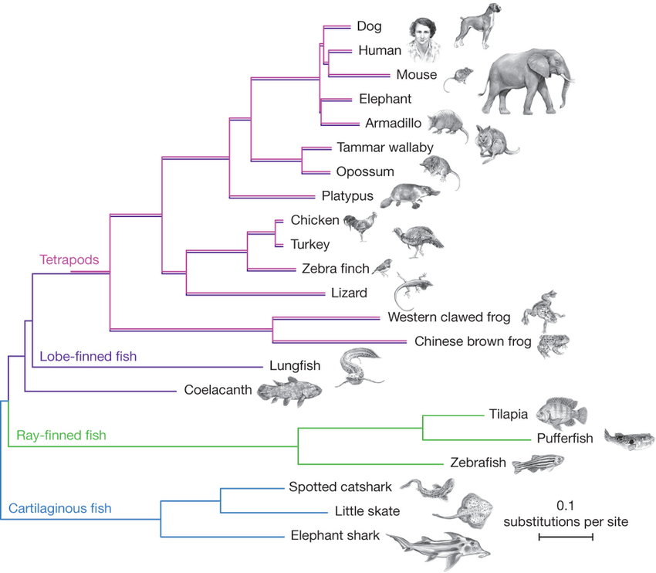
Phylogenetic tree
Notes:
Phylogenetic tree of jawed vertebrates. Note the roots on the left, how every node has at least two children and the taxa at the leaves
The problem we’re concerned with is that given a bunch of phylogenetic trees with the same leafsets, how to we build a master tree or a consensus tree that summarises the branching information in all these trees.
There are a variety of rules following which we can come up with consensus trees, but we will be focusing on the frequency difference consensus tree.

Slide 3
Clusters
a
a
d
e
b
c
b
c
d
e
Notes:
Non empty subsets of the leafset are clusters
Every node in a phylogenetic tree has a cluster associated with it – give example from tree
{c, d, e} is a cluster, but does not belong to this tree
Clusters are compatible if – one is a subset of the other or they’re disjoint. That is, they shouldn’t overlap. So {a, b} is incompatible with T1 ({b, c}).
The two tree are incompatible because {a, b, c} is incompatible with {b, c, d, e}

Slide 4
Frequency difference consensus tree
2
1
2
2
1
1
e
a
2
2
2
2
a
b
c
d
e
a
d
e
d
2
b
c
c
b
c
d
e
a
b
a
b
c
d
e
Notes:
The four trees shown are the input trees
We assign a weight to each cluster equal to the number of trees it occurs in
The {a, b} cluster appears in trees 1 and 3
The {c, d, e} cluster only appears in tree 1
The {b, c} cluster appears in trees 2 and 4
Then all the other weights
A cluster appears in the fqd consensus tree if its weight is larger than all the clusters it is incompatible with
So w({a, b}) = 2 and w({b, c}) = 2, hence neither of them are in the fdct
{a, b, c} is incompatible with {c, d, e} and {b, c, d, e}, but both of those have smaller weight, so it appears

Slide 5
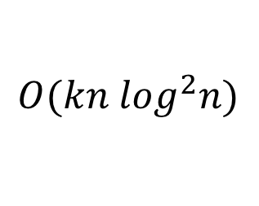
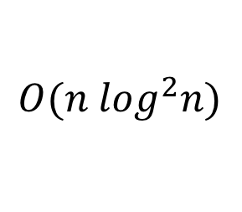



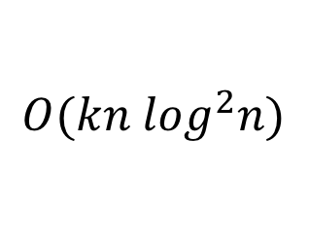
Frequency_Difference
$$O(f\left(n\right)+k∙g\left(n\right))$$
$$O(kn \log^{2}n)$$
Labelling
Filtering
$$f\left(n\right)$$
$$g\left(n\right)$$
$$O(kn \log^{2}n)$$
$$O(n \log^{2}n)$$
Notes:
Literature gives us an algorithm that splits the process of constructing this tree into two main bottlenecks – labelling and filtering. Labelling gives each cluster a weight, as seen on the previous slide. Filtering will be described in due course. It is further shown that the runtime of FD can be written as f(n) + k g(n) where f(n) = runtime of Labelling and g(n) = runtime of Filtering. The best known solution to the labelling step runs in kn log²n and the best known solution to filtering runs in n log²n, giving an overall runtime of kn log²n. The algorithms we have come up with solve these in kn log n and n log n time, giving an overall runtime of kn log n.

Slide 6
Labelling
Input: A set of trees {T₁, T₂, ..., T_{k}} with identical leafsets
Output: Every node is labelled such that nodes associated with the same cluster have the same labels and for any node u, id(u) is in the range [1, 2k |leafset|]

Slide 7
T₁:
7,6
T₂:
7,6
6,5
8,7
4,8
5,1
5,1
4,4
5,0
3,2
4,4
c
g
e
g
f
1,1
a
b
c
h
d
b
d
h
f
a
e
T₁|L’:
T₁|L’’:
T₂|L’:
T₂|L’’:
7
6
7
6
5
6
1
5
8
4
7
8
e
d
1
2
3
4
2
3
4
5
3
1
2
3
4
a
b
c
d
f
g
h
c
e
f
g
h
1
2
a
b
Notes:
Demonstrated on the above two trees
These trees have leafsets {a … h}
We divide this into two equal halves – {a … d} and {e … f}
For each of these we construct “restricted subtrees”
Take T₁ | L’. Contains all nodes that are lcas of these leaves, arranged in the same manner as the original tree.
Similarly we construct T₂ | L’.
We then recursively label these trees
Similarly, L’’ trees and labelling is done
Now we need to label T₁ and T₂
The {a, b} node is associated with the {a, b} node in T₁ | L’. It doesn’t have any leaves from L’’, so for that we give it 0. Thus we have created a label for this node, and this label uniquely identifies the leafset of the node.
Similarly for {c, d, f, g, h}
And label all of them
What’s left is to radix sort these pairs so that we can assign new ids.
Finally, note that we can counting sort the resulting ids to find the weight of each node.

Slide 8

Labelling
$$T\left(kn\right)=2T\left(\frac{kn}{2}\right)+O\left(kn\right)$$
$$T\left(kn\right)=O(kn\log{n})$$

Slide 9
Filtering
Input: Trees T_{A} and T_{B} with identical leafsets
Output: T_{A} but only with nodes for which the weight is greater than the weight of any node they is incompatible with in T_{B}

Slide 10
RootsOfSubtrees
C = {a, b, c, f, g, h}
d
c
e
f
g
h
a
b
Notes:
We take the cluster {a, b, c, f, g, h} and compare it with the given tree. Notice that the clusters associated with the circled nodes are subsets of C. Such nodes for subsets of the tree. This allows us to define maximal compatible subtrees, which are subtrees that have no parent which is also a subset of C. These subtrees are identified by their roots, as circled.
Also notice that the root of the tree is the lca of the cluster as a whole.
Then the nodes in rectangles, which are proper ancestors of the rootsOfSubtrees and proper descendants of the lca are all incompatible with C

Slide 11
Recursively formulating incompatibility
Given the set of nodes incompatible with some node c₁, we would like to find the set of nodes incompatible with its parent, u

Slide 12









Recursively formulating incompatibility
$l_{c_{1}}$ = lca of the cluster associated with c₁
$$l_{u}$$
rootsOfSubtrees(c₁) = {r₁, r₂}
$l_{u}$ = lca of the cluster associated with u
rootsOfSubtrees(u) = {r₁, r₃, r₄, r₅}
$$l_{c_{1}}$$
$$r_{4}$$
$$r_{5}$$
$$r_{1}$$
$$r_{3}$$
$$r_{2}$$

Slide 13
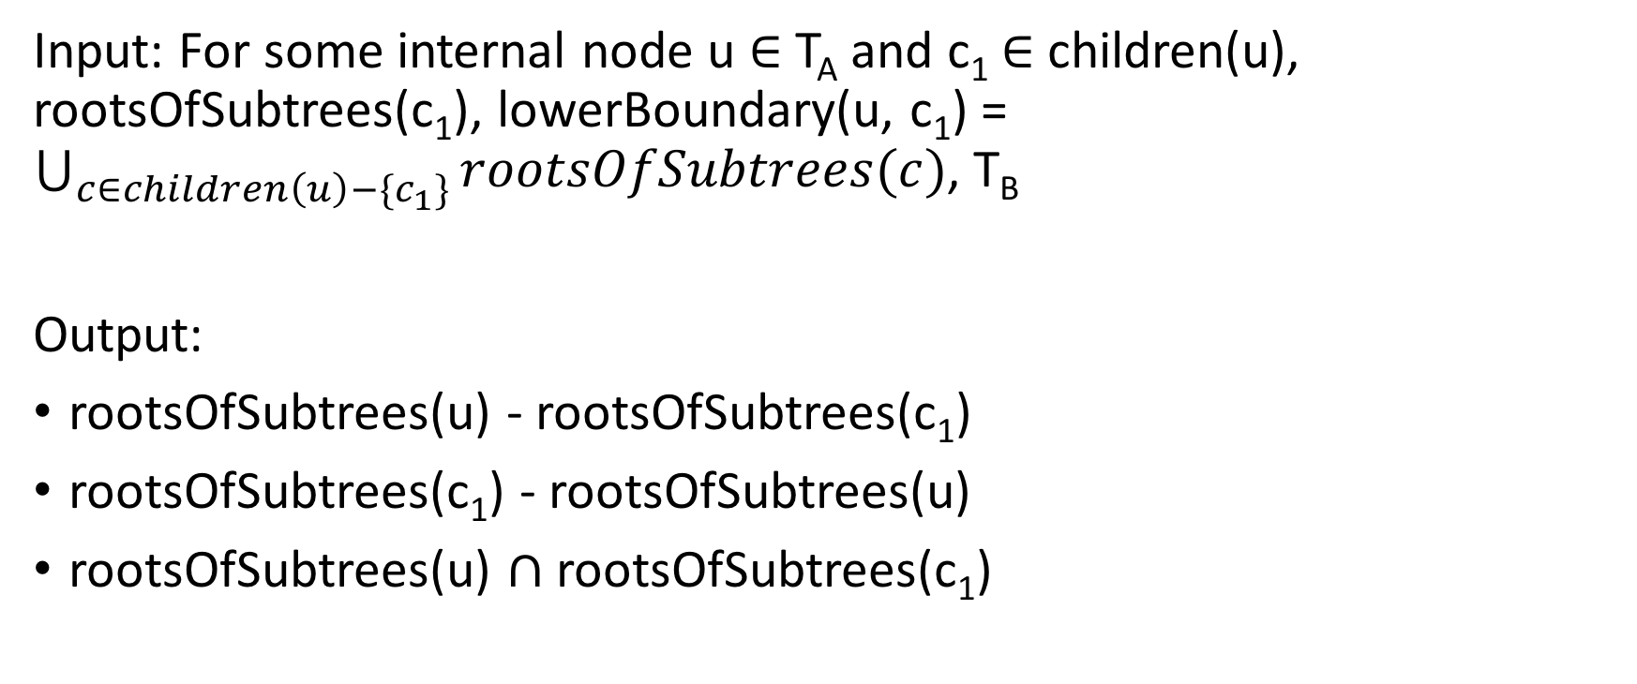
Compute_Roots_Of_Subtrees
Input: For some internal node u $∈$ T_{A} and c₁ $∈$ children(u), rootsOfSubtrees(c₁), lowerBoundary(u, c₁) = $\bigcup_{c∈children\left(u\right)−\{c_{1}\}}{rootsOfSubtrees(c)}$, T_{B}
Output:
rootsOfSubtrees(u) - rootsOfSubtrees(c₁)
rootsOfSubtrees(c₁) - rootsOfSubtrees(u)
rootsOfSubtrees(u) $∩$ rootsOfSubtrees(c₁)

Slide 14
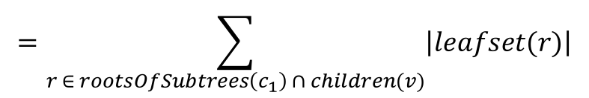
Compute_Roots_Of_Subtrees
$$=\sum_{r ∈ rootsOfSubtrees\left(c_{1}\right) ∩ children(v)}{\left|leafset(r)\right|}$$
counter(v)
c₁ = {a, c, g, h}
4
2
1
u = {a, c, g, h, b, d, f}
3
1
1
d
2
1
c
e
f
g
h
a
b

Slide 15
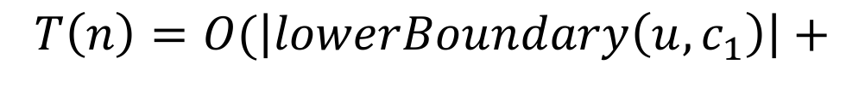
Compute_Roots_Of_Subtrees
$$T\left(n\right)=O(\left|lowerBoundary\left(u, c_{1}\right)\right|+$$
$$\left|rootsOfSubtrees\left(c_{1}\right)−rootsOfSubtrees\left(u\right)\right|)$$

Slide 16
Filter_Clusters_Helper
Input: Trees T_{A} and T_{B} where leafset of T_{A} is a subset of leafset of T_{B}
Output: rootsOfSubtrees(T_{A})
Side Effect: Marks any node in T_{A} that doesn’t satisfy the frequency difference condition for deletion.

Slide 17





Filter_Clusters_Helper
$$p_{5}$$
incompatible(p₅)
$$p_{4}$$
incompatible(p₄)
$$p_{3}$$
incompatible(p₃)
$$p_{2}$$
incompatible(p₂)
$$p_{1}$$
incompatible(p₁)
Notes:
Centroid path decomposition

Slide 18
Optimisations
RMQ structure on T_{B}
Recall that nodes along certain paths are being inserted
Create an RMQ structure allowing querying maximum weight along a certain path in constant time
Brodal queue to store incompatible nodes
O(1) insertions
O(log n) deletions

Slide 19

Filter_Clusters_Helper
$$T\left(n\right)=O\left(n\right)+\sum_{τ∈sideTrees(T_{A})}{T(\left|τ\right|)}$$
$$T\left(n\right)=O(n\log{n})$$

Slide 20
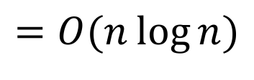
Filtering
$$T\left(n\right)=O\left(n\log{n}\right)+O(n\log{n})$$
$$=O(n\log{n})$$

Slide 21

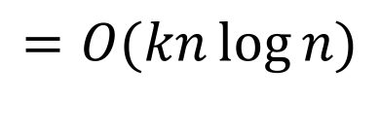
Frequency_Difference
$$T\left(n\right)=O\left(kn\log{n}+k∙n\log{n}\right)$$
$$=O(kn\log{n})$$

Slide 22
References
Amemiya, Chris T., et al. "The African coelacanth genome provides insights into tetrapod evolution." Nature 496.7445 (2013): 311.

