Slide 1



What is HDFS?
HDFS, or Hadoop Distributed File System, is a distributed file system designed to run on commodity hardware. It provides high-throughput access to application data and is suitable for applications with large data sets.
HDFS is a core component of the Apache Hadoop software framework and is widely used for storage and processing of big data.

Slide 2
Architecture of HDFS
Master Node
Slave Node
The NameNode is the master node that manages the file system namespace and regulates access to files by clients.
The DataNode is the slave node that stores the actual data. It serves read and write requests from the file system's clients.

Slide 3
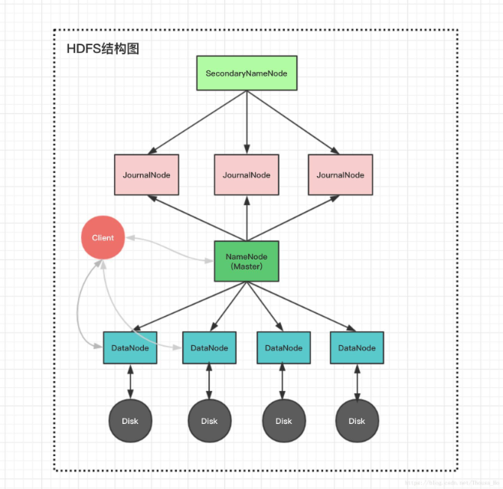
NameNode and DataNode
The NameNode is the centerpiece of the HDFS architecture, responsible for managing the metadata of the file system.
DataNodes are responsible for storing the actual data in HDFS and serving read and write requests from the clients.

Slide 4

Data Replication in HDFS
1
Replication Process
When a file is added to HDFS, it's divided into blocks and replicated across multiple DataNodes.
2
Block Placement
HDFS ensures replicas are placed on different racks to achieve fault tolerance and data reliability.
3
Replication Factor
The replication factor determines the number of copies of each block and can be configured based on requirements.

Slide 5
Fault tolerance in HDFS
1
Replication of Data
2
Automatic Recovery
HDFS replicates data across multiple DataNodes to ensure redundancy and fault tolerance.
If a DataNode fails, HDFS automatically replicates the data to ensure continuous availability.
3
Data Checksums
4
Metadata Redundancy
HDFS uses checksums to ensure the integrity of data and identify any potential corruption.
NameNode metadata is replicated to prevent loss in the event of a NameNode failure.

Slide 6
HDFS commands
hadoop fs -ls
hadoop fs -put
List the contents of a directory in HDFS.
Upload files or directories to HDFS.
hadoop fs -get
hadoop fs -rm
Copy files from HDFS to the local file system.
Delete files or directories from HDFS.

Slide 7




HDFS file operations
Create a file
Use the “hadoop fs -touchz” command to create an empty file in HDFS.
Upload a file
Transfer a local file to HDFS using the “hadoop fs -put” command.
Delete a file
Remove a file from HDFS with the “hadoop fs -rm” command.

Slide 8



HDFS Security
Authentication
Firewall Protection
Data Encryption
Ensures only authorized users have access to the HDFS.
Prevents unauthorized access and protects against cyber threats.
Secures data transmission and storage to prevent unauthorized access.

Slide 9
HDFS performance tuning
Data partitioning
1
Optimizing data storage for better performance
Block size configuration
2
Adjusting block size for efficient data processing
Memory management
3
Optimizing memory allocation for increased throughput

Slide 10

HDFS Use Cases
In the context of Hadoop Distributed File System (HDFS), some key use cases include large-scale data analytics, data warehousing, and log processing. HDFS is also utilized for machine learning, real-time data processing, and archival storage due to its fault tolerance and scalability.

