Slide 1
Spatial Regression
Lecture #23 | GEOG 510
GIS & Spatial Analysis in Public Health
Varun Goel

Slide 2
Outline
Spatial regression
  Spatial Lag and Error models
    A bit more...
    Review of pattern vs process
    Example
  Geographically Weighted Regression

Slide 3
Comparing Variables
Correlation
  Tells us about relationship between two variables
    Direction and strength
Regression
  Tells us about relationship among variables
    Direction, strength, and magnitude

Slide 4
Residual Autocorrelation
Regression residuals should not be spatially autocorrelated
  Residuals should be randomly distributed (independent)
  To test, join residuals back to spatial data features
    Run a Moran's I analysis using the residual as the variable
      We hope to get “null” results (high p value), meaning a random distribution!

Slide 5
Residual Autocorrelation
Potential fixes...
  Find missing independent variable
  Spatial regression approaches
    Spatial Lag Model
    Spatial Error Model
  Spatial filtering
    Removes spatial autocorrelation from input variables (prior to regression)

Slide 6
Spatial Dependence
Nuisance
  Something to get rid of
  Involves model residuals only
    Spatial Error Model
Substantive
  Value of interest
  Involves neighbors of Y
    Spatial Lag Model

Slide 7
Spatial Regression
Spatial regression approaches
  Spatial Lag Models
    Similar, in thought, to a 2nd order spatial process (spillover)
  Spatial Error Models
    Similar, in thought, to a 1st order spatial process (underlying driver)

Slide 8
Pattern and Process
Simple difference
  A spatial pattern is generally the result of some spatial process
    We map/observe patterns
    We aim to understand processes
Process is the “real life” action or interaction happening
  Requires us to think about how real life is expressed via data

Slide 9
Pattern and Process
Thinking about “why” we observe geographic variation in our data...
  e.g., why is disease prevalence or incidence higher here than there?
    The geographic variation that we map is the pattern
    The real life actions/interactions are the process that result in the geographic variation

Slide 10
Spatial Processes
First order effects
  Observed spatial variation is due to an extrinsic (external) factor (or factors)
    For example
      Disease cases and population counts
      Health outcomes and poverty
    Often, we use correlation/regression based methods to capture first order effects

Slide 11
Spatial Processes
Second order effects
  Spatial variation is due to interaction or intrinsic factors
    For example
      Directly transmittable disease (cases spawn more cases)
      Some retail behavior (competition), Dispersion

Slide 12
Spatial Regression
Linking process with models...
  2nd order spatial process
    Geographic variation in outcome variable driven by intrinsic (internal) factors
  Understanding or characterizing spatial dependence (in the outcome variable), because it helps to explain process
    Spatial lag model

Slide 13
Spatial Lag Model
Considers potential autocorrelation in the Y variable
  Neighbor weight (W)
    y is the neighbor's value of Y
  Estimates, ρ, which is very much similar to a regression coefficient

Slide 14
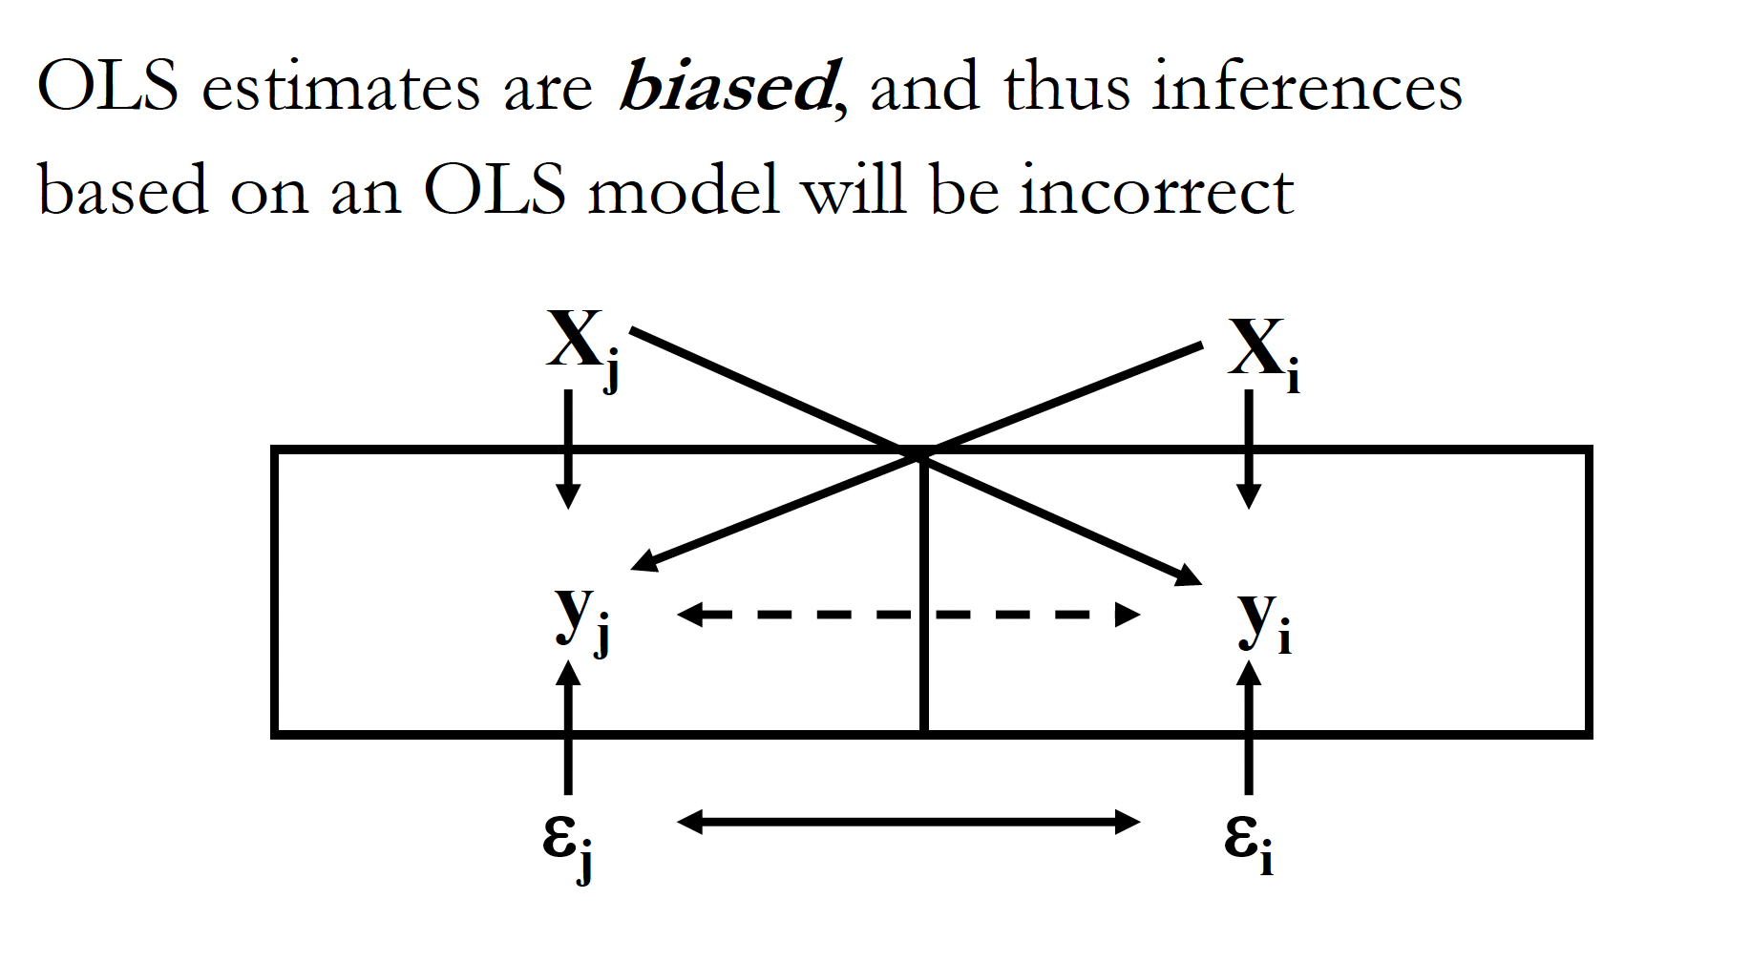
Spatial Lag Model

Slide 15
Spatial Lag Model
Maximum Likelihood Estimator
  Returns similar results to OLS regression
    Coefficients, SEs, p-values
    Some software provides a pseudo R²

Slide 16
Spatial Regression
Linking process with models...
  1st order spatial process
    Geographic variation in outcome variable driven by extrinsic (external) factors
  Removing spatial dependence in the residuals, because process not fully captured (by factors)
    Spatial error model
where,

Slide 17
Spatial Error Model
Considers potential autocorrelation in the error of the model
  e → autocorrelated residuals from non-spatial model
  Neighbor weight (W)
    μ is the “unobserved variable”
  Estimates, λ, which is very much similar to a regression coefficient
where,

Slide 18
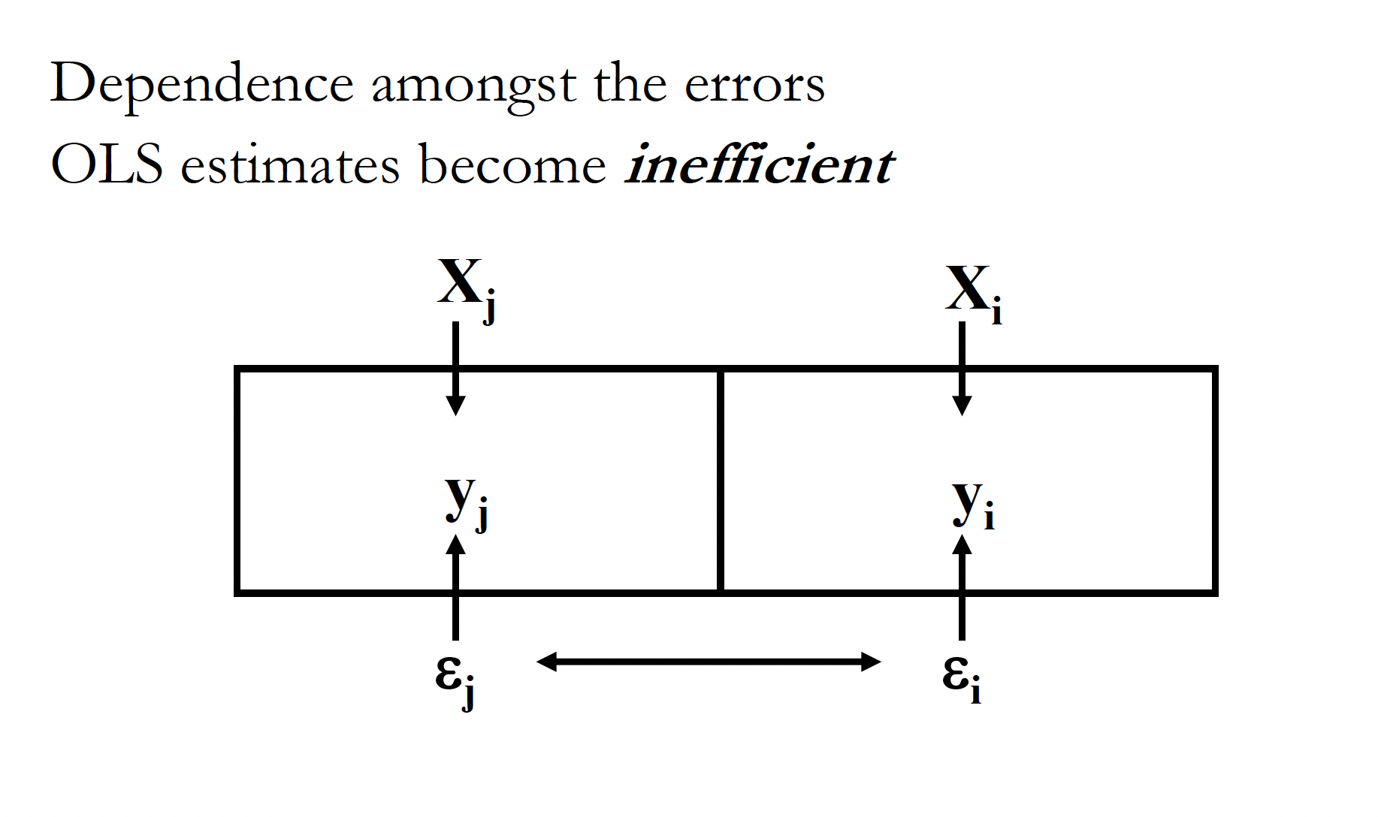
Spatial Error Model

Slide 19
Spatial Error Model
Maximum Likelihood Estimator
  Returns similar results to OLS regression
    Coefficients, SEs, p-values
    Some software provides a pseudo R²
where,

Slide 20
Spatial Regression
If residuals from OLS are correlated,
  How do I know whether to use a Lag or Error model?
    Theory!
    Diagnostics (in GeoDa)

Slide 21
Spatial Regression
Diagnostics
  Lagrange Multiplier (LM) tests
    LM error and LM lag
    Robust LM error and LM lag
  Start with non-robust tests
    If one is significant (low p value) and the other not, then use one that is significant
    If both significant, move to Robust versions (interpret similarly to above)
      If both highly significant, go with lowest p

Slide 22
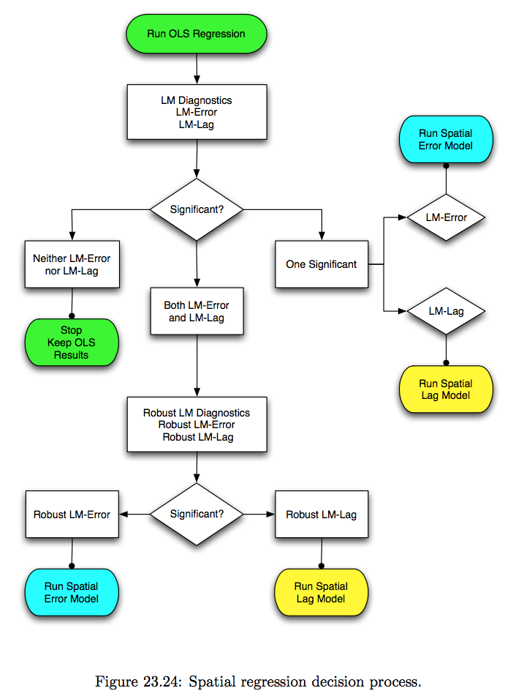

Slide 23
Spatial Regression
Neighbor definition and weights
  May affect the regression model results
    Similar to autocorrelation tests
    Good to conduct sensitivity analysis

Slide 24
Spatial Regression
In practice, using real data...
  Almost always messy and rarely a straightforward procedure
    Do your best to ensure regression assumptions are met
    Interpret with caution

Slide 25
Spatial Processes
Relationships among factors often assumed to be static across space
  e.g., effects of precipitation and temperature on mosquito density
  Not always the case
    Relationships themselves can vary across space
      Spatially varying process

Slide 26
GWR
Geographic Weighted Regression
Global regression
  Assumes that relationships (βs) are stationary across space
      Invariant from place to place (global)
GW Regression
  Assumes that relationships (βs) are nonstationary (across space)
    Vary from place to place (local)

Slide 27
GWR
Basically, numerous “local” regressions
  Provides β for every observation
    Variation in the effect over space
  Provides R² for every observation
Take care in using for inference
  Interesting results... but trustworthy?

Slide 28
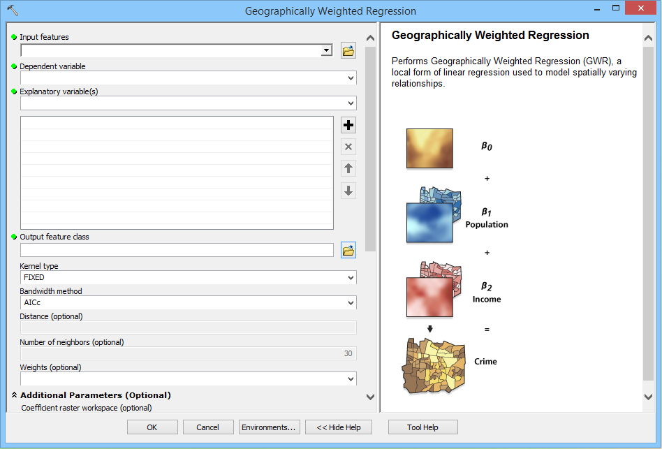

Slide 29
Regression
What's available?
  GeoDa
    OLS, Spatial Lag, Spatial Error
  GeoDaSpace
    OLS, Spatial Lag, Spatial Error, SpLE
      With standard error corrections (for heteroscedasticity)
  ArcGIS
    OLS, GWR

Slide 30
Keywords
Residual autocorrelation
Spatial Lag
Spatial Error
First and Second order processes
LM tests
Spatially varying process
GWR

