Slide 1
Distance and Buffers
Lecture #13 | GEOG 510
GIS & Spatial Analysis in Public Health
Varun Goel

Slide 2
Outline
Distance
  Euclidean distance
    Distance to features
    Buffer
  Alternate distances
    Great circle, Manhattan, Network, Cost distance (raster)

Slide 3
Distance
Why distance?
  Distance is a fundamental geographic concept that affects relationships and interactions among phenomena
    Sometime we want to explain it
    Sometimes we want to measure it for input to other calculations
    Sometimes we want to map it

Slide 4
Euclidean Distance
Based on Pythagorean Theorem
  a² + b² = c²
  Assumes:
    A planar Earth (i.e., a projected cs)
    No differences in elevation
Euclidean distance is also called “Cartesian” distance in ESRI help
Does not require GIS!... simple mathematical calculation
y
(x₂, y₂)
(x₁, y₁)
x

Slide 5
Distance: Vector
Point distance
  Distance between points
Line length
  Distance between nodes
  Distance between vertices
    Sum of segment lengths
Polygon Perimeter
  Distance between vertices
    Sum of segment lengths

Slide 6
Distance to Features
Measure distance from one set of features to another
  Vector distance tool
  Near
    Locate nearest feature, return distance
  Generate Near Table
    Locate k nearest features, return distance
      Output written to a new table

Slide 7
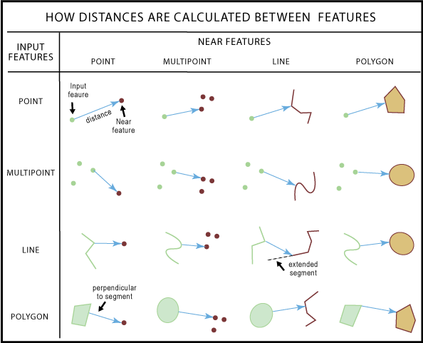

Slide 8
Distance: Raster
Measured from some source cell
  Or, source cells (could be a line or polygon)
  Distance from each cell to source calculated as Euclidean distance
1.4 | 1 | 1.4
1 | 0 | 1
1.4 | 1 | 1.4
2.8 | 2.2 | 2 | 2.2 | 2.8
2.2 | 1.4 | 1 | 1.4 | 2.2
2 | 1 | 0 | 1 | 2
2.2 | 1.4 | 1 | 1.4 | 2.2
2.8 | 2.2 | 2 | 2.2 | 2.8
d

Slide 9
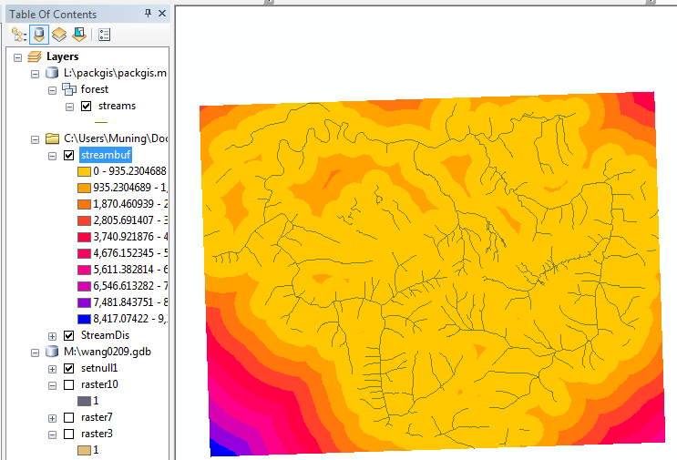
Distance to Features
Raster maps of distance are commonly used as measures of accessibility

Slide 10
Buffers
A buffer is a region surrounding a feature (or set of features)
  Region (or neighborhood) defined using a set distance from a given feature (point, line, polygon, grid cell, or group of cells)
  Create new spatial objects defined as the area within a specified distance from existing features

Slide 11
Buffers
A buffer is a region surrounding a feature (or set of features)
  Region (or neighborhood) defined using a set distance from a given feature (point, line, polygon, grid cell, or group of cells)
  Create new spatial objects defined as the area within a specified distance from existing features

Slide 12
Buffers
A buffer is a region surrounding a feature (or set of features)
  Region (or neighborhood) defined using a set distance from a given feature (point, line, polygon, grid cell, or group of cells)
  Create new spatial objects defined as the area within a specified distance from existing features

Slide 13
Buffer Output
Output shape options for overlapping buffers in same feature class
  An autonomous buffer for each feature
    Retains input features' attributes
1
2
3
1
2
3
Planar topology?

Slide 14
Buffer Output
Output shape options for overlapping buffers in same feature class
  An autonomous buffer for each feature
    Retains input features' attributes
  Dissolved output
    Original features' attributes cannot be “separated”
1
2
3

Slide 15
Interior Buffer
Interior polygon buffers
  Rather than choose a distance “outside” of the polygon, an interior buffer (“setback”) can be created
    Use a “negative” value for the buffer distance

Slide 16
Variable Distance Buffer
Buffer distance can be the same for all objects in a feature class (fixed-distance)
  Buffer distance can also vary
    Variable-distance buffer
    Based on an attribute in the feature class

Slide 17
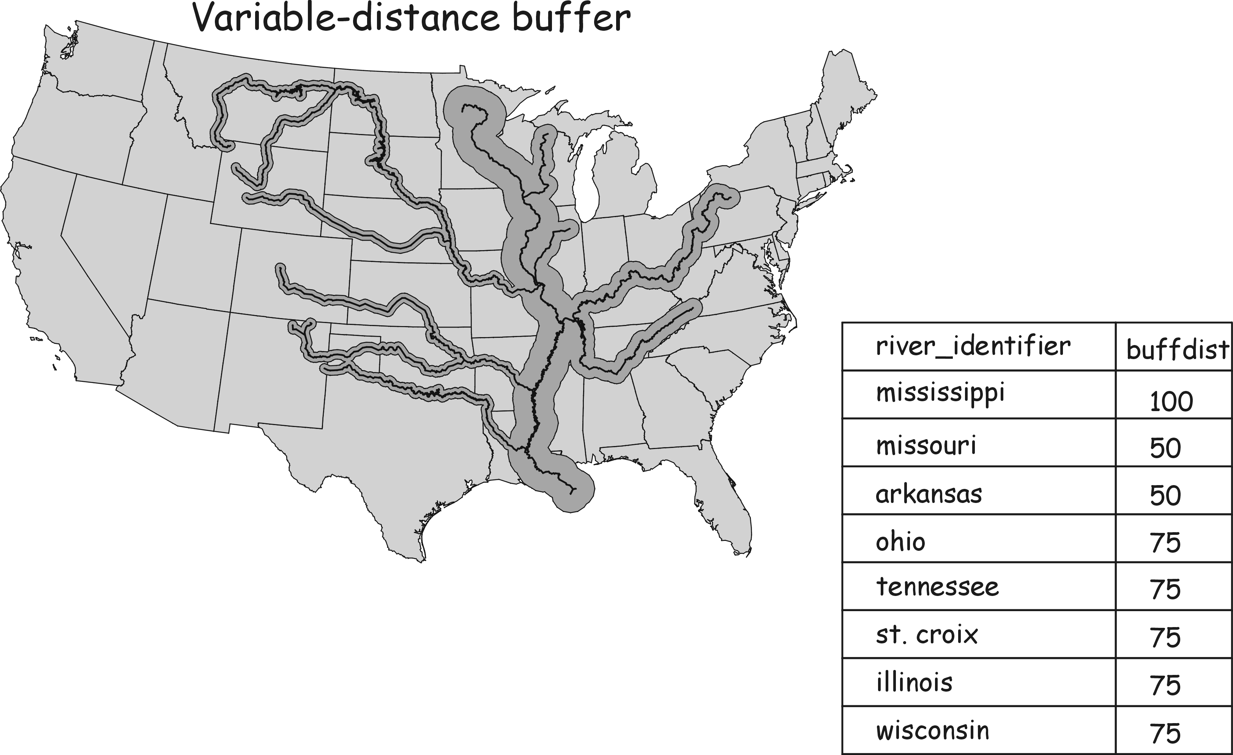

Slide 18
Euclidean Distance
Limitations
  Assumes flat earth
    Especially limiting over large distances
  Assumes no slope in terrain
    Especially limiting in mountainous terrain
  Assumes no barriers to movement
    Barriers can include anything that’s not a road (in the case of vehicular travel) or anything on the landscape that stands in the way

Slide 19
Great Circle Distance
Great circle distance is the shortest distance between two points on a sphere
  Used for points stored in spherical coordinates
  Required to calculate distance in spherical coordinates, especially if points are far apart
  Also called “geodesic” distance in ESRI help
D
Point 1: (λ₁,Φ₁) ← longitude, latitude
Point 2: (λ₂,Φ₂) ← longitude, latitude
R: radius of the Earth (~6378km)

Slide 20
Manhattan Distance
One way to account for barriers is to recognize that travel can be limited to transportation routes that follow cardinal directions (N, S, E, W)
  e.g., in Manhattan where most streets are at right angles
y
(x₂, y₂)
(x₁, y₁)
x

Slide 21
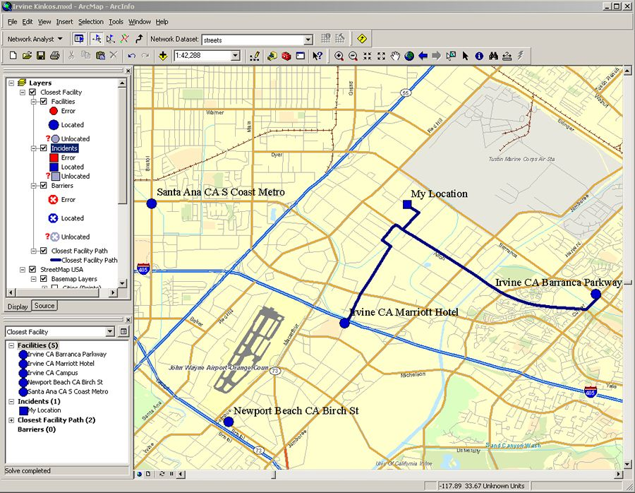
Network Distance
Network distance restricts travel along existing arcs (lines)
  e.g., on city streets
  Distance is the sum of the lengths of arcs that make up the route

Slide 22
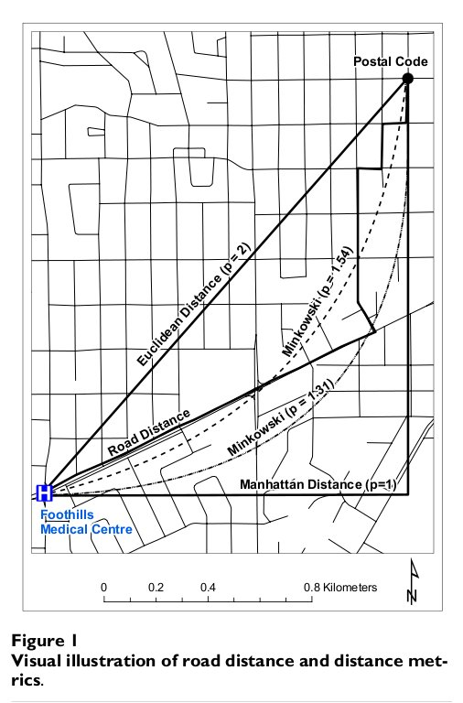
Minkowski Distance
Falls between Euclidean and Manhattan distance
Distance of a curved arc connecting two points
where 1 < p < 2

Slide 23
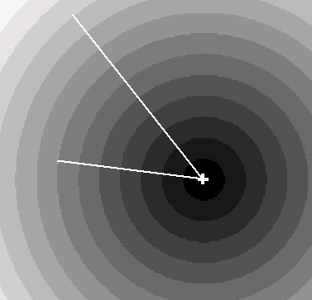
Shortest Path (Raster)
Greater distances are in lighter shades
Straight lines emanating from source location

Slide 24
Cost Distance
Implemented as a modification to calculating raster distance
  Functional or cost distance
    User defines relative barriers to movement by mapping the cost, or friction, of movement for each raster cell
    Cost can be defined by any spatial feature or attribute that limits the ability of people, animals, ideas, diseases, air, etc. to move across the landscape

Slide 25
Cost Distance
Cost
TOTAL COST, c = 1.4
2 | 1 | 1
2 | 1 | 1
2 | 1 | 1
destination
c = 0.7 * 1
c = 0.7 * 1
Distance
source
1.4 | 1 | 1.4
1 | 0 | 1
1.4 | 1 | 1.4

Slide 26
Calculate Cost Distance
Create a grid of costs (cost grid) to define the relative cost of traversing each grid cell
Identify source cell(s)
Calculate “cost distance” as the sum of unit costs accumulated to get from one place to other places
Identify least cost path
  i.e., the path of minimum cost between places
1 | 1 | 1 | 1 | 1
1 | 4 | 1 | 1 | 1
1 | 4 | 1 | 1 | 1
1 | 4 | 1 | 1 | 1
1 | 1 | 1 | 1 | 1
3.4 | 2.4 | 2 | 2.4 | 2.8
3.8 | 3.5 | 1 | 1.4 | 2.4
4.8 | 2.5 | 0 | 1 | 2
3.8 | 3.5 | 1 | 1.4 | 2.4
3.4 | 2.4 | 2 | 2.4 | 2.8
Cost grid
Cost distance
(minimum to
all cells in grid)
3.4 | 2.4 | 2 | 2.4 | 2.8
3.8 | 3.5 | 1 | 1.4 | 2.4
4.8 | 2.5 | 0 | 1 | 2
3.8 | 3.5 | 1 | 1.4 | 2.4
3.4 | 2.4 | 2 | 2.4 | 2.8
0 | 1 | 0 | 0 | 0
1 | 0 | 1 | 0 | 0
0 | 0 | 1 | 0 | 0
0 | 0 | 0 | 0 | 0
0 | 0 | 0 | 0 | 0
Least cost path

Slide 27
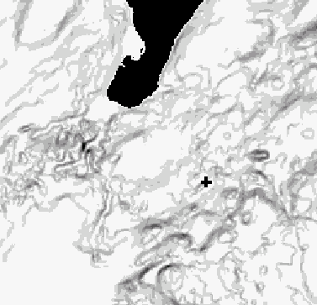
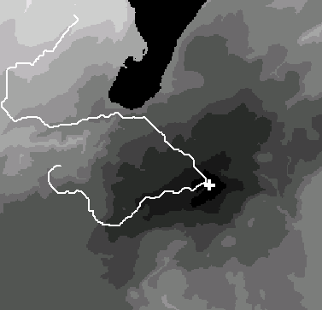
Cost Distance Example
Cost grid: Slope
Slope value is relative barrier (higher is darker)
Lake is absolute barrier
Cost Distance and Least Cost Path
Greater accumulated cost distance is in lighter colors

Slide 28
Cost Distance
Catchment area (like buffer)
  Area within a specific “cost” of source
    e.g., cost < 3.5
3.4 | 2.4 | 2 | 2.4 | 2.8
3.8 | 3.5 | 1 | 1.4 | 2.4
4.8 | 2.5 | 0 | 1 | 2
3.8 | 3.5 | 1 | 1.4 | 2.4
3.4 | 2.4 | 2 | 2.4 | 2.8
3.4 | 2.4 | 2 | 2.4 | 2.8
3.8 | 3.5 | 1 | 1.4 | 2.4
4.8 | 2.5 | 0 | 1 | 2
3.8 | 3.5 | 1 | 1.4 | 2.4
3.4 | 2.4 | 2 | 2.4 | 2.8

Slide 29
Keywords
Buffer
Distance
  Euclidean, Great circle, Manhattan, Network, Minkownski
  Least Cost Path
    Functional or cost distance

