Slide 1


Console App
Bank Operations

Slide 2

CONTENT
01
Python and it’s Implementation
02
SCOPE OF PROJECT
03
Class Design 1
04
Class Design 2
05
Requirement Framing
06
Operating Environment
07
Summary of Application

Slide 3


Python
Python and it’s Implementation :
Python is a high-level , interpreted programming language that emphasizes code readability and a clean syntax. It follows OOPS concept which includes following:
Abstraction : It refers to the practice of hiding complex implementation details of an object and essential features through well-defined interfaces.
Encapsulation : It is the process of putting data members and methods that operate on that data into a single unit, called a class.
Inheritance : It refers to the the process of inheriting a class that promotes the process of reusability.
Polymorphism : It enables objects of different classes to be treated as instances of a common superclass through a shared interface.

Slide 4

SCOPE OF PROJECT
A banking application developed as a console application encompasses a range of features tailored for command line interaction. Users can create new accounts of both the type like Saving account and Current account , can also view the balance that is available in bank account , can deposit the amount , can withdraw the amount , can transfer the amount to other account. User can select the type of service by entering the number associated with each service.
Our application provides the basic functionalities for the proper functioning of banking operation in a online mode.

Slide 5
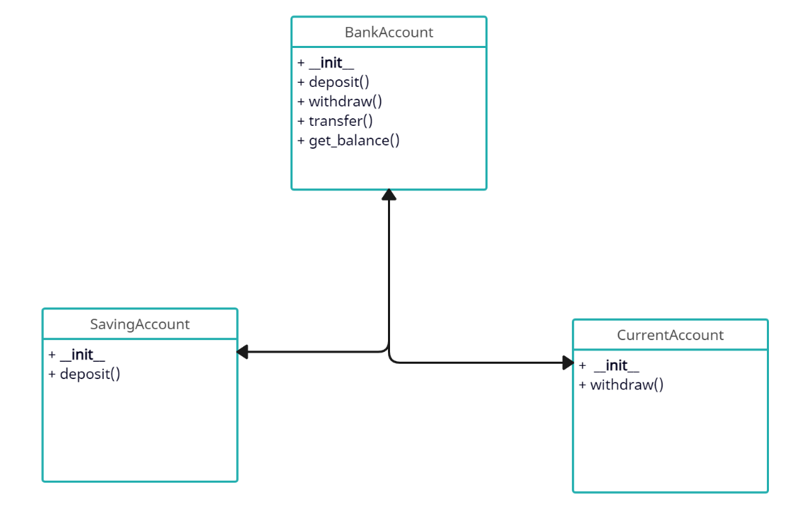
Class Design – Individual Classes

Slide 6
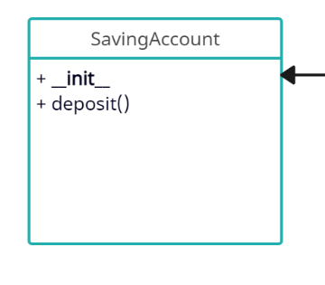
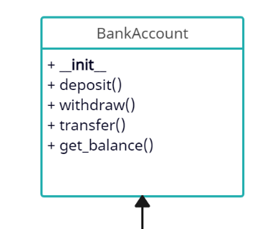
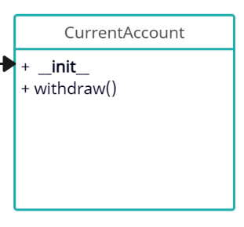

Class Design – On a Single Canvas

Slide 7
Functional Requirements of App

Slide 8
Requirement ID | Requirement CATEGORY | Requirement TYPE | PRIORITY | HIERARCHY | REF
R001 | FUNCTIONAL | STATED | HIGH
Requirement DESCRIPTION | Deposit Money Function
SCOPE | Amount is deposited into the Bank Account
METHODOLOGICAL DETAILS of Requirement | Amount of deposit is given as a argument to the deposit function. 3% of interest is given on every deposit to savings account. Deposit to current account do not give any interest on every deposit.

Slide 9
Requirement ID | Requirement CATEGORY | Requirement TYPE | PRIORITY | HIERARCHY | REF
R002 | FUNCTIONAL | STATED | HIGH
Requirement DESCRIPTION | Withdraw Money Function
SCOPE | Amount is withdrawn from the Bank Account
METHODOLOGICAL DETAILS of Requirement | Amount of Withdrawl is passed as the argument to the withdrawl function. Rs 200 is deducted on every Current Account withdrwal. On Saving Account withdrawl no charges are deducted.

Slide 10
Requirement ID | Requirement CATEGORY | Requirement TYPE | PRIORITY | HIERARCHY | REF
R003 | FUNCTIONAL | STATED | HIGH
Requirement DESCRIPTION | Transfer Money Function
SCOPE | Amount is transferred from the one Bank Account to other Bank Account
METHODOLOGICAL DETAILS of Requirement | Money is deducted from source Bank Account. Money is deposited to others Bank Account.

Slide 11
Requirement ID | Requirement CATEGORY | Requirement TYPE | PRIORITY | HIERARCHY | REF
R004 | FUNCTIONAL | STATED | HIGH
Requirement DESCRIPTION | Check Balance Function
SCOPE | Available amount is displayed.
METHODOLOGICAL DETAILS of Requirement | Balance present in the Account is displayed on the console window based on the account number. Both Saving account and Current account balance will be displayed based on account number.

Slide 12


OPERATING ENVIRONMENT
01
02
03
04

Slide 13
SUMMARY OF APPLICATION
The Console-based banking application offers a suite of functionalities to manage accounts. Users can use “Deposit” function to add funds . The “Withdrawal” function lets user deduct the funds within set limits, ensuring balance sufficiency and transaction records. The “transfer” function allows seamless movement of funds between accounts , adhering to account type constraints and logging transfers. The “Check_Balance” function provides real-time account balance information. These functions collectively empower users to perform financial tasks securely and conveniently through the application’s text-based interface.

Slide 14

THANK YOU
By :
Varun Goel

