Slide 1

CSS
Cascading Style Sheets

Slide 2
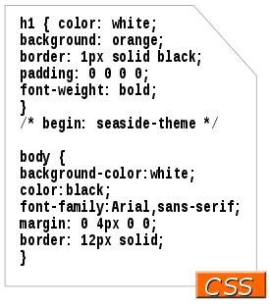
What is CSS
Cascading Style Sheets (CSS) is a style sheet language used for describing the presentation of a document written in a markup language like HTML. CSS is a cornerstone technology of the World Wide Web, alongside HTML and JavaScript.
CSS is designed to enable the separation of presentation and content, including layout, colors, and fonts.

Slide 3
Why CSS
CSS is used to define styles for your web pages, including the design, layout and variations in display for different devices and screen sizes.
Determines how elements will be displayed
Makes your content look GOOD
CSS saves time and work, can control multiple pages
CSS can add animation
CSS can add interaction
Adapt the way your page looks with CSS, perfect for responsive design

Slide 4

Different browsers
https://en.wikipedia.org/wiki/Comparison_of_browser_engines_(CSS_suppor t)
some browsers may have different levels of support for technology features to other
sometimes browsers have bugs, or implement features differently.

Slide 5
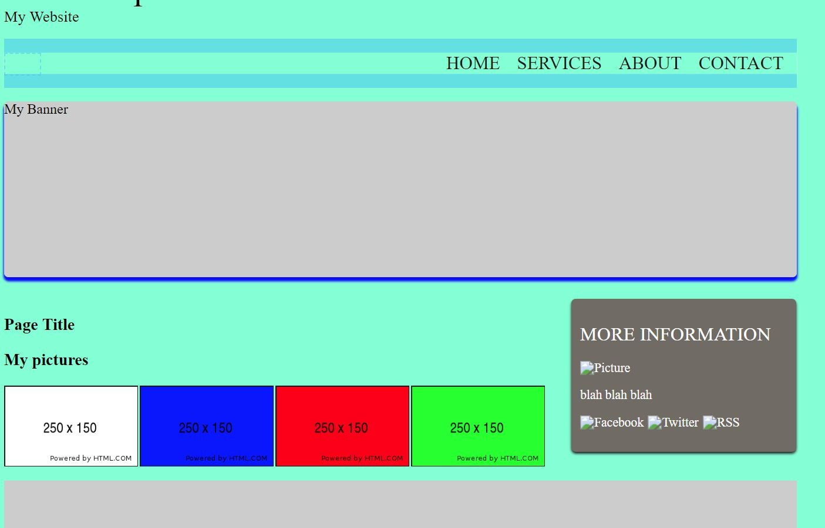
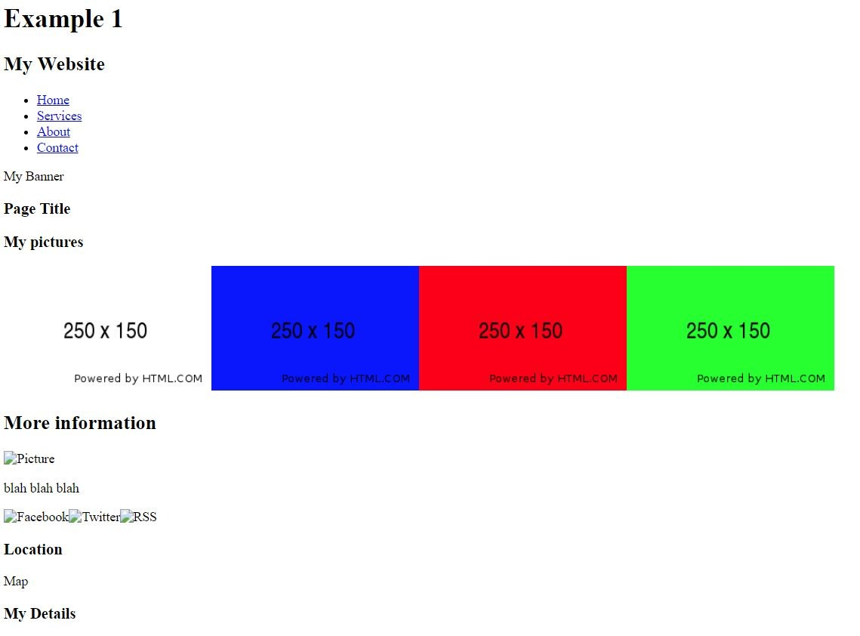
Different Look same HTML

Slide 6
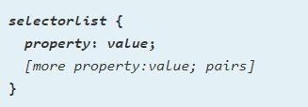
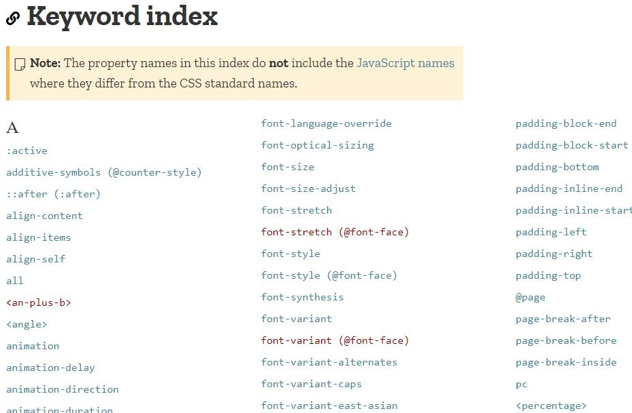
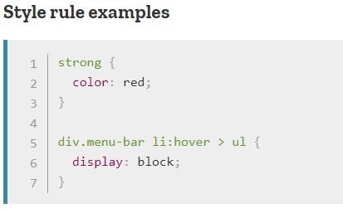
CSS reference
https://developer.mozilla.org/en-US/docs/Web/CSS
https://css-tricks.com/almanac/

Slide 7
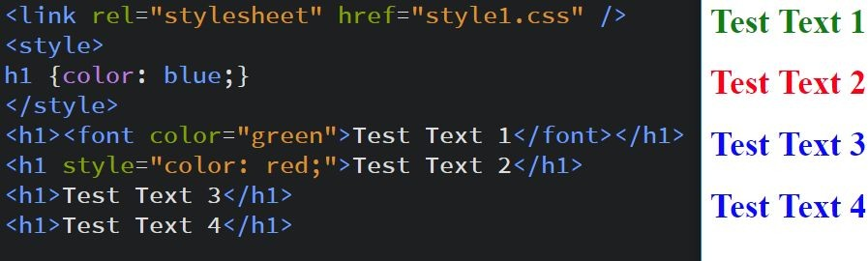
Basics of Styling
<link rel="stylesheet" href="style1.css" />
<style>
h1 {color: blue;}
</style>
<h1><font color="green">Test Text 1</font></h1>
<h1 style="color: red;">Test Text 2</h1>
<h1>Test Text 3</h1>
<h1>Test Text 4</h1>
example1.html / style1.css

Slide 8
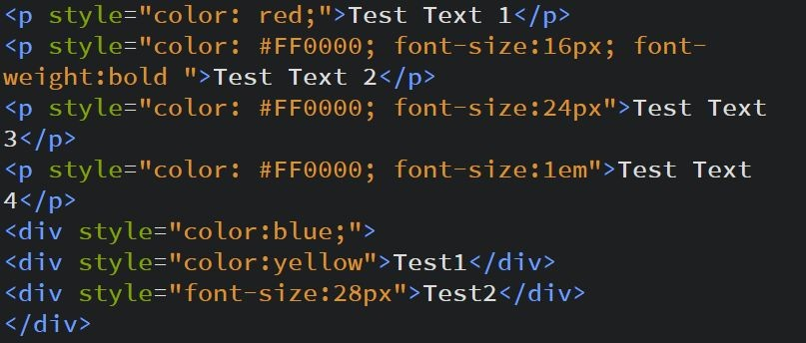
Inline styles
CSS styles to a single, specific element. Using an attribute style you can apply the styling to the element, and all child elements. Notice styling works from the element out, so less direct styling is overwritten as it goes out from the element. example2.html

Slide 9

Try it - inline
Open you editor
Create HTML elements
Change the color
Change the size

Slide 10
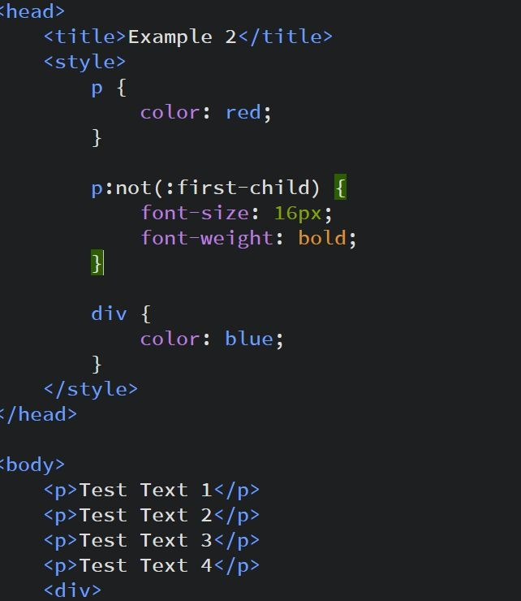
Internal styles
Use the style tag to add styling. This is where selection is really important. As you can see much of CSS is about making selections of the elements.
example3.html

Slide 11
Try it
Open you editor
Create HTML elements
Within the style tag select the element by tag and change the color and size.
Create various different tags apply style.
Nest tags within other tags, select the tag to add styling

Slide 12
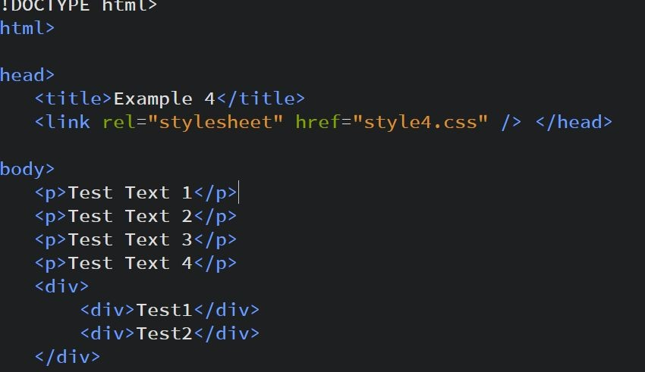
CSS Style external link
Benefits of linking to an external CSS file
everything is stored within a single file
once changed/updated, the changes are reflected on all other pages that reference the stylesheet
makes it easier to maintain larger websites
example4.html

Slide 13
Try it
Open you editor
Create HTML elements
Link to an external CSS file

Slide 14
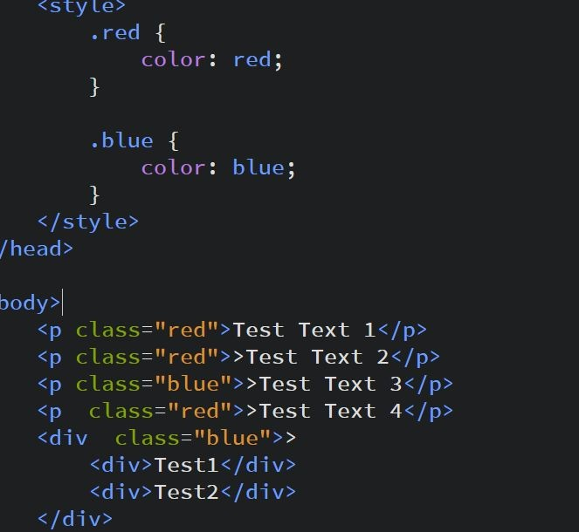
Selection Classes and ID
Classes and IDs are used for selection of elements.
Use classes for the ability to apply styling to multiple elements.
Use ID for applying styling to one specific element.
example5.html

Slide 15
Try it
Open you editor
Create HTML elements
Select elements using the class and id attributes.
Apply multiple classes to the same element.

Slide 16
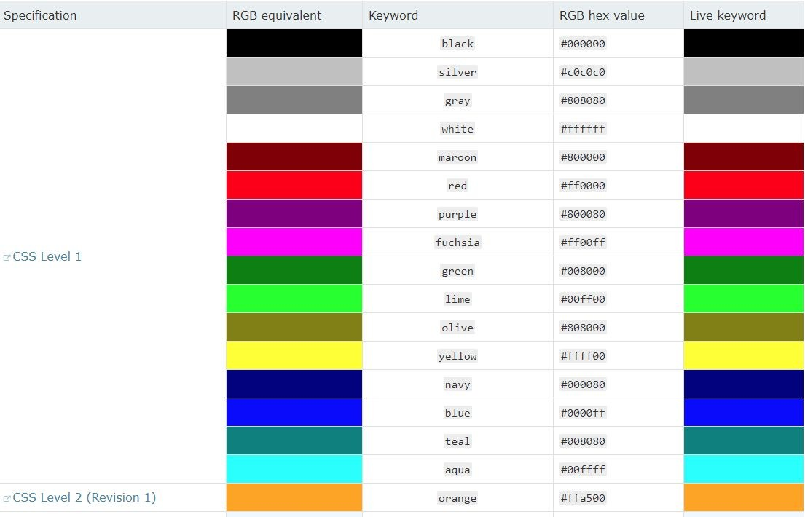
Color options
https://developer.mozilla.org/en-US/do cs/Web/CSS/color_value
http://paletton.com/ You can use :
Keyword color ‘red’
RGB Hex value ‘#ff0000’
RGB value ‘rgb( 255, 0, 0)’
RGB value ‘rgba( 255, 0, 0,.5)’
example6.html

Slide 17
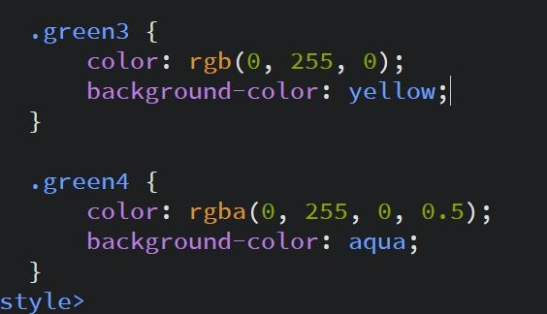
Background Colors / Images
Using divs and spans can help with the selection of elements.
Example8.html
Background shorthand
https://developer.mozilla.org/en-US/do cs/Web/CSS/background

Slide 18
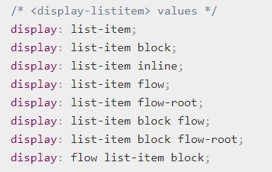

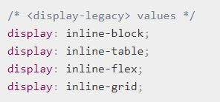

CSS display property
https://developer.mozilla.org/en-US/docs/Web/CSS/display
Example : display.css

Slide 19
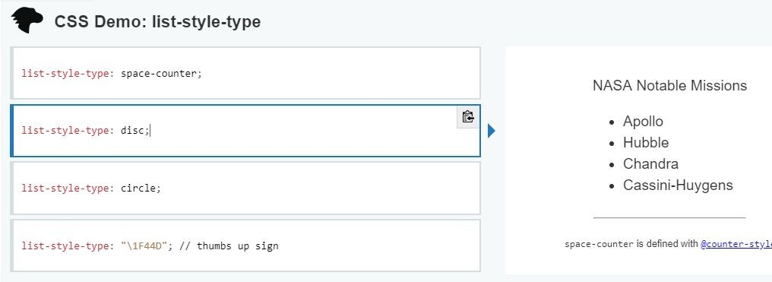
List items
Manipulate list items.
https://developer.mozilla.org/en-US/do cs/Web/CSS/list-style-type
list-style: none; display: inline-block;

Slide 20
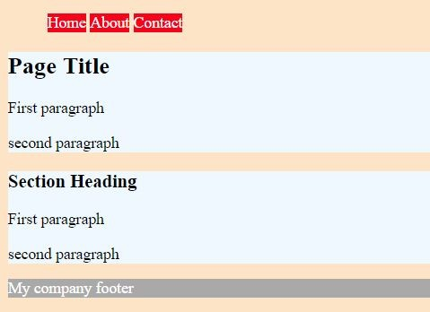
Exercise #1
Fun with colors
Open editor
Open exercise1.html
Create new exercise1.css file
Apply CSS properties and values to different element groups
Have fun with colors, background and text.
Create simple website

Slide 21
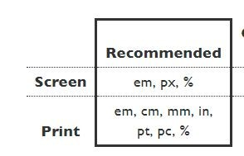
CSS measures and properties
https://www.w3.org/Style/Examples/007/units.en.htm l
Percentage (%) - expressed as a percentage in relation to the containing element. Pixel Unit (PX) - Fixed unit size in pixels dots on your computer screen.
EM unit (EM) - Scalable unit. em unit is relative to the font-size of the parent. REM unit (REM) - Scalable unit. The rem unit is relative to the root html element.
*not used often

Slide 22
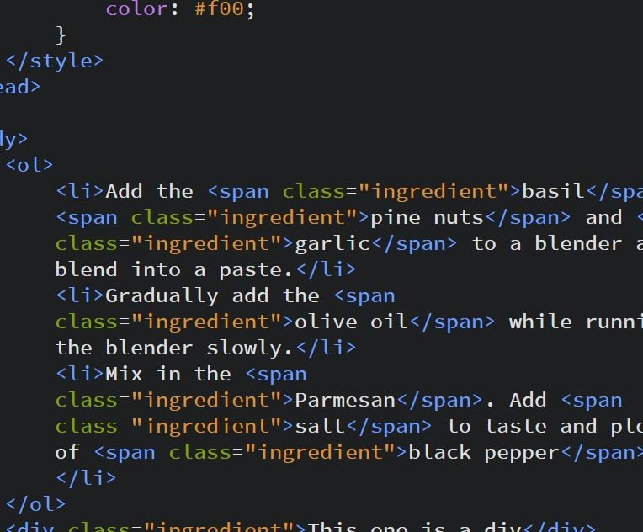
Divs and Spans
Using divs and spans can help with the selection of elements.
example7.html

Slide 23
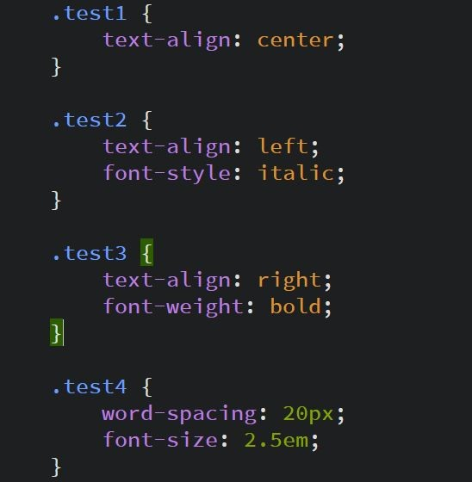
Styling text
http://www.blindtextgenerator.com/ snippets?snipps=ANY-snippets-lore m
example13.html

Slide 24
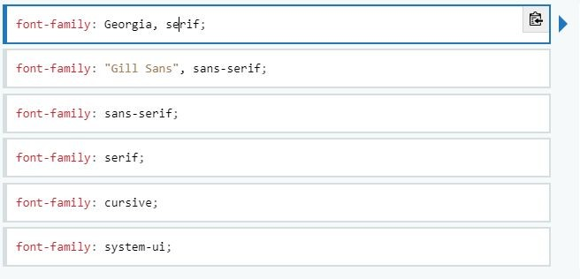
CSS Font Family
Using divs and spans can help with the selection of elements.
Example9.html
https://developer.mozilla.org/en-US/do cs/Web/CSS/font-family

Slide 25
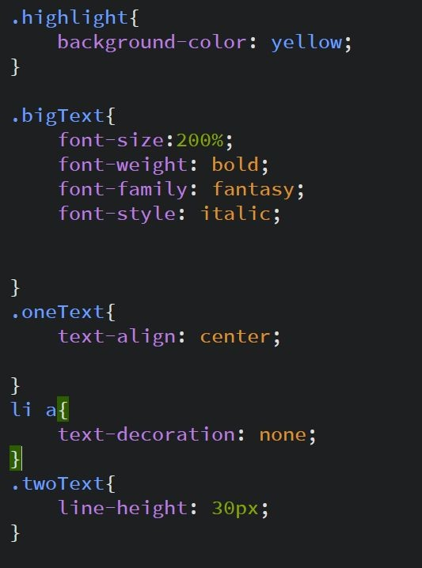
Google Fonts
https://fonts.google.com/
Text-align
Font-style
Font-weight
Font-size
font-family

Slide 26
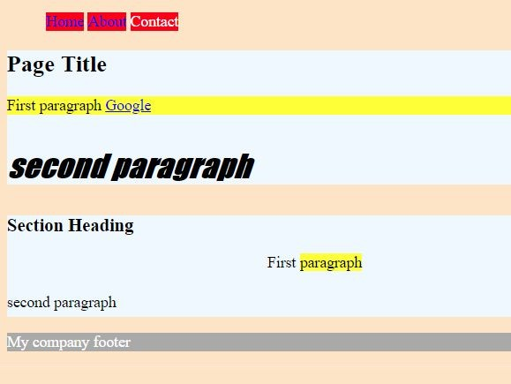
Exercise #2
Fun with text
Open editor
Open exercise2.html
Create new exercise2.css file
Apply CSS properties and values to different element groups
Update the fonts and colors
Create your mini webpage

Slide 27
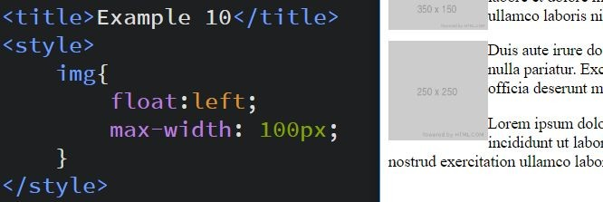
Images CSS floats
USe float to position images inline with text.
Try max-width to limit the size of an image.
example10.html

Slide 28

CSS floats
Floats are not just for images.
Clearing of floats example11.html

Slide 29
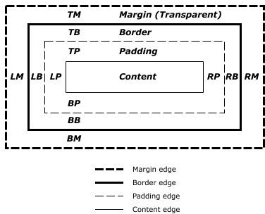
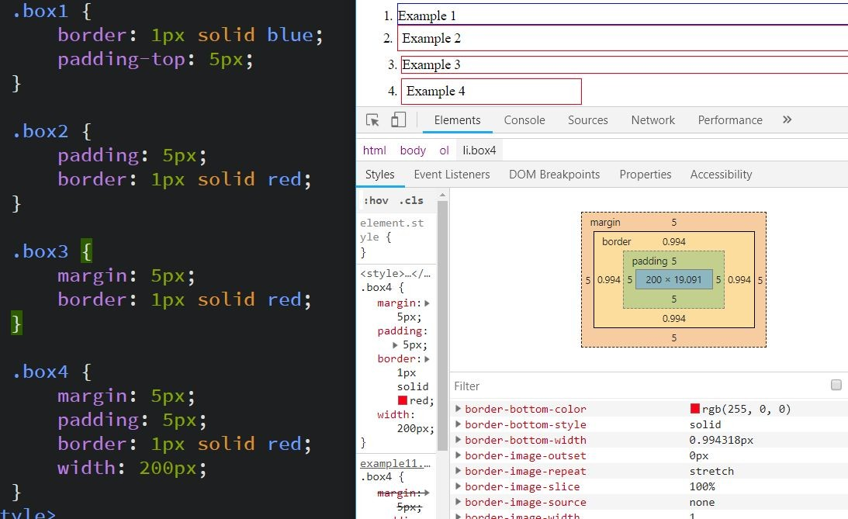
BOX Model
https://www.w3.org/TR/CSS2/box.html
Border, padding, margin, width/height
Chrome inspector

Slide 30
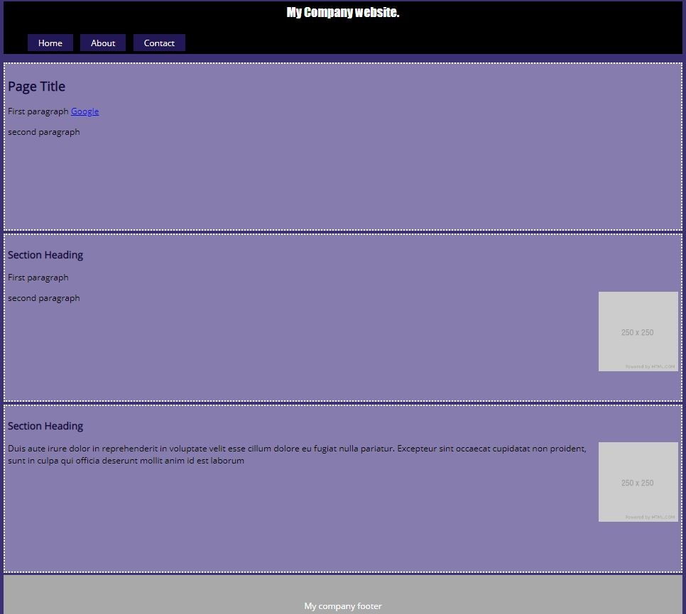
Exercise #3
1. create background of body to color #3C3176; 2. make H2 #10073B
make section background #867DB0 with dotted border. add small margin top/bottom only to separate the sections. Padding for slight indent of text. Add a minimum height to the sections
create nav bar - using padding and colors #231858 background #FFF font;
make logo font color white, align center, font 6. size 1.5em and font style fantasy
import your favorite google font and add to the body
footer padding and centered text with grey background
images to max size of 150px and to be right aligned

Slide 31
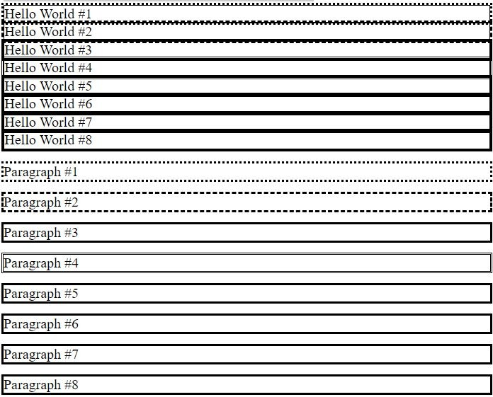
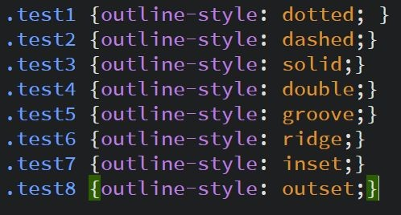
CSS Outline
The outline-style property specifies the style of the outline.
Example outline.css

Slide 32
CSS positioning
https://developer.mozilla.org/en-US/docs/Web/CSS/position
Static : The default value places the item in the normal flow
Relative : The item is placed in the normal flow, and then shifted or offset from that position. Subsequent flow items are laid out as if the item had not been moved.
Absolute : Specifies absolute positioning. The element is positioned in relation to its nearest non-static ancestor.
Fixed : The item is absolutely positioned in a fixed position on the screen even as the rest of the document is scrolled
example12.html

Slide 33
CSS positioning
left,top,right,bottom
example12.html

Slide 34
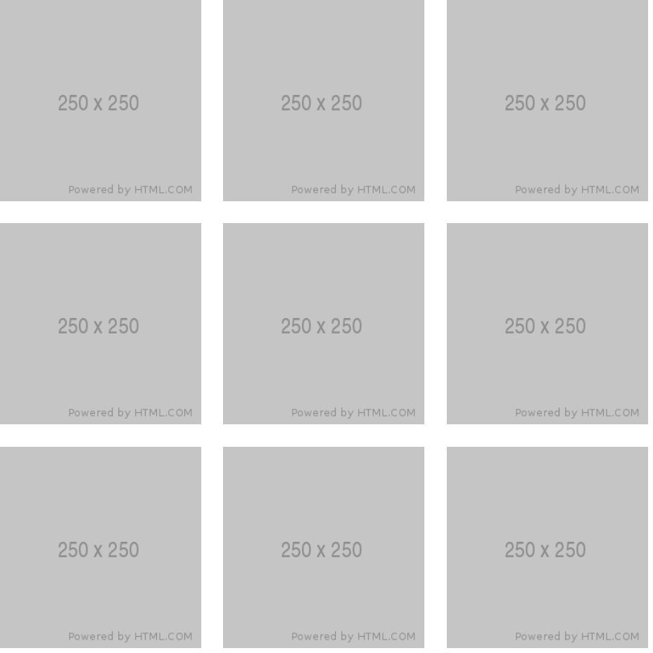
Exercise #4
Making the image Grid?

Slide 35

CSS for hyperlinks
a:link - default - unvisited link
a:visited - visited link
a:hover - when the mouse cursor is over the link a:active -when the link is clicked
Example links.css

Slide 36
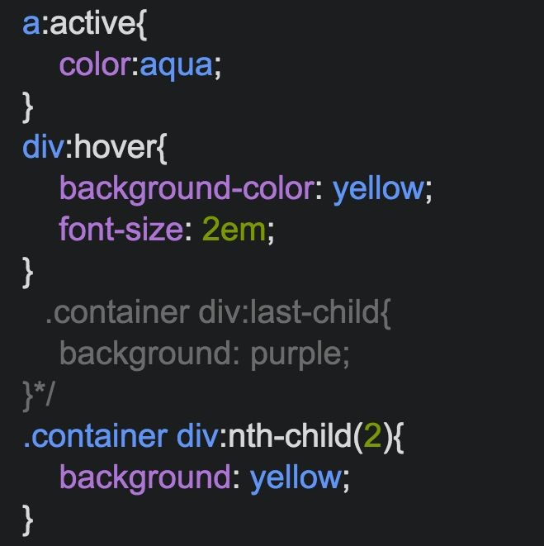
CSS Pseudo Class
https://developer.mozilla.org/en-US/docs/ Web/CSS/Pseudo-classes
A CSS pseudo-class is a keyword added to a selector that specifies a special state of the selected element(s). For example, :hover can be used to change a button's color when the user hovers over it.

Slide 37
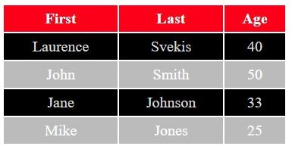
CSS for tables
The way a table is styled should be done using CSS. Lots of options to make your table look good.
Example tables.css

Slide 38
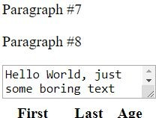
Overflow and MaxWidth/Height
Overflow tells the browser how to handle content that does not fit within the element.
Max width and height force on responsive when available to restrict the height value to the max.
Example : overflow.css

Slide 39
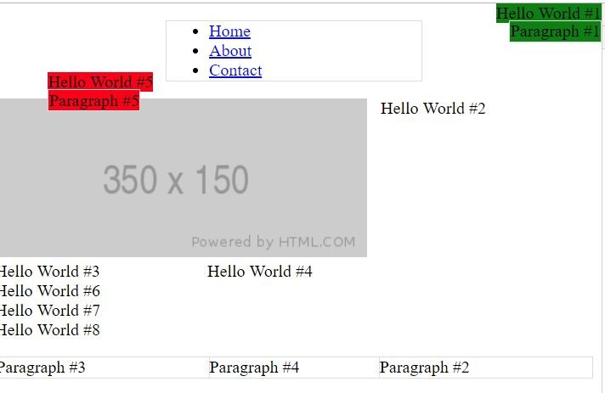
Align Elements
Aligning of elements can be done with several options available including margins, padding, display positions.
Example align.css

