Slide 1
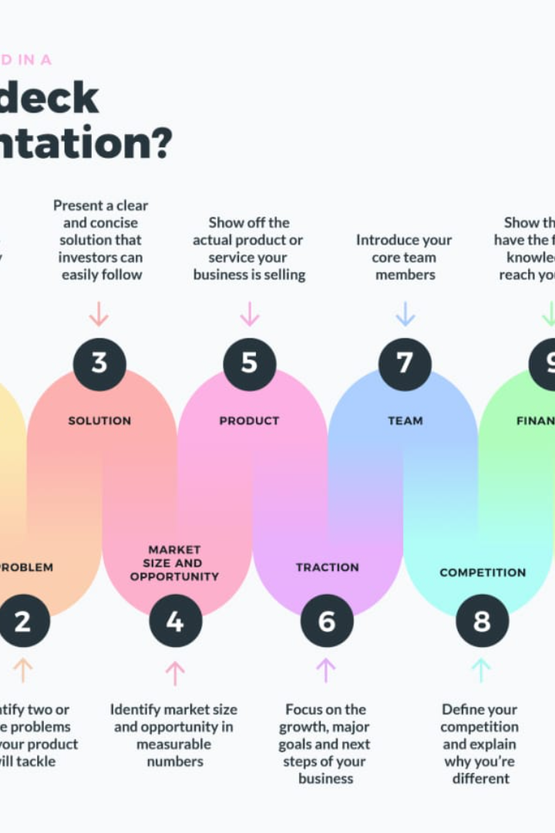

Entrepreneurship Development Cell (EDC) Presents:
Welcome to Incubathon-2023, the ultimate platform for aspiring entrepreneurs to pitch their innovative business ideas. Get ready to unleash your potential and make your mark in the world of startups!

Slide 2

Introduction to Incubathon-2023
Incubathon-2023 is a prestigious idea pitching competition organized by the Entrepreneurship Development Cell (EDC)-HITAM. It provides a unique opportunity for participants to showcase their entrepreneurial prowess and bring their revolutionary business ideas to life.

Slide 3

Overview of the Competition
Incubathon-2023 is a multi-stage competition that evaluates the feasibility, innovativeness, and market potential of the submitted business ideas. From initial screening to the final pitch, participants will go through an intensive mentorship and evaluation process.

Slide 4
The Perfect Pitch: What to Include in a Pitch Deck
Slide 1: Problem Statement and Market Opportunity
Slide 2: Solution and Unique Value Proposition
Clearly articulate the problem your business idea solves and highlight the potential market size and growth opportunities.
Present your unique solution and how it addresses the identified problem. Showcase the key features and benefits that set your idea apart from competitors.
Slide 3-4: Business Model and Revenue Streams
Slide 5-6: Marketing and Growth Strategies
Outline your business model, including the target customer segments, pricing strategy, and revenue generation streams. Illustrate how your idea translates into a profitable venture.
Detail your marketing and customer acquisition strategies. Emphasize how you will attract and retain customers, create brand awareness, and achieve sustainable growth.

Slide 5


Team and Management Structure
Slide 7: Team
Slide 8: Management Structure
Introduce your talented and diverse team members. Highlight their qualifications, expertise, and how their collective skills contribute to the success of your venture.
Illustrate the organizational structure and key roles within your startup. Showcase how your team will efficiently manage operations and drive the company towards success.

Slide 6

Financial Projections and Ask
Slide 9: Financial Projections
Present realistic financial projections, including revenue forecasts, expenses, and profitability. Provide a clear picture of the potential return on investment for investors.
Slide 10: Q&A and Next Steps
Conclude your pitch deck by opening the floor for questions from the audience or judging panel. Share your next steps, such as seeking investments, partnerships, or launching the prototype.

