Slide 1
The Laurel Review
Client:
Luke Rolfes
Co-editor of The Laurel Review
Department of Language, Literature, and Writing
Northwest Missouri State University
Team Members:
1.Rajesh Tarigopula
2. Sai Tejaswini Narne
3. Venkatesh Kunduru
4. Bala Gopi Krishna Sabbineni
5. Satish Hiru Gadge
6.Varun Goud Pulipalpula

Slide 2
About the Laurel Review
The Laurel Review is a biannual print magazine seeking submissions of poetry, fiction, creative nonfiction, script, review, and those that blur the lines between genres.
They seek both established and new voices in the writing world, and they are especially interested in writing by those whose identities have been historically under-represented.
Submitters living outside of the United States are encouraged to submit. Translations in various genres are also of interest.

Slide 3
Client Requirements
A new website design that is simplified and user friendly
Navigation: Submissions, Subscriptions, Issues/Chapbooks, Podcast, About Us)
An area on the website to house back issues, chapbooks, and online content
An area on the website that links to our social media and provides updates on news/announcements
A website that is easy to update for our staff, especially uploading online content
A section of the website devoted to our online podcast series where users can stream and/or download audio files

Slide 4
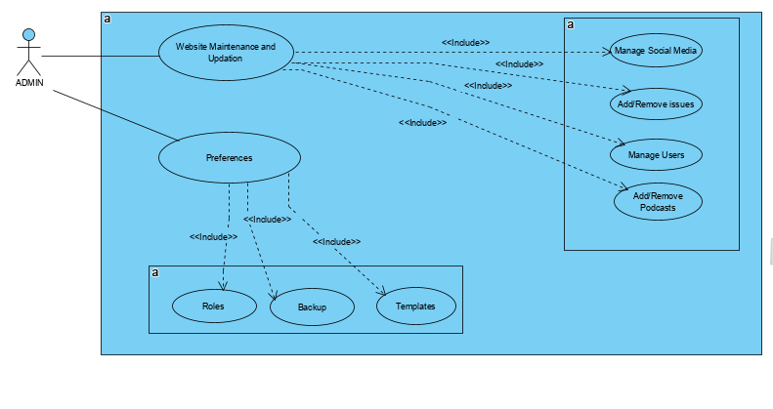
Admin Use case

Slide 5
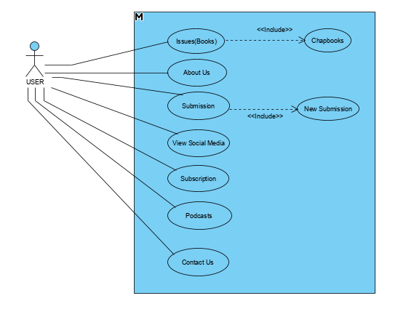
User Use case

Slide 6
Thank you!

