Slide 1
Predicting Bankruptcy Risk
Group 1
Created By AI

Slide 2
Team Mates
Domma Anil Kumar
Narendra Damera
Kanasani Dhaneswar Reddy
Gajula Balaji
Jyoti Sagar
Varun Gowda S
Abhinav Maturi

Slide 3
01
Introduction to Bankruptcy Prediction
02
Data Exploration and Analysis (EDA)
03
Data Preprocessing and Feature Engineering
CONTENT
04
Model Development and Evaluation
05
Logistic Regression Analysis
06
Model Deployment
08
Conclusion and Recommendations

Slide 4
01
PART
Introduction to Bankruptcy Prediction

Slide 5
The Importance of Bankruptcy Prediction
Business Stability
Financial Planning
Stakeholder Confidence
Predicting bankruptcy ensures stability; proactive measures can be taken to mitigate risks, avoid financial distress, and maintain operational continuity.
Bankruptcy prediction facilitates informed financial planning, enabling better resource allocation, investment strategies, and debt management.
Accurate predictions boost stakeholder confidence, including investors, creditors, and employees, fostering trust and long-term relationships.

Slide 6
Project Overview
Business Objective
Model Type
Data Source
The primary objective is to develop a model to accurately predict a company's likelihood of bankruptcy based on financial and risk indicators.
A binary classification model will be used, categorizing companies as either "bankruptcy" or "non-bankruptcy" based on input features.
The analysis utilizes data extracted from the "Bankruptcy.xlsx" file, specifically from the "bankruptcy-prevention" sheet.
PART 01
PART 02
PART 03

Slide 7
02
PART
Data Exploration and Analysis (EDA)

Slide 8
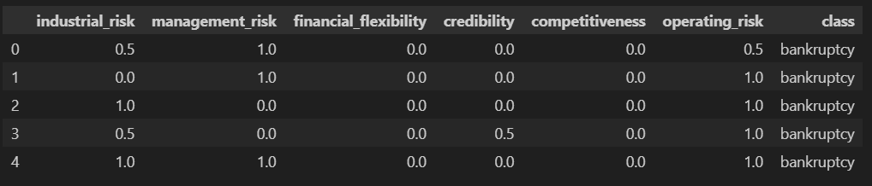
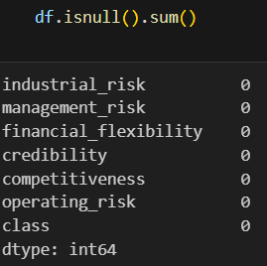
Initial Data Assessment
1
Data Structure
The dataset comprises 250 rows and 7 columns, including six numeric risk-related features and one categorical outcome variable ("class").
2
3
Data Completeness
Duplicate Records
The dataset has no missing values, ensuring data integrity for analysis and modeling purposes.
The dataset contains 147 duplicate entries, which were removed to ensure the uniqueness and validity of the analysis.

Slide 9
EDA
Exploratory Data Analysis
Descriptive Statistics
Key statistical measures such as mean, standard deviation, minimum, and maximum values provide insights into the distribution of risk factors.
Data Visualization
Visual tools like histograms, pair plots, and heatmaps are employed to explore relationships and patterns between variables and the target class.

Slide 10
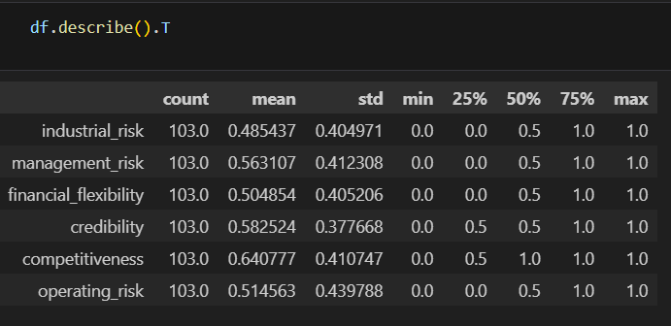
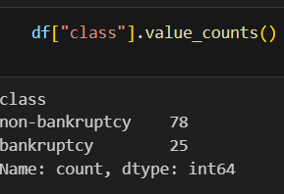
Descriptive Statistics

Slide 11
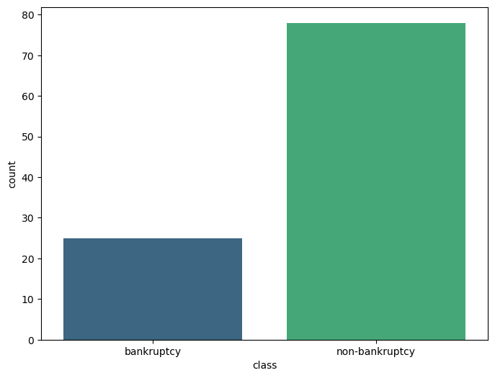
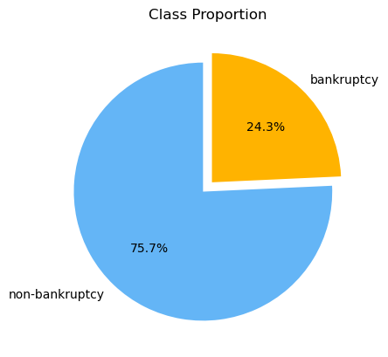
Data Visualization

Slide 12
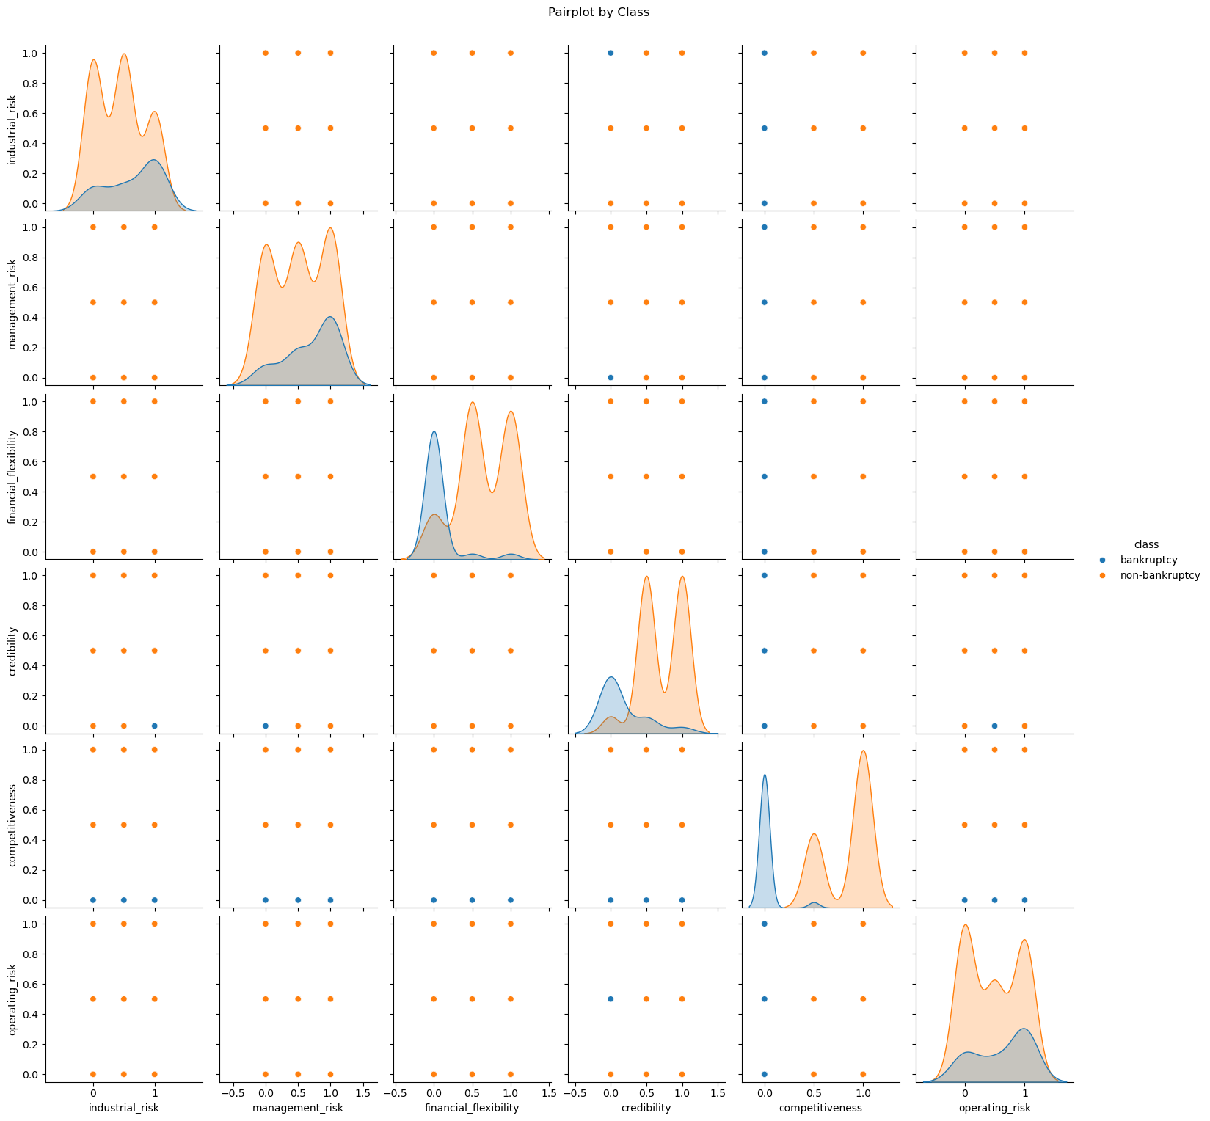
Data Visualization

Slide 13
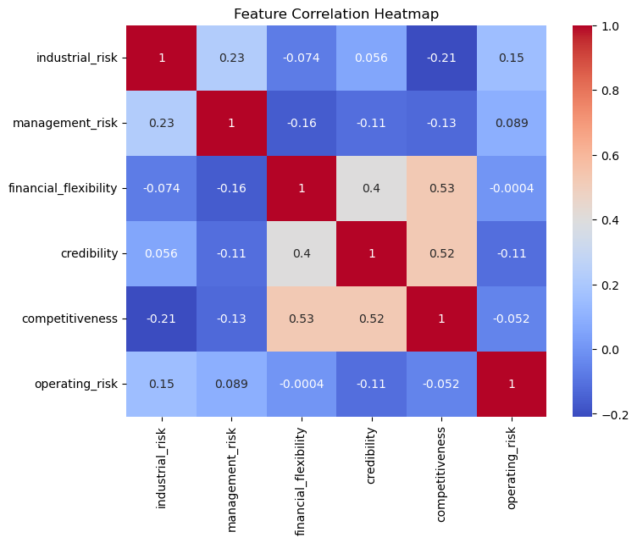
Data Visualization

Slide 14
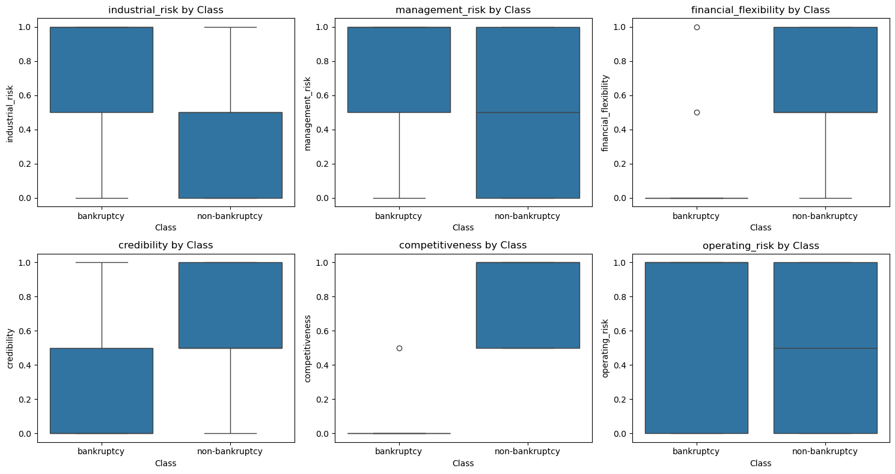
Data Visualization

Slide 15
Key Inferences from EDA
Dataset Characteristics
After removing duplicates, the dataset consists of 103 unique entries, maintaining data quality for subsequent modeling steps.
Class Imbalance
The dataset exhibits class imbalance, with 76% of cases labeled as "non-bankruptcy" and 24% as "bankruptcy", affecting model development strategies.

Slide 16
03
PART
Data Preprocessing and Feature Engineering

Slide 17
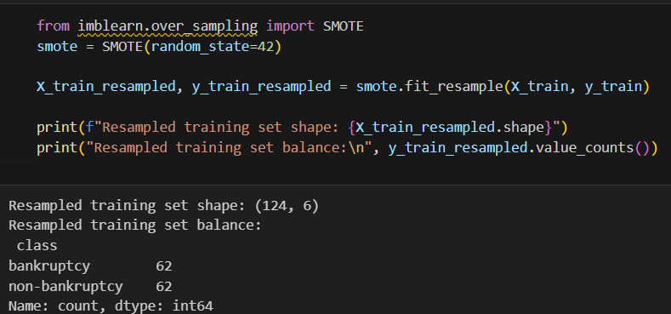
Addressing Class Imbalance
SMOTE Technique
The Synthetic Minority Over-sampling Technique (SMOTE) is utilized to balance the class distribution, enhancing model accuracy and robustness.
Importance
Resampling Outcomes
It ensures the model does not get biased towards majority class (non-bankruptcy), improving its ability to identify bankruptcy cases.
SMOTE equalizes the dataset, generating 62 samples for both "bankruptcy" and "non-bankruptcy" classes, enabling fair model learning.
01
03
02

Slide 18
S
Feature Selection and Engineering
Balancing Act
Prioritizing class balancing is crucial, as adding new features might increase overfitting risk due to the relatively small dataset size.
Existing Features
The dataset contains well-defined features closely linked to bankruptcy, reducing the need for extensive feature engineering.

Slide 19
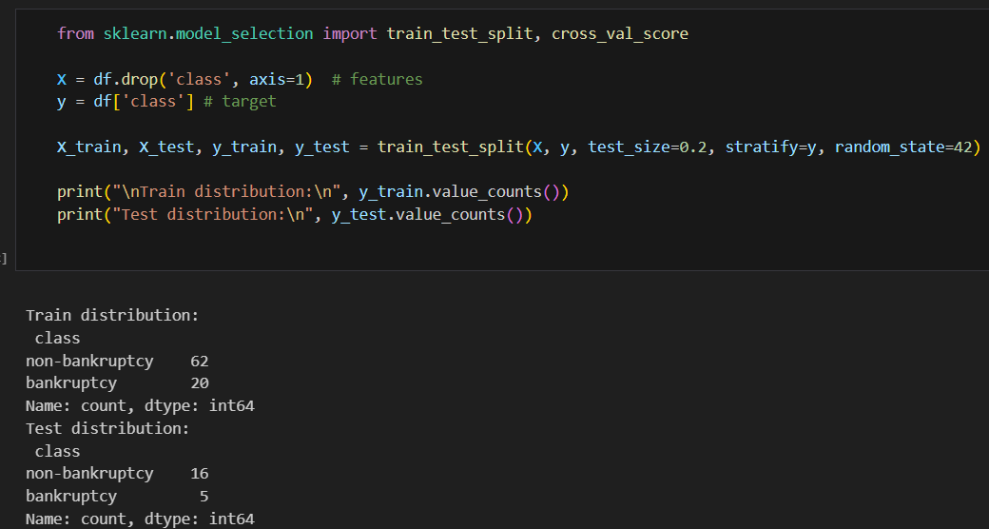
Train-Test Split
Splitting the Data
The dataset is divided into training (80%) and test (20%) sets, ensuring unbiased model evaluation and generalization.
Distribution Metrics
Stratified Sampling
The stratified split ensures that the distribution of bankruptcy and non-bankruptcy cases is similar in both training and testing sets.
Stratified sampling preserves the original class distribution in both sets, maintaining data representativeness.
01
03
02

Slide 20
04
PART
Model Development and Evaluation

Slide 21

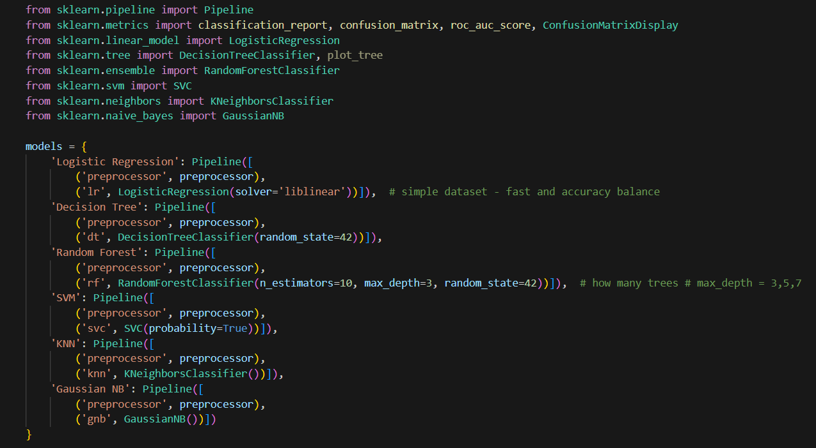
Model Selection
1
Algorithm Choices
Several classification algorithms were tested, including Logistic Regression, Decision Tree, Random Forest, SVM, KNN, and Gaussian NB.
2
Model Training
Each model is trained on the balanced training dataset using appropriate preprocessing steps like scaling and label encoding.
3
Justification
This comprehensive approach ensures a thorough evaluation to select the best-performing model for bankruptcy prediction.

Slide 22
Performance Metrics
Key Metrics
Confusion Matrices
Classification Reports
Evaluation metrics include precision, recall, F1-score, accuracy, AUC (Area Under the Curve), and confusion matrix.
Detailed classification reports provide insights into model performance at each class level, aiding in evaluating model effectiveness.
Confusion matrices visually represent prediction accuracy, highlighting true positives, true negatives, false positives, and false negatives.

Slide 23
Best Models
01.
02.
03.
Top Performers
AUC Scores
Model Selection
Logistic Regression, Decision Tree, Random Forest, SVM, KNN, and Gaussian NB achieved perfect scores, indicating strong predictive capabilities.
All selected models attained an AUC score of 1.0000, signifying exceptional ability to distinguish between bankruptcy and non-bankruptcy cases.
Perfect scores on small test data can indicate overfitting; better if we try on larger data, then we can know how our model performs.

Slide 24
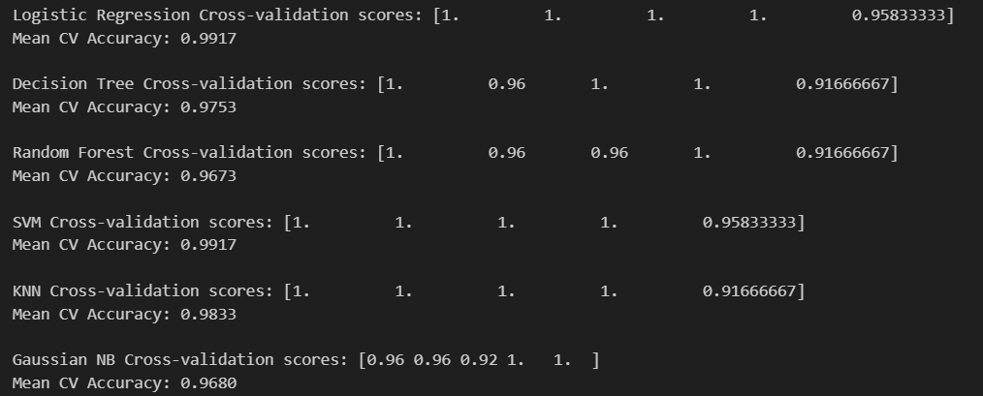
Best Models
01.
02.
03.
Top Performers
Cross Validation Score
Model Selection
Logistic Regression, Decision Tree, Random Forest, SVM, KNN, and Gaussian NB achieved perfect scores, indicating strong predictive capabilities.
All selected models attained an Cross validation score of above 0.95, signifying exceptional ability to distinguish between bankruptcy and non-bankruptcy cases.
Perfect scores on small test data can indicate overfitting; better if we try on larger data, then we can know how our model performs.

Slide 25
05
PART
Logistic Regression Analysis

Slide 26
Why We Choose Logistic Regression
1
Perfect for Binary Classification
4
Fast and Efficient
Logistic Regression is designed for Yes/No, 0/1, Good/Bad type predictions. Bankruptcy prediction is also binary — so it fits naturally.
Very quick to train even on large datasets. Good baseline model before trying complex algorithms.
2
5
Interpretable and Easy to Explain
Handles Probability Output
It tells how each feature affects the probability of an outcome. Stakeholders understand it easily: simple coefficients, odds, and probabilities.
It tells how each feature affects the probability of an outcome. Stakeholders understand it easily: simple coefficients, odds, and probabilities.
3
3
Less Prone to Overfitting (with Regularization)
Performs Well with Linearly Separable Data
Works very well when classes can be separated by a linear boundary. Often provides solid performance with minimal tuning.
L1/L2 regularization helps prevent overfitting. More stable and reliable as a first-choice model.

Slide 27
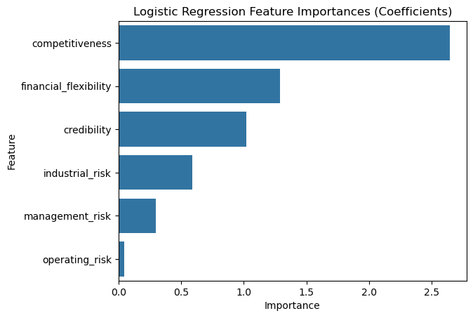
Feature Importance
1
Rationale
This analysis helps understand key drivers contributing to the prediction of bankruptcy, driving better decision-making.
2
Coefficient Analysis
The importance of each feature is determined based on the coefficients from the logistic regression model.
3
Key Influencers
Competitiveness, financial flexibility, and credibility are identified as the most influential factors in predicting bankruptcy risk.

Slide 28
Cross-Validation
Validation Process
Performance Metrics
Implications
Cross-validation is applied to ensure the robustness and reliability of the logistic regression model, guarding against overfitting.
Mean cross-validation accuracy scores range from 97% to 99%, affirming the model's accuracy and stability across varying data subsets.
Validating model consistency helps stakeholders have a higher degree of assurance in its predictive capabilities.
PART 01
PART 02
PART 03

Slide 29
05
PART
Model
Deployment

Slide 30
Deployment
Deployment Objective
Deploy the bankruptcy prediction model as an interactive web app. Allow users to input financial indicators and receive real-time predictions. Provide a simple, accessible interface for non-technical stakeholders.
Deployment Workflow
Pre-trained model loaded using joblib.
Dataset loaded to prefill inputs with realistic values.
User inputs collected through interactive number fields.
Prediction includes: Class label (Bankrupt / Non-Bankrupt) Probability score (0–100%)
PDF report generated for download.

Slide 31
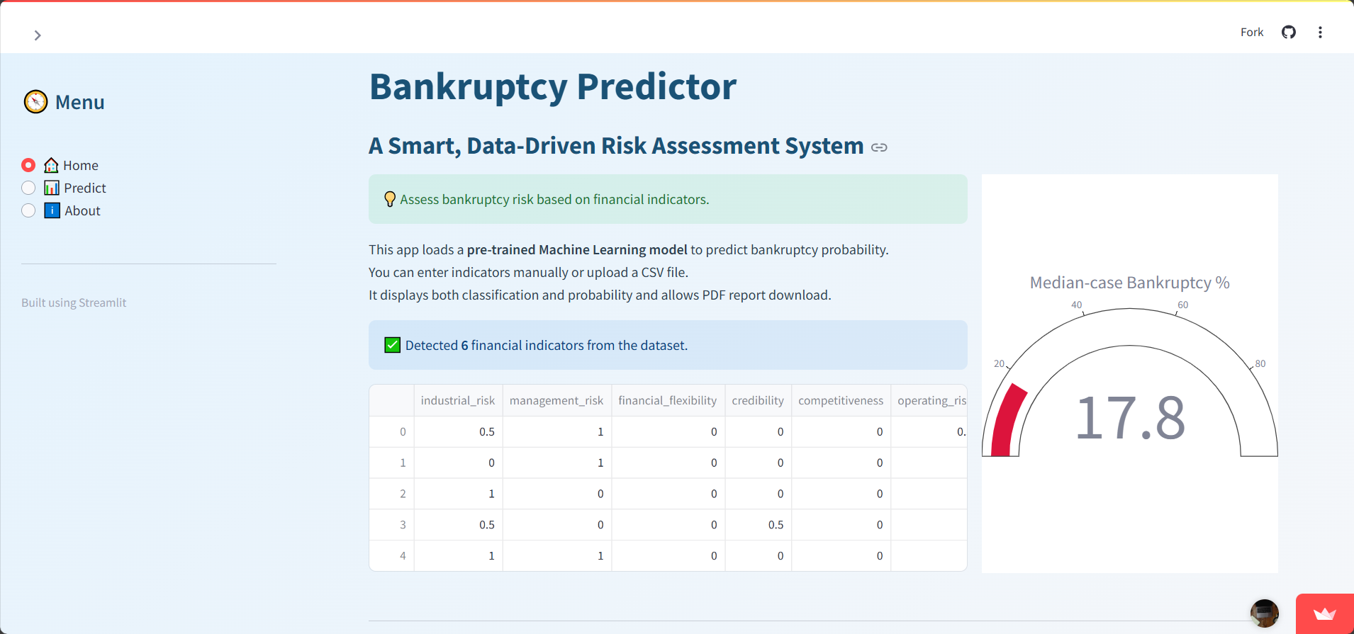
Output - Home

Slide 32
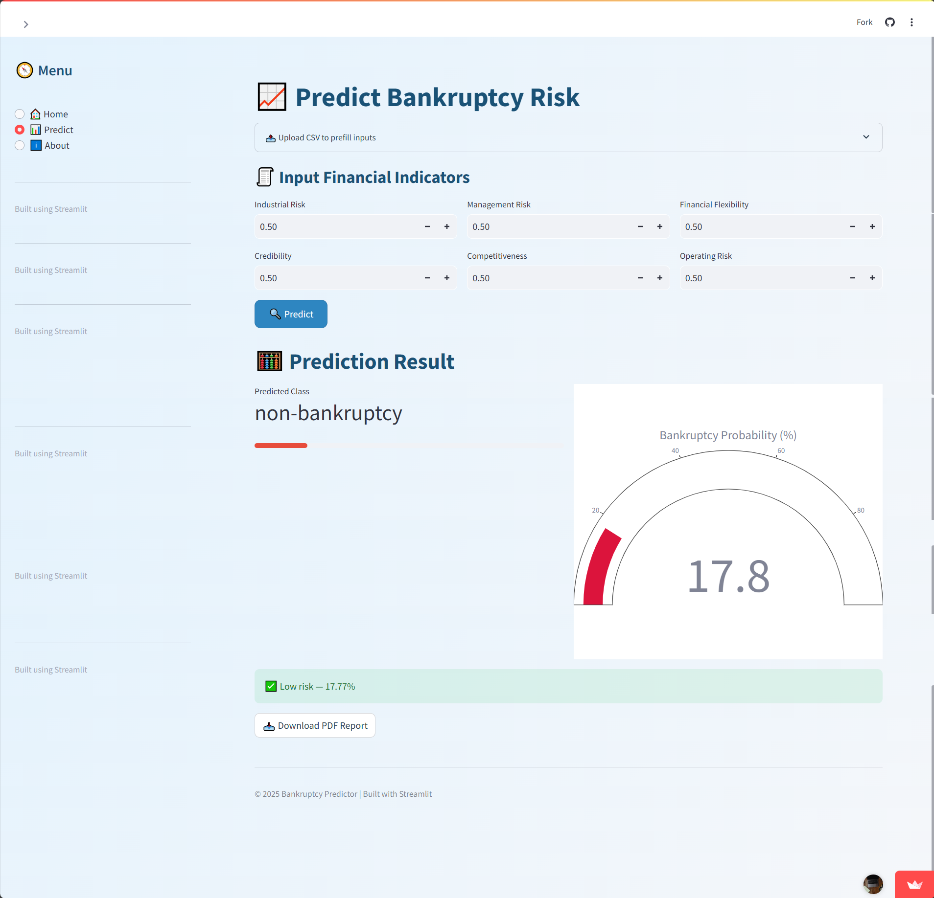
Output - Predict

Slide 33
06
PART
Conclusion and Recommendations

Slide 34
Summary of Findings
01
02
03
Key Outcomes
Model Performance
Business Impact
The project successfully developed predictive models capable of accurately distinguishing between companies at risk of bankruptcy and those that are not.
Logistic Regression was identified as a top-performing model, notable for its interpretability and effectiveness in feature importance analysis.
These models will provide actionable outputs (saved models, feature importance) for business decision-making, model fine-tuning, and future data collection.

Slide 35
Recommendations
01
Expand the Data
Expand the dataset with more features to enhance model performance and generalizability. These could include macroeconomic indicators, industry-specific metrics, and qualitative assessments.
Model Monitoring
02
Implement ongoing monitoring of the models to ensure sustained accuracy and relevance, adjusting as new data and economic conditions evolve.
03
Apply Ensemble Methods
Consider ensemble methods for increased prediction accuracy. These techniques combine multiple models to reduce bias and variance, potentially improving overall performance.

Slide 36
THANK
YOU
PPTTemplatehttp://www.1ppt.com/moban/

