Slide 1

Data-Intensive Text Processing with MapReduce
Tutorial at 2009 North American Chapter of the Association for Computational Linguistics―Human Language Technologies Conference (NAACL HLT 2009)
Jimmy Lin The iSchool
University of Maryland
Sunday, May 31, 2009
Chris Dyer
Department of Linguistics
University of Maryland
This work is licensed under a Creative Commons Attribution-Noncommercial-Share Alike 3.0 United States See http://creativecommons.org/licenses/by-nc-sa/3.0/us/ for details. PageRank slides adapted from slides by Christophe Bisciglia, Aaron Kimball, & Sierra Michels-Slettvet, Google Distributed Computing Seminar, 2007 (licensed under Creation Commons Attribution 3.0 License)

Slide 2
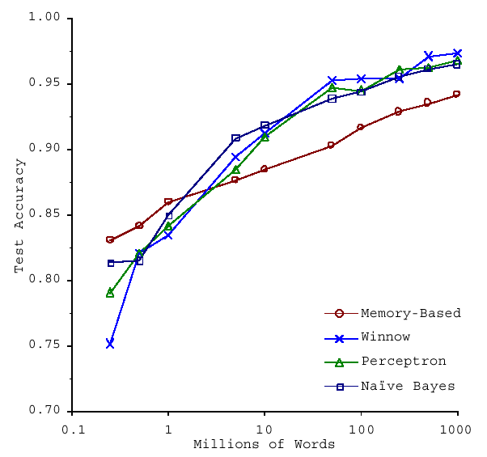
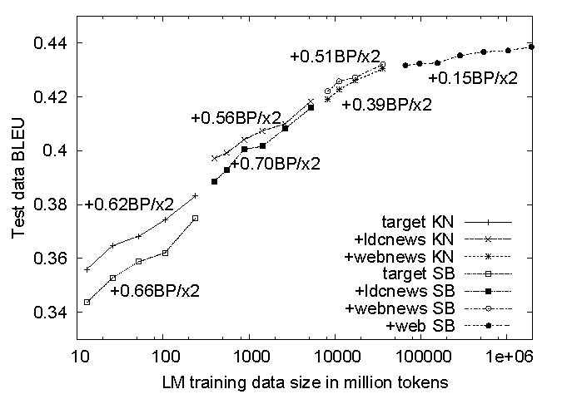
No data like more data!
s/knowledge/data/g;
How do we get here if we’re not Google?
(Banko and Brill, ACL 2001)
(Brants et al., EMNLP 2007)

Slide 3
cheap commodity clusters
(or utility computing)
+ simple, distributed programming models
= data-intensive computing for the masses!

Slide 4
Who are we?

Slide 5
Outline of Part I
(Jimmy)
Why is this different?
Introduction to MapReduce
MapReduce “killer app” #1: Inverted indexing
MapReduce “killer app” #2: Graph algorithms and PageRank

Slide 6
Outline of Part II
(Chris)
MapReduce algorithm design
Managing dependencies
Computing term co-occurrence statistics
Case study: statistical machine translation
Iterative algorithms in MapReduce
Expectation maximization
Gradient descent methods
Alternatives to MapReduce
What’s next?

Slide 7
But wait…
Bonus session in the afternoon (details at the end)
Come see me for your free $100 AWS credits! (Thanks to Amazon Web Services)
Sign up for account
Enter your code at http://aws.amazon.com/awscredits
Check out http://aws.amazon.com/education
Tutorial homepage (from my homepage)
These slides themselves (cc licensed)
Links to “getting started” guides
Look for Cloud⁹

Slide 8
Why is this different?

Slide 9
Divide and Conquer
“Work”
Partition
w₁
w₂
w₃
“worker”
“worker”
“worker”
r₁
r₂
r₃
Combine
“Result”

Slide 10
It’s a bit more complex…
Fundamental issues
scheduling, data distribution, synchronization, inter-process communication, robustness, fault tolerance, …
Different programming models
Message Passing
Shared Memory
Memory
P₁
P₂
P₃
P₄
P₅
P₁
P₂
P₃
P₄
P₅
Architectural issues
Flynn’s taxonomy (SIMD, MIMD, etc.), network typology, bisection bandwidth UMA vs. NUMA, cache coherence
Different programming constructs
mutexes, conditional variables, barriers, …
masters/slaves, producers/consumers, work queues, …
Common problems
livelock, deadlock, data starvation, priority inversion…
dining philosophers, sleeping barbers, cigarette smokers, …
The reality: programmer shoulders the burden of managing concurrency…

Slide 11
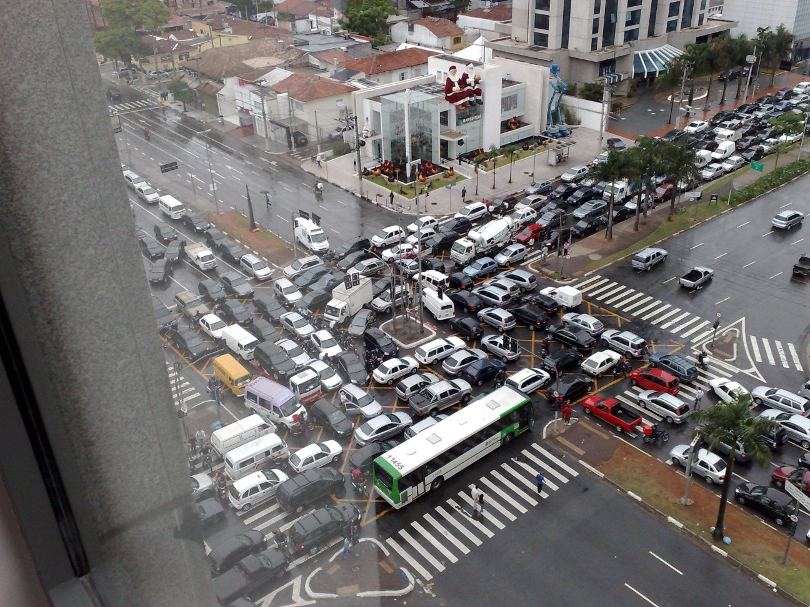
Source: Ricardo Guimarães Herrmann

Slide 12
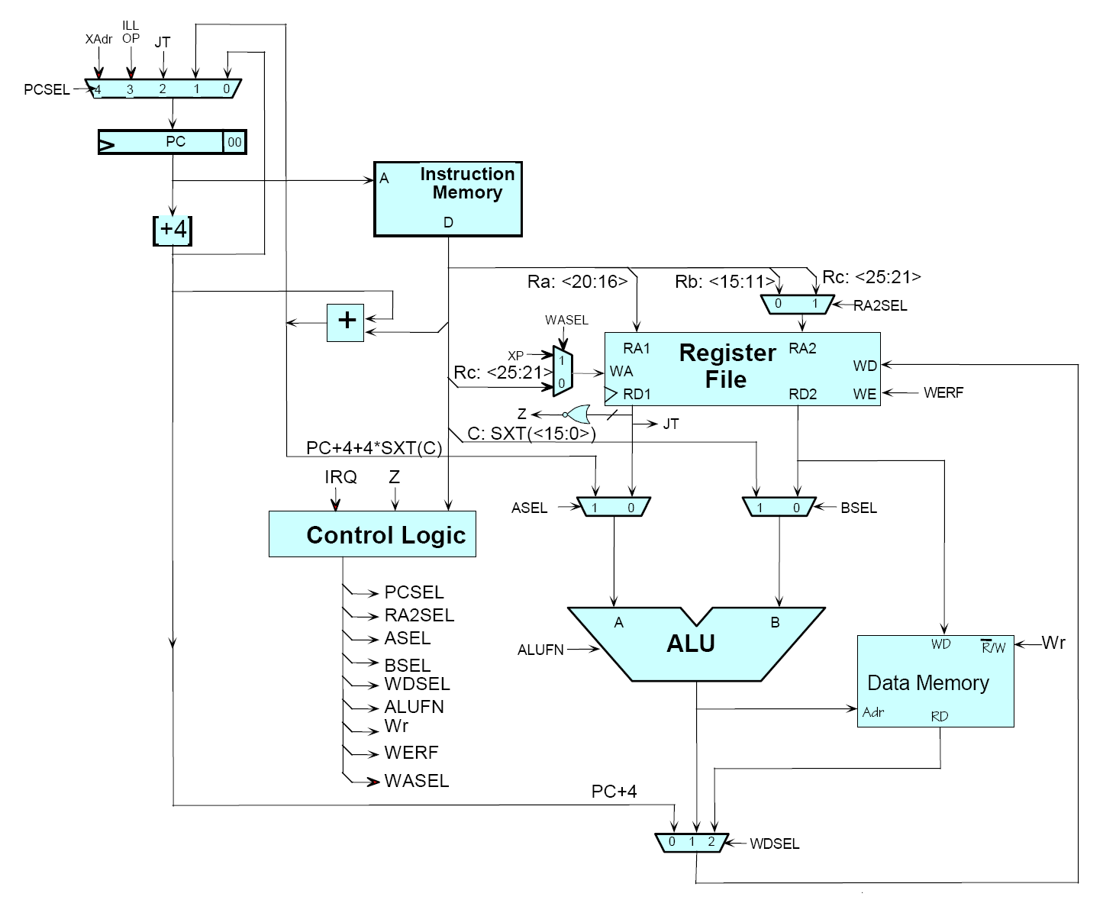
Source: MIT Open Courseware

Slide 13

Source: MIT Open Courseware

Slide 14
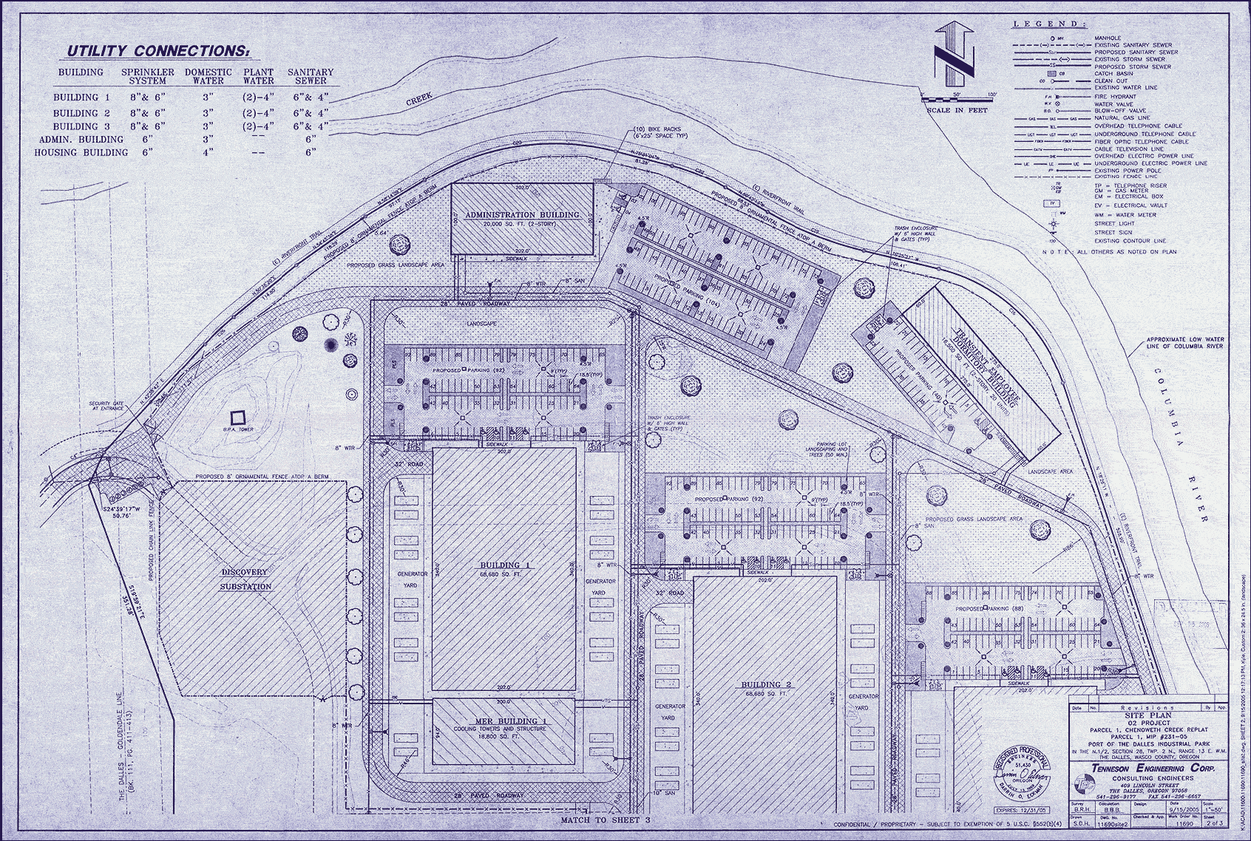
Source: Harper’s (Feb, 2008)

Slide 15
Typical Problem
Iterate over a large number of records
Extract something of interest from each
Shuffle and sort intermediate results
Aggregate intermediate results
Generate final output
Map
Reduce
Key idea: provide a functional abstraction for these two operations
(Dean and Ghemawat, OSDI 2004)

Slide 16
Map
f
f
f
f
f
Map
Fold
Reduce
g
g
g
g
g

Slide 17
MapReduce
Programmers specify two functions:
map (k, v) → <k’, v’>*
reduce (k’, v’) → <k’, v’>*
All values with the same key are reduced together
Usually, programmers also specify:
partition (k’, number of partitions) → partition for k’
Often a simple hash of the key, e.g. hash(k’) mod n
Allows reduce operations for different keys in parallel
combine (k’, v’) → <k’, v’>*
Mini-reducers that run in memory after the map phase
Used as an optimization to reducer network traffic
Implementations:
Google has a proprietary implementation in C++
Hadoop is an open source implementation in Java

Slide 18
k₁
v₁
k₂
v₂
k₃
v₃
k₄
v₄
k₅
v₅
k₆
v₆
map
map
map
map
a
1
b
2
c
3
c
6
a
5
c
2
b
7
c
9
Shuffle and Sort: aggregate values by keys
a
1
5
b
2
7
c
2
3
6
9
reduce
reduce
reduce
r₁
s₁
r₂
s₂
r₃
s₃

Slide 19
MapReduce Runtime
Handles scheduling
Assigns workers to map and reduce tasks
Handles “data distribution”
Moves the process to the data
Handles synchronization
Gathers, sorts, and shuffles intermediate data
Handles faults
Detects worker failures and restarts
Everything happens on top of a distributed FS (later)

Slide 20
“Hello World”: Word Count
Map(String input_key, String input_value):
// input_key: document name
// input_value: document contents
for each word w in input_values:
EmitIntermediate(w, "1");
Reduce(String key, Iterator intermediate_values):
// key: a word, same for input and output
// intermediate_values: a list of counts
int result = 0;
for each v in intermediate_values:
result += ParseInt(v);
Emit(AsString(result));

Slide 21
User Program
(1) fork
(1) fork
(1) fork
Master
(2) assign map
(2) assign reduce
worker
split 0
(6) write
output
file 0
split 1
(3) read
(5) remote read
worker
split 2
(4) local write
split 3
worker
split 4
worker
output
file 1
worker
Input
files
Map
phase
Intermediate files
(on local disk)
Reduce
phase
Output
files
Redrawn from (Dean and Ghemawat, OSDI 2004)

Slide 22

How do we get data to the workers?
NAS
SAN
Compute Nodes
What’s the problem here?

Slide 23
Distributed File System
Don’t move data to workers… Move workers to the data!
Store data on the local disks for nodes in the cluster
Start up the workers on the node that has the data local
Why?
Not enough RAM to hold all the data in memory
Disk access is slow, disk throughput is good
A distributed file system is the answer
GFS (Google File System)
HDFS for Hadoop (= GFS clone)

Slide 24
GFS: Assumptions
Commodity hardware over “exotic” hardware
High component failure rates
Inexpensive commodity components fail all the time
“Modest” number of HUGE files
Files are write-once, mostly appended to
Perhaps concurrently
Large streaming reads over random access
High sustained throughput over low latency
GFS slides adapted from material by (Ghemawat et al., SOSP 2003)

Slide 25
GFS: Design Decisions
Files stored as chunks
Fixed size (64MB)
Reliability through replication
Each chunk replicated across 3+ chunkservers
Single master to coordinate access, keep metadata
Simple centralized management
No data caching
Little benefit due to large data sets, streaming reads
Simplify the API
Push some of the issues onto the client

Slide 26
Application
GFS master
/foo/bar
(file name, chunk index)
GSF Client
File namespace
chunk 2ef0
(chunk handle, chunk location)
Instructions to chunkserver
(chunk handle, byte range)
Chunkserver state
GFS chunkserver
GFS chunkserver
chunk data
Linux file system
Linux file system
…
…
Redrawn from (Ghemawat et al., SOSP 2003)

Slide 27
Master’s Responsibilities
Metadata storage
Namespace management/locking
Periodic communication with chunkservers
Chunk creation, re-replication, rebalancing
Garbage Collection

Slide 28
Questions?

Slide 29
MapReduce “killer app” #1:
Inverted Indexing

Slide 30
Text Retrieval: Topics
Introduction to information retrieval (IR)
Boolean retrieval
Ranked retrieval
Inverted indexing with MapReduce

Slide 31
Architecture of IR Systems
Documents
Query
online
offline
Representation
Function
Representation
Function
Query Representation
Document Representation
Index
Comparison
Function
Hits

Slide 32
How do we represent text?
Documents → “Bag of words”
Assumptions
Term occurrence is independent
Document relevance is independent
“Words” are well-defined

Slide 33
Inverted Indexing: Boolean Retrieval
Document 1
Term
Document 1
Stopword
List
Document 2
The quick brown
fox jumped over
the lazy dog’s
back.
aid
0
1
for
all
0
1
is
back
1
0
of
brown
1
0
the
come
0
1
to
dog
1
0
fox
1
0
Document 2
good
0
1
jump
1
0
lazy
1
0
Now is the time
for all good men
to come to the
aid of their party.
men
0
1
now
0
1
over
1
0
party
0
1
quick
1
0
their
0
1
time
0
1
Notes:
9

Slide 34
Inverted Indexing: Postings
Term
Doc 2
Term
Postings
Doc 3
Doc 1
Doc 4
Doc 5
Doc 6
Doc 7
Doc 8
aid
0
0
0
1
0
0
0
1
aid
4
8
all
0
1
0
1
0
1
0
0
all
2
4
6
back
1
0
1
0
0
0
1
0
back
1
3
7
brown
1
0
1
0
1
0
1
0
brown
1
3
5
7
come
0
1
0
1
0
1
0
1
come
2
4
6
8
dog
0
0
1
0
1
0
0
0
dog
3
5
fox
0
0
1
0
1
0
1
0
fox
3
5
7
good
0
1
0
1
0
1
0
1
good
2
4
6
8
jump
0
0
1
0
0
0
0
0
jump
3
lazy
1
0
1
0
1
0
1
0
lazy
1
3
5
7
men
0
1
0
1
0
0
0
1
men
2
4
8
now
0
1
0
0
0
1
0
1
now
2
6
8
over
1
0
1
0
1
0
1
1
over
1
3
5
7
8
party
0
0
0
0
0
1
0
1
party
6
8
quick
1
0
1
0
0
0
0
0
quick
1
3
their
1
0
0
0
1
0
1
0
their
1
5
7
time
0
1
0
1
0
1
0
0
time
2
4
6
Notes:
12

Slide 35
Boolean Retrieval
To execute a Boolean query:
Build query syntax tree
For each clause, look up postings
Traverse postings and apply Boolean operator
Efficiency analysis
Postings traversal is linear (assuming sorted postings)
Start with shortest posting first
AND
( fox or dog ) and quick
quick
OR
fox
dog
dog
3
5
fox
3
5
7
dog
3
5
OR = union
fox
3
5
7
3
5
7

Slide 36
Ranked Retrieval
Order documents by likelihood of relevance
Estimate relevance(d_{i}, q)
Sort documents by relevance
Display sorted results
Vector space model (leave aside LM’s for now):
Documents → weighted feature vector
Query → weighted feature vector
Cosine similarity:
Inner product:

Slide 37
TF.IDF Term Weighting
weight assigned to term i in document j
number of occurrence of term i in document j
number of documents in entire collection
number of documents with term i

Slide 38
Postings for Ranked Retrieval
tf
1
2
3
4
idf
complicated
5
2
0.301
complicated
0.301
3,5
4,2
contaminated
4
1
3
0.125
contaminated
0.125
1,4
2,1
3,3
fallout
5
4
3
0.125
fallout
0.125
1,5
3,4
4,3
information
6
3
3
2
0.000
information
0.000
1,6
2,3
3,3
4,2
interesting
1
0.602
interesting
0.602
2,1
nuclear
3
7
0.301
nuclear
0.301
1,3
3,7
retrieval
6
1
4
0.125
retrieval
0.125
2,6
3,1
4,4
siberia
2
0.602
siberia
0.602
1,2

Slide 39
Ranked Retrieval: Scoring Algorithm
Initialize accumulators to hold document scores
For each query term t in the user’s query
Fetch t’s postings
For each document, score_{doc} += w_{t,d} × w_{t,q}
(Apply length normalization to the scores at end)
Return top N documents

Slide 40
MapReduce it?
The indexing problem
Must be relatively fast, but need not be real time
For Web, incremental updates are important
Crawling is a challenge in itself!
The retrieval problem
Must have sub-second response
For Web, only need relatively few results

Slide 41
Indexing: Performance Analysis
Fundamentally, a large sorting problem
Terms usually fit in memory
Postings usually don’t
How is it done on a single machine?
How large is the inverted index?
Size of vocabulary
Size of postings

Slide 42
Vocabulary Size: Heaps’ Law
V is vocabulary size
n is corpus size (number of documents)
K and β are constants
Typically, K is between 10 and 100, β is between 0.4 and 0.6
When adding new documents, the system is likely to have seen most terms already… but the postings keep growing
Notes:
22

Slide 43
Postings Size: Zipf’s Law
f = frequency
r = rank
c = constant
or
A few words occur frequently… most words occur infrequently

Slide 44
MapReduce: Index Construction
Map over all documents
Emit term as key, (docid, tf) as value
Emit other information as necessary (e.g., term position)
Reduce
Trivial: each value represents a posting!
Might want to sort the postings (e.g., by docid or tf)
MapReduce does all the heavy lifting!

Slide 45
Query Execution?
MapReduce is meant for large-data batch processing
Not suitable for lots of real time operations requiring low latency
The solution: “the secret sauce”
Document partitioning
Lots of system engineering: e.g., caching, load balancing, etc.

Slide 46
Questions?

Slide 47
MapReduce “killer app” #2:
Graph Algorithms

Slide 48
Graph Algorithms: Topics
Introduction to graph algorithms and graph representations
Single Source Shortest Path (SSSP) problem
Refresher: Dijkstra’s algorithm
Breadth-First Search with MapReduce
PageRank

Slide 49
What’s a graph?
G = (V,E), where
V represents the set of vertices (nodes)
E represents the set of edges (links)
Both vertices and edges may contain additional information
Different types of graphs:
Directed vs. undirected edges
Presence or absence of cycles
...

Slide 50
Some Graph Problems
Finding shortest paths
Routing Internet traffic and UPS trucks
Finding minimum spanning trees
Telco laying down fiber
Finding Max Flow
Airline scheduling
Identify “special” nodes and communities
Breaking up terrorist cells, spread of avian flu
Bipartite matching
Monster.com, Match.com
And of course... PageRank

Slide 51
Representing Graphs
G = (V, E)
Two common representations
Adjacency matrix
Adjacency list

Slide 52
Adjacency Matrices
Represent a graph as an n x n square matrix M
n = |V|
M_{ij} = 1 means a link from node i to j
2
 | 1 | 2 | 3 | 4
1 | 0 | 1 | 0 | 1
2 | 1 | 0 | 1 | 1
3 | 1 | 0 | 0 | 0
4 | 1 | 0 | 1 | 0
1
3
4

Slide 53
Adjacency Lists
Take adjacency matrices… and throw away all the zeros
 | 1 | 2 | 3 | 4
1 | 0 | 1 | 0 | 1
2 | 1 | 0 | 1 | 1
3 | 1 | 0 | 0 | 0
4 | 1 | 0 | 1 | 0
1: 2, 4
2: 1, 3, 4
3: 1
4: 1, 3

Slide 54
Single Source Shortest Path
Problem: find shortest path from a source node to one or more target nodes
First, a refresher: Dijkstra’s Algorithm

Slide 55
Dijkstra’s Algorithm Example
∞
∞
1
10
0
2
3
9
4
6
5
7
∞
∞
2
Example from CLR

Slide 56
Dijkstra’s Algorithm Example
10
∞
1
10
0
2
3
9
4
6
5
7
5
∞
2
Example from CLR

Slide 57
Dijkstra’s Algorithm Example
8
14
1
10
0
2
3
9
4
6
5
7
5
7
2
Example from CLR

Slide 58
Dijkstra’s Algorithm Example
8
13
1
10
0
2
3
9
4
6
5
7
5
7
2
Example from CLR

Slide 59
Dijkstra’s Algorithm Example
8
9
1
10
0
2
3
9
4
6
5
7
5
7
2
Example from CLR

Slide 60
Dijkstra’s Algorithm Example
8
9
1
10
0
2
3
9
4
6
5
7
5
7
2
Example from CLR

Slide 61
Single Source Shortest Path
Problem: find shortest path from a source node to one or more target nodes
Single processor machine: Dijkstra’s Algorithm
MapReduce: parallel Breadth-First Search (BFS)

Slide 62
Finding the Shortest Path
First, consider equal edge weights
Solution to the problem can be defined inductively
Here’s the intuition:
DistanceTo(startNode) = 0
For all nodes n directly reachable from startNode, DistanceTo(n) = 1
For all nodes n reachable from some other set of nodes S, DistanceTo(n) = 1 + min(DistanceTo(m), m ∈ S)

Slide 63
From Intuition to Algorithm
A map task receives
Key: node n
Value: D (distance from start), points-to (list of nodes reachable from n)
∀p ∈ points-to: emit (p, D+1)
The reduce task gathers possible distances to a given p and selects the minimum one

Slide 64
Multiple Iterations Needed
This MapReduce task advances the “known frontier” by one hop
Subsequent iterations include more reachable nodes as frontier advances
Multiple iterations are needed to explore entire graph
Feed output back into the same MapReduce task
Preserving graph structure:
Problem: Where did the points-to list go?
Solution: Mapper emits (n, points-to) as well

Slide 65
Visualizing Parallel BFS
3
1
2
2
2
3
3
3
4
4

Slide 66
Weighted Edges
Now add positive weights to the edges
Simple change: points-to list in map task includes a weight w for each pointed-to node
emit (p, D+w_{p}) instead of (p, D+1) for each node p

Slide 67
Comparison to Dijkstra
Dijkstra’s algorithm is more efficient
At any step it only pursues edges from the minimum-cost path inside the frontier
MapReduce explores all paths in parallel

Slide 68
Random Walks Over the Web
Model:
User starts at a random Web page
User randomly clicks on links, surfing from page to page
PageRank = the amount of time that will be spent on any given page

Slide 69
PageRank: Defined
Given page x with in-bound links t₁…t_{n}, where
C(t) is the out-degree of t
α is probability of random jump
N is the total number of nodes in the graph
t₁
X
t₂
…
t_{n}

Slide 70
Computing PageRank
Properties of PageRank
Can be computed iteratively
Effects at each iteration is local
Sketch of algorithm:
Start with seed PR_{i} values
Each page distributes PR_{i} “credit” to all pages it links to
Each target page adds up “credit” from multiple in-bound links to compute PR_{i+1}
Iterate until values converge

Slide 71
PageRank in MapReduce
Map: distribute PageRank “credit” to link targets
Reduce: gather up PageRank “credit” from multiple sources to compute new PageRank value
Iterate until
convergence
...

Slide 72
PageRank: Issues
Is PageRank guaranteed to converge? How quickly?
What is the “correct” value of α, and how sensitive is the algorithm to it?
What about dangling links?
How do you know when to stop?

Slide 73
Graph Algorithms in MapReduce
General approach:
Store graphs as adjacency lists
Each map task receives a node and its outlinks (adjacency list)
Map task compute some function of the link structure, emits value with target as the key
Reduce task collects keys (target nodes) and aggregates
Iterate multiple MapReduce cycles until some termination condition
Remember to “pass” graph structure from one iteration to next

Slide 74
Questions?

Slide 75
Outline of Part II
MapReduce algorithm design
Managing dependencies
Computing term co-occurrence statistics
Case study: statistical machine translation
Iterative algorithms in MapReduce
Expectation maximization
Gradient descent methods
Alternatives to MapReduce
What’s next?

Slide 76
MapReduce Algorithm Design
Adapted from work reported in (Lin, EMNLP 2008)

Slide 77
Managing Dependencies
Remember: Mappers run in isolation
You have no idea in what order the mappers run
You have no idea on what node the mappers run
You have no idea when each mapper finishes
Tools for synchronization:
Ability to hold state in reducer across multiple key-value pairs
Sorting function for keys
Partitioner
Cleverly-constructed data structures

Slide 78
Motivating Example
Term co-occurrence matrix for a text collection
M = N x N matrix (N = vocabulary size)
M_{ij}: number of times i and j co-occur in some context (for concreteness, let’s say context = sentence)
Why?
Distributional profiles as a way of measuring semantic distance
Semantic distance useful for many language processing tasks

Slide 79
MapReduce: Large Counting Problems
Term co-occurrence matrix for a text collection = specific instance of a large counting problem
A large event space (number of terms)
A large number of observations (the collection itself)
Goal: keep track of interesting statistics about the events
Basic approach
Mappers generate partial counts
Reducers aggregate partial counts
How do we aggregate partial counts efficiently?

Slide 80
First Try: “Pairs”
Each mapper takes a sentence:
Generate all co-occurring term pairs
For all pairs, emit (a, b) → count
Reducers sums up counts associated with these pairs
Use combiners!

Slide 81
“Pairs” Analysis
Advantages
Easy to implement, easy to understand
Disadvantages
Lots of pairs to sort and shuffle around (upper bound?)

Slide 82
Another Try: “Stripes”
Idea: group together pairs into an associative array
Each mapper takes a sentence:
Generate all co-occurring term pairs
For each term, emit a → { b: count_{b}, c: count_{c}, d: count_{d} … }
Reducers perform element-wise sum of associative arrays
(a, b) → 1
(a, c) → 2
(a, d) → 5
(a, e) → 3
(a, f) → 2
a → { b: 1, c: 2, d: 5, e: 3, f: 2 }
a → { b: 1, d: 5, e: 3 }
a → { b: 1, c: 2, d: 2, f: 2 }
a → { b: 2, c: 2, d: 7, e: 3, f: 2 }
+

Slide 83
“Stripes” Analysis
Advantages
Far less sorting and shuffling of key-value pairs
Can make better use of combiners
Disadvantages
More difficult to implement
Underlying object is more heavyweight
Fundamental limitation in terms of size of event space

Slide 84
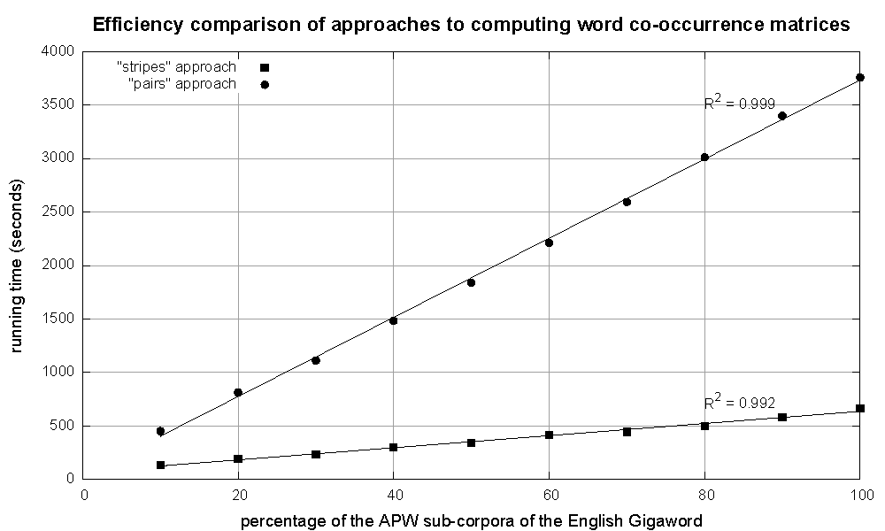
Cluster size: 38 cores
Data Source: Associated Press Worldstream (APW) of the English Gigaword Corpus (v3), which contains 2.27 million documents (1.8 GB compressed, 5.7 GB uncompressed)

Slide 85
Conditional Probabilities
How do we estimate conditional probabilities from counts?
Why do we want to do this?
How do we do this with MapReduce?

Slide 86
P(B|A): “Stripes”
Easy!
One pass to compute (a, *)
Another pass to directly compute P(B|A)
a → {b₁:3, b₂ :12, b₃ :7, b₄ :1, … }

Slide 87
P(B|A): “Pairs”
For this to work:
Must emit extra (a, *) for every b_{n} in mapper
Must make sure all a’s get sent to same reducer (use partitioner)
Must make sure (a, *) comes first (define sort order)
Must hold state in reducer across different key-value pairs
(a, *) → 32
Reducer holds this value in memory
(a, b₁) → 3
(a, b₂) → 12
(a, b₃) → 7
(a, b₄) → 1
…
(a, b₁) → 3 / 32
(a, b₂) → 12 / 32
(a, b₃) → 7 / 32
(a, b₄) → 1 / 32
…

Slide 88
Synchronization in Hadoop
Approach 1: turn synchronization into an ordering problem
Sort keys into correct order of computation
Partition key space so that each reducer gets the appropriate set of partial results
Hold state in reducer across multiple key-value pairs to perform computation
Illustrated by the “pairs” approach
Approach 2: construct data structures that “bring the pieces together”
Each reducer receives all the data it needs to complete the computation
Illustrated by the “stripes” approach

Slide 89
Issues and Tradeoffs
Number of key-value pairs
Object creation overhead
Time for sorting and shuffling pairs across the network
Size of each key-value pair
De/serialization overhead
Combiners make a big difference!
RAM vs. disk and network
Arrange data to maximize opportunities to aggregate partial results

Slide 90
Questions?

Slide 91
Case study:
statistical machine translation

Slide 92
Statistical Machine Translation
Conceptually simple: (translation from foreign f into English e)
Difficult in practice!
Phrase-Based Machine Translation (PBMT) :
Break up source sentence into little pieces (phrases)
Translate each phrase individually
Dyer et al. (Third ACL Workshop on MT, 2008)

Slide 93
Maria
no
dio
una
bofetada
a
la
bruja
verde
Mary
not
give
a
slap
to
the
witch
green
did not
a slap
by
green witch
no
slap
to the
did not give
to
the
slap
the witch
Example from Koehn (2006)

Slide 94
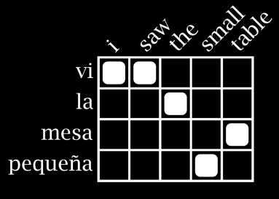
MT Architecture
Training Data
Word Alignment
Phrase Extraction
i saw the small table
(vi, i saw)
(la mesa pequeña, the small table)
…
vi la mesa pequeña
Parallel Sentences
he sat at the table
the service was good
Language Model
Translation Model
Target-Language Text
Decoder
maria no daba una bofetada a la bruja verde
mary did not slap the green witch
Foreign Input Sentence
English Output Sentence

Slide 95
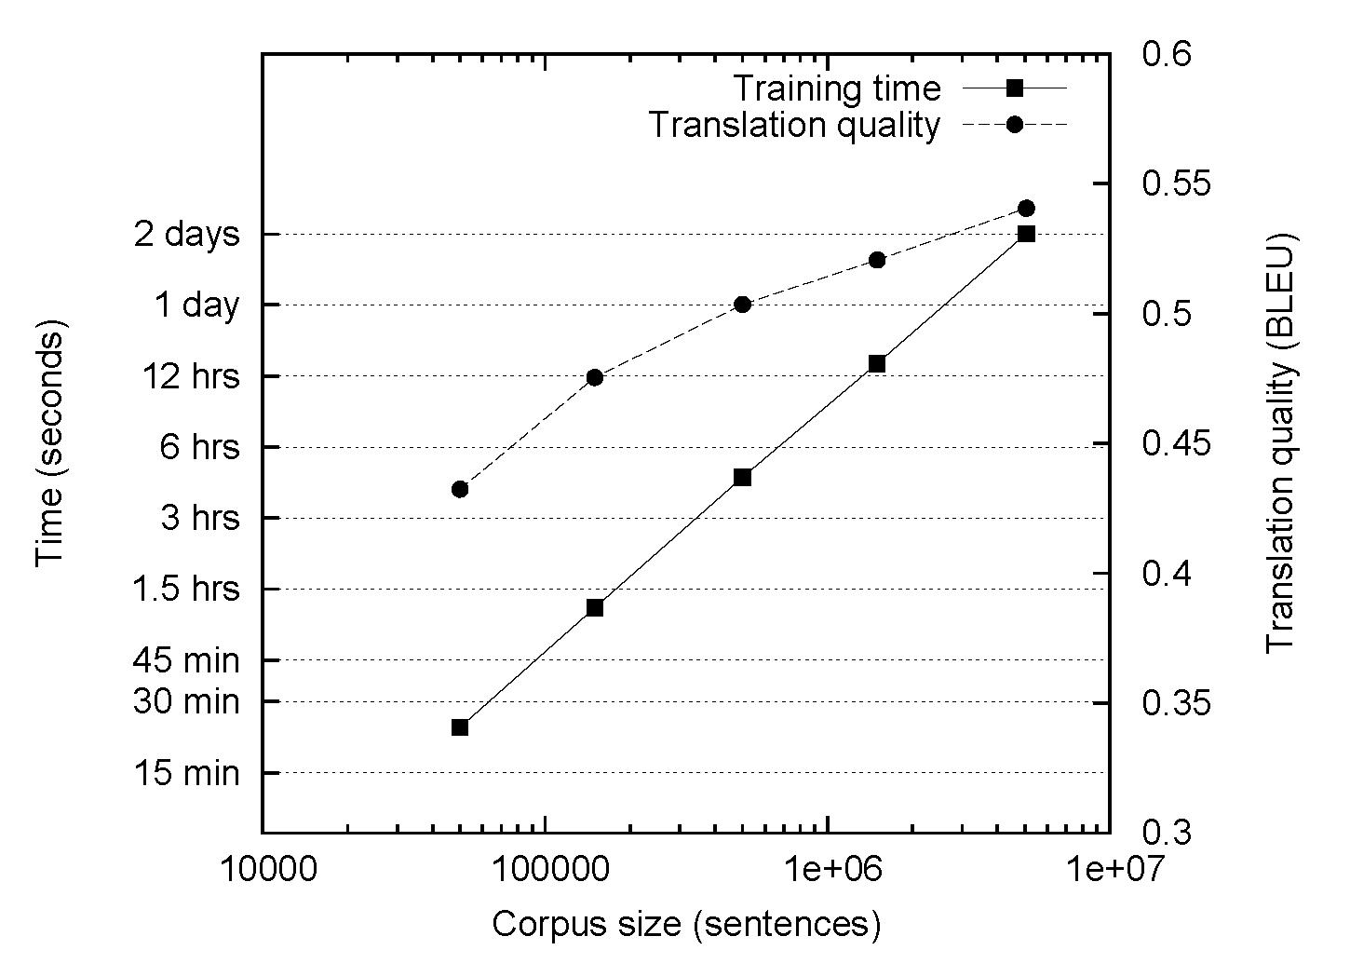
The Data Bottleneck

Slide 96
MT Architecture
There are MapReduce Implementations of these two components!
Training Data
Word Alignment
Phrase Extraction
i saw the small table
(vi, i saw)
(la mesa pequeña, the small table)
…
vi la mesa pequeña
Parallel Sentences
he sat at the table
the service was good
Language Model
Translation Model
Target-Language Text
Decoder
maria no daba una bofetada a la bruja verde
mary did not slap the green witch
Foreign Input Sentence
English Output Sentence

Slide 97
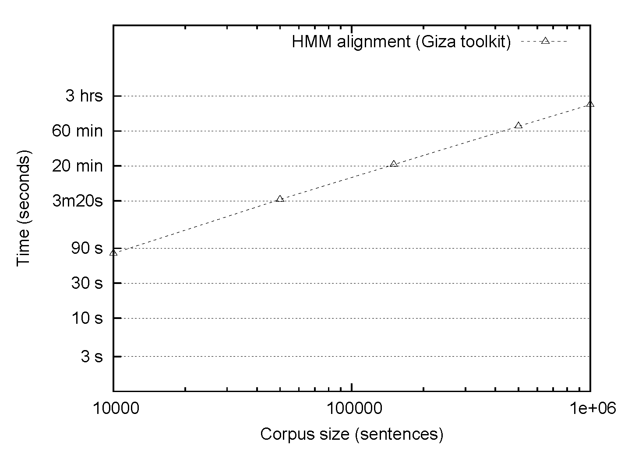
HMM Alignment: Giza
Single-core commodity server

Slide 98
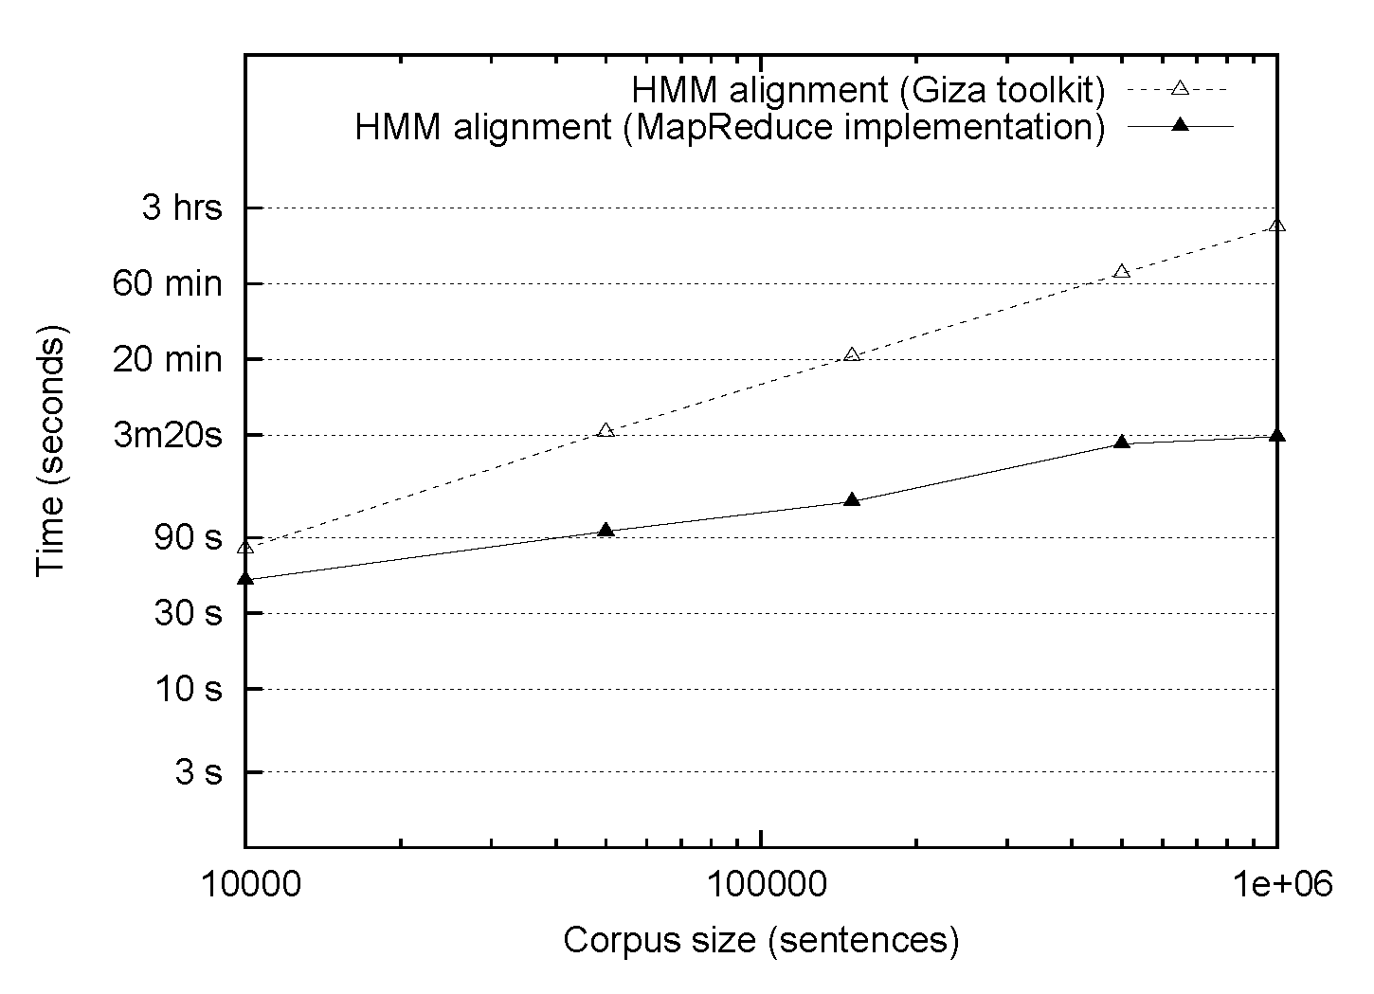
HMM Alignment: MapReduce
Single-core commodity server
38 processor cluster

Slide 99
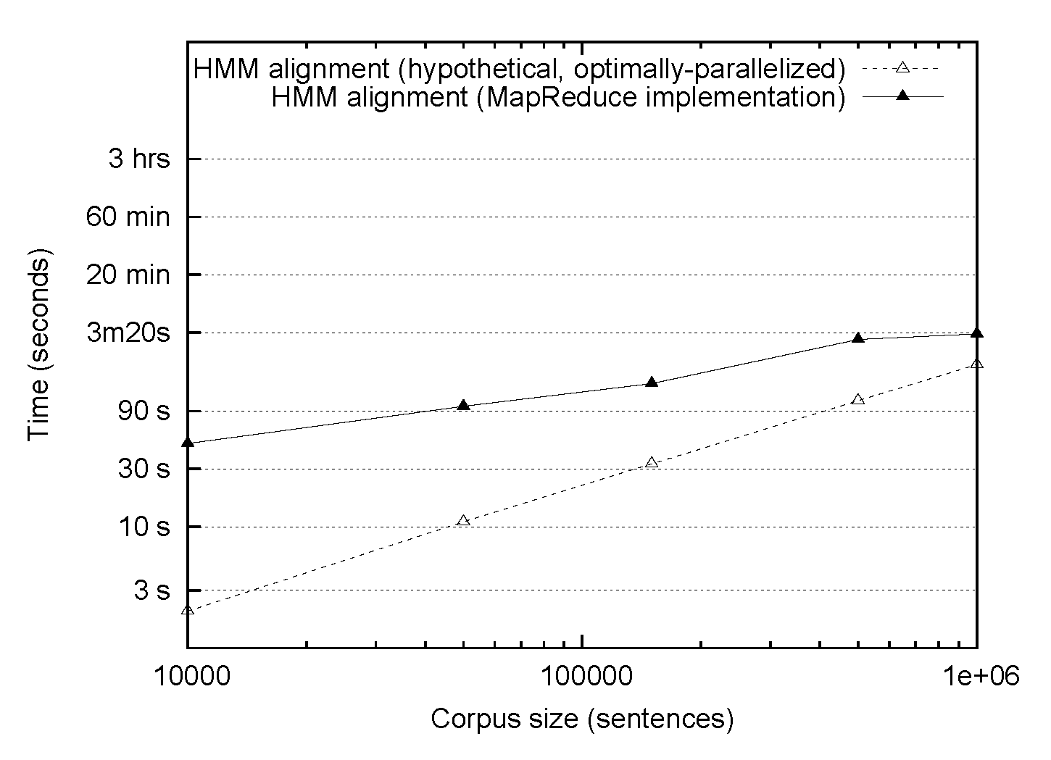
HMM Alignment: MapReduce
38 processor cluster
1/38 Single-core commodity server

Slide 100
MT Architecture
There are MapReduce Implementations of these two components!
Training Data
Word Alignment
Phrase Extraction
i saw the small table
(vi, i saw)
(la mesa pequeña, the small table)
…
vi la mesa pequeña
Parallel Sentences
he sat at the table
the service was good
Language Model
Translation Model
Target-Language Text
Decoder
maria no daba una bofetada a la bruja verde
mary did not slap the green witch
Foreign Input Sentence
English Output Sentence

Slide 101
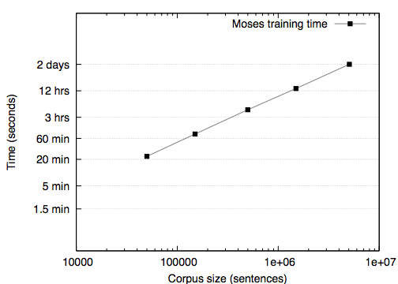
Phrase table construction
Single-core commodity server
Single-core commodity server

Slide 102
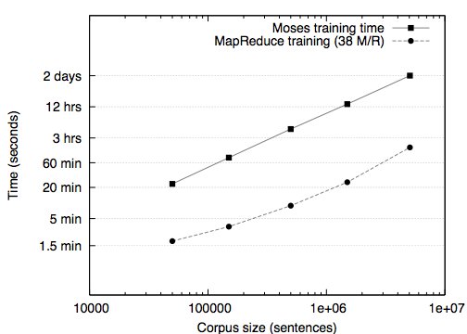
Phrase table construction
Single-core commodity server
Single-core commodity server
38 proc. cluster

Slide 103
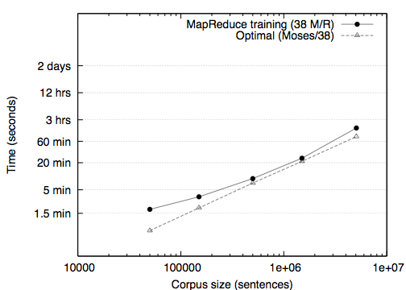
Phrase table construction
Single-core commodity server
38 proc. cluster
1/38 of single-core

Slide 104
What’s the point?
The optimally-parallelized version doesn’t exist!
It’s all about the right level of abstraction
Goldilocks argument
Lessons
Overhead from Hadoop

Slide 105
Questions?

Slide 106
Iterative Algorithms

Slide 107
Iterative Algorithms in MapReduce
Expectation maximization
Training exponential models
Computing gradient, objective using MapReduce
Optimization questions

Slide 108


EM Algorithms in MapReduce
E step
Compute the expected log likelihood with respect to the conditional distribution of the latent variables with respect to the observed data.
M step
(Chu et al. NIPS 2006)

Slide 109
EM Algorithms in MapReduce
E step
Compute the expected log likelihood with respect to the conditional distribution of the latent variables with respect to the observed data.
Expectations are just sums of function evaluation over an event times that event’s probability: perfect for MapReduce!
Mappers compute model likelihood given small pieces of the training data (scale EM to large data sets!)

Slide 110
EM Algorithms in MapReduce
M step
Many models used in NLP (HMMs, PCFGs, IBM translation models) are parameterized in terms of conditional probability distributions which can be maximized independently… Perfect for MapReduce.

Slide 111
Challenges
Each iteration of EM is one MapReduce job
Mappers require the current model parameters
Certain models may be very large
Optimization: any particular piece of the training data probably depends on only a small subset of these parameters
Reducers may aggregate data from many mappers
Optimization: Make smart use of combiners!

Slide 112

Exponential Models
NLP’s favorite discriminative model:
Applied successfully to POS tagging, parsing, MT, word segmentation, named entity recognition, LM…
Make use of millions of features (h_{i}’s)
Features may overlap
Global optimum easily reachable, assuming no latent variables

Slide 113
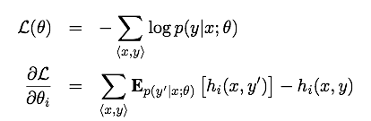
Exponential Models in MapReduce
Training is usually done to maximize likelihood (minimize negative llh), using first-order methods
Need an objective and gradient with respect to the parameters that we want to optimize

Slide 114
Exponential Models in MapReduce
How do we compute these in MapReduce?
As seen with EM: expectations map nicely onto the MR paradigm.
Each mapper computes two quantities: the LLH of a training instance <x,y> under the current model and the contribution to the gradient.

Slide 115
Exponential Models in MapReduce
What about reducers?
The objective is a single value – make sure to use a combiner!
The gradient is as large as the feature space – but may be quite sparse. Make use of sparse vector representations!

Slide 116
Exponential Models in MapReduce
After one MR pair, we have an objective and gradient
Run some optimization algorithm
LBFGS, gradient descent, etc…
Check for convergence
If not, re-run MR to compute a new objective and gradient

Slide 117
Challenges
Each iteration of training is one MapReduce job
Mappers require the current model parameters
Reducers may aggregate data from many mappers
Optimization algorithm (LBFGS for example) may require the full gradient
This is okay for millions of features
What about billions?
… or trillions?

Slide 118
Questions?

Slide 119
Alternatives to MapReduce

Slide 120
When is MapReduce appropriate?
MapReduce is a great solution when there is a lot of data:
Input (e.g., compute statistics over large amounts of text) – take advantage of distributed storage, data locality
Intermediate files (e.g., phrase tables) – take advantage of automatic sorting/shuffing, fault tolerance
Output (e.g., webcrawls) – avoid contention for shared resources
Relatively little synchronization is necessary

Slide 121
When is MapReduce less appropriate?
MapReduce can be problematic when
“Online” processes are necessary, e.g., decisions must be made conditioned on the full state of the system
Perceptron-style algorithms
Monte Carlo simulations of certain models (e.g., Hierarchical Dirichlet processes) may have global dependencies
Individual map or reduce operations are extremely expensive computationally
Large amounts of shared data are necessary

Slide 122
Alternatives to Hadoop: Parallelization of computation
 | libpthread | MPI | Hadoop
Job scheduling | none | with PBS | minimal (at pres.)
Synchronization | fine only | any | coarse only
Distributed FS | no | no | yes
Fault tolerance | no | no | via idempotency
Shared memory | yes | for messages | no
Scale | <16 | <100 | >10000
MapReduce | no | limited reducers | yes

Slide 123
Alternatives to Hadoop: Data storage and access
 | RDBMS | Hadoop/HDFS
Transactions | row/table | none
Write operations | Create, update, delete | Create, append*
Shared disk | some | Yes
Fault tolerance | yes | yes
Query language | SQL | Pig
Responsiveness | online | offline
Data consistency | enforced | no guarantee

Slide 124
Questions?

Slide 125
What’s next?
Web-scale text processing: luxury → necessity
Fortunately, the technology is becoming more accessible
MapReduce is a nice hammer:
Whack it on everything in sight!
MapReduce is only the beginning…
Alternative programming models
Fundamental breakthroughs in algorithm design

Slide 126
Applications (NLP, IR, ML, etc.)
Programming Models (MapReduce…)
Systems (architecture, network, etc.)

Slide 127
Afternoon Session
Hadoop “nuts and bolts”
“Hello World” Hadoop example (distributed word count)
Running Hadoop in “standalone” mode
Running Hadoop on EC2
Open-source Hadoop ecosystem
Exercises and “office hours”

Slide 128







Questions?
Comments?
Thanks to the organizations who support our work:

