Slide 1

E-Asset Management
Presented by:- Runtime Terror

Slide 2
OUR TEAM
Aishwarya Rokade (TSE)
Ajay Yewale (TSE)
Harshal Yewale (TSE)
Madhura Avachat (TSE)
Mrunal Malekar (TSE)
Prachi Kanakdande (TSE)
Rushabh Pahade (TSE)
Sayan Mukhopadhyay (TSE)
Varun Gujarathi (TSE)

Slide 3
ABOUT
The E-Asset Management system is a web-based application to keep track of :
Several assets that can be borrowed like Laptops, Books, Mobiles and Devices
Availability of Assets
Current location of Assets
Current borrower of Assets
Asset history.

Slide 4
APPLICATION FEATURES
Layered architecture with loose coupling
Validating all user inputs with proper error handling
Elegant UI layout with header, footer
Session Management

Slide 5
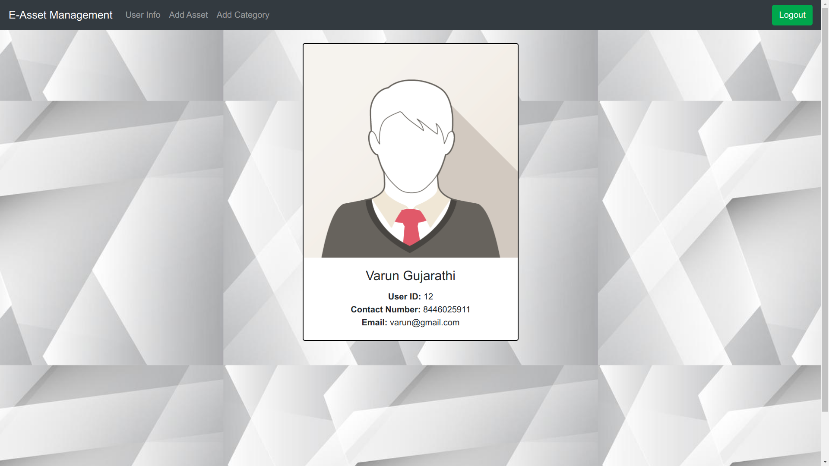
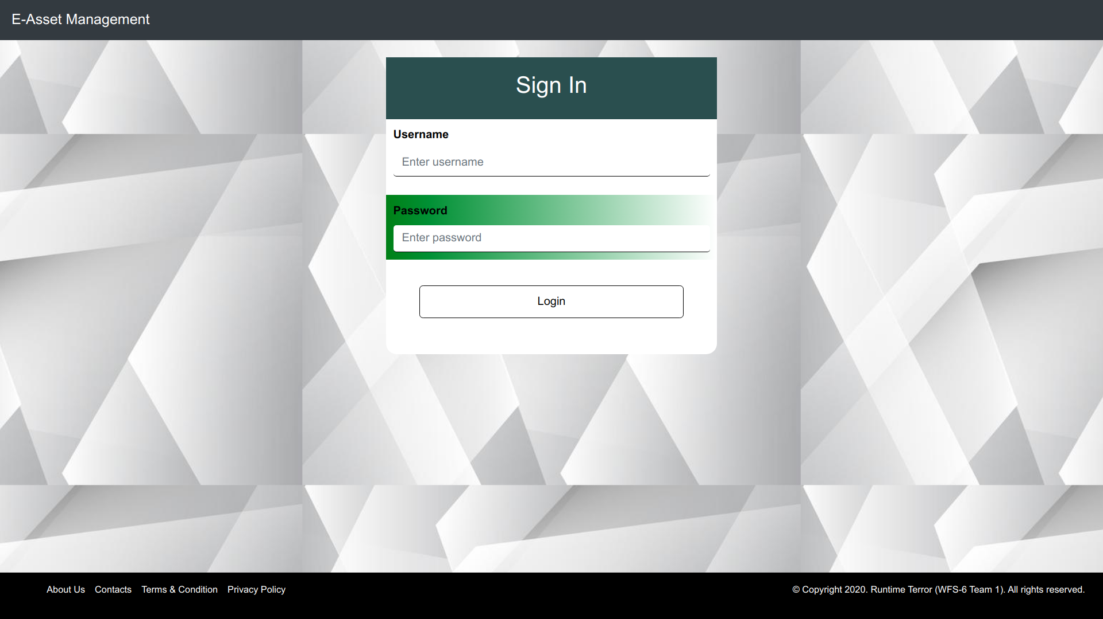
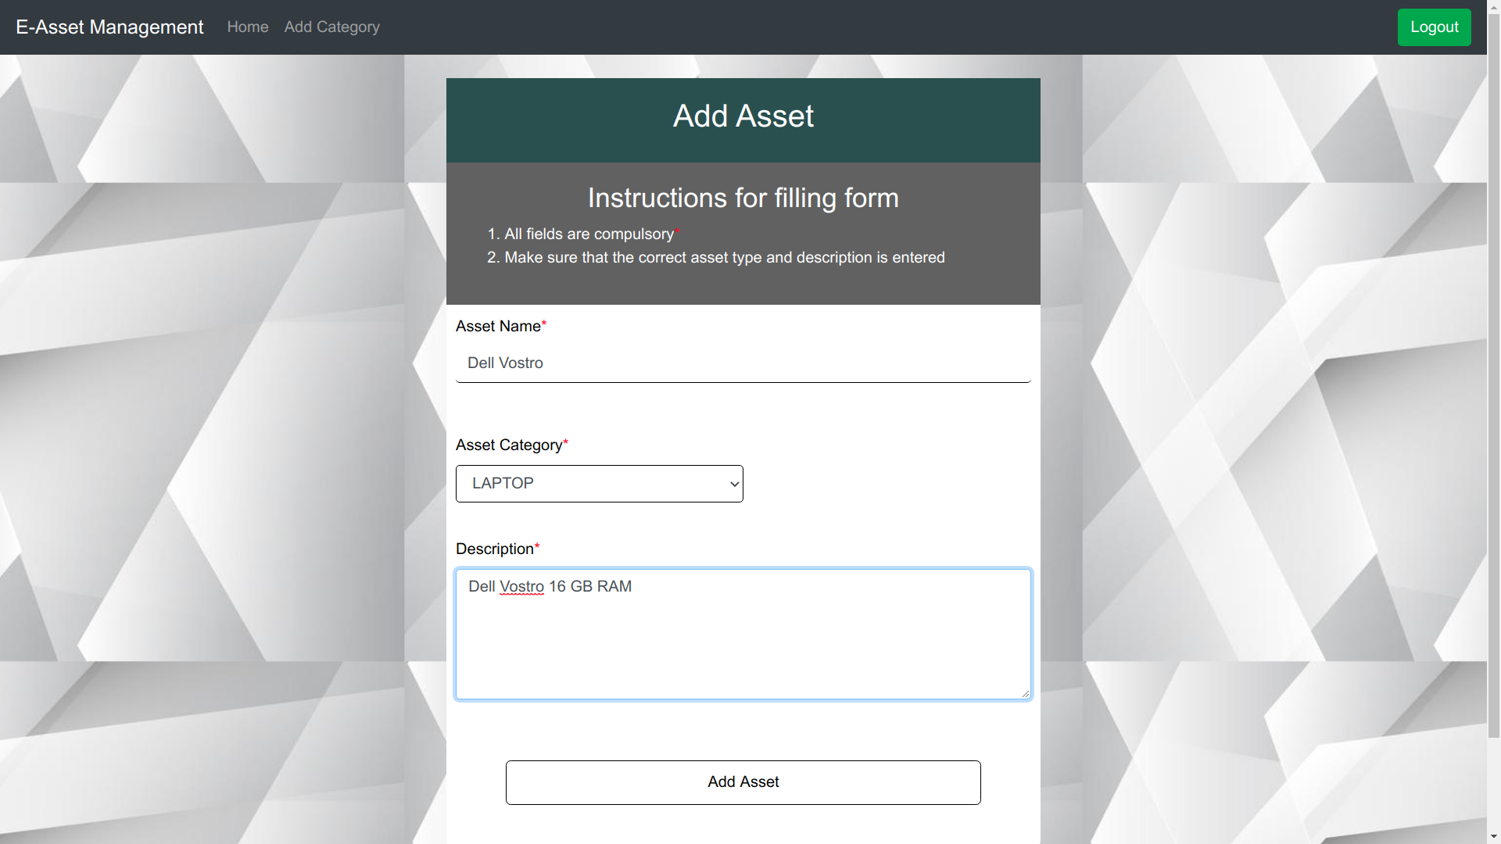
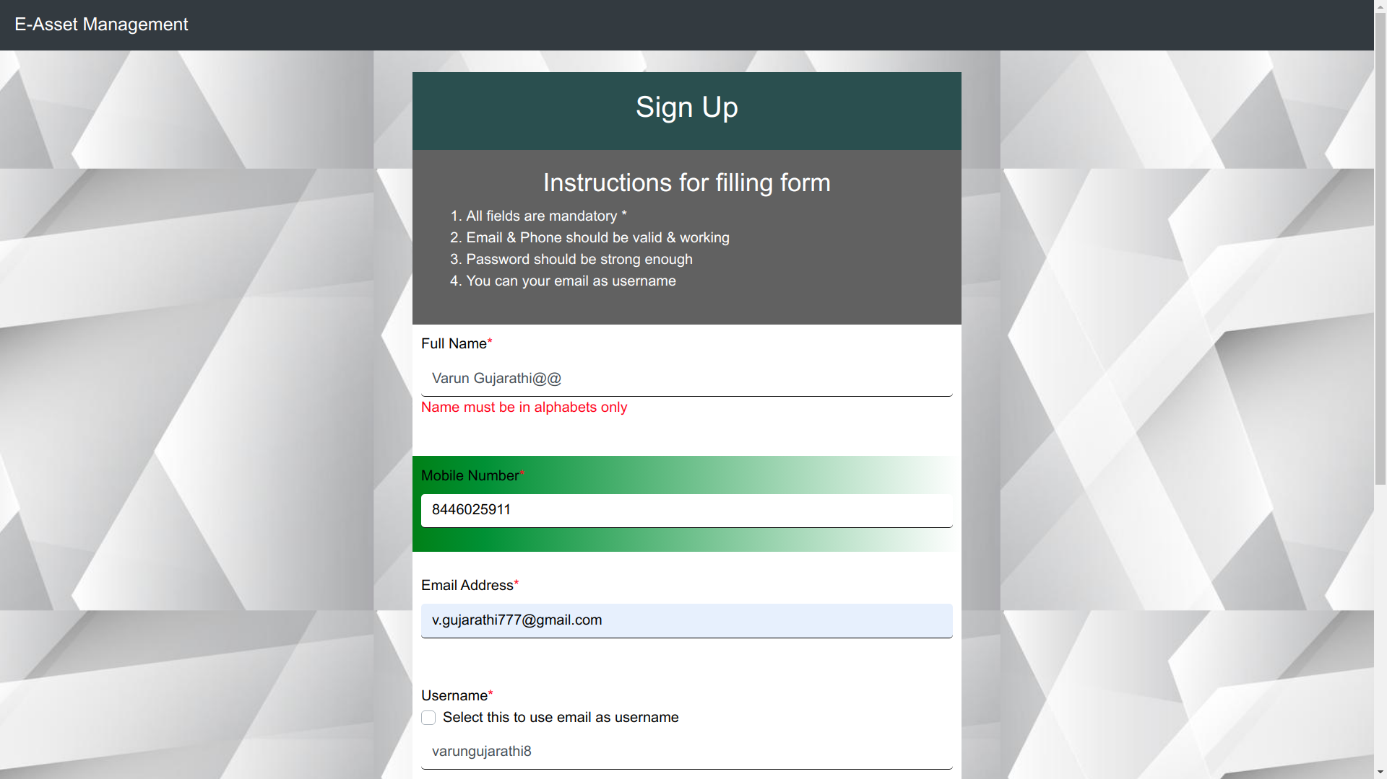
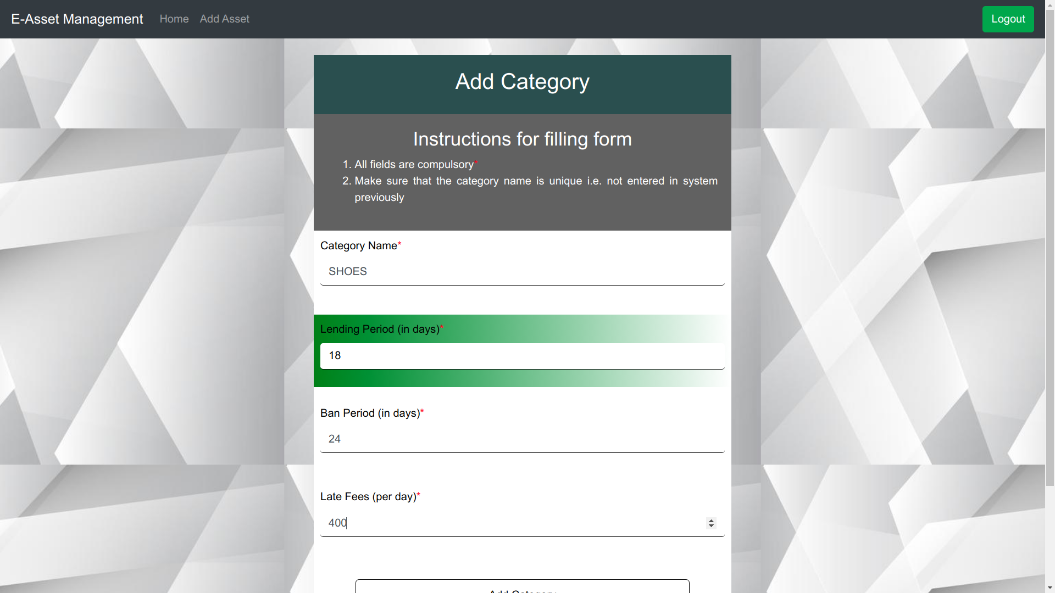
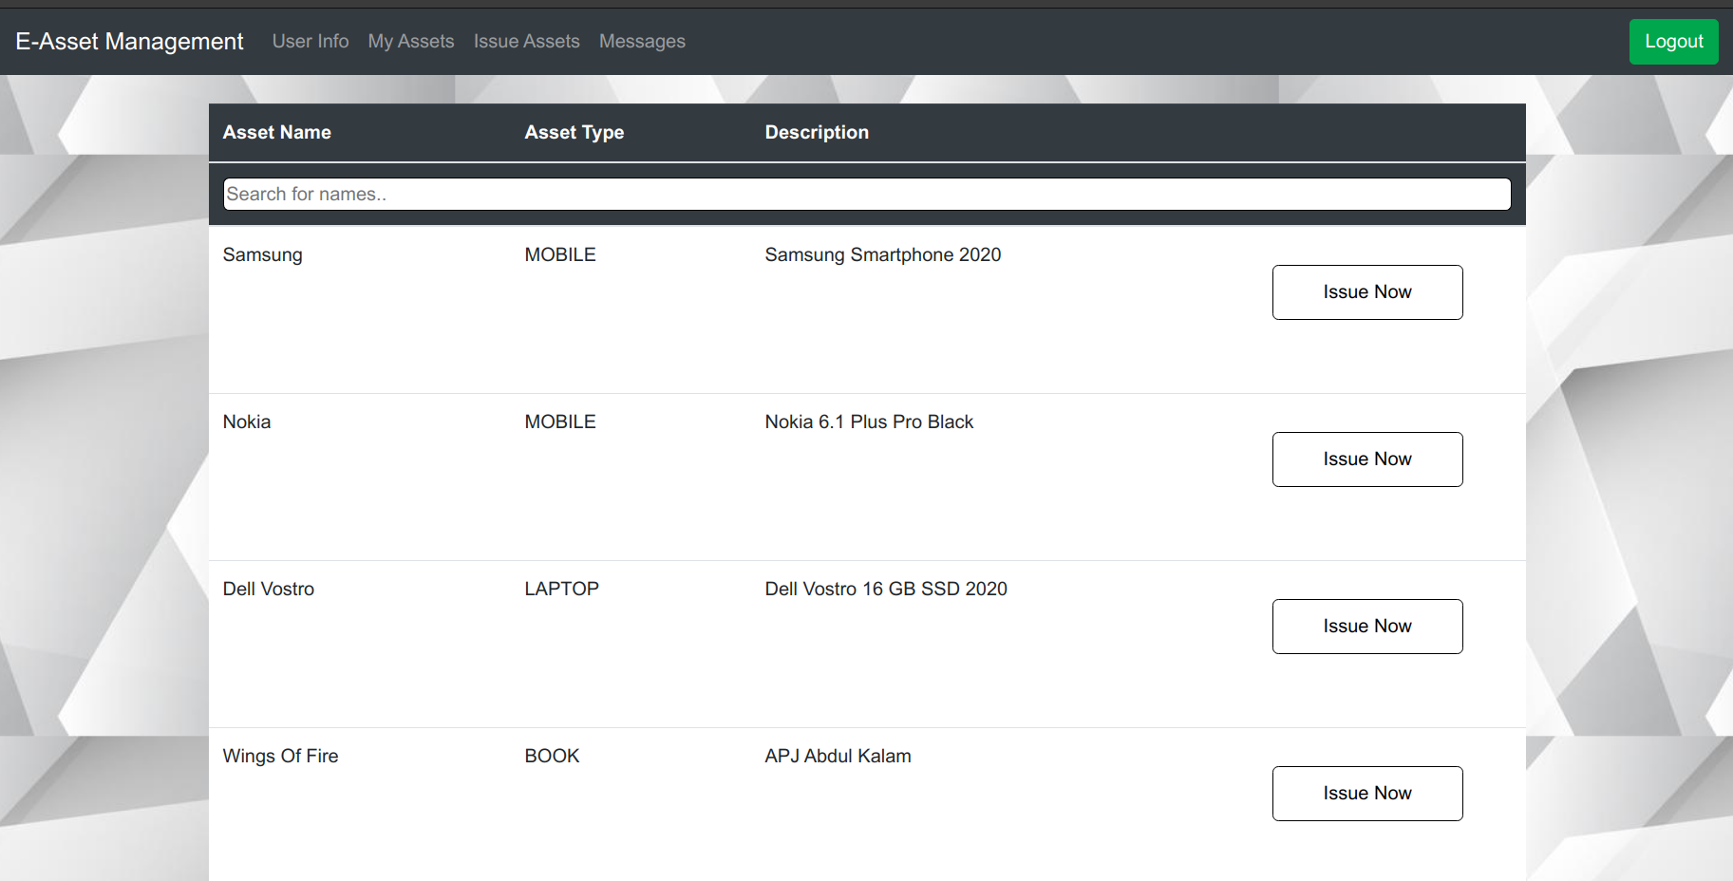
UI SCREENSHOTS

Slide 6
ROADMAP
STRATEGY:
ANALYSIS AND PLANNING:
DESIGNING:
DEVELOPMENT:
TESTING:
Defining strategic goal, understanding the problem statement.
Identify requirements, define team structure and prepare roadmap.
UI/UX Design, Database design, Layered Architecture design, Controller design.
Developed backend, frontend using AGILE Development process.
Validate website's quality thoroughly with a series of testing criteria.

