Slide 1
Udacity SQL project (DVDStore)

Slide 2
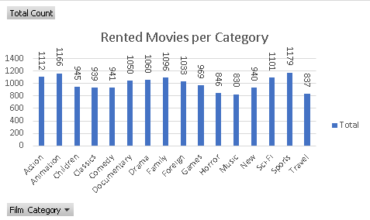
Set 1 Question 1: We want to understand more about the movies that families are watching. The following categories are considered family movies: Animation, Children, Classics, Comedy, Family and Music. Conclusion: Customers are least interested in watching travel and music related films and most interested in Sport films.
SET 1 Q1:
SELECT f.title film_name,c.name film_category, COUNT(1) rental_count
FROM film_category fc
INNER JOIN film f
ON f.film_id = fc.film_id
INNER JOIN category c
ON c.category_id = fc.category_id
INNER JOIN inventory inv
ON inv.film_id = f.film_id
INNER JOIN rental r
ON r.inventory_id = inv.inventory_id
GROUP BY f.title,c.name
ORDER BY f.title

Slide 3
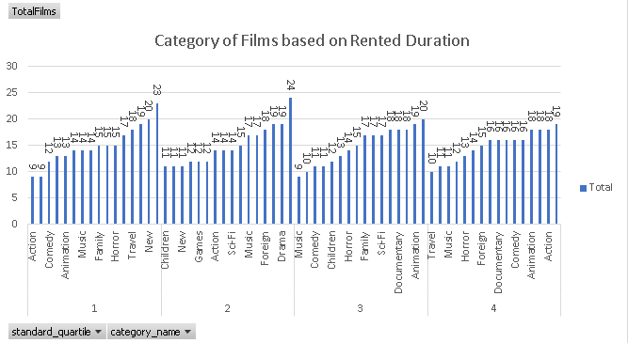
Set 1 Question2 :Now we need to know how the length of rental duration of these family-friendly movies compares to the duration that all movies are rented for. Can you provide a table with the movie titles and divide them into 4 levels (first_quarter, second_quarter, third_quarter, and final_quarter) based on the quartiles (25%, 50%, 75%) of the rental duration for movies across all categories? Make sure to also indicate the category that these family-friendly movies fall into. Conclusion: Most of movies are rented for short duration of time (belonging to SQ1 or SQ 2) and action movies are rented for longer durations
Set1 Q2
SELECT film_name, category_name, NTILE (4) OVER (ORDER BY rental_duration) standard_quartile FROM
(SELECT f.title film_name,c.name category_name, SUM(DATE_PART('day', r.return_date - r.rental_date)) rental_duration
FROM film_category fc
INNER JOIN film f
ON f.film_id = fc.film_id
INNER JOIN category c
ON c.category_id = fc.category_id
INNER JOIN inventory inv
ON inv.film_id = f.film_id
INNER JOIN rental r
ON r.inventory_id = inv.inventory_id
GROUP BY f.title,c.name ) A

Slide 4
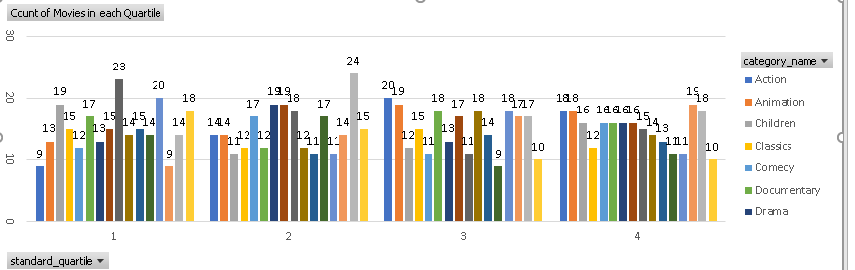
Finally, provide a table with the family-friendly film category, each of the quartiles, and the corresponding count of movies within each combination of film category for each corresponding rental duration category. The resulting table should have three columns: Category, Rental length category, Count Conclusion: Based for Quartiles for movie duration, foreign movies are rented for very short duration on time, and Animated movies are rented for long duration of time.
Set 1 Q3:
SELECT category_name, standard_quartile, COUNT (film_name) FROM
(SELECT film_name, category_name, NTILE (4) OVER (ORDER BY rental_duration) standard_quartile FROM
(SELECT f.title film_name,c.name category_name, SUM(DATE_PART('day', r.return_date - r.rental_date)) rental_duration
FROM film_category fc
INNER JOIN film f
ON f.film_id = fc.film_id
INNER JOIN category c
ON c.category_id = fc.category_id
INNER JOIN inventory inv
ON inv.film_id = f.film_id
INNER JOIN rental r
ON r.inventory_id = inv.inventory_id
GROUP BY f.title,c.name ) A ) B
GROUP BY category_name, standard_quartile
ORDER BY category_name, standard_quartile

Slide 5
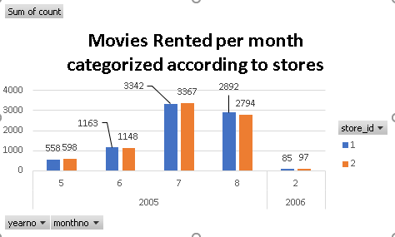
We want to find out how the two stores compare in their count of rental orders during every month for all the years we have data for. Write a query that returns the store ID for the store, the year and month and the number of rental orders each store has fulfilled for that month. Your table should include a column for each of the following: year, month, store ID and count of rental orders fulfilled during that month. Conclusion: Movies were rented month in July 2005 from both the stores and it is almost equal distribution for both stores in all months
Set 2 Q1
SELECT DATE_PART('month',rental_date) MonthNo, DATE_PART('year',rental_date) yearno, s.store_id, COUNT (1)
FROM rental r
INNER JOIN store s
ON s.manager_staff_id = r.staff_id
GROUP BY DATE_PART('month',rental_date), DATE_PART('year',rental_date), s.store_id
ORDER BY DATE_PART('year',rental_date), DATE_PART('month',rental_date), s.store_id

