Slide 1

AI Agents: Revolutionizing Intelligent Systems
A Deep Dive into Evolution, Architectures, Applications, and Future Horizons
Presented by: Varun Gupta Date: April 18, 2025

Slide 2
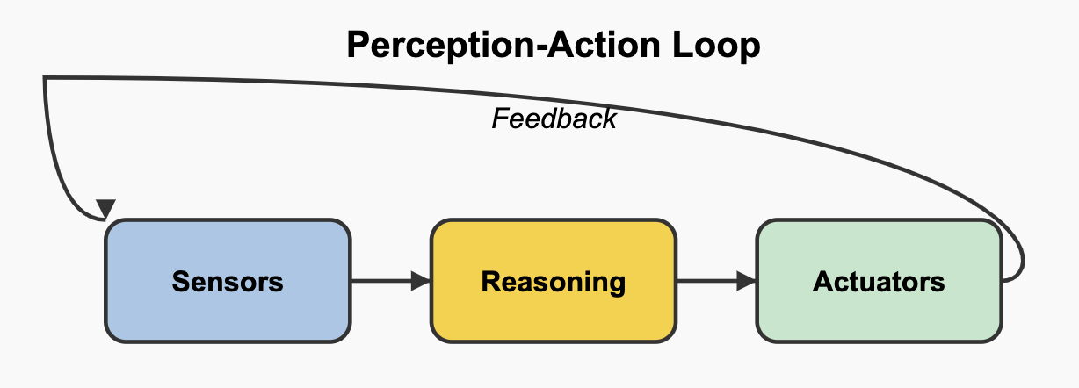
What Are AI Agents?
Definition: Autonomous systems that perceive environments, make decisions, and act to achieve specific objectives.
Core Properties (Wooldridge & Jennings, 1995):
Autonomy: Independent operation without constant human input.
Social Ability: Interaction with other agents or humans.
Reactivity: Real-time response to environmental changes.
Proactivity: Goal-oriented behavior with initiative.
Components: Sensors (perception), reasoning engine, actuators (action). (Diagram of the perception-action loop (sensors → reasoning → actuators))
AI agents range from simple (e.g., thermostats) to complex (e.g., self-driving cars).
Modern agents leverage large language models (LLMs) for advanced reasoning.
Example: A delivery drone navigating obstacles is an AI agent.

Slide 3
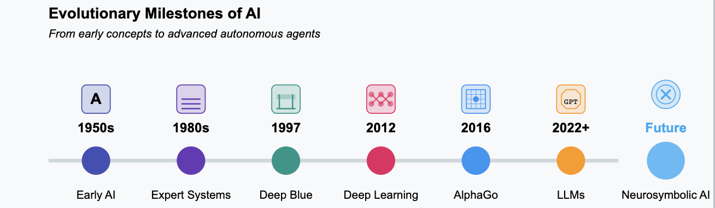
The Journey of AI Agents
1970s-1980s: Rule-based expert systems laid the groundwork (e.g., MYCIN for medical diagnosis).
1990s: Intelligent agent frameworks emerged (e.g., Russell & Norvig’s AI principles).
2000s: Reinforcement learning powered multi-agent systems.
2010s: Deep learning breakthroughs; AlphaGo defeated world champions (2016).
2020s: Large language models (LLMs) enable multimodal, context-aware agents.
2025 Trend: Agents integrate vision, text, and audio for human-like interactions. Visual: Sleek timeline highlighting AlphaGo and LLM milestones.

Slide 4
Diverse Flavours of AI Agents
Reactive Agents: Instant responses, no memory (e.g., robotic vacuum dodging obstacles).
Deliberative Agents: Plan with internal models (e.g., Deep Blue beating Kasparov).
Learning Agents: Evolve through experience (e.g., AlphaStar mastering StarCraft).
Hybrid Agents: Blend reactivity, planning, and learning (e.g., self-driving cars).
LLM-Based Agents: Leverage LLMs for reasoning and action (e.g., ChatGPT planning tasks).
Fun Fact: Hybrid agents power Tesla’s Full Self-Driving system!

Slide 5
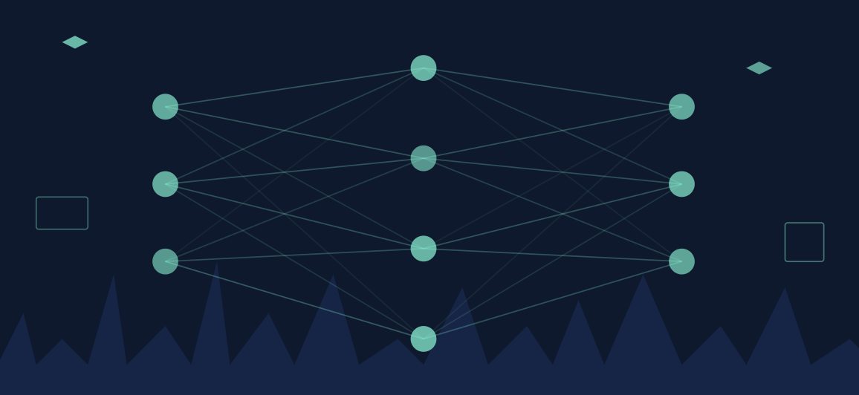
Inside the Mind of an AI Agent
LLM-Based Architecture:
Brain: LLM processes inputs and plans (e.g., GPT-4).
Perception: Sensors/input streams (text, images, audio).
Action: Outputs like text, commands, or physical actions.
Multi-Agent Systems: Teams of agents tackle complex tasks (e.g., robot swarms).
Key Frameworks:
TPTU (Task Planning and Tool Usage): Breaks tasks into steps.
BDI (Belief-Desire-Intention): Drives goal-oriented behavior.
Example: An LLM-based agent schedules meetings by parsing emails and calendars.

Slide 6
AI Agents Transforming Business (Applications)
Workflow Automation: Streamline operations with tools like n8n and Flowise (e.g., auto-scheduling shipments).
Smart Documentation: Generate technical manuals in seconds.
Customer Support: 24/7 chatbots resolve 80% of queries autonomously (2024 data).
Data Insights: Real-time analytics for market trends.
Impact: Enterprises report 40% faster workflows with AI agents (2024 study).
Current Trend: Agentic RAG (Retrieval-Augmented Generation) for knowledge management.

Slide 7
AI Agents in Everyday Life
Voice Assistants: Conversational AI like ElevenLabs and Vapi (e.g., “Hey, set a reminder!”).
Task Planning: Organize schedules, suggest meals, or book travel.
Smart Homes: Control lights, thermostats, and security with context-aware agents.
Gaming: Adaptive NPCs react to player strategies (e.g., AI in Baldur’s Gate 3).
Cool Example: Amazon’s Alexa predicts your needs, like reordering groceries!

Slide 8
AI Agents Powering Discovery
Drug Discovery: Generate hypotheses and screen molecules (e.g., AlphaFold solved protein folding).
Literature Analysis: Summarize 10,000 papers in minutes.
Simulations: Model climate change or quantum systems with precision.
Breakthrough: AI agents slashed drug candidate identification from 2 years to 6 months (2023 case).
2025 Vision: Agents collaborate with scientists for real-time hypothesis testing.

Slide 9
AI Agents on the Road
How They Work:
Perception: LIDAR, cameras, and radar detect surroundings.
Reasoning: Plan routes and avoid obstacles.
Action: Control steering, braking, and acceleration.
Impact: 30% fewer accidents in autonomous fleets (2024 data).
Real-World: Waymo’s driverless taxis serve 100,000 rides weekly (2025).
Challenge: Navigating rare scenarios (e.g., construction zones).
Wow Factor: Tesla’s AI agents process 1TB of sensor data per second!

Slide 10
Collaborative Intelligence at Scale
Paradigm: LLM-based agents with specialized roles (e.g., coder, tester, debugger).
Applications:
Software: AutoGen builds apps 15x faster than solo LLMs (2024).
Simulations: Model societal dynamics with 10M virtual agents (DeepMind, 2025).
Mechanisms: Message passing, shared memory, and conflict resolution protocols.
Breakthrough: Emergent cooperation in non-cooperative games (arXiv:2409.10122).

Slide 11
Pushing Technical Boundaries
Hallucinations: LLMs generate plausible but false outputs (e.g., 20% error rate in open-domain tasks).
Scalability: Inference costs for GPT-4o exceed $10M/month for large deployments.
Generalization: Agents fail in out-of-distribution scenarios (e.g., 30% drop in performance).
Robustness: Adversarial attacks disrupt 25% of agent decisions (2024 study).
Solutions: Sparse MoE models, online RL, and neurosymbolic grounding.
2025 Priority: Self-supervised agents with zero-shot adaptability.

Slide 12
Ethics at the Core of Agent Design
Bias: Agents amplify training data biases (e.g., 15% higher error rates for minority groups).
Privacy: Differential privacy lags in multimodal agents (e.g., vision data leaks).
Accountability: Ambiguity in liability for autonomous decisions (e.g., AV accidents).
Societal Impact: 25% of low-skill jobs at risk by 2030 (Brookings, 2024).
Mitigation: Explainable AI, federated learning, and global AI governance.
Critical Question: How do we encode universal ethics into autonomous systems?

Slide 13
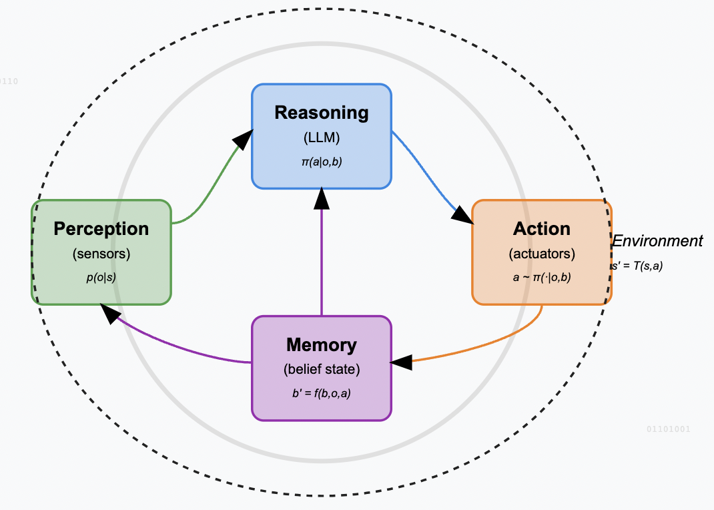
Rethinking Agent Evaluation
Current Limits:
Accuracy checking: Ignores latency, cost, and robustness.
Narrow Benchmarks: AgentBench covers only 10% of real-world tasks.
New Metrics:
Efficiency: FLOPs per task (e.g., Llama 3.1 vs. GPT-4).
Robustness: Performance under adversarial inputs.
Ethics: Bias and fairness scores.
Case: ReAct agents outperform TPTU in reasoning but lag in cost (arXiv:2407.01502).
Vision: Open-domain testbeds for lifelong learning agents.

Slide 14
The Next Frontier for AI Agents
Multimodal Convergence: Unified models for text, vision, audio, and robotics (e.g., xAI’s BigBrain prototypes).
Self-Improving Agents: Recursive optimization via meta-learning (e.g., Reflexion 2.0).
Ethical Governance: Global standards for agent autonomy (e.g., UNESCO AI Ethics).
Quantum Integration: Quantum RL for exponential speedup (speculative, 2030+).
Human-AI Symbiosis: Agents as cognitive prosthetics for creativity and reasoning.
Provocation: Will agents achieve AGI by autonomously redesigning themselves?

Slide 15
References
Wooldridge, M., & Jennings, N. R. (1995). Intelligent Agents: Theory and Practice. Knowledge Engineering Review.
Russell, S., & Norvig, P. (1995). Artificial Intelligence: A Modern Approach.
Rao, A. S., & Georgeff, M. P. (1995). BDI Agents: From Theory to Practice. ICMAS.
Xi, Z., et al. (2023). The Rise and Potential of Large Language Model Based Agents. arXiv:2309.07864.
Yao, S., et al. (2023). ReAct: Synergizing Reasoning and Acting in Language Models. arXiv:2210.03629.
Shinn, N., et al. (2023). Reflexion: Language Agents with Verbal Reinforcement Learning. arXiv:2303.11366.
Kapoor, S., et al. (2024). AI Agents That Matter. arXiv:2407.01502.
Wang, L., et al. (2024). AutoGen: Enabling Next-Gen LLM Applications via Multi-Agent Collaboration. arXiv:2308.08155.
Stanford AI100 Report. (2024). AI Research Trends.
Brookings Institution. (2024). AI’s Societal Impacts.

