Slide 1
Sales Dashboard Summary
Created using Tableau | Summary by ChatGPT

Slide 2
Key Performance Indicators (KPIs)
- Total Sales
- Total Profit
- Sales Growth Over Time
- Quantity Sold

Slide 3
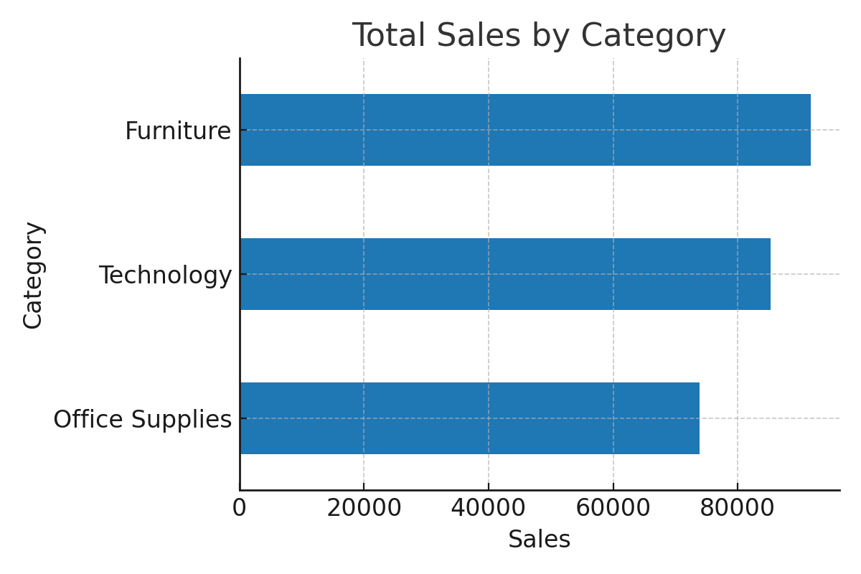
Sales by Category

Slide 4
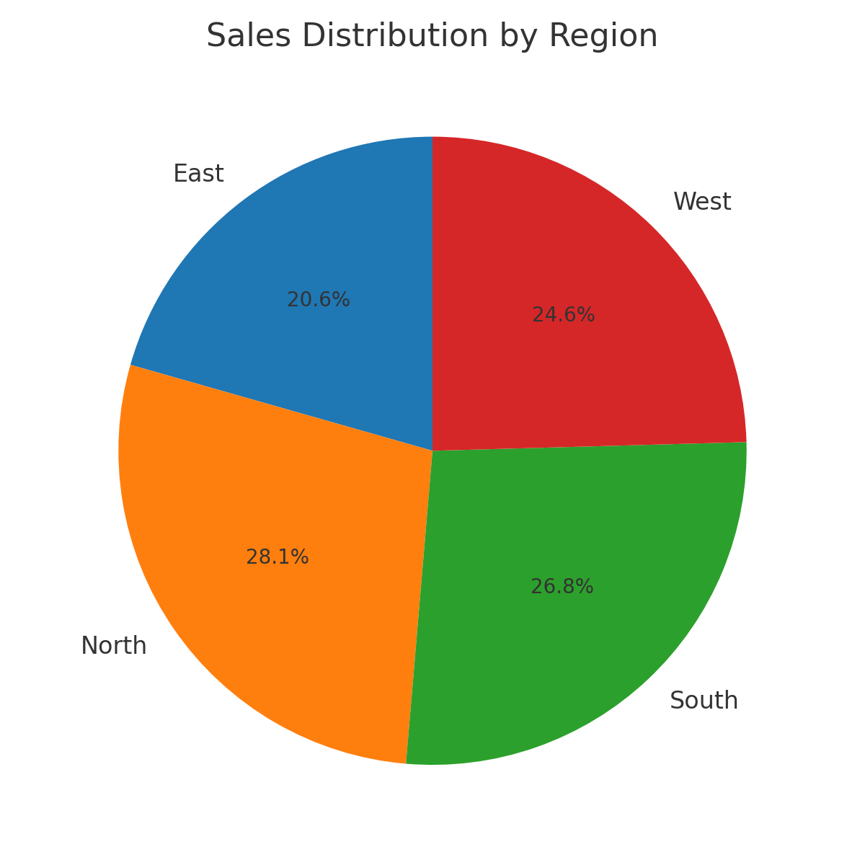
Sales by Region

