Slide 1
Convolutional Neural Network
Varuni Dantanarayana
July 2020
Springboard

Slide 2
Introduction
Rate of image uploads to the Internet has grown at a nearly exponential rate in the past few years
Increased availability of tagged photos on social media and facial detection processes such as unlocking phones
Accurate age and gender prediction models can be applied in social networks, healthcare, security and targeted marketing
Challenging as people in the same age range can look very different depending on various factors such as race, socioeconomic status, and even genetics while there are many people who are gender nonconforming

Slide 3
Data Preprocessing
Publicly available IMDB-Wiki dataset* validated as:
Valid gender (0 for female, 1 for male)
Age between 9-99
Valid face_score value above 1 [1]
Null value for second_face_score value, i.e. images with a detected second face were not considered

Slide 4
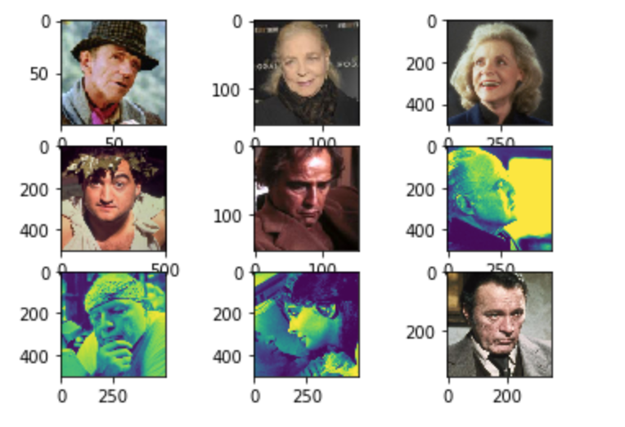
Imperfect dataset
Mislabeled images for gender and date of birth
Damaged images
Sideways or covered face shots
Partial face shots
Group images with no clear face shot

Slide 5
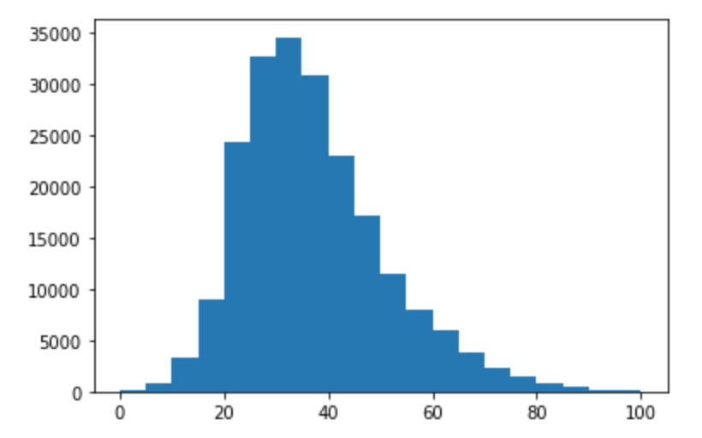
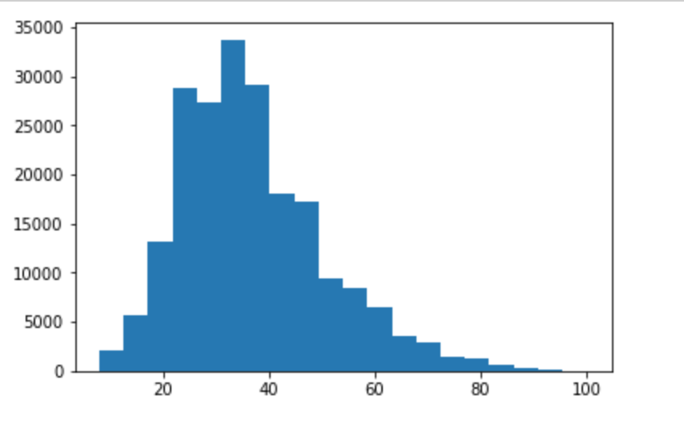
Age Distribution
Original: 0-100 years
Validated: 9-99 years

Slide 6
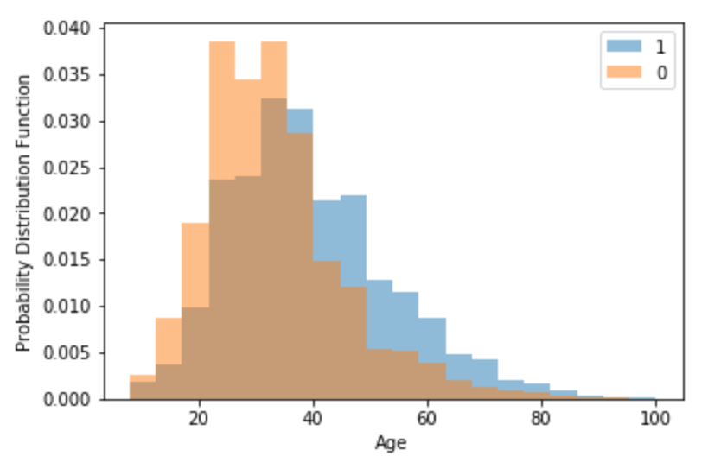
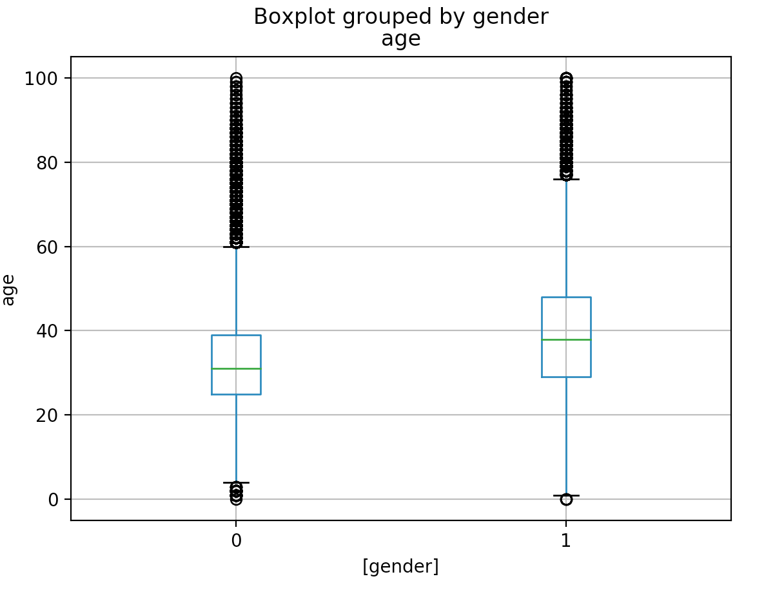
Age and Gender Distributions

Slide 7
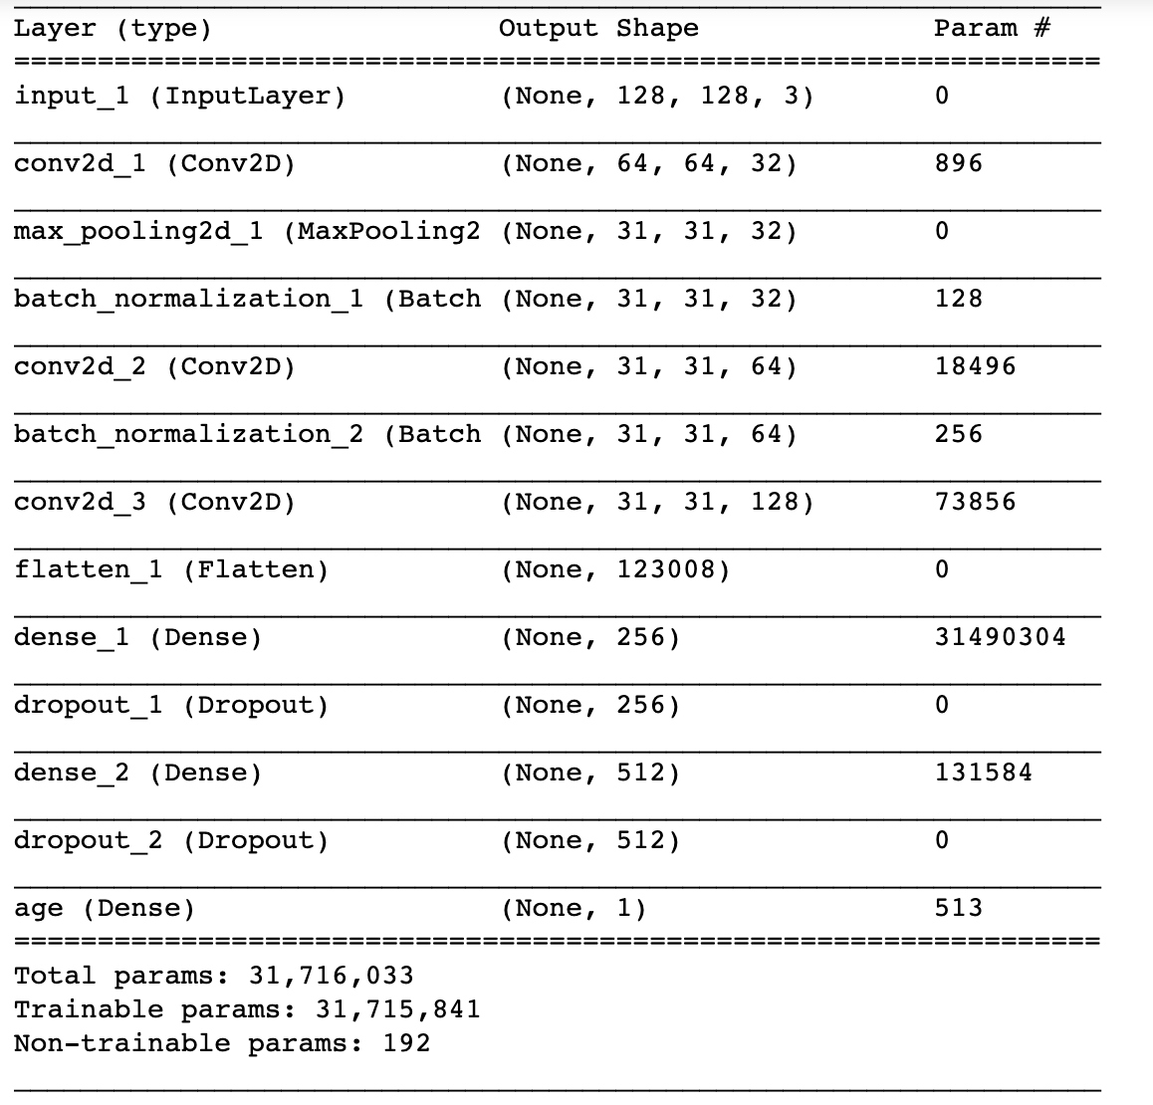
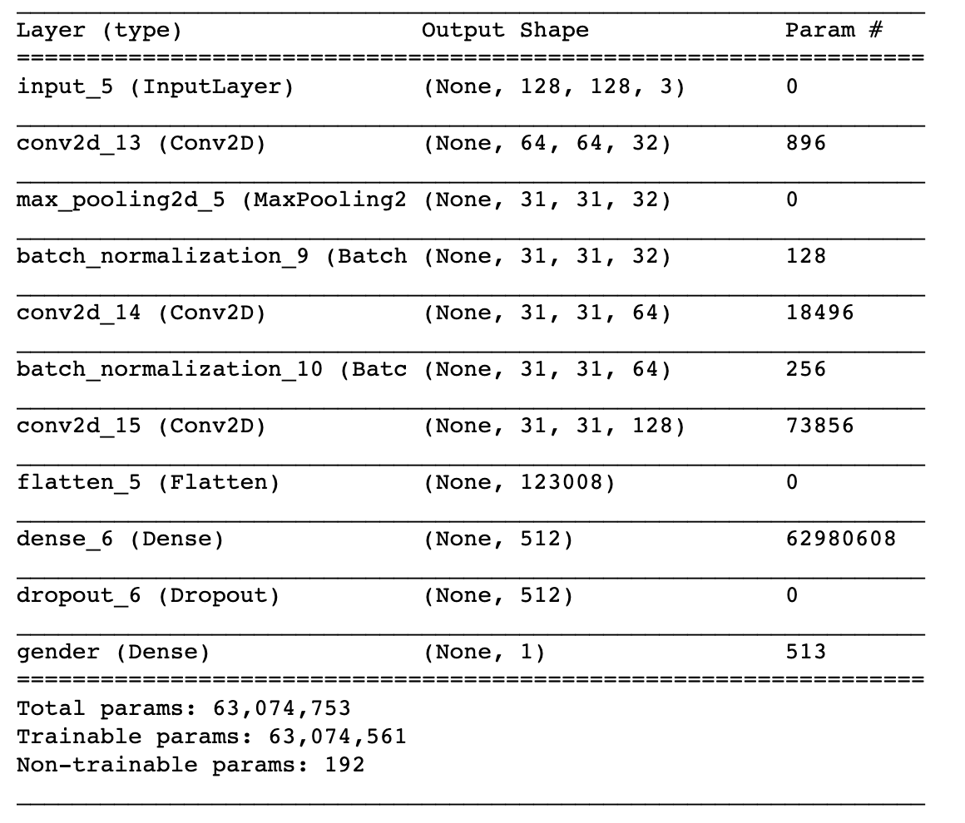
Model Design
Age Model:
Gender Model:
Notes:
Consider talking about:
Convolutional
Pooling
Fully connected
Receptive field
Weights

Slide 8
Model Building blocks
Convolutional Layer: extract useful information from the images
Maxpooling Layer: down-sample input, to prevent overfitting
Batch Normalization: perform the normalization for each training mini-batch
Flatten layer: connection between the convolution and dense layers
Dense Layer: fully-connected layer
Dropout Layer: randomly drop a specified amount of and their connections
Output layer: ‘sigmoid’ activation function for gender classification and ‘linear’ activation function for age regression modeling
Notes:
Consider talking about:
Convolutional layer
Pooling layer
ReLU layer
Fully connected layer
Loss layer

Slide 9
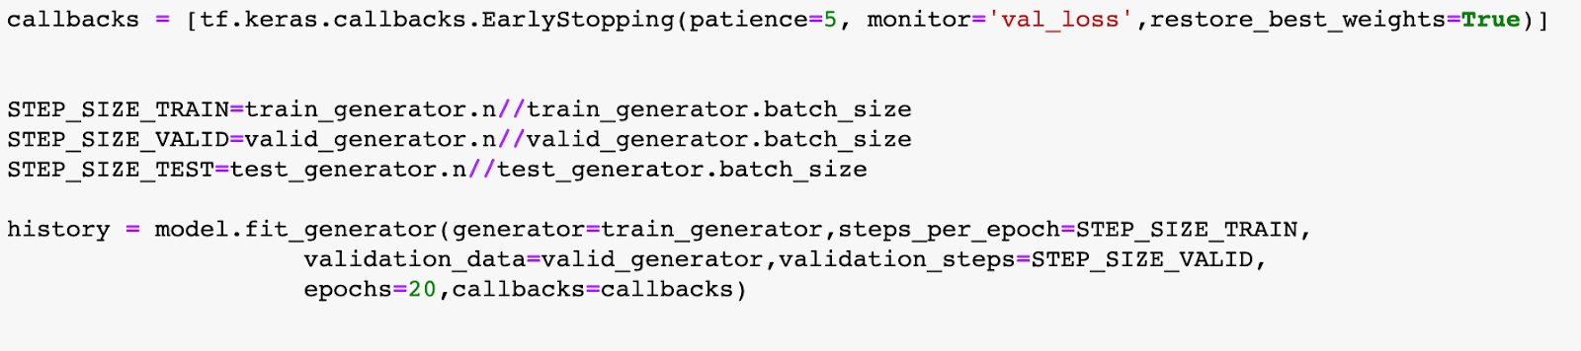
Compile and Train
Model compile:
Adam optimizer
‘binary_crossentropy’ as the loss function for gender classification, and ‘mean_absolute_error’ for age regression
‘accuracy’ as the model performance metric for for gender classification, and ‘mean_absolute_error’ for age regression
Model Training:

Slide 10
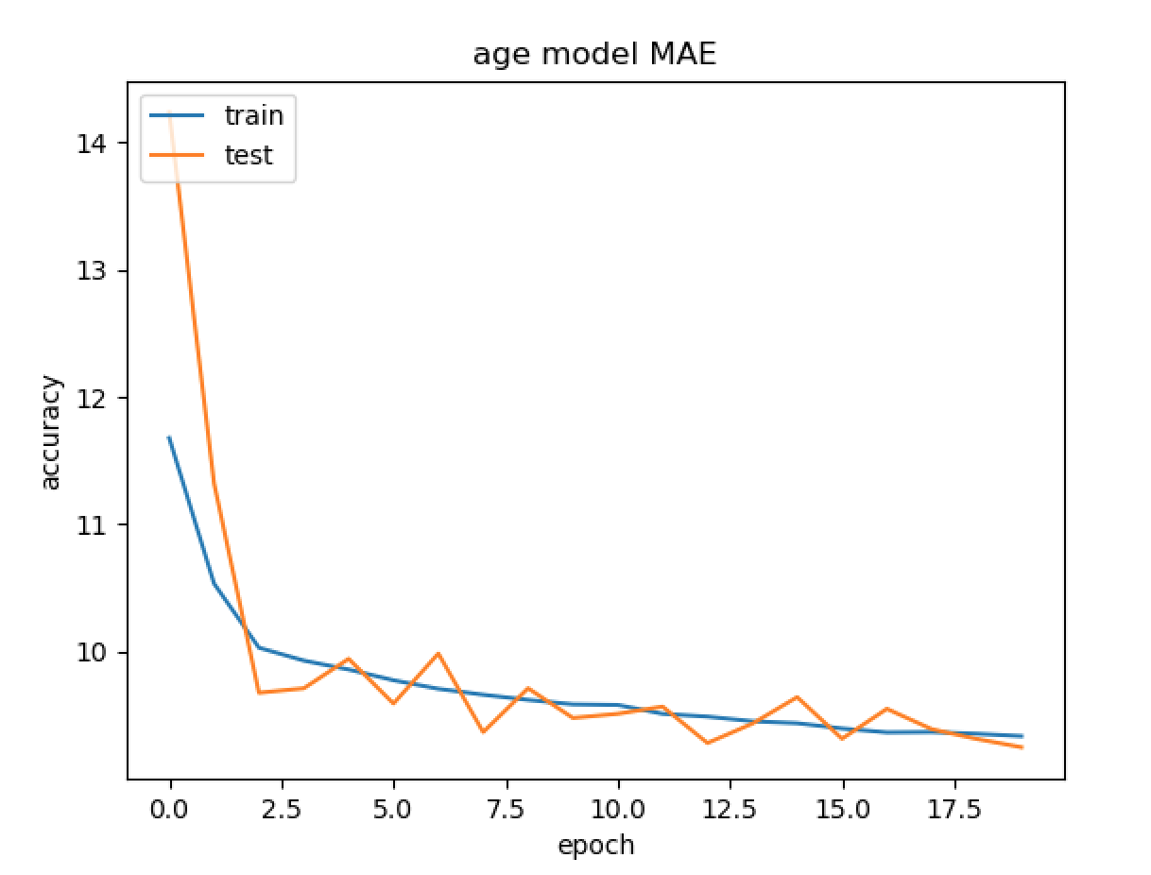
Results: Age model

Slide 11
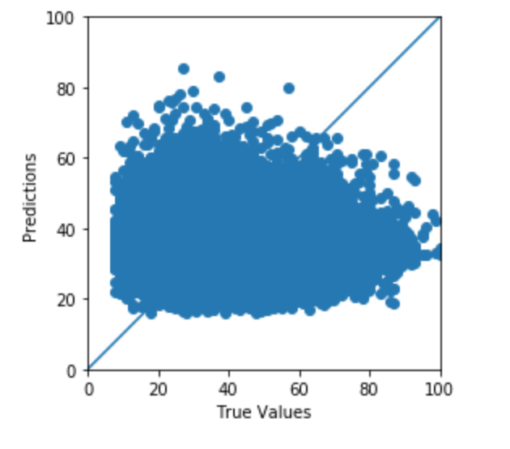
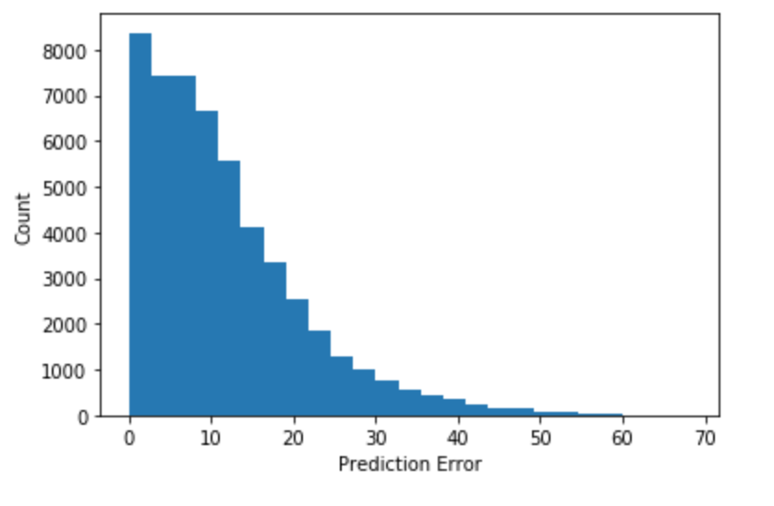
Results: Age model

Slide 12
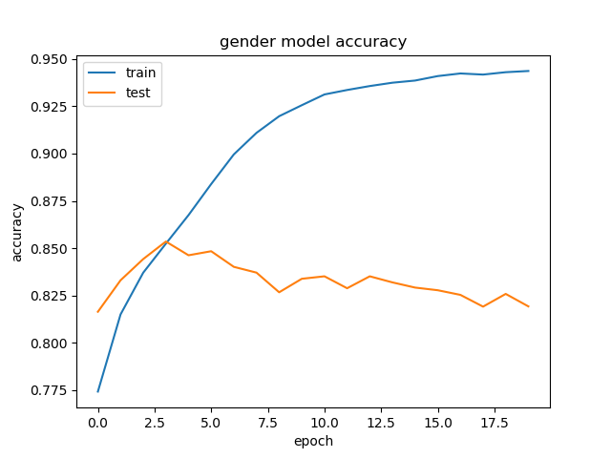
Results: Gender model
Without data augmentation:

Slide 13
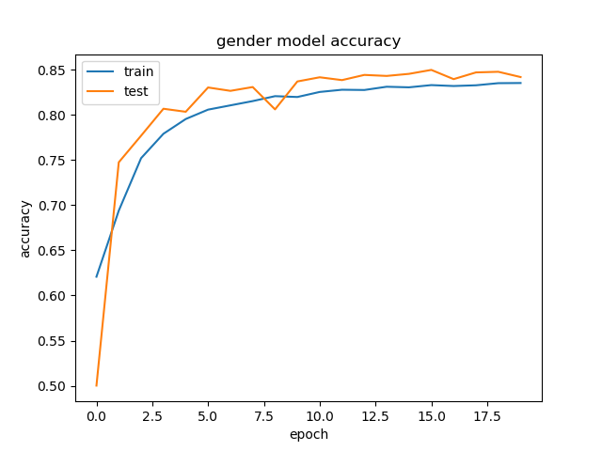
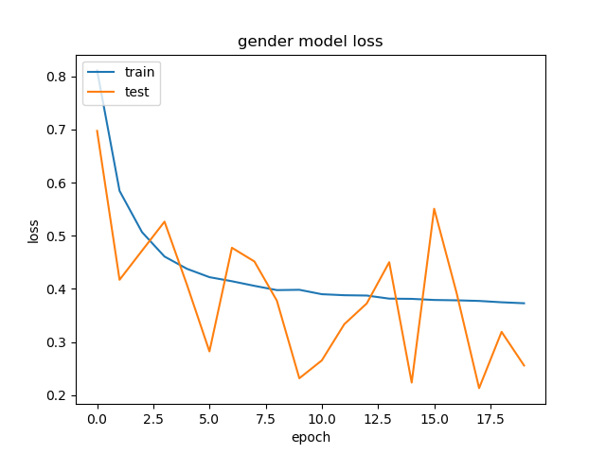
Results: Gender model
With data augmentation:

Slide 14
Conclusion and Future work
Accurate and efficient network architecture; mult-task model is computationally too intensive
Gender model accurary: 84%
Age model MAE: <10 years
Future work:
Hyper-parameter tuning: learning rate, optimizer, no. of neurons and layer, dropout rate, batch size, no. of epochs
Transfer learning

