Slide 1
Predicting the response rate on Stack Overflow with Google BigQuery
Varuni Dantanarayana
Capstone Project 1
Springboard

Slide 2
Introduction
Stack Overflow is the number one resource used by coders worldwide
Provides a great source of information from beginner to advanced level programming questions under a variety of topics
Real-world data set published publicly on Google BigQuery (contains 16 tables with number of rows ranging from 4-32 million)
Goal: Predict the response time based on various features of a question posted on Stack Overflow
Benefits: Stack Overflow users, i.e. ~10 million registered users as of 2019 and more than 50 million visitors every month

Slide 3
Data Acquisition
Published on the Google Cloud Platform
Direct analysis on BigQuery console in SQL
To access from Jupyter notebook:
1) Enable Google BigQuery API on the Google Cloud Platform
2) Get authentication for Jupyter Notebook by obtaining a service account key for the BigQuery in a JSON file
3) Install Google BigQuery API client libraries for Python on local computer

Slide 4
Exploratory Data Analysis

Slide 5
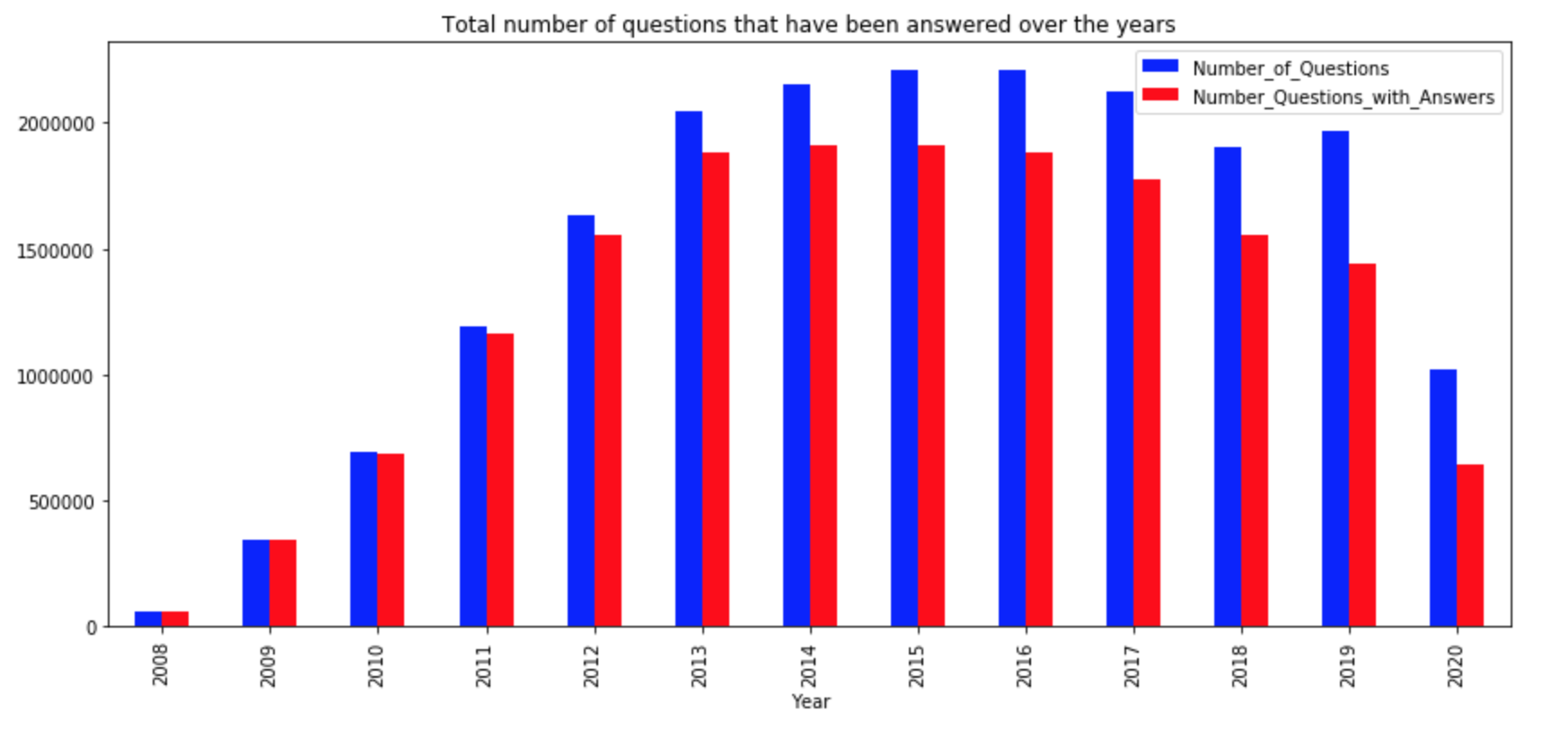
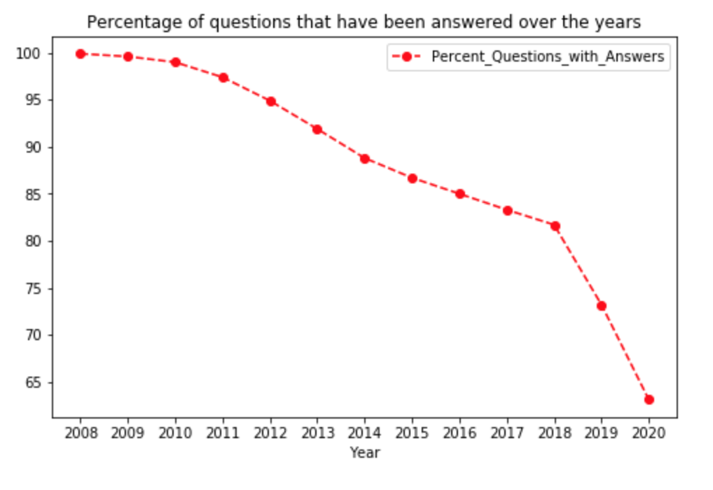
Questions that got answers over the years
Almost 100% of the questions have been answered in the starting years of StackOverflow till 2010
% of questions without answers increases
Highest % of unanswered questions in 2019

Slide 6
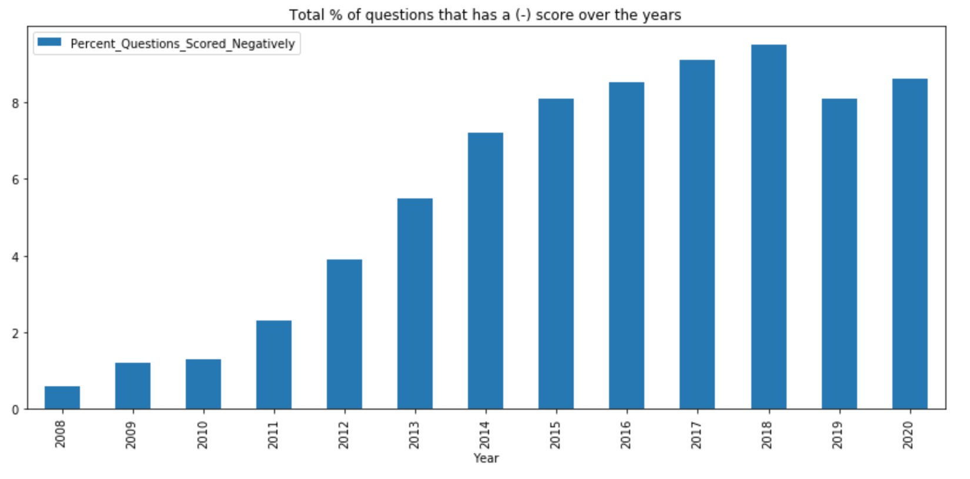
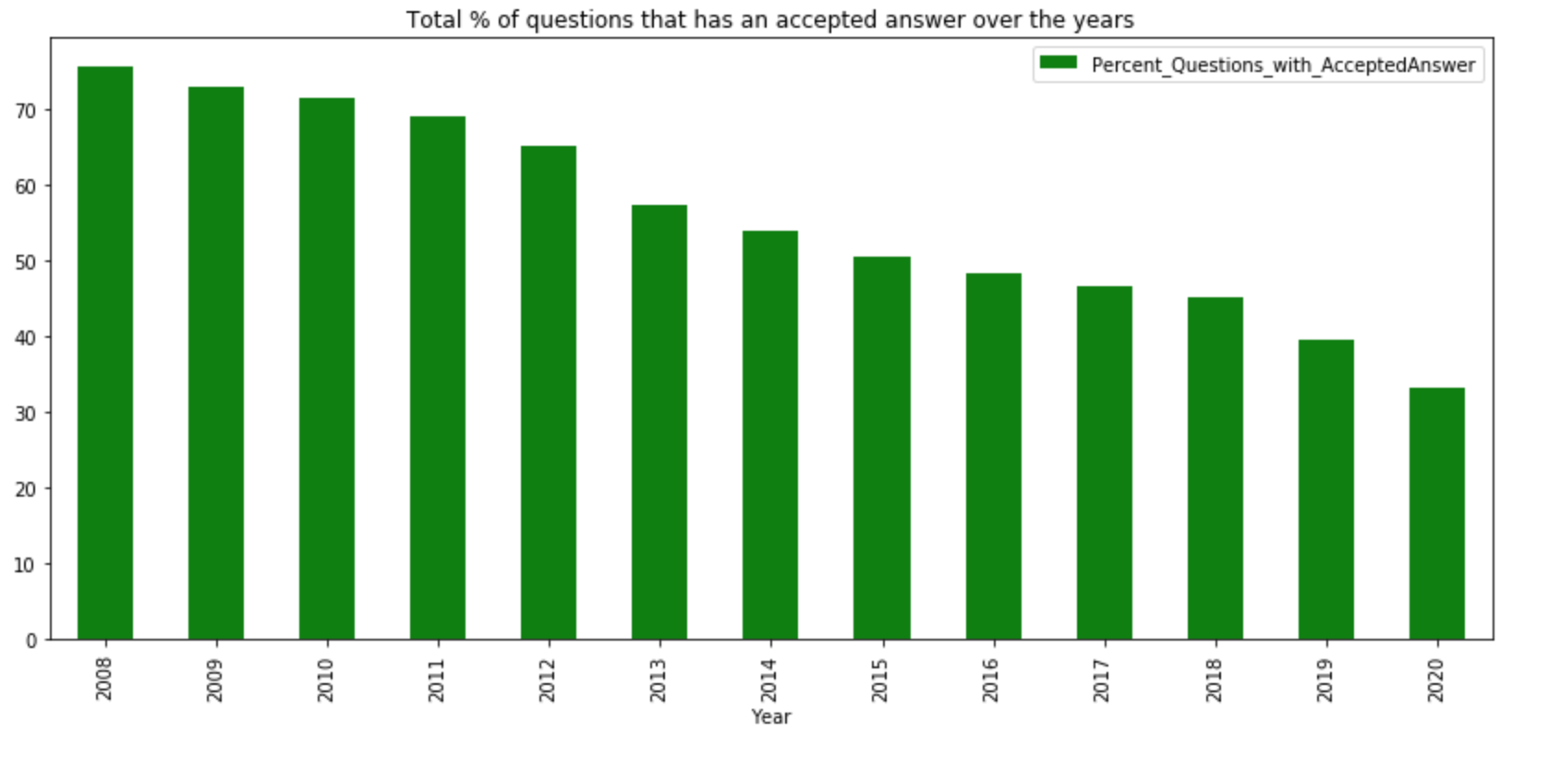
Distribution of answer quality
The percentage of negatively scored questions show a general upward trend till 2018 and decrease in 2019
General downward trend of the percentage of questions with an accepted answer from 2008 and significant drop going from 2018 to 2019
High percentage of unanswered questions in 2019 is due to the lack of unaccepted answers and not as a result of negatively scored questions

Slide 7
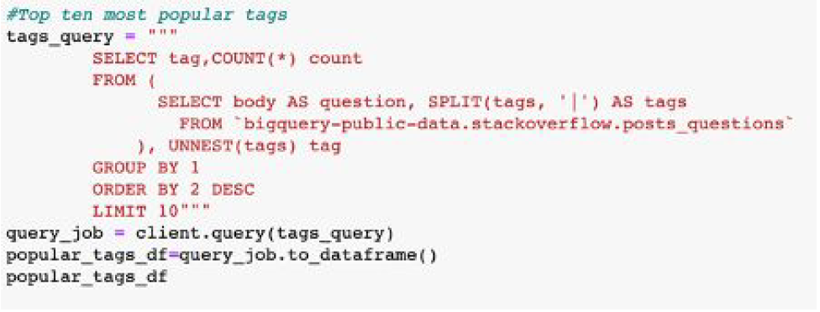
Top ten most popular tags and gold badges
Tag | Count
Javascript | 1909607
Java | 1613271
C# | 1363741
Php | 1320047
Python | 1297726
Android | 1237162
Jquery | 9714118
Html | 863493
C++ | 644513
Ios | 615317
Javascript is the most popular tag on Stack Overflow with over a 18% margin over the second most popular tag, Java.
In fact, three out of the ten most popular tags are related to Java-the Java community seems to have a lot of technical questions!
Badge name | Count
Famous Question | 668653
Great Answer | 77521
Great Question | 35936
Fanatic | 33217
Unsung Hero | 22120
Electorate | 21201
Populist | 20924
Steward | 14158
Stellar Question | 7725
Socratic | 4070

Slide 8
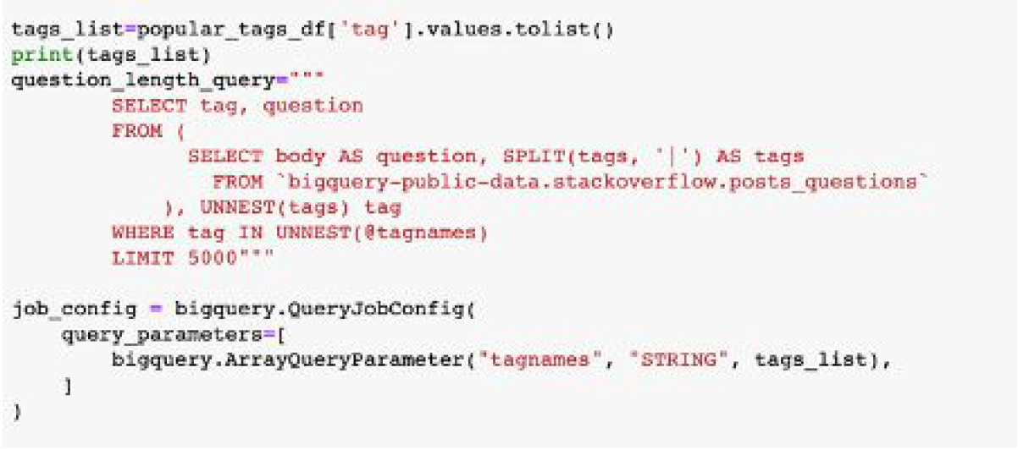
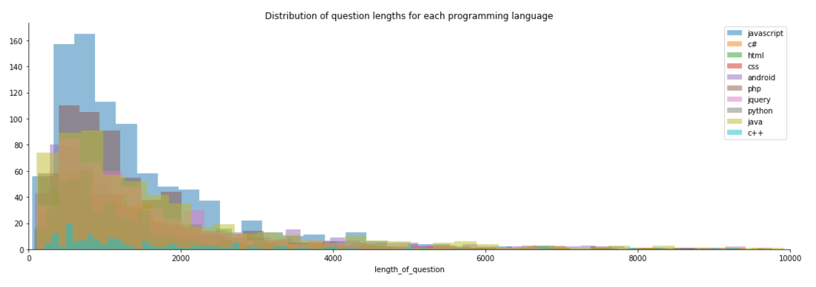
Avg question length distribution

Slide 9
Data acquisition
1) bigquery-public-data.stackoverflow.posts_questions
2) bigquery-public-data.stackoverflow.posts_answers
3) bigquery-public-data.stackoverflow.users
Above tables were joined using Standard SQL to create relevant features about questions
Dataset containing 10 features and ~240,000 rows

Slide 10
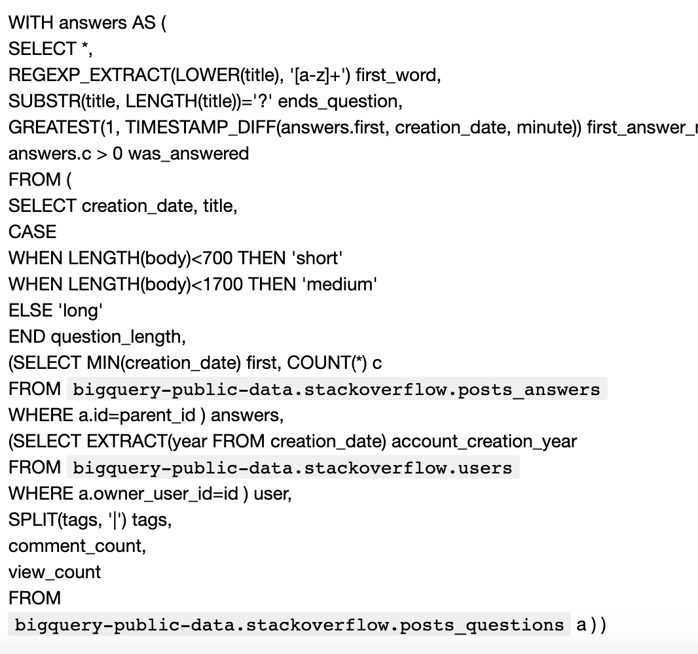
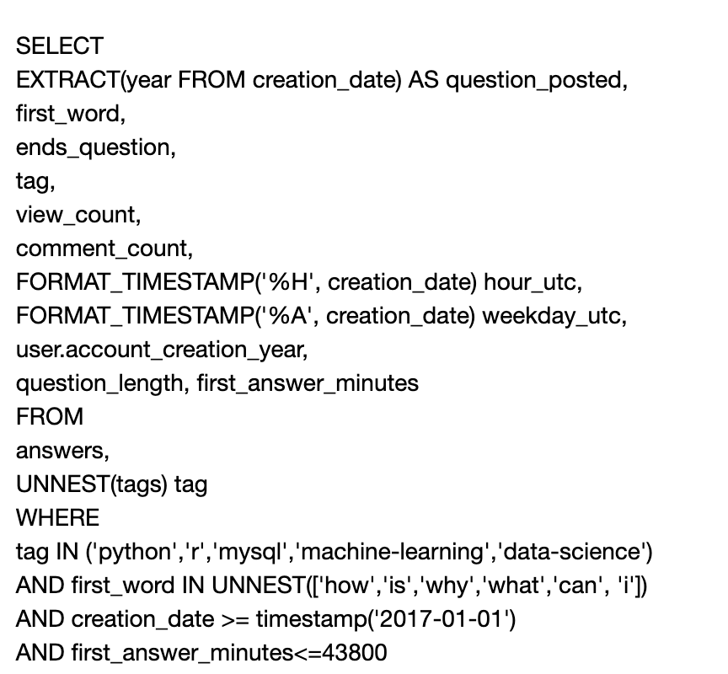
Data wrangling

Slide 11
Feature Engineering
Starting word
Ends with a question mark
Length of each question (short if <700 characters, medium if <1700 characters, long if >1700 characters)
Day of week
Time of day it was posted
User account creation date
Tags: 'python', 'r','mysql', 'machine-learning','data-science’
Questions posted after 2017
No. of views
No. of comments
Time taken for the first answer: dependent variable

Slide 12
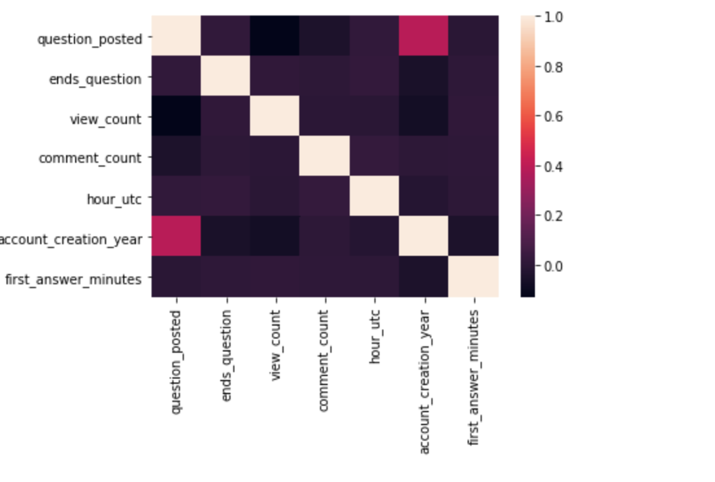
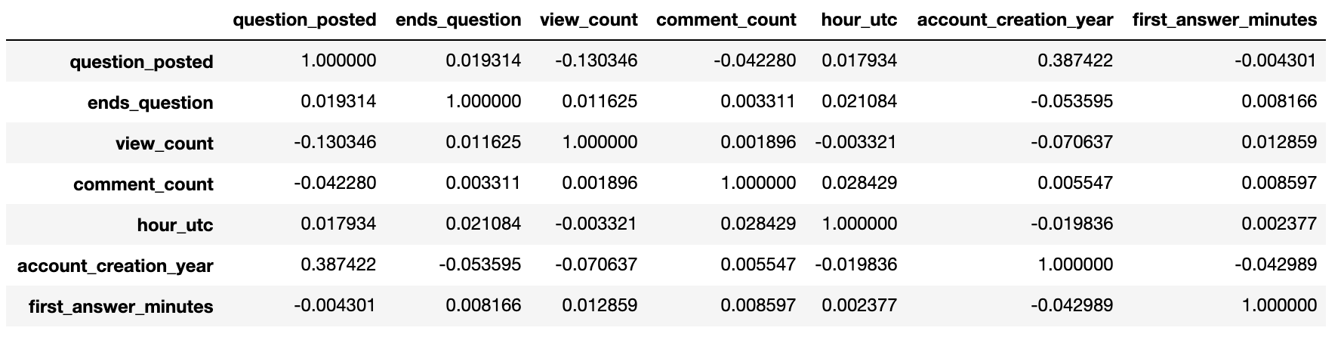
Numerical feature correlation
strong correlations between any features
‘account_creation_year’ and no. of questions posted seems to be somewhat correlated

Slide 13
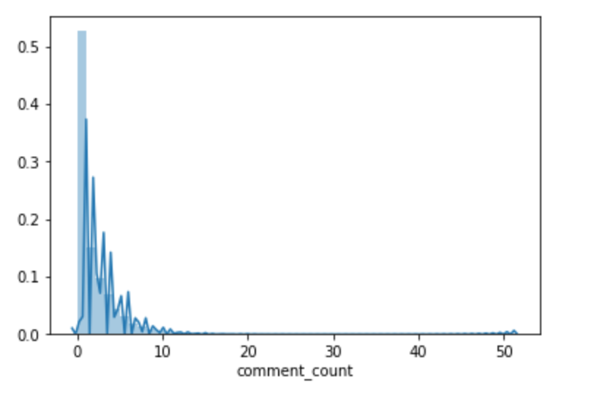
Density plot of comment count

Slide 14
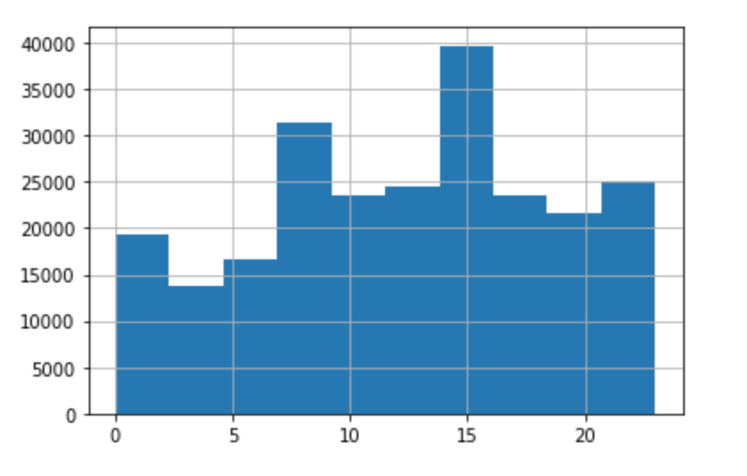
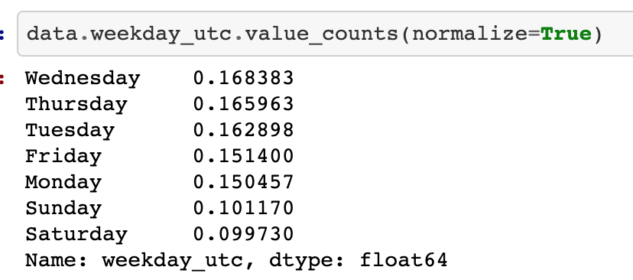
Distribution of time of day and week of day
Most questions get posted midweek, while the weekend produces the least no. of questions
50% of the questions get asked before noon and 75% of the questions get asked before 5pm

Slide 15
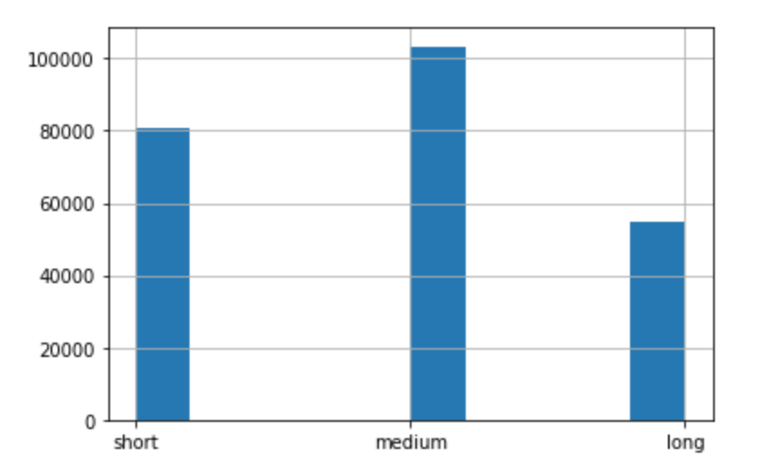
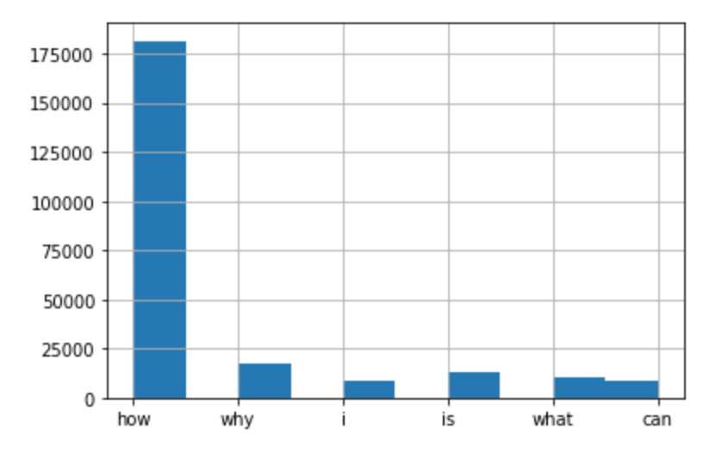
Distribution of categorical variables
Question length:
First word:

Slide 16
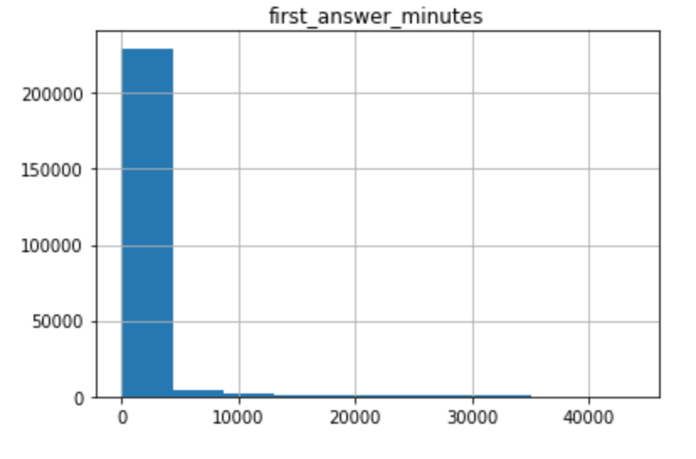
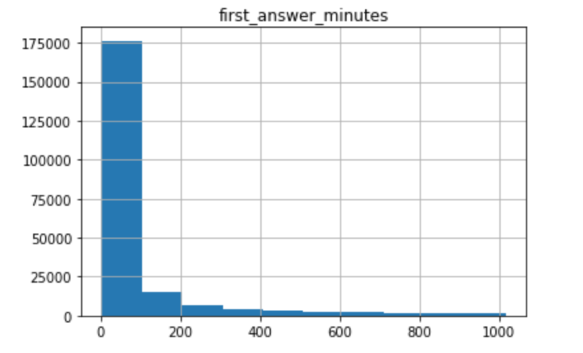
Outlier removal
Dependent variable has a extremely right-skewed distribution
Percentage based outlier removal at the 95% percentile
Original distribution:
After outlier removal:

Slide 17
Machine Learning Models

Slide 18
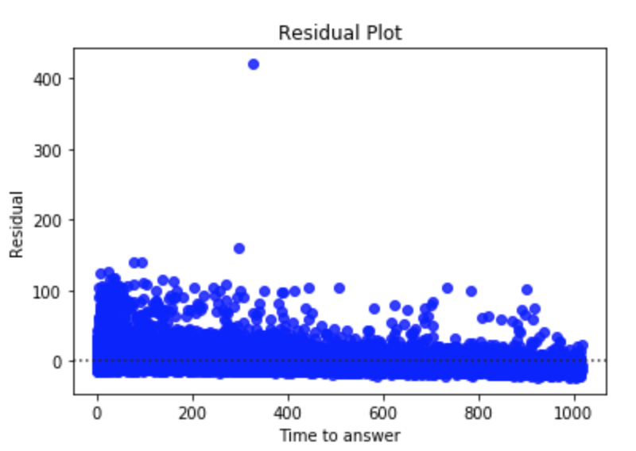
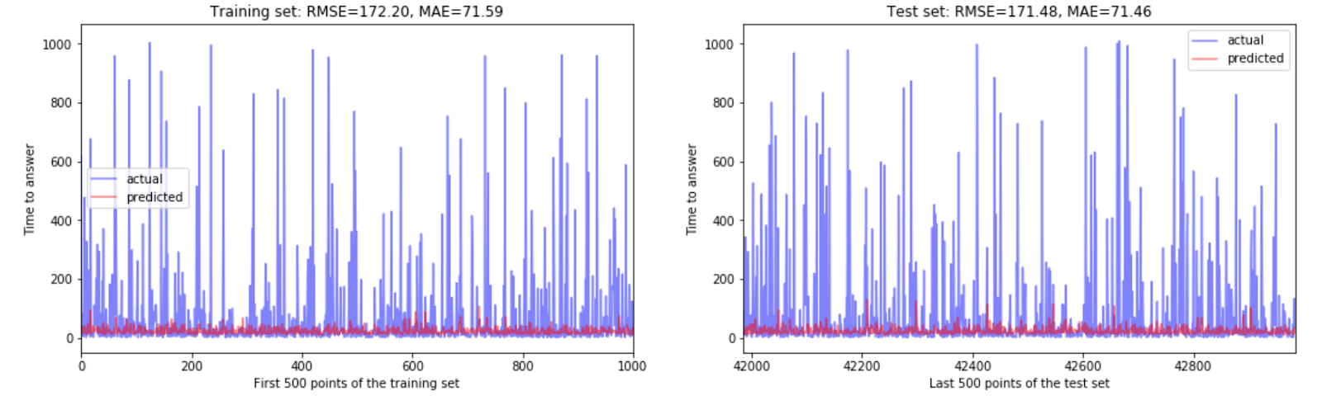
Linear Models
Linear Regression:

Slide 19
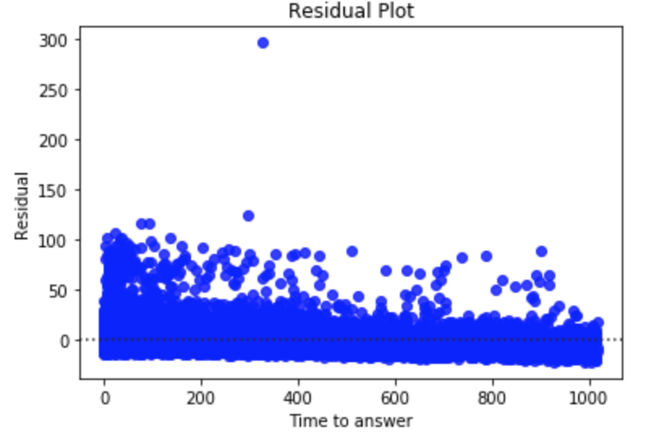
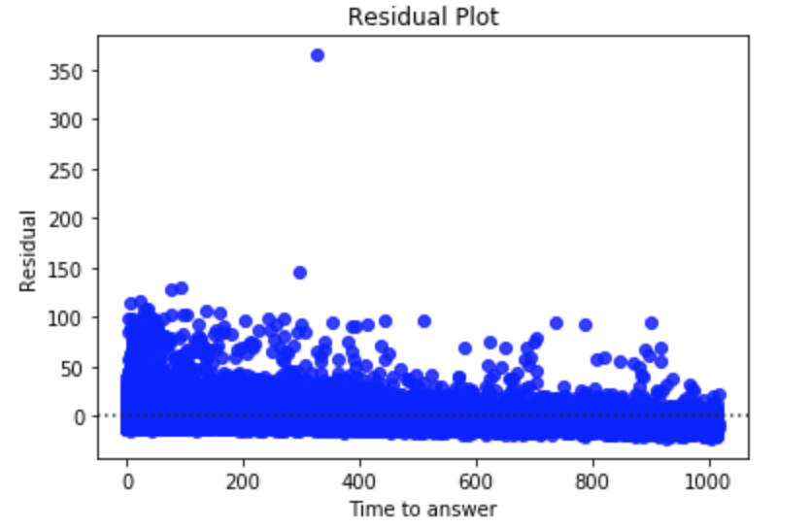
Linear Regression w/
Lasso Regularization:
Linear Regression w/
Ridge Regularization:

Slide 20
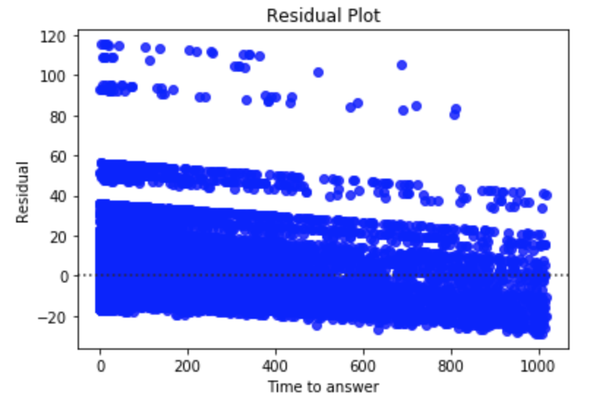
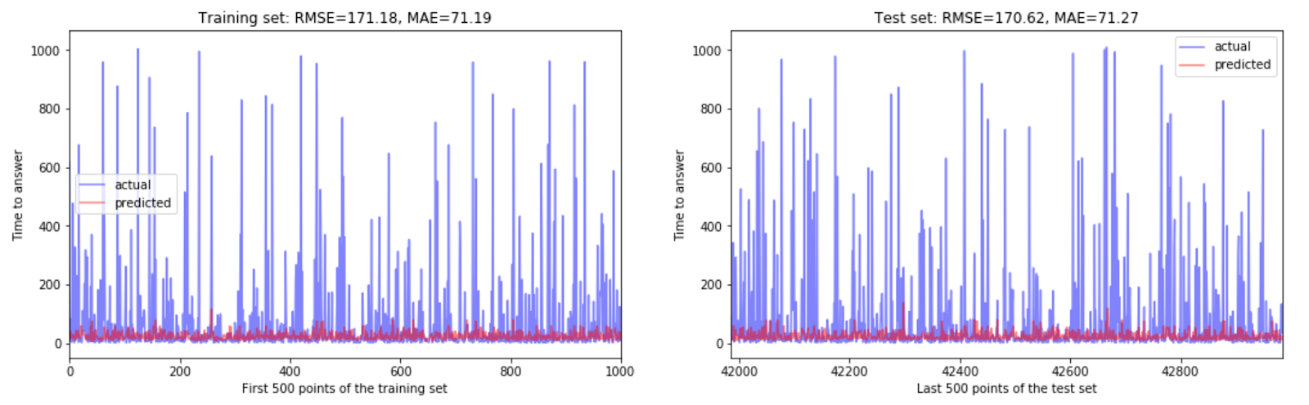
Tree-based Models w/ 5-fold CV and Hyperparameter Tuning
Decision Tree:

Slide 21
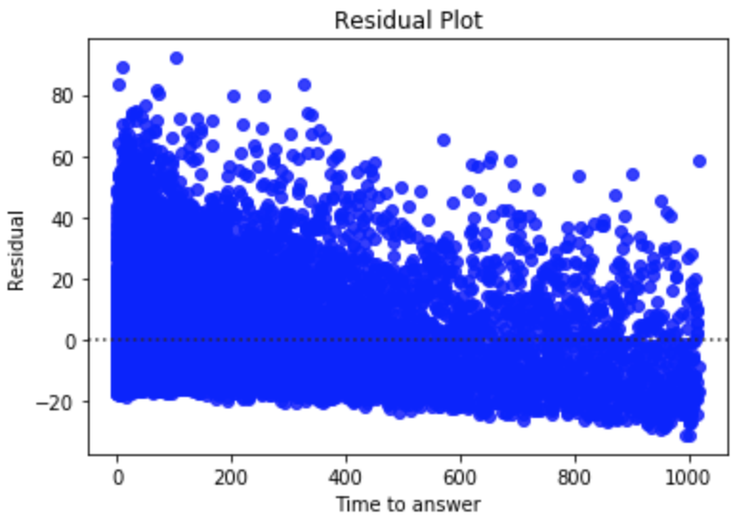
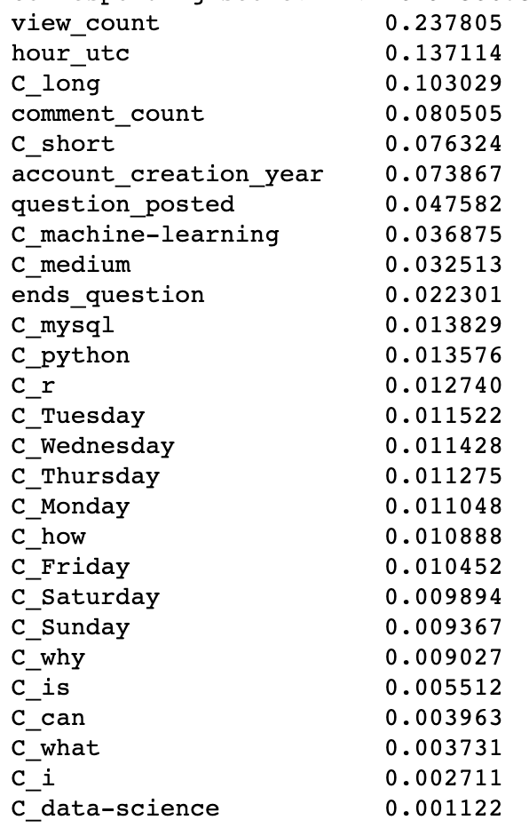
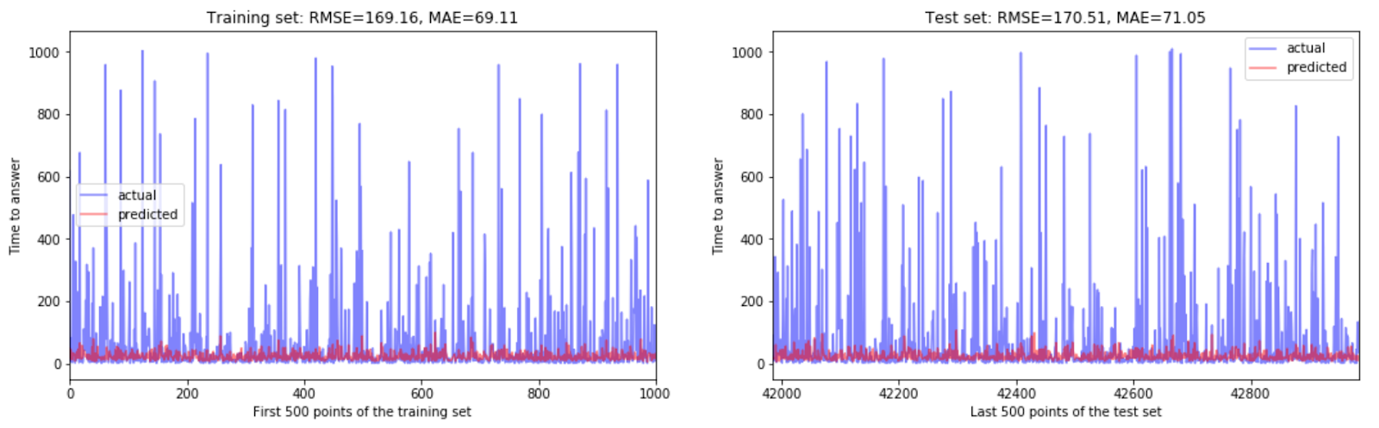
Random Forest Model
Feature Importances

Slide 22
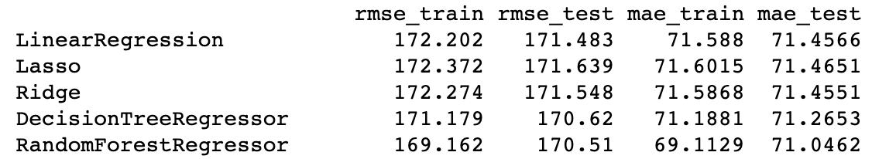
Model Metrics
Random Forest algorithm displays the highest accuracy with the lowest RMSE and mean squared error, for both train and test sets
Predict how long it would take for a question to get an answer, the error scales linearly, and MAE is a good metric
Top three features that affect the time it would take for an answer for a particular question seems to be: the view count, the time of day the question is posted and length of the question, respectively
start_word and tag seem to have the lowest impact

Slide 23
Conclusion
Stack Overflow is a platform used by millions of computer scientists worldwide, and usually post questions while working on a project, thus anticipating an answer as soon as possible
Successfully developed a model to predict the response rate for a question posted on Stack Overflow
Evaluated multiple supervised machine learning algorithms, and evaluated each model for accuracy and efficiency
Accurate prediction can drive up user engagement, thus ad revenue

