Slide 1
New Product : Awesome Board Game
GOAL : Design a product that allows people to borrow board games with other people and invite others to their home for board game sessions.
What is the product? Board Games Lending & Borrowing Platform.
Problem solved/ How will it help? Provides an easy way to lend or borrow board games and invite people for playing.
Who will use? End users -> Owners / Players/Borrowers.
Lend board games
Borrow games
Invite people to play
Return borrowed games
Manage ‘My Account’.
Access product catalog
Access FAO
Registered user

Slide 2
Assumptions:
Web portal to lend, borrow & invite people to play board games.
Users will have to register to lend, borrow or invite people to play.
Borrow period is valid for 2 weeks
Valid for India region.
Invite option lists users having same postal code.
Platform charges 20% fees for putting board game for lending.
Borrow game workflow:
User
Games catalog
Cart
Registered ?
Create account
Add to Cart
Checkout
NO
YES
Done
Pay
Confirm Address

Slide 3
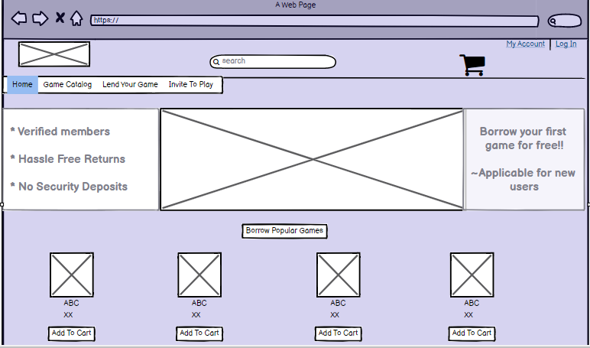

Slide 4
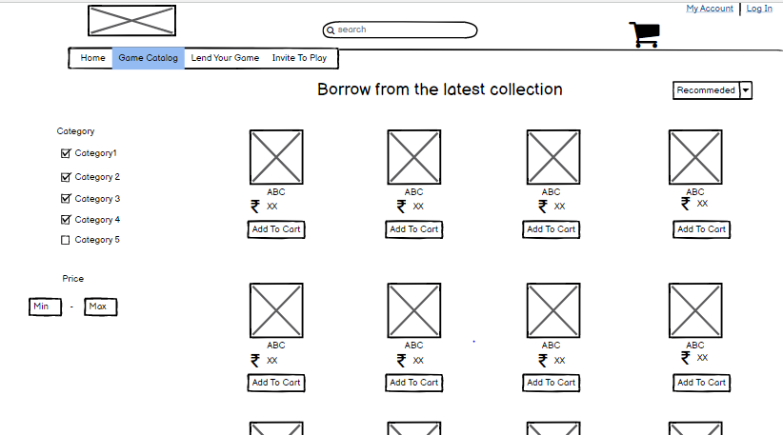

Slide 5
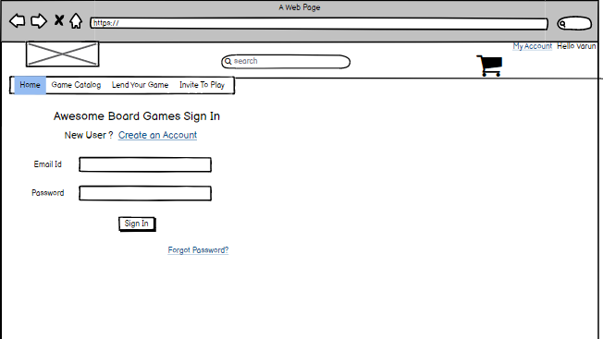

Slide 6
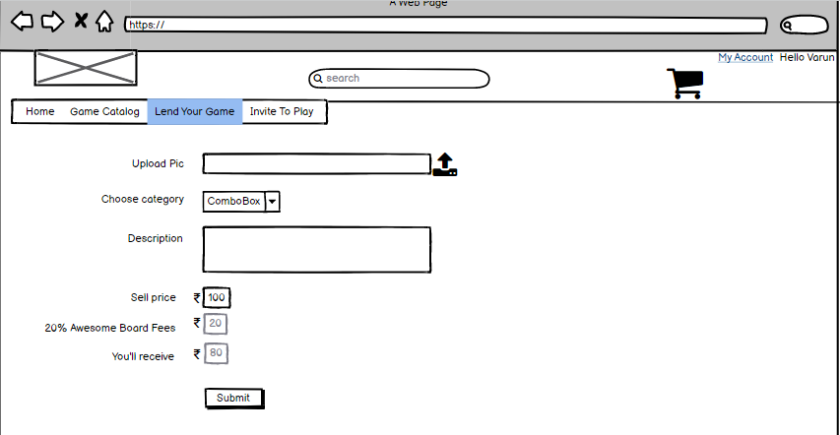

Slide 7
