Slide 2
PROBLEM STATEMENT
SafePass is a novel street navigation application that enables us to successfully find the safest of all paths using multi-criteria parameters of crimes happening in the locality, thus choosing the best path to safely reach the destination.
SafePass uses actual LAPD data, statistics, various mathematical models to provide a route that minimizes the risk of becoming a victim to the criminal activities on the path. It focuses on the practical and theoretical implementation of finding the safest path.

Slide 3
MOTIVATION
Studies show that traveling in the city of Los Angeles is not always safe past midnight.
Despite the current mapping tools providing the users with the fastest route to reach the destination, there has not been a significant decrease in the number of crimes.
SafePass assists us find this path, rendering advancements to the desired destination by avoiding all the plausible crime areas.

Slide 4
HOW IS IT DIFFERENT?
Unlike GoogleMaps and Lyft, which use the fastest path tracking based on the commute time and distance, SafePass additionally considers the safety index involved in the travel via the path, and the risk analysis, thus predicting the desired path with the lowest crime index, allowing users to travel safe and sound.
It learns from the previously found routes and continuously marks the danger level of the routes to be avoided in the future, as high.

Slide 5
TECH STACK
Data Analytics
Data cleaning - Mean Replacement, Mode Replacement, Handling Missing Values, Removing Irrelevant Data.
Data regularization
Feature Extraction
K-Means Clustering
Elbow Method - Within Cluster Sum of Squares
Scikit-learn, numpy, pandas
Software Development
Flask + Python Web App
Open Route Service Geolocation and Distance Matrix APIs
Bootstrap, AJAX, JQUERY, JS

Slide 6
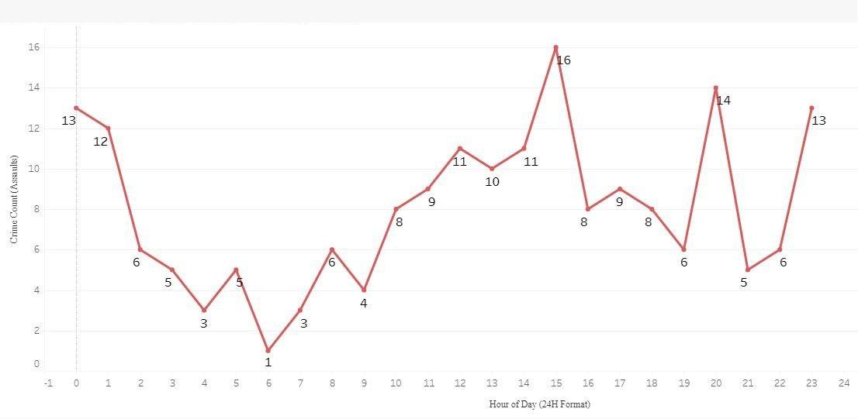
TECHNICAL SOLUTION
SafePass uses the actual LAPD database spanning from 2020 to 2021, involving more than 400k registered, balanced and curated criminal activities consisting of the following parameters :
TIme of Crime
Victim Gender
Victim Ethnicity
Victim Age
Crime location
Preprocessing the data, outputs a particular crime count, its danger level for the specific geolocation based on the above parameters.

Slide 7
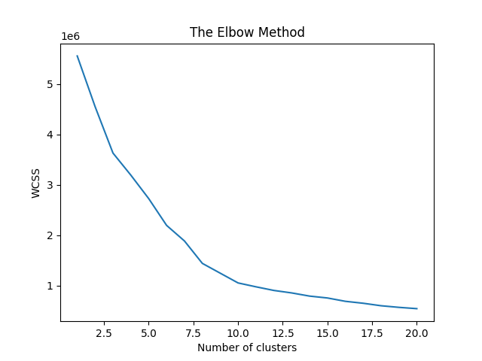
The clustering algorithm takes into account the preordained distance from a random point from origin to destination, thus predicting the safest point to be taken from the clusters.
The WCSS method determines the number of clusters to be processed.
Training : Using the dataset, we have trained the model and divided the dataset into 6 clusters (WCSS method).
The danger of the cluster is directly proportional to the total number of points belonging to the cluster.
Thus we identify the danger level for all clusters.

Slide 8
Using Open Route Service Geolocation, we find the paths between two points as requested by the user.
For each path, we consider several number of points, combine them with the remaining categorical parameters and feed them into the model.
We then compute the cluster to which maximum number of data points that lie on this path, belong to.
Coding Color Scheme is assigned to each path as below :
0/1 - Green
2/3 - Orange
4/5 - Red

Slide 9
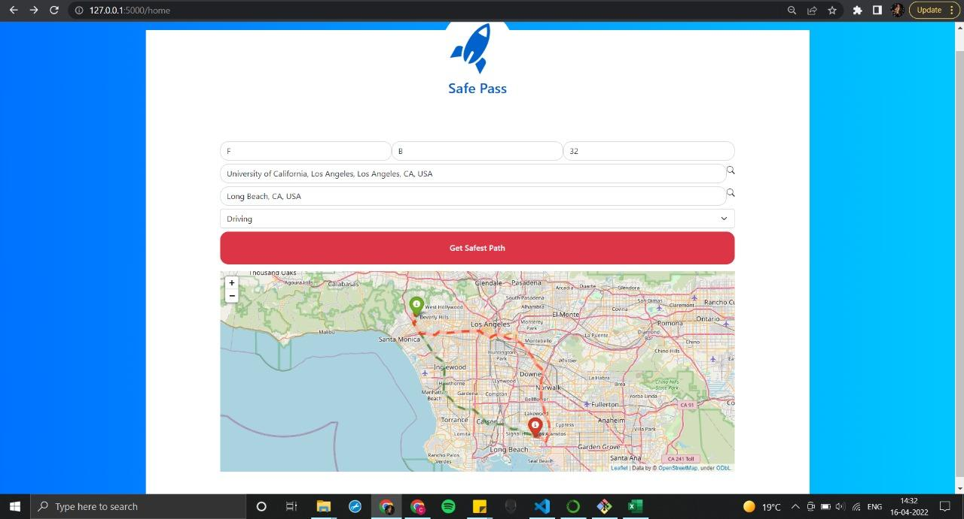
Web App UI

Slide 10
SOCIAL IMPACT
SafePass provides means to the users to be able to cautiously select their transit route.
SafePass can be used to identify the areas for which the police patrolling needs to be ramped up.
SafePass can be used to determine what segments of the population are more susceptible to crimes at what locations and times.
Apart from the obvious use of the application for finding the safe path, the analytical work behind the app also helps us identify trends in targeted crimes.

Slide 11
Feasibility
and
Scalability
Consistent periodic retraining of the model with new data is required to keep the results well-balanced, curated and relevant.
We can increase the scalability and use cases of the model by incorporating the data from different relevant datasets and increasing the time frame of our data.

Slide 12
FUTURE WORK
Adding GPS feature
Incorporating the transport choice option for the users
Larger dataset for predicting accurate categorization of clusters

