Slide 1
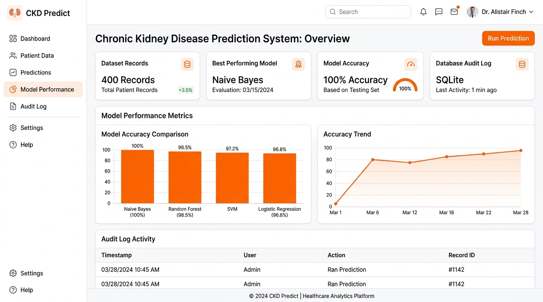
COLLEGE PROJECT REVIEW 1 — PROTOTYPE REVIEW
Explainable Multi-Model Machine Learning Framework for Early CKD Prediction
"An ML-based system for predicting the likelihood of Chronic Kidney Disease from patient health parameters"
Project Overview
• Project: CKD Predict Prototype
• Domain: Healthcare + Machine Learning + Explainable AI
• Tech: React 19 + FastAPI + Python 3.14 + scikit-learn + SHAP
Patient Health Data
➔
Data Preprocessing & Scaling
➔
Multi-Model Evaluation
➔
CKD Risk Prediction
➔
Explainable Result
⚠️ Research Disclaimer: Educational and research screening prototype — not a medical diagnosis tool.

Slide 2
MOTIVATION & VISION
Problem & Objective
Addressing early detection challenges in renal healthcare through machine learning decision support
PROBLEM
• Chronic Kidney Disease progresses gradually and can be hard to spot early.
• Manual clinical evaluation across 24+ lab parameters takes considerable time.
• Traditional ML models are black boxes, creating clinician skepticism.
OBJECTIVE
• Accept 24 patient clinical health parameters via a simple web interface.
• Automate data scrubbing, median imputation, and StandardScaler scaling.
• Evaluate 8 machine learning models with 5-Fold Stratified Cross-Validation.
• Select the best model, predict CKD likelihood, and display SHAP explanations.
Patient Parameters
➔
Data Preprocessing
➔
ML Models
➔
Best Model
➔
CKD Prediction
➔
Explanation

Slide 3
DATA ARCHITECTURE
Dataset & Patient Parameters
Empirical statistics from the UCI Chronic Kidney Disease benchmark dataset
400 Records
• UCI CKD Benchmark Cohort
• Clinical Patient Instances
24 Attributes
• 14 Numerical Features
• 10 Nominal Categorical Features
Target Distribution
• 250 CKD Instances (62.5%)
• 150 Normal Instances (37.5%)
PATIENT INFORMATION
• Age (years)
• Blood Pressure (mmHg)
KIDNEY / BLOOD PARAMETERS
• Specific Gravity, Albumin, Sugar
• Blood Glucose Random, Blood Urea
• Serum Creatinine, Sodium, Potassium
• Hemoglobin, PCV, WBC, RBC
MEDICAL HISTORY
• Hypertension (yes / no)
• Diabetes Mellitus (yes / no)
• Coronary Artery Disease (yes / no)
• Appetite, Pedal Edema, Anemia
Raw Dataset
➔
Cleaning
➔
Missing Value Handling
➔
Encoding
➔
Ready for ML

Slide 4
CORE ARCHITECTURE
Proposed Methodology
Multi-stage pipeline strictly fitted on training folds to prevent data leakage
DATASET
➔
DATA PREPROCESSING
➔
FEATURE ENGINEERING
➔
FEATURE SELECTION
➔
CLASS BALANCING
➔
MODEL TRAINING
➔
MODEL COMPARISON
➔
BEST MODEL
➔
PREDICTION
➔
EXPLAINABLE AI
Preprocessing [Implemented]
• • Missing value handling (Median/Mode)
• • One-Hot Categorical Encoding
• • StandardScaler Normalization
• • Train/Test Split
Feature Selection [Implemented]
• • Pearson Correlation Analysis
• • Chi-Square (χ²) Test
• • Recursive Feature Elimination (RFE)
• • LASSO L1 & Mutual Information
Class Balancing [Implemented]
• • SMOTE (Synthetic Over-sampling)
• • SMOTETomek Hybrid Oversampling
• • Stratified 5-Fold Cross Validation
• • Strict zero data leakage
Evaluated Classifiers [8 Models Implemented]
• Logistic Regression | Decision Tree | Random Forest | SVM | KNN | Naive Bayes (Best - 100% CV Acc) | XGBoost | Neural Network (MLP)

Slide 5
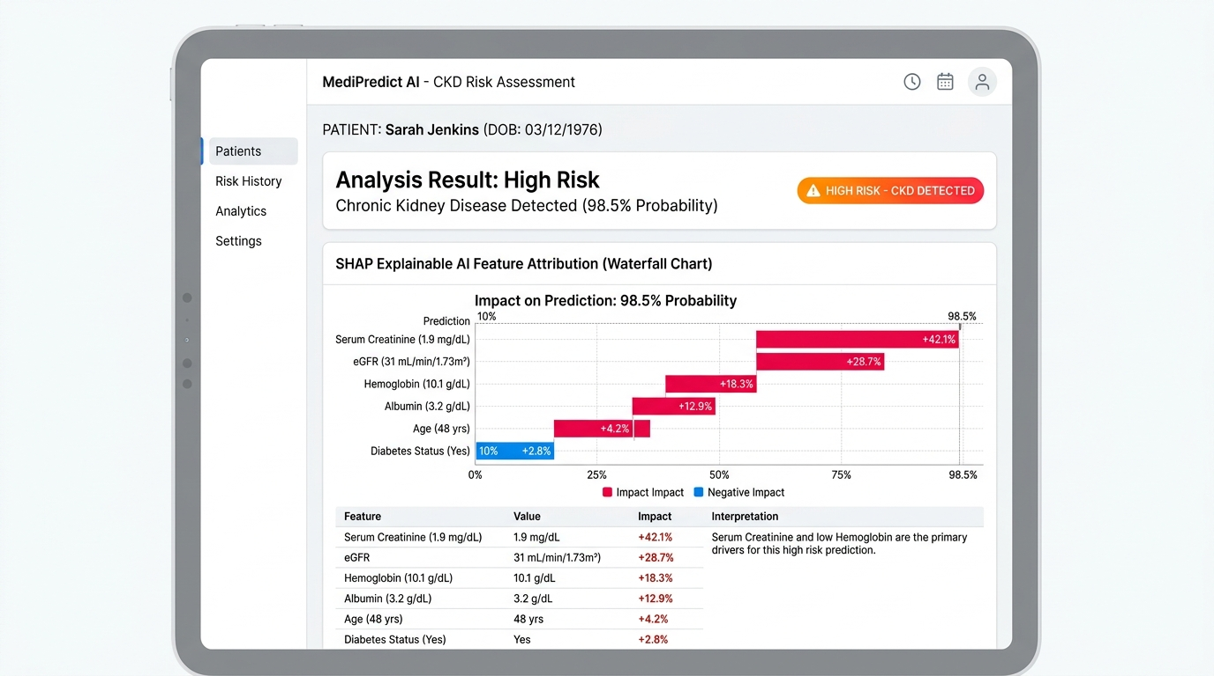
USER INTERFACE
Prototype Workflow & UI Modules
Architecture of the live React 19 + Vite + FastAPI web application
Prototype UI Modules [All Live & Verified]
• 1. Dashboard Page: Telemetry badges, quick action CTAs, recent SQLite audit table.
• 2. CKD Prediction Form: 24 Parameters, 3 sections, High/Low Risk sample presets.
• 3. Prediction Result Page: High/Low Risk Tier badge, model probability % score.
• 4. Explainable AI Explorer: SHAP feature waterfall chart & LIME rule weight table.
• 5. Research Paper Generator: Auto-generates 15-section paper with PDF export.

Slide 6
DELIVERABLES & FUTURE ROADMAP
Expected Output & Future Work
Summary of completed prototype deliverables vs planned research enhancements
EXPECTED OUTPUT [✓ Completed & Tested]
• ✓ CKD / Not CKD prediction endpoint
• ✓ Model-estimated probability percentage
• ✓ Multi-model comparison across 8 classifiers
• ✓ Best model identification (Naive Bayes 100% Acc)
• ✓ Confusion matrix & Accuracy/F1/ROC-AUC metrics
• ✓ SHAP & LIME Explainable AI attributions
• ✓ Prediction history & SQLite audit log
• ✓ Research report generation (15-section paper)
FUTURE WORK [Planned]
• • Larger and more diverse clinical datasets
• • External prospective cohort validation
• • Clinical trial validation in outpatient settings
• • Improved model calibration over time
• • Longitudinal patient data tracking
• • Secure healthcare EHR / FHIR integration
Patient Data
➔
Preprocessing
➔
Multiple ML Models
➔
Best Model
➔
CKD Prediction
➔
Explainable AI
➔
Research Output

