Slide 1
Automatic attendance system
Capstone Project II – Team Mavericks
Tech-Lead: Shraddha Khadepatil 100820094 Team Member: Geethu Kannan 100801786 Team Member: Varun Kadian 100820124 Team Member: Yash Halani 100848564

Slide 2
Scope
Provides an automated attendance system that is practical, reliable and eliminate disturbance and time loss of traditional attendance systems.
Present a system that accurately evaluate students’ performance depending on their recorded attendance rate.

Slide 3

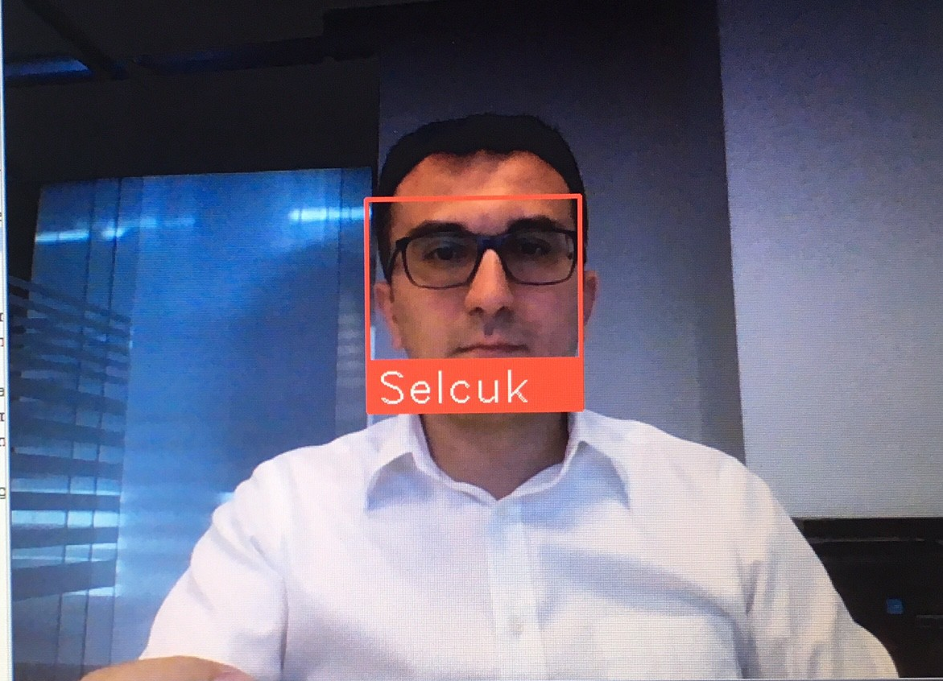
Model development
Data Collection
Prepare and Pre-process the data
Model the data
Train and Test the model
Verify and Deploy the Model

Slide 4
Technologies to be used
Model Development: Python
Web Development: Flask
Application Deployment: Heroku

