Slide 1


News article summarization app
Group Members –
Shraddha Khadepatil - 100820094
Varun Kadian - 100820124

Slide 2

Problem Definition
Ever feel like you don’t have enough time to read everything that you want to?
Summarized documents from your favorite news source, academic articles, or work-related documents

Slide 3

Objective
The quality, type, and density of information
News articles vary significantly from source to source.
Our goal here is to minimize the time you spend reading.

Slide 4
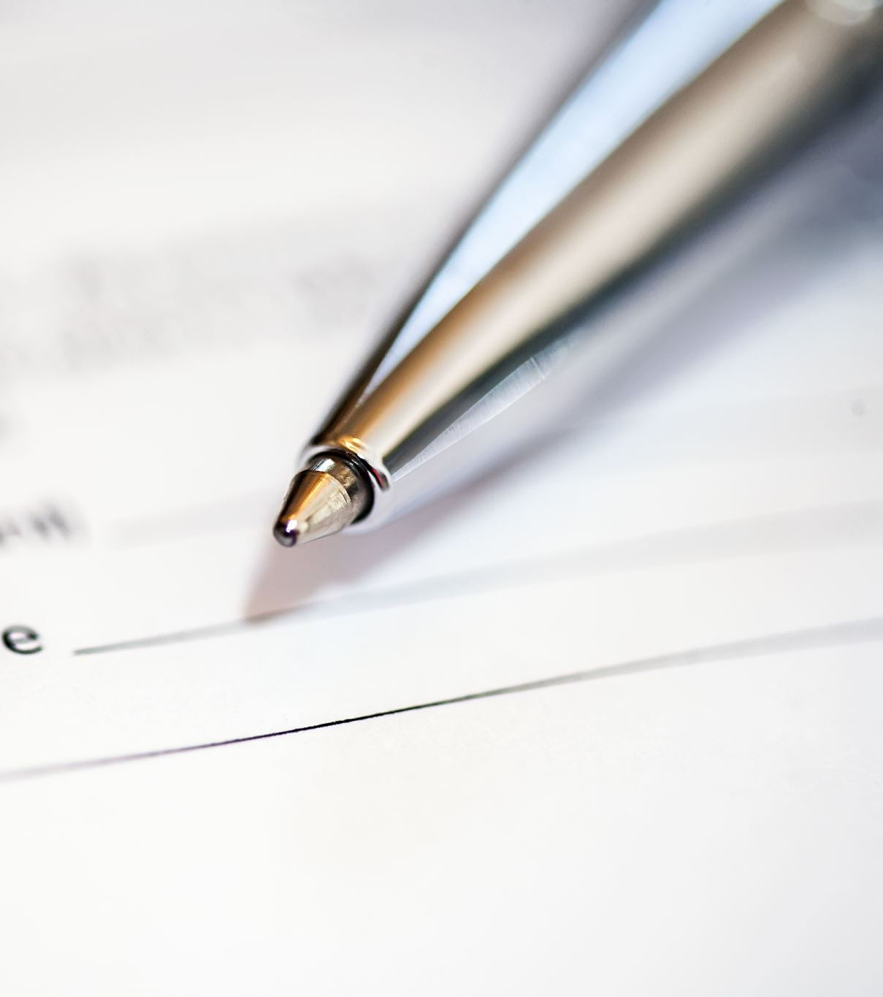
What is Text Summarization?
Text summarization is a Natural Language Processing (NLP) task that summarizes the information in large texts for quicker consumption without losing vital information.
There are two main text summarization methods:
Extractive Text Summarization
Abstractive Text Summarization

Slide 5
Implementation
Used the abstractive method on a news article
A pretrained library is used to scrape and summarize the news article
Newspaper3k library - web scraping of news articles
It is a library worked for Natural Language Processing (NLP) and it is based upon Natural Language Tool Kit(NLTK)
Newspaper3k additionally works in more than 30 dialects

Slide 6
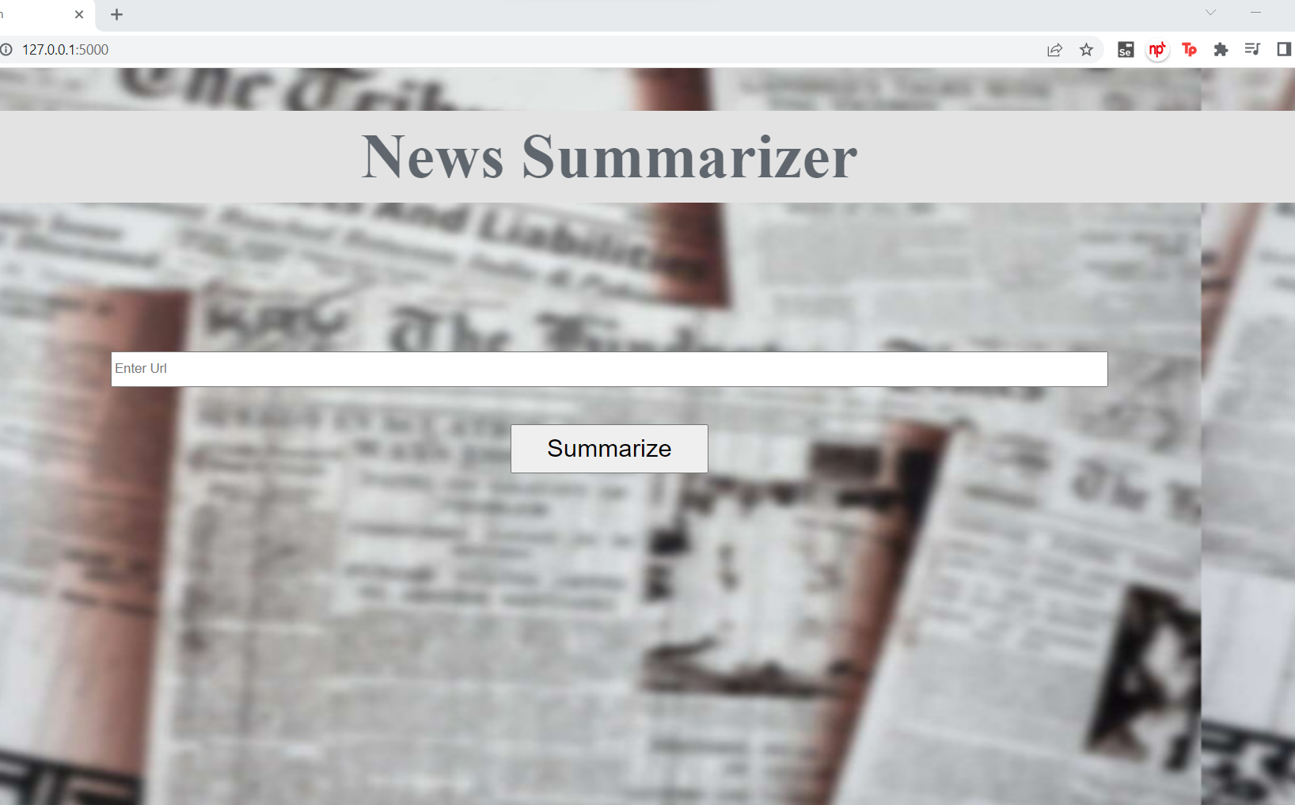

User Interface

Slide 7
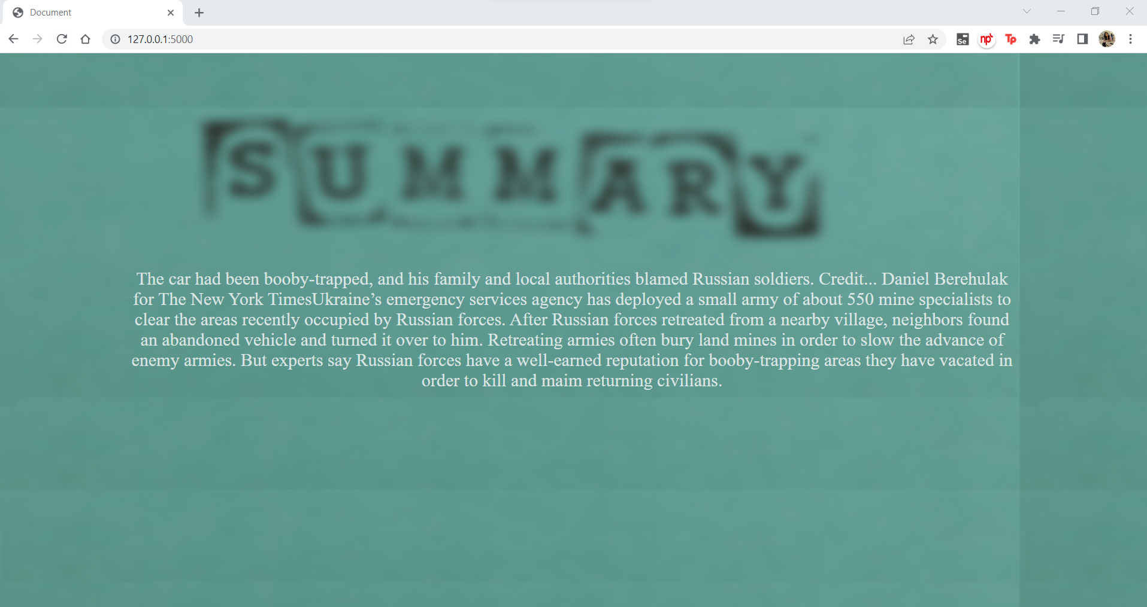
User Interface

Slide 8
References
Fahad, A. H. (2021, December 30). Sentiment Analysis — Let TextBlob do all the Work! - Red Buffer. Medium. https://medium.com/red-buffer/sentiment-analysis-let-textblob-do-all-the-work-9927d803d137
freeCodeCamp.org. (2017, October 24). An intro to ROUGE, and how to use it to evaluate summaries. https://www.freecodecamp.org/news/what-is-rouge-and-how-it-works-for-evaluation-of-summaries-e059fb8ac840/
GeeksforGeeks. (2021, November 30). Newspaper: Article scraping & curation (Python). https://www.geeksforgeeks.org/newspaper-article-scraping-curation-python/
Helstowski, C. (2021). Newspaper3k – A Python Library For Fast Web Scraping. Finxter. https://blog.finxter.com/newspaper3k-a-python-library-for-fast-web-scraping/
Newspaper3k: Article scraping & curation — newspaper 0.0.2 documentation. (2021). . https://newspaper.readthedocs.io/en/latest/

Slide 9
Thank You!

